Slide 1
Capstone Results Sample size: 100
June 24

Slide 2
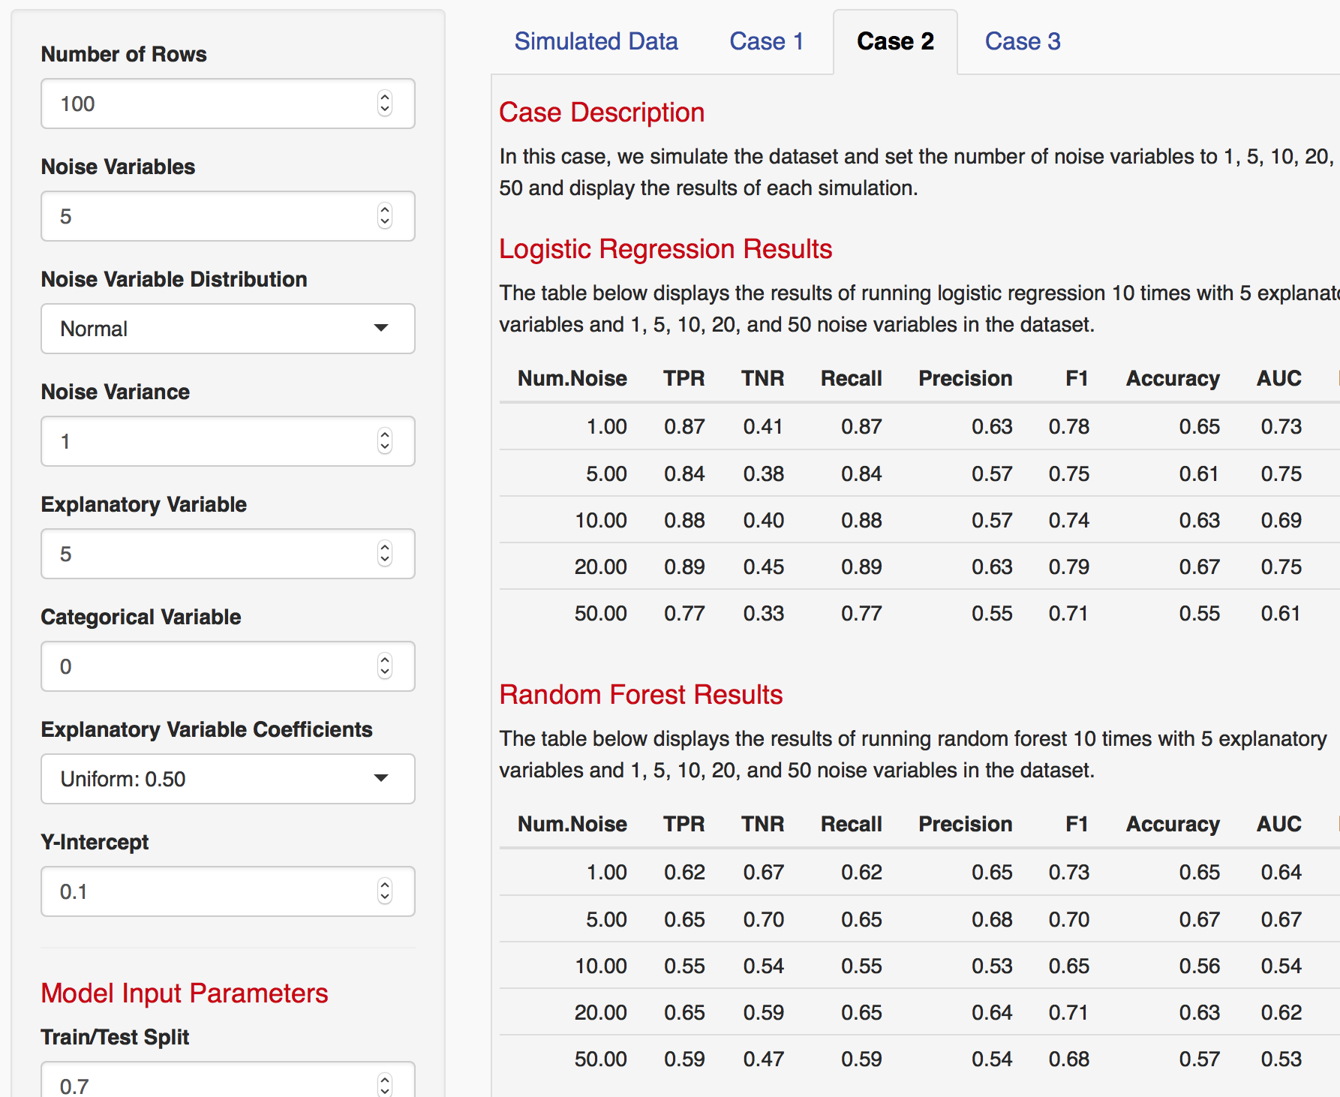
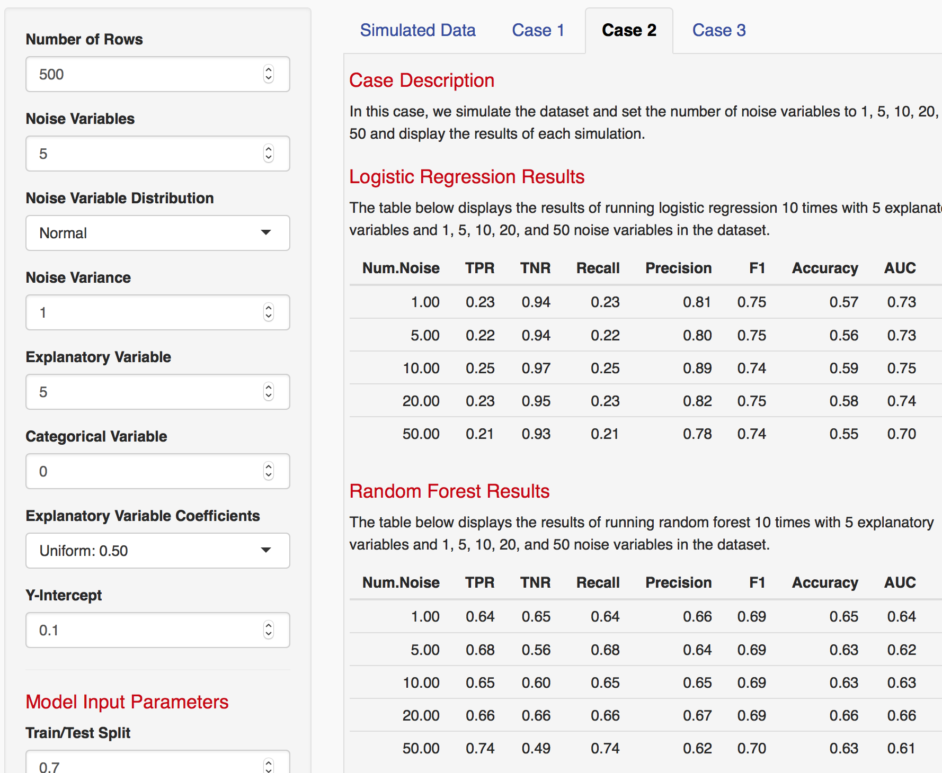
Varying Data Points

Slide 3
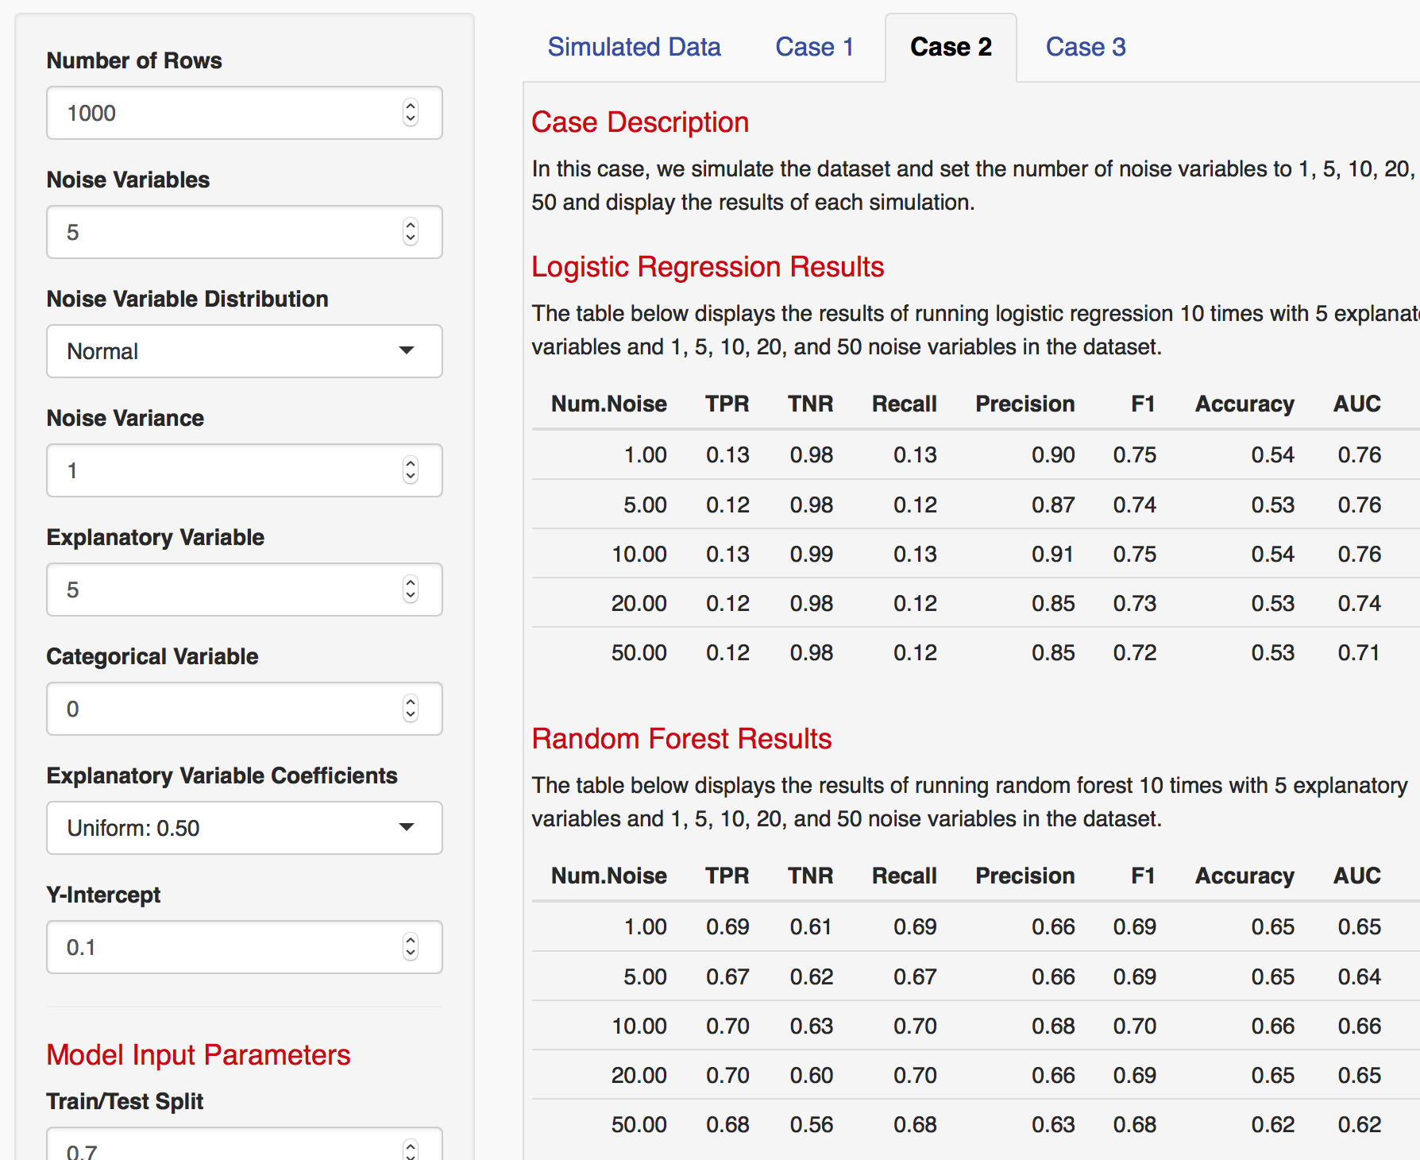
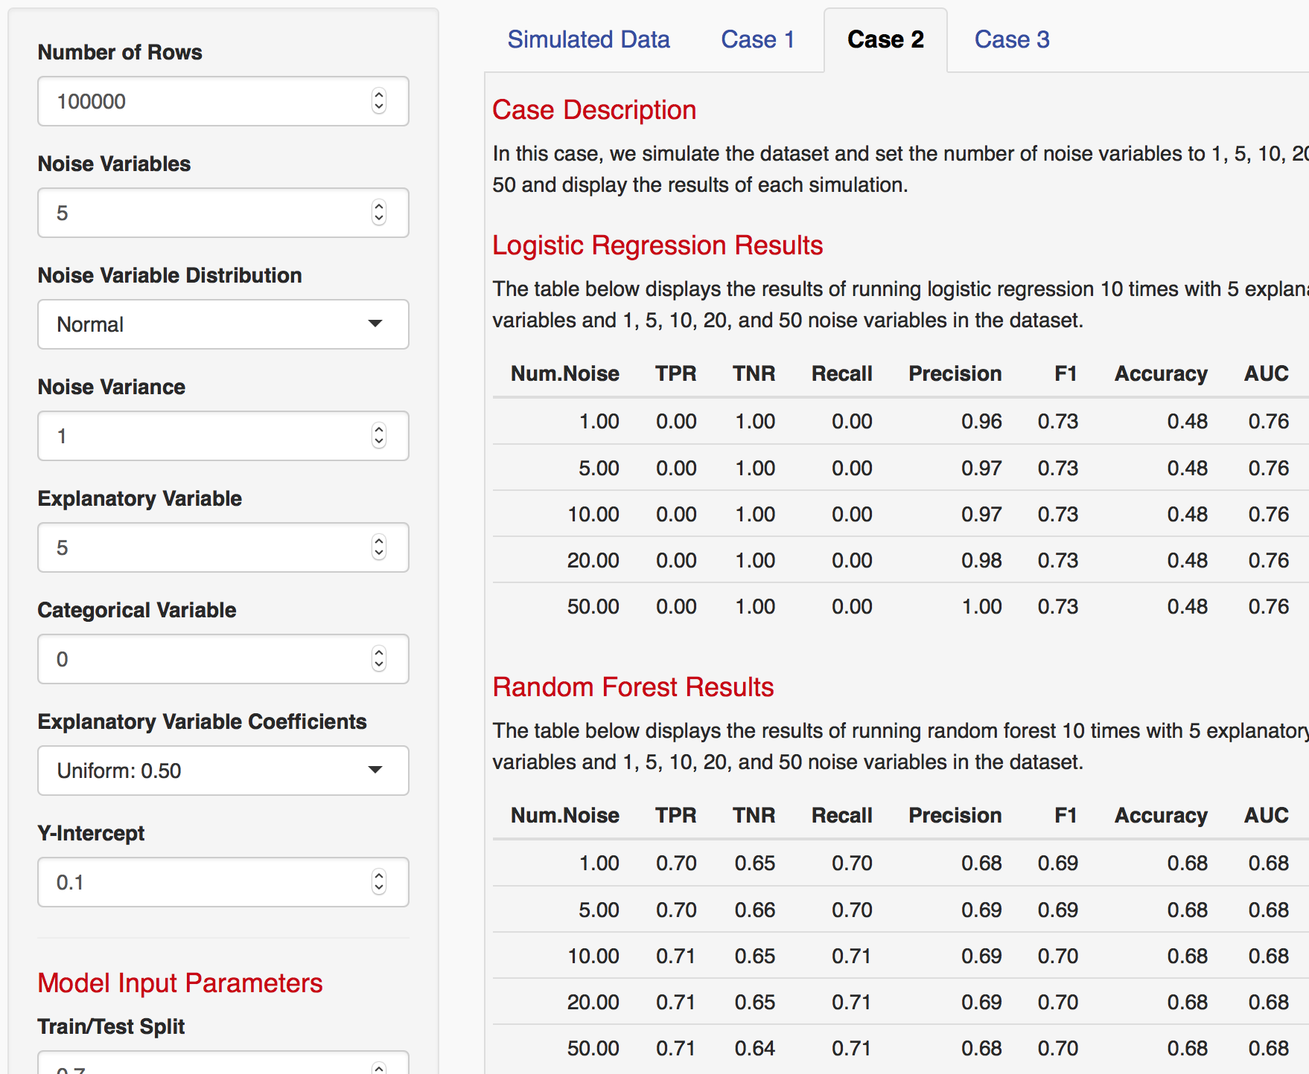
Varying Data Points

Slide 4
Case 1
In this case, we simulate the dataset and set the variance of each variable (noise and explanatory) to 0.5 to 5.0 in an interval of 0.5 and display the results of each simulation.
(Trace) 5 noise, 10 explanatory
(KK) 10 noise / 10 explanatory, 10 noise / 5 explanatory
All 1000 data points, 1000 sims

Slide 5
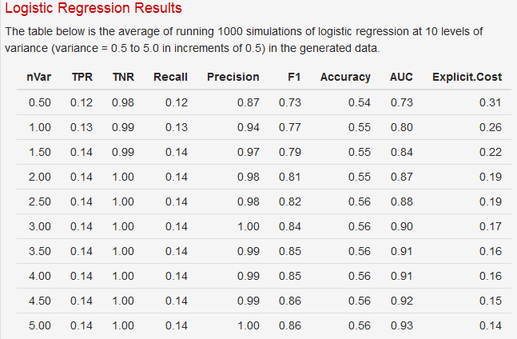
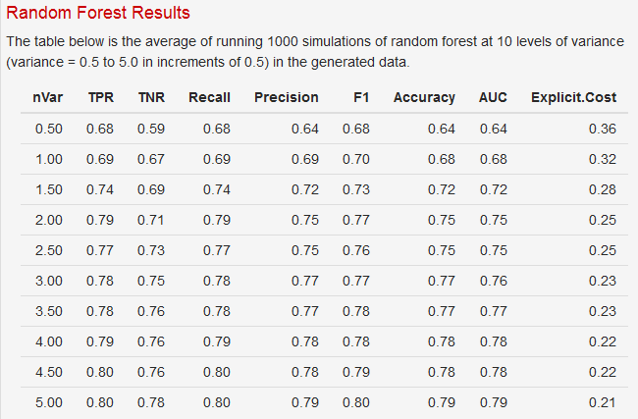
Case 1 - 10 noise / 10 explanatory

Slide 6
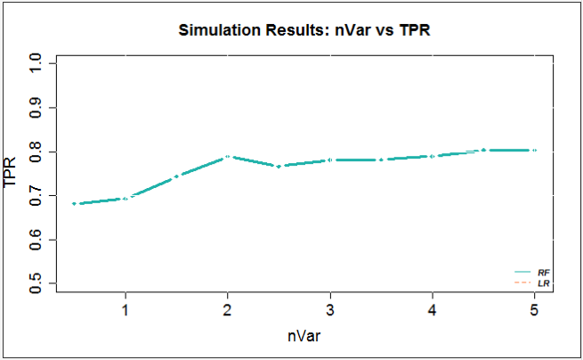
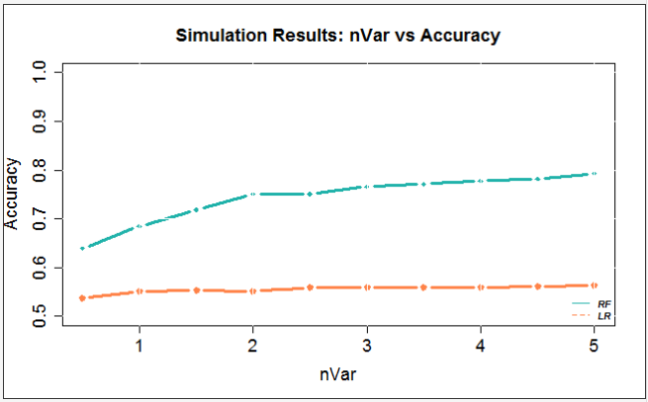
Case 1 - 10 noise / 10 explanatory

Slide 7
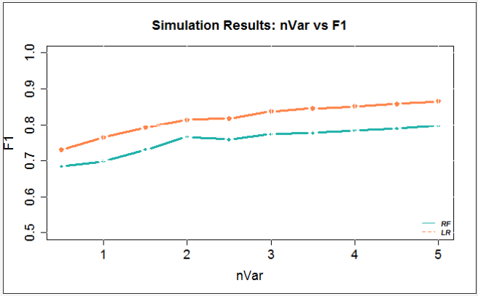
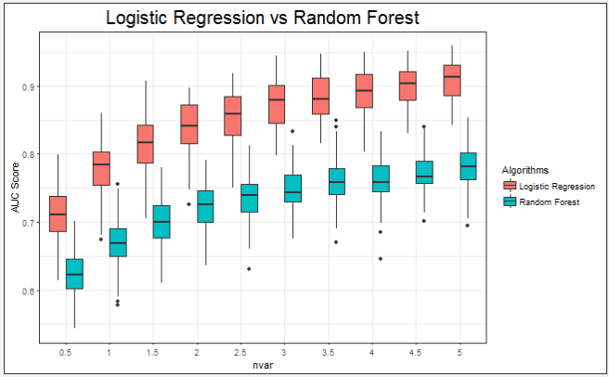
Case 1 - 10 noise / 10 explanatory

Slide 8
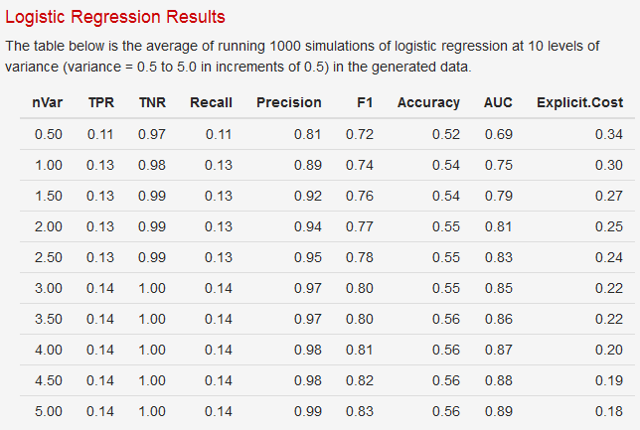
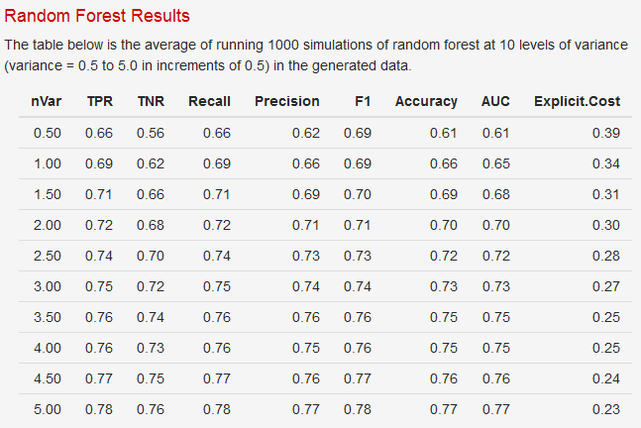
Case 1 - 10 noise / 5 explanatory

Slide 9
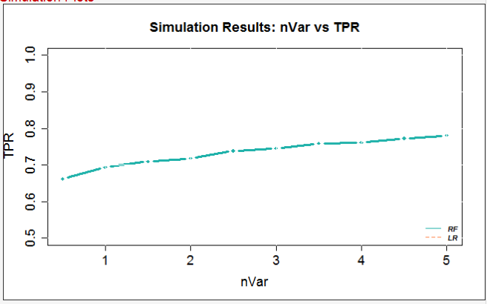
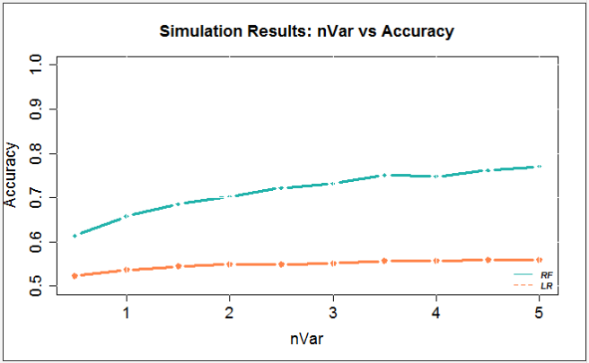
Case 1 - 10 noise / 5 explanatory

Slide 10
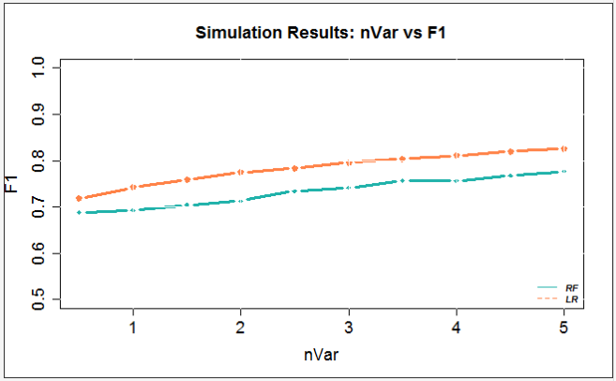
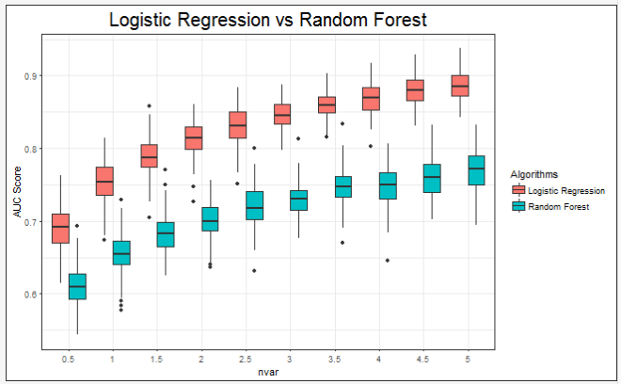
Case 1 - 10 noise / 5 explanatory

Slide 11
Case 2
In this case, we simulate the dataset and set the number of noise variables to 1, 5, 10, 20, and 50 and display the results of each simulation.
Run with 1000 sims
100, 1000 and 100,000 data points
1, 5, 10, 20 explanatory variables
Uniform 0.5 Coefficients – no difference
Small/Medium/Large: 0.20, 0.50, 0.80 – no difference
Forward & backward + Small/ med/ large

Slide 12
Case 2: 1000 sims, 1000 datapoints, 1 Ex Vars

Slide 13
Case 2: 1000 sims, 1000 datapoints, 1 Ex Vars

Slide 14
Case 2: 1000 sims, 1000 datapoints, 1 Ex Vars

Slide 15
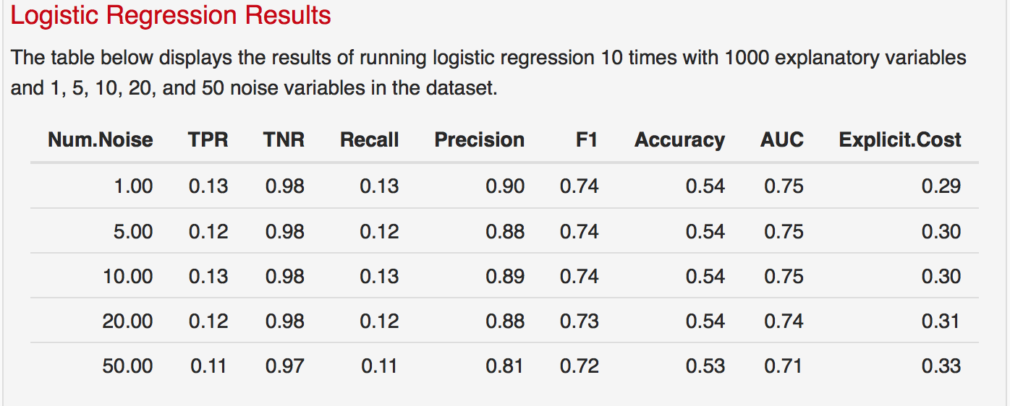
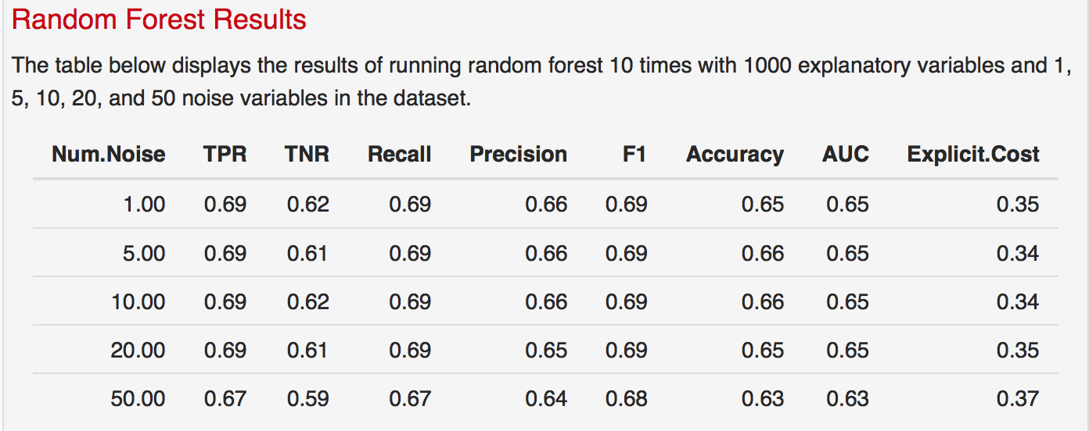
Case 2: 1000 sims, 1000 data points, 5 Ex Vars
*Description is hardcoded
*TPR for LR is the only one that is incorrect – reran to fix it

Slide 16
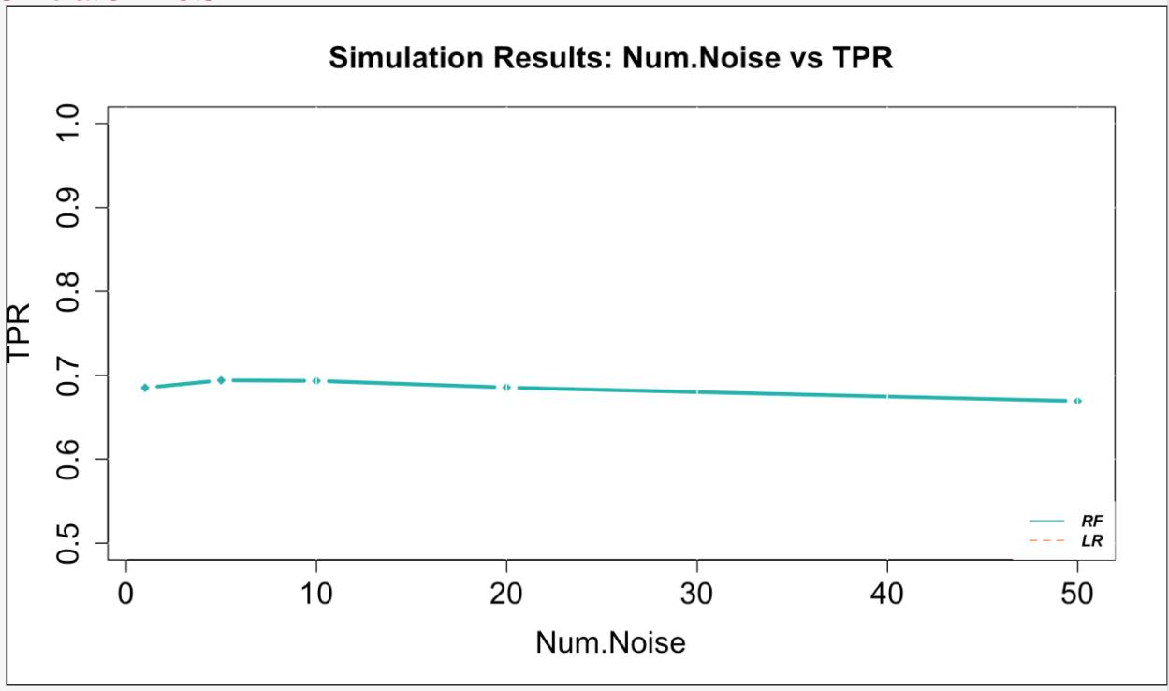
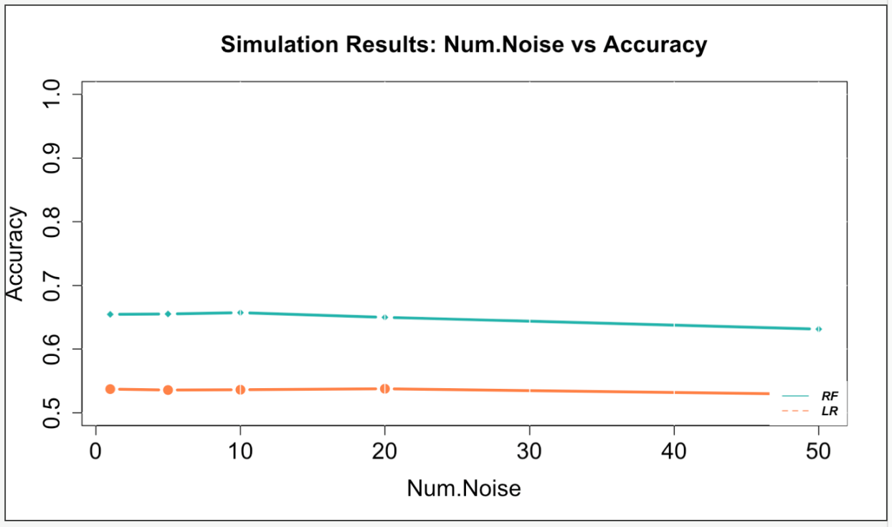
Case 2: 1000 sims, 1000 data points, 5 Ex Vars

Slide 17
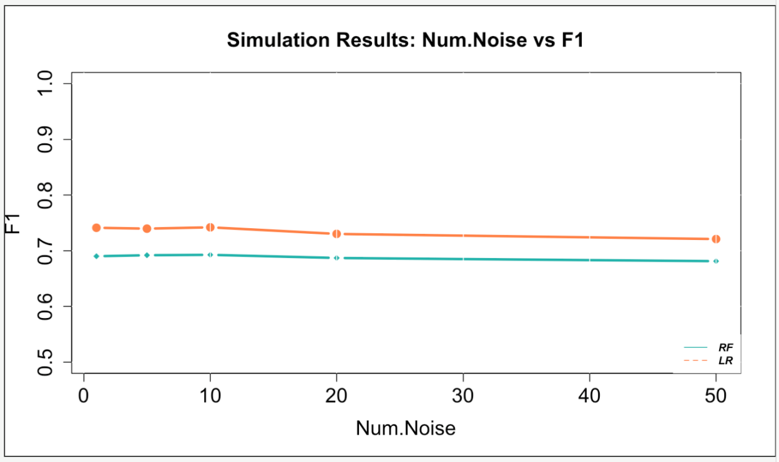
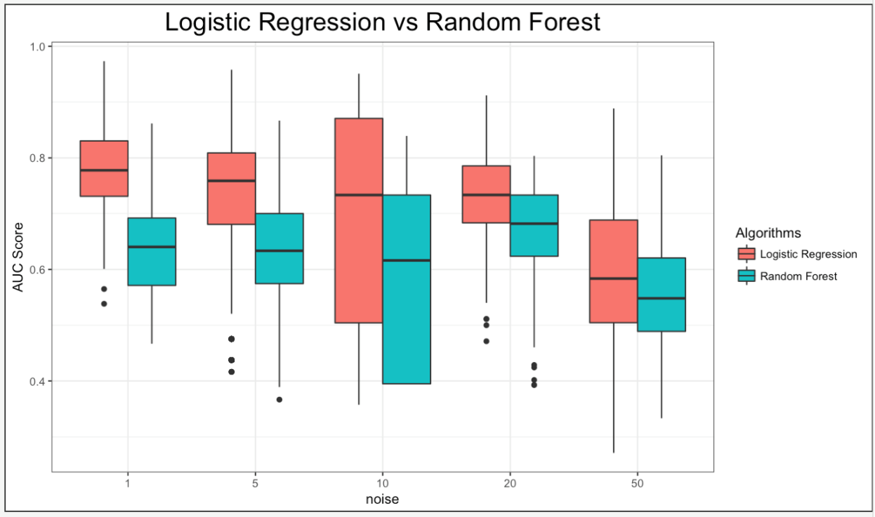
Case 2: 1000 sims, 1000 data points, 5 Ex Vars

Slide 18
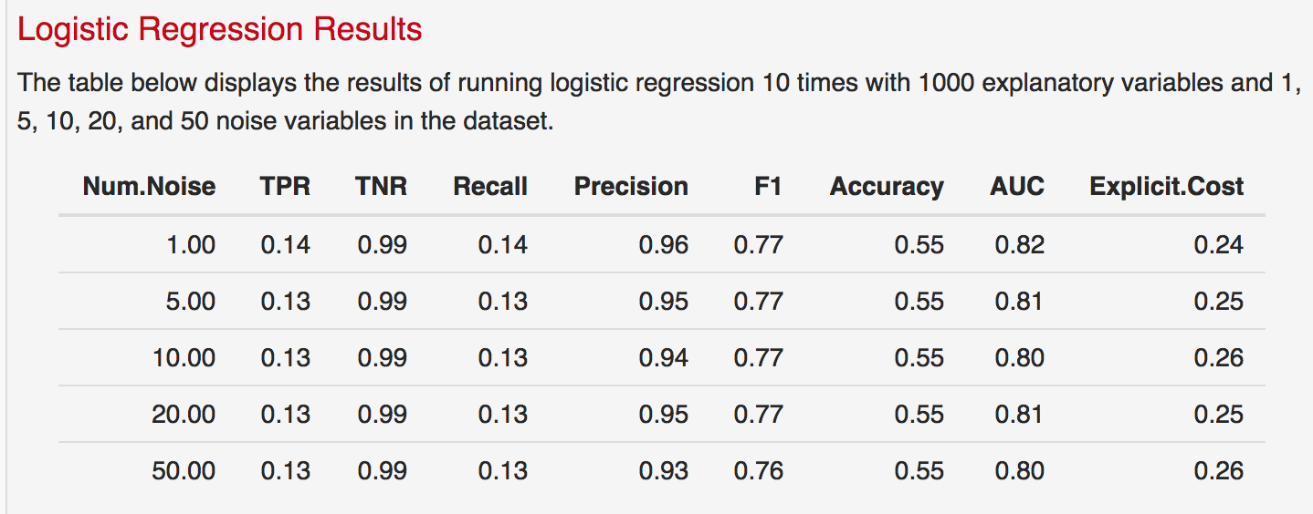
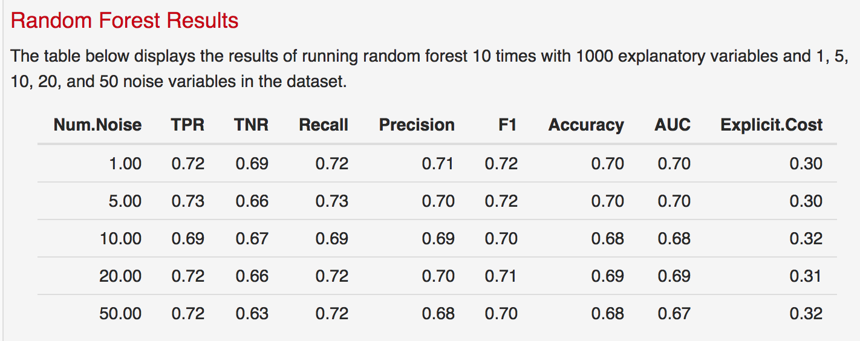
Case 2: 1000 sims, 1000 data points, 10 Ex Vars
*Description is hardcoded
*TPR for LR is the only one that is incorrect – reran to fix it

Slide 19
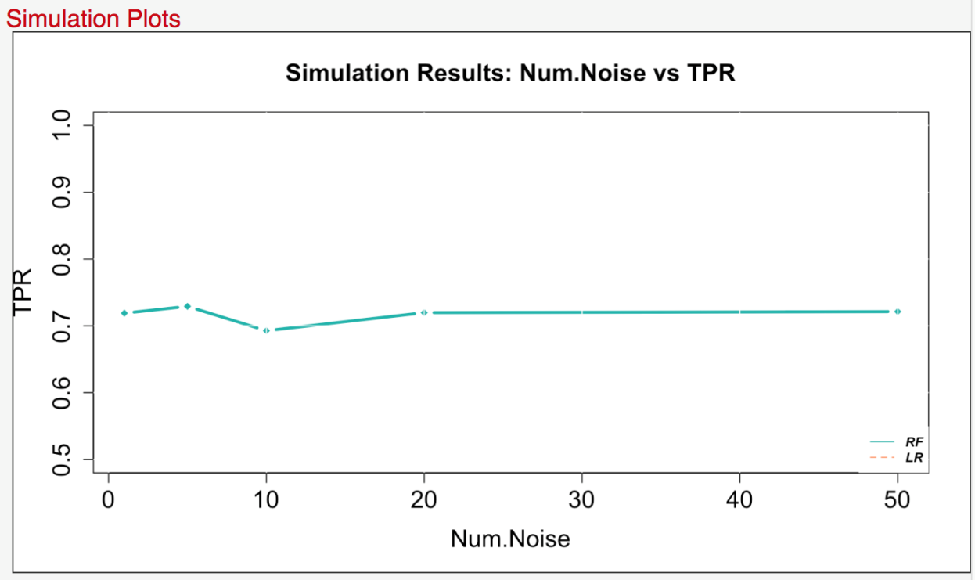
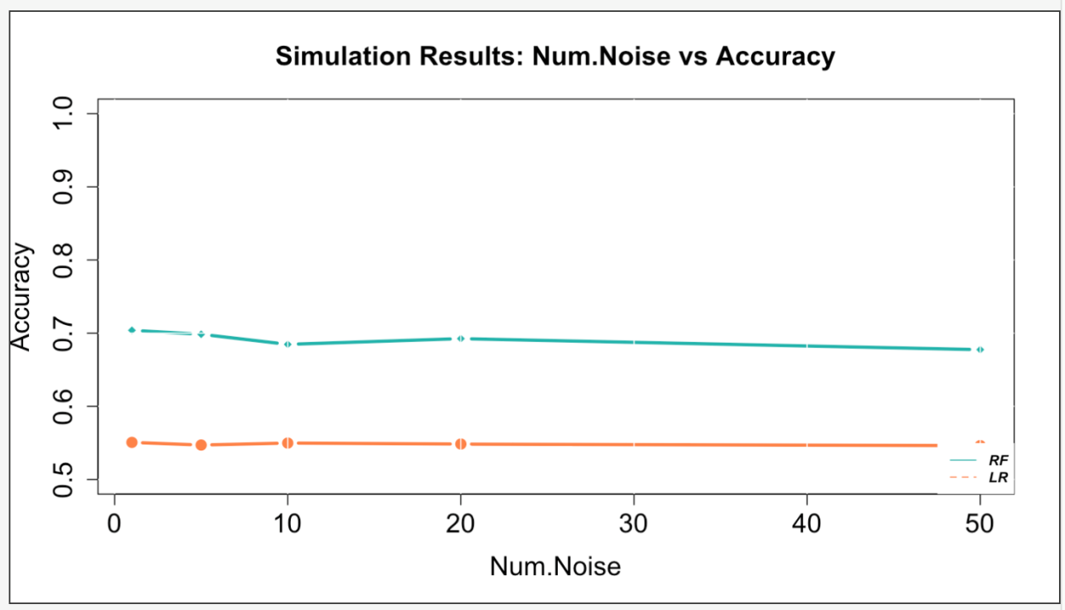
Case 2: 1000 sims, 1000 data points, 10 Ex Vars
*TPR for LR is the only one that is incorrect – reran to fix it

Slide 20
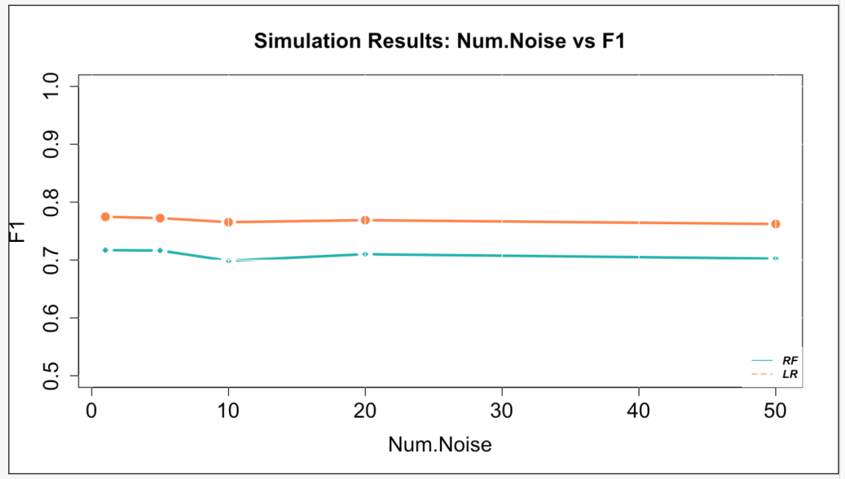
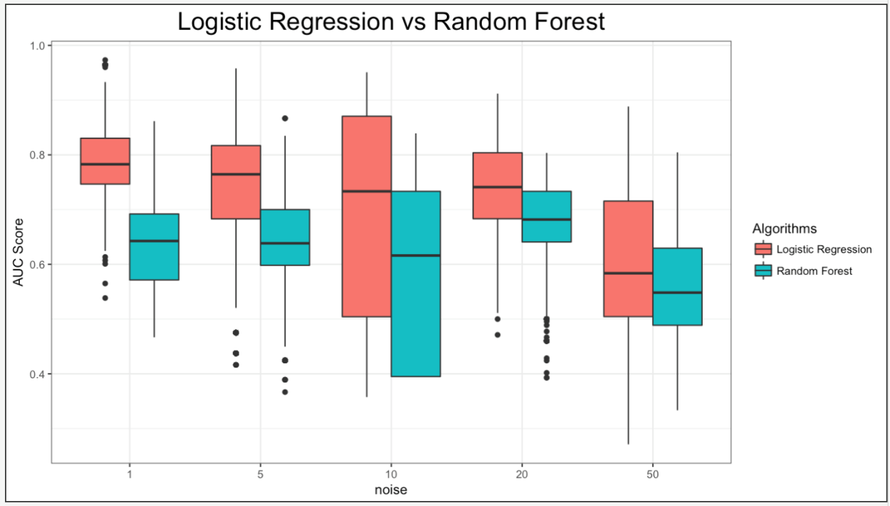
Case 2: 1000 sims, 1000 data points, 10 Ex Vars

Slide 21
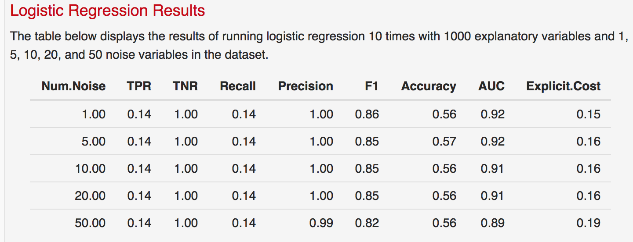
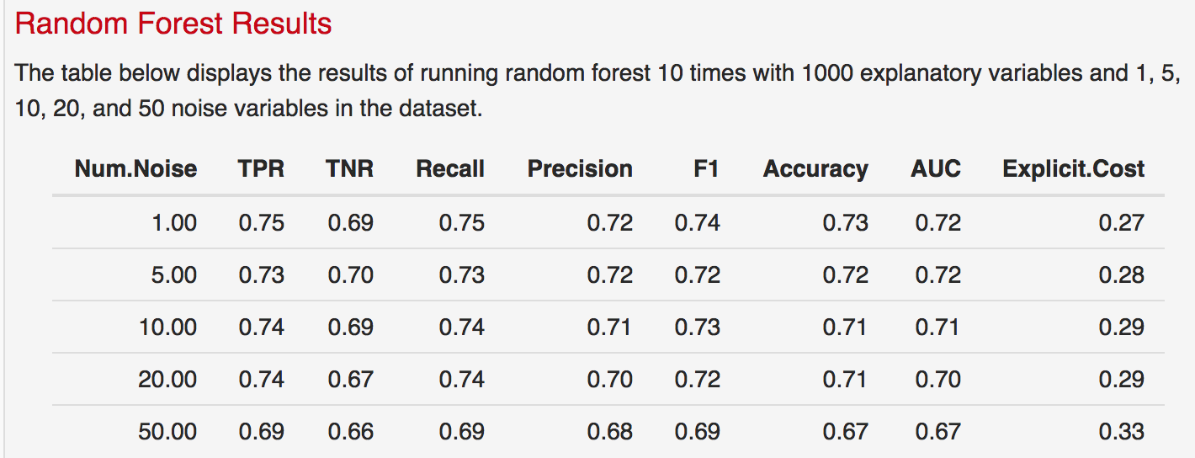
Case 2: 1000 sims, 1000 data points, 50 Ex Vars

Slide 22
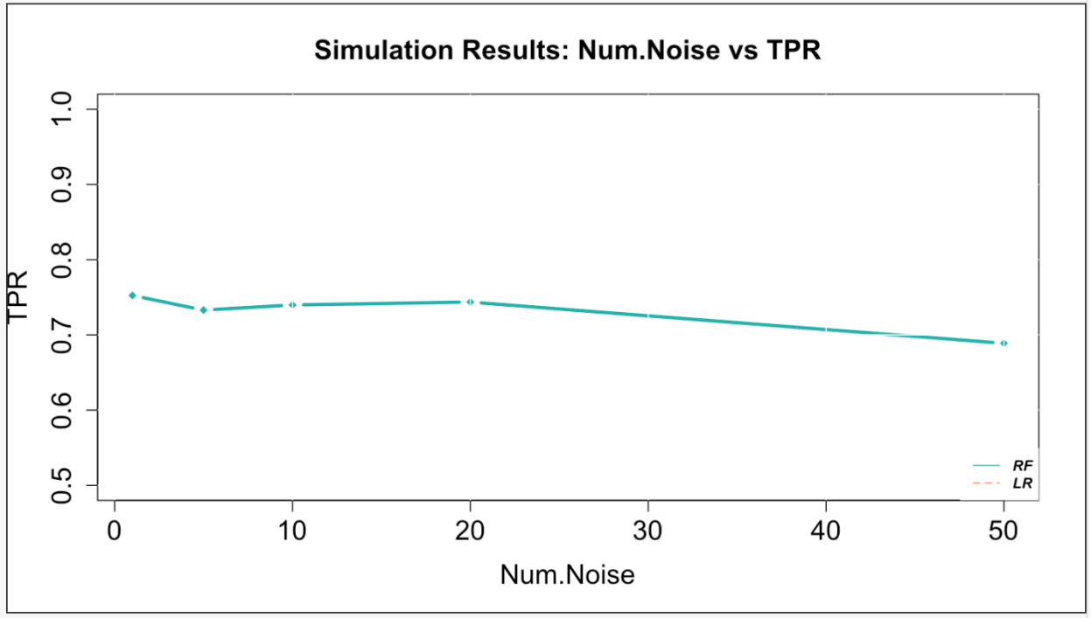
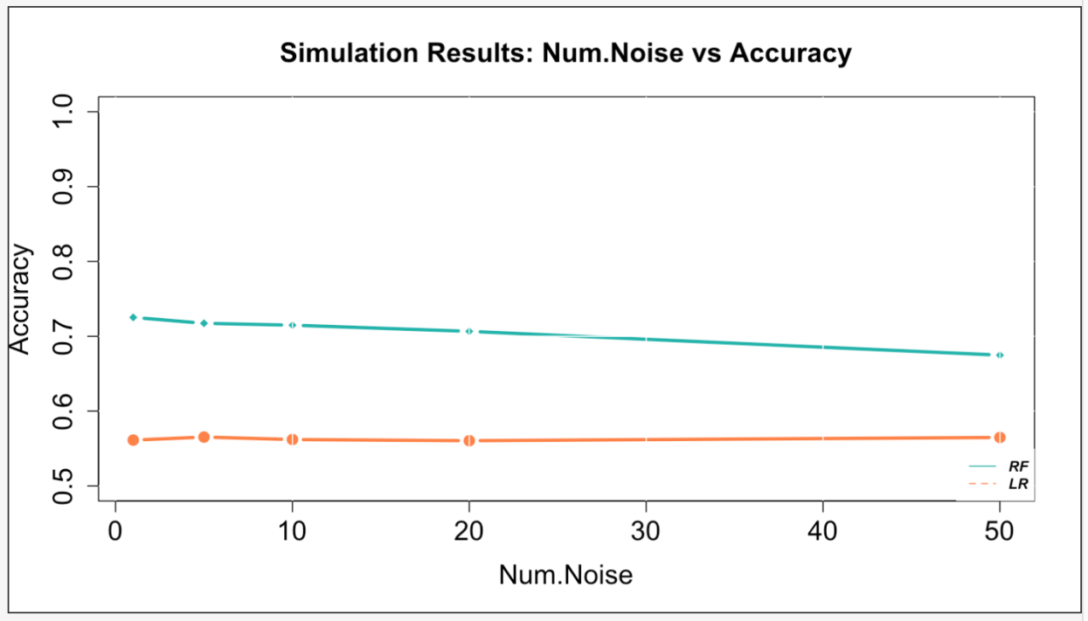
Case 2: 1000 sims, 1000 data points, 50 Ex Vars

Slide 23
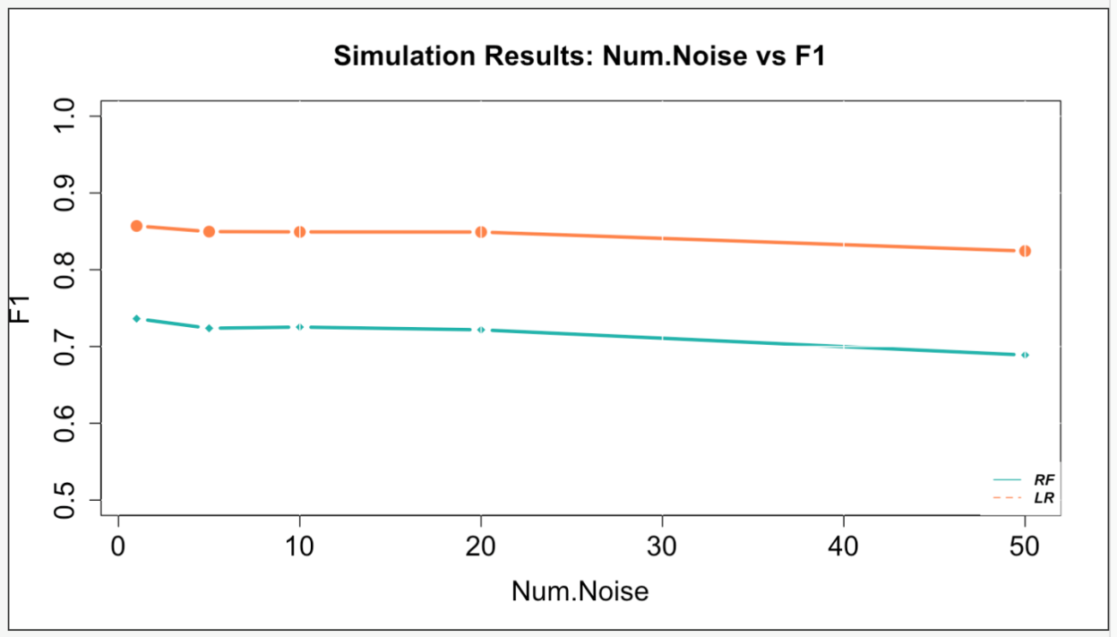
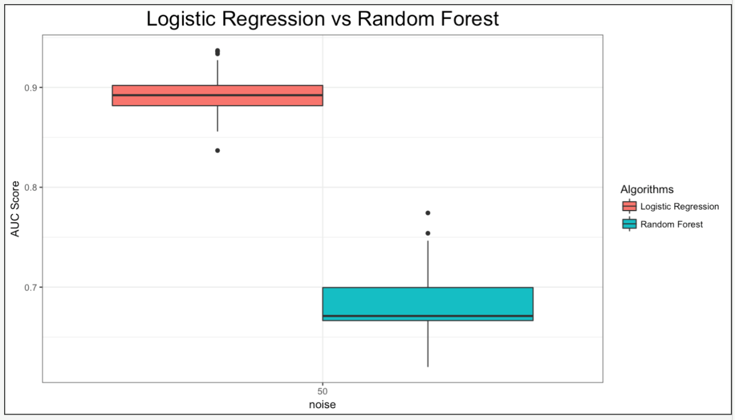
Case 2: 1000 sims, 1000 data points, 50 Ex Vars

Slide 24
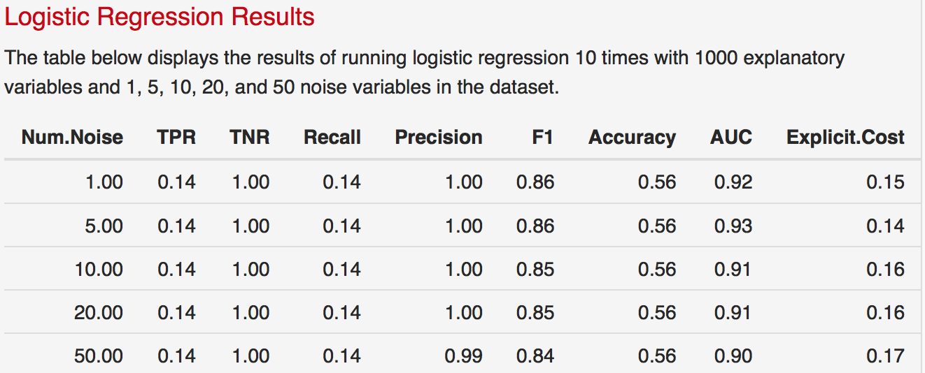
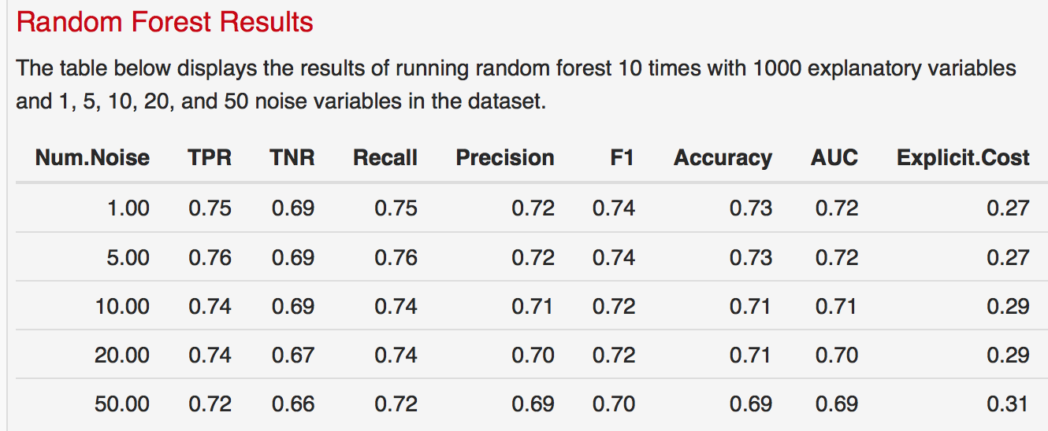
Case 2 – Run 2: 1000 sims, 1000 data points, 50 Ex Vars

Slide 25
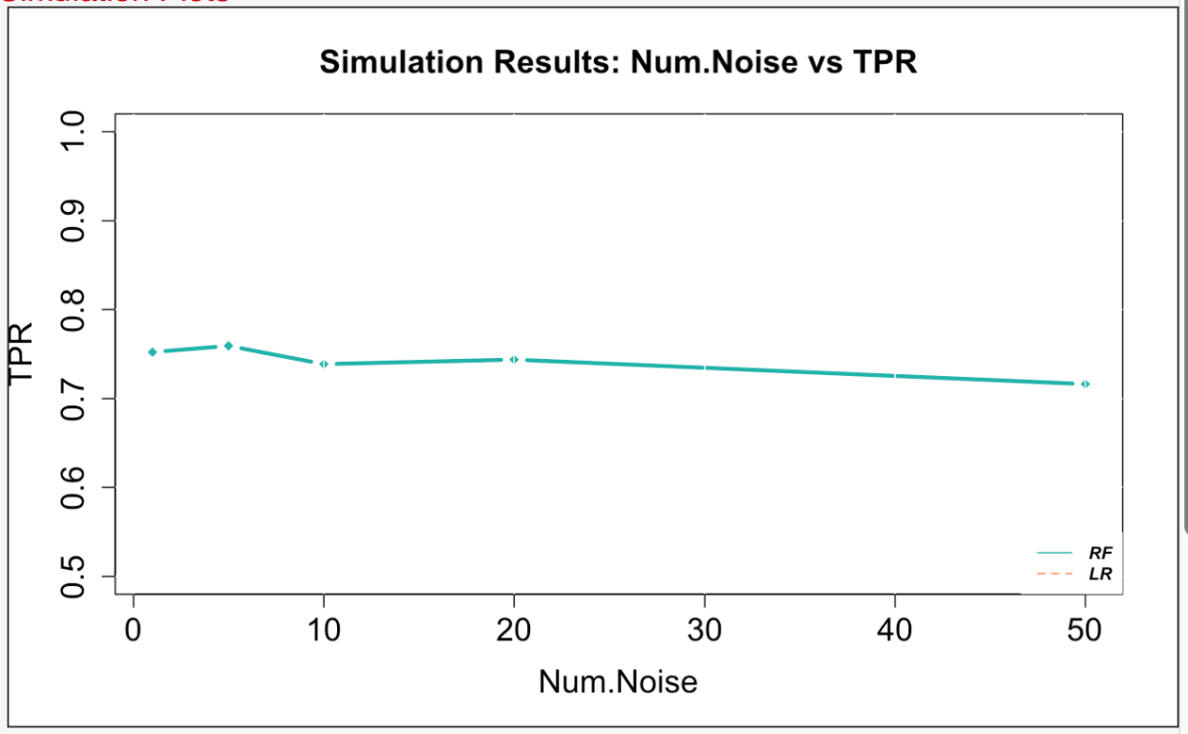
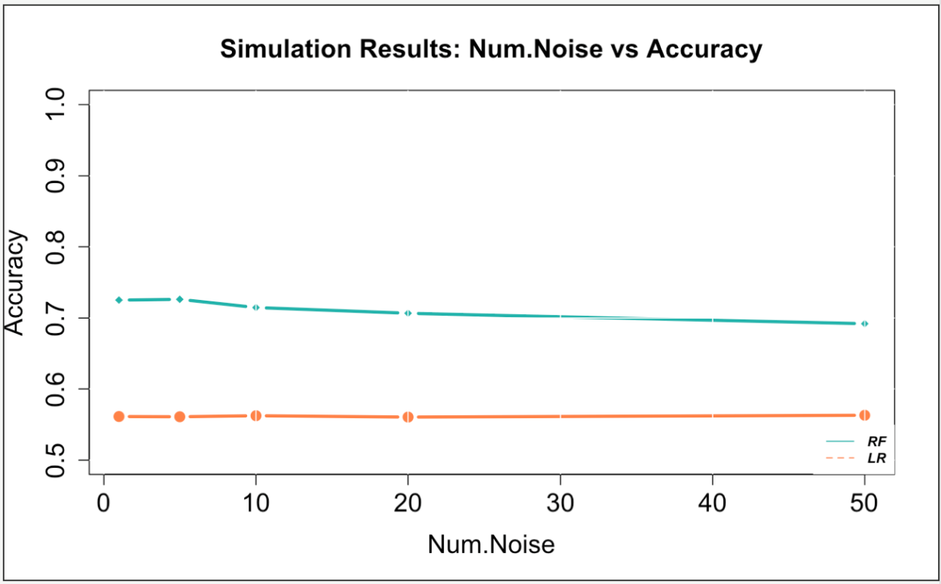
Case 2 – Run 2: 1000 sims, 1000 data points, 50 Ex Vars

Slide 26
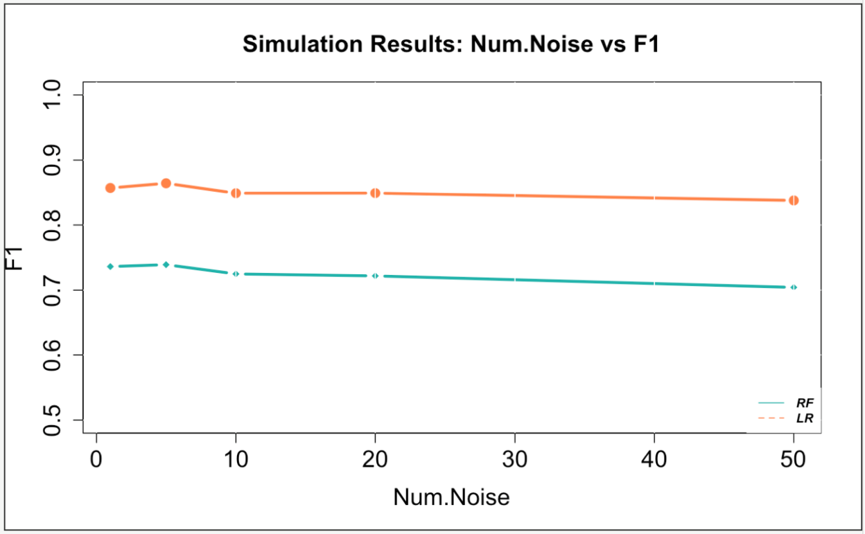
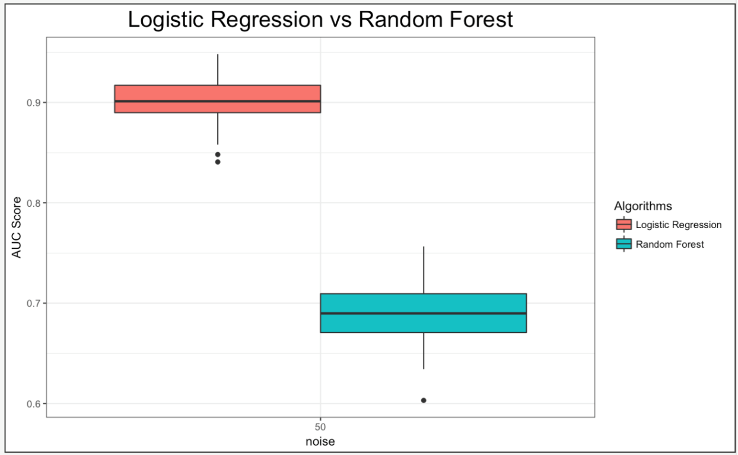
Case 2 – Run 2: 1000 sims, 1000 data points, 50 Ex Vars

Slide 27
Case 2: 1000 sims, 100,000 data points, 5 Ex Vars

Slide 28
Case 2: 1000 sims, 100,000 data points, 5 Ex Vars

Slide 29
Case 2: 1000 sims, 100,000 data points, 5 Ex Vars

Slide 30
Case 2: 1000 sims, 100,000 data points, 10 Ex Vars

Slide 31
Case 2: 1000 sims, 100,000 data points, 10 Ex Vars

Slide 32
Case 2: 1000 sims, 100,000 data points, 10 Ex Vars

Slide 33
Case 2: 1000 sims, 100,000 data points, 50 Ex Vars

Slide 34
Case 2: 1000 sims, 100,000 data points, 50 Ex Vars

Slide 35
Case 2: 1000 sims, 100,000 data points, 50 Ex Vars

Slide 36
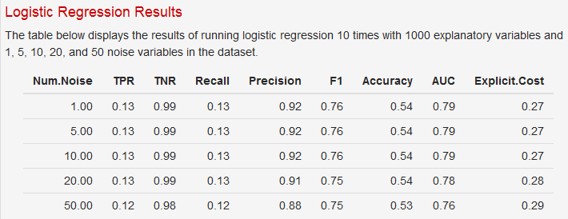
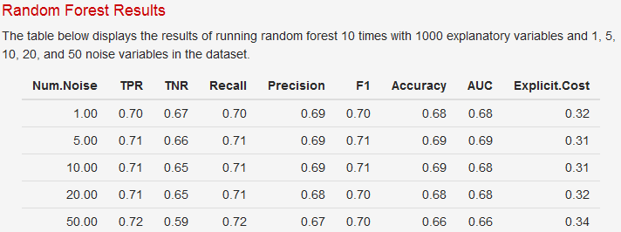
Case 2: 1000 sims, 1000 data points, 5 Ex Vars Small/ Med/ Large coefficients

Slide 37
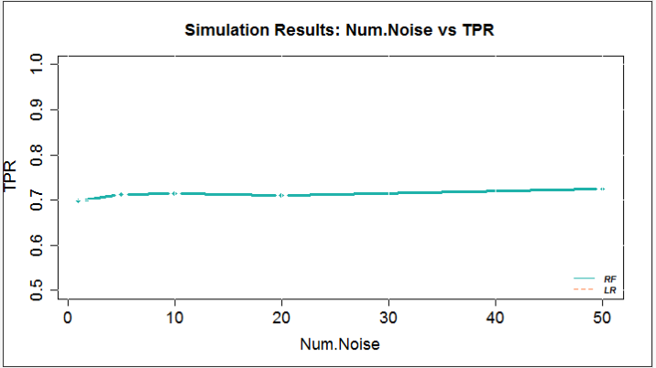
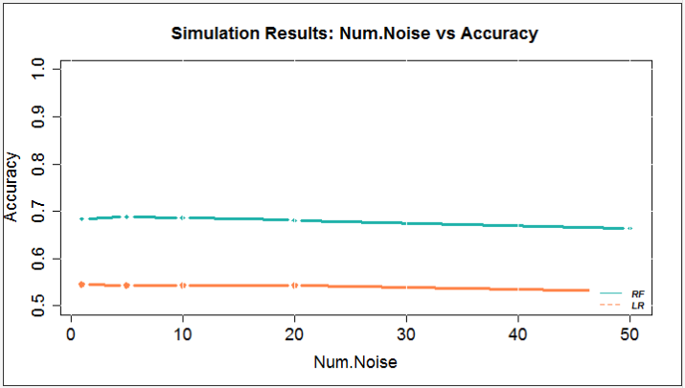
Case 2: 1000 sims, 1000 data points, 5 Ex Vars Small/ Med/ Large coefficients

Slide 38
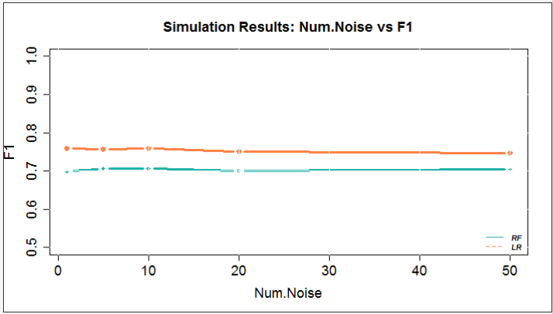
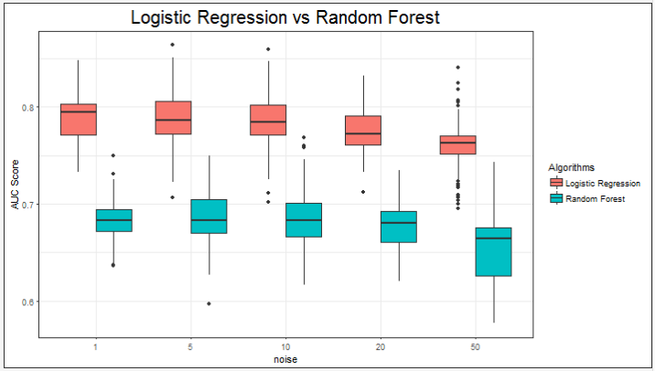
Case 2: 1000 sims, 1000 data points, 5 Ex Vars Small/ Med/ Large coefficients

Slide 39
Case 2: 1000 sims, 1000 data points, 5 Ex Vars Small/ Med/ Large coefficients + forward/ backward

