Slide 1
Capstone Results Sample size: 100
June 24

Slide 2
Case 1
In this case, we simulate the dataset and set the variance of each variable (noise and explanatory) to 0.5 to 5.0 in an interval of 0.5 and display the results of each simulation.

Slide 3
Case 2
In this case, we simulate the dataset and set the number of noise variables to 1, 5, 10, 20, and 50 and display the results of each simulation.
Run with 1000 sims
100, 1000 and 100,000 data points
1, 5, 10, 20 explanatory variables

Slide 4
Case 2: 1000 sims, 1000 datapoints, 1 Ex Vars

Slide 5
Case 2: 1000 sims, 1000 datapoints, 1 Ex Vars

Slide 6
Case 2: 1000 sims, 1000 datapoints, 1 Ex Vars

Slide 7
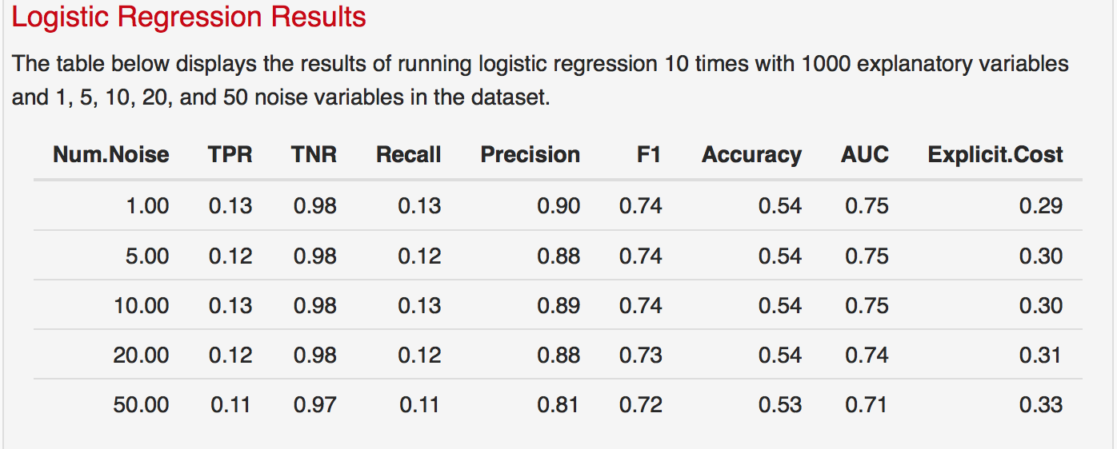
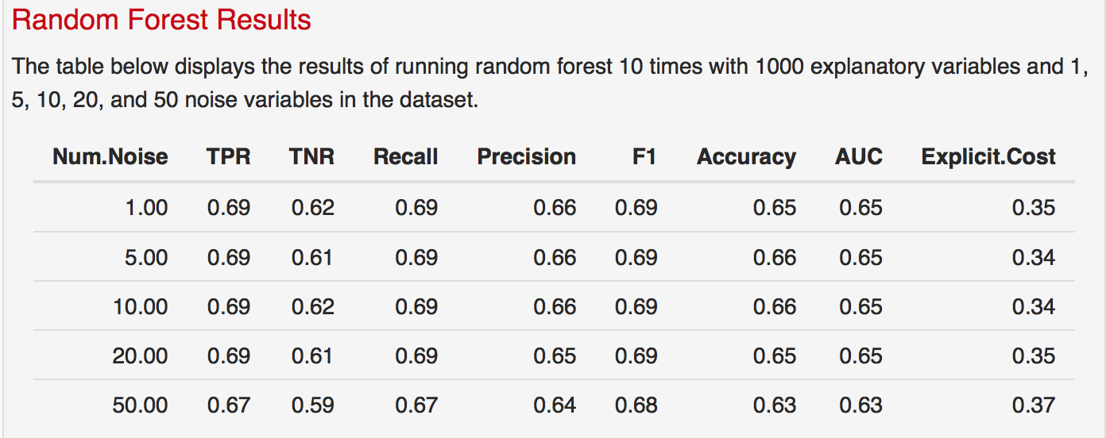
Case 2: 1000 sims, 1000 data points, 5 Ex Vars
*Description is hardcoded
*TPR for LR is the only one that is incorrect – reran to fix it

Slide 8
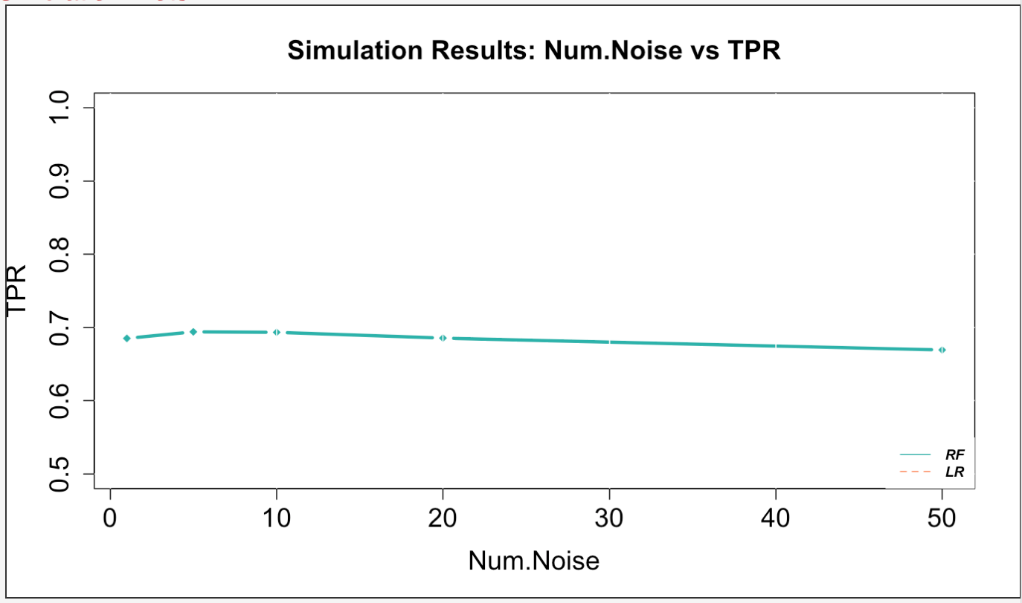
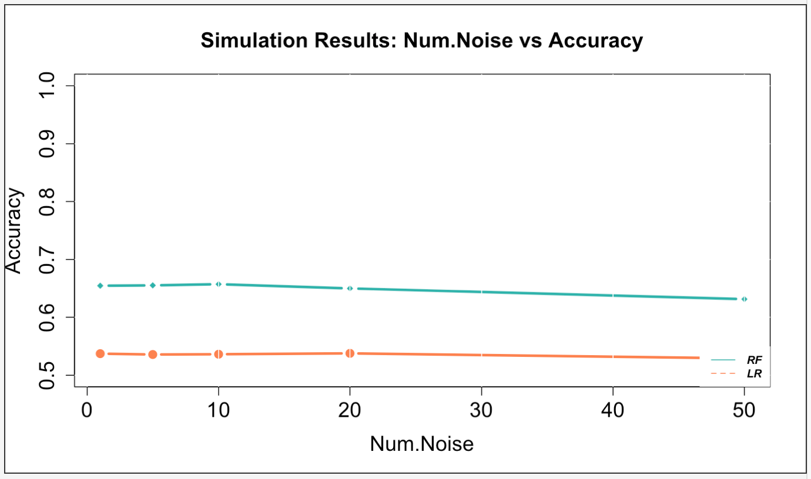
Case 2: 1000 sims, 1000 data points, 5 Ex Vars
*TPR for LR is the only one that is incorrect – reran to fix it

Slide 9
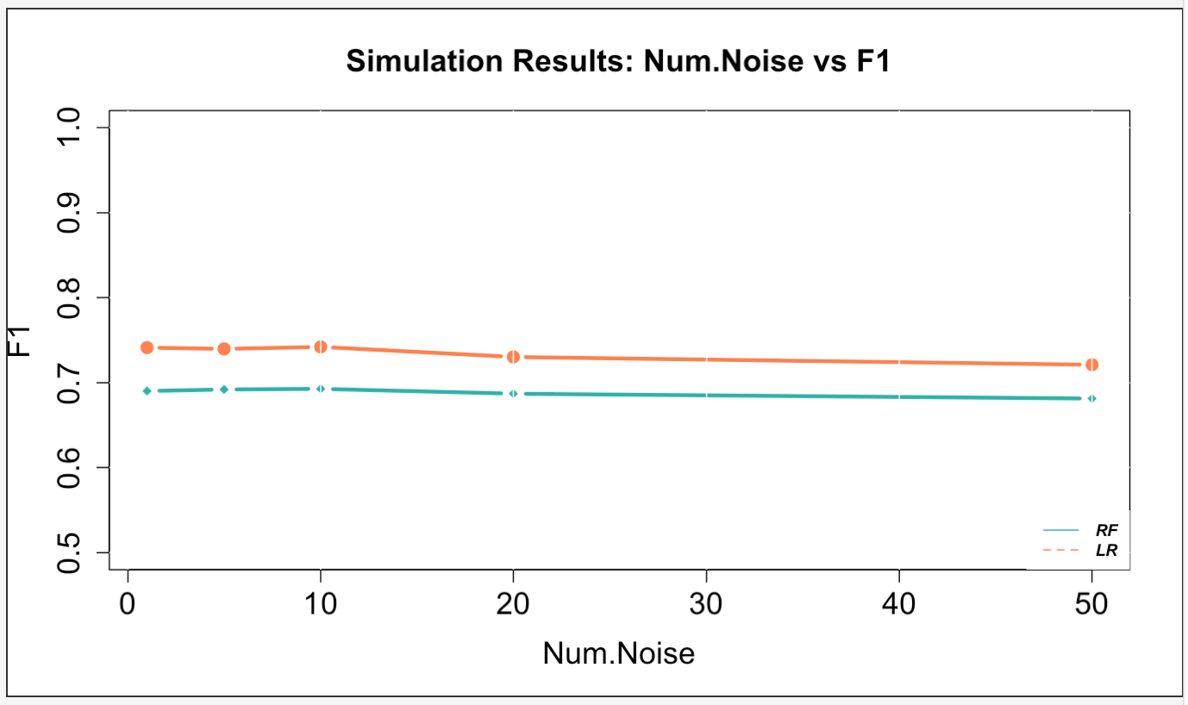
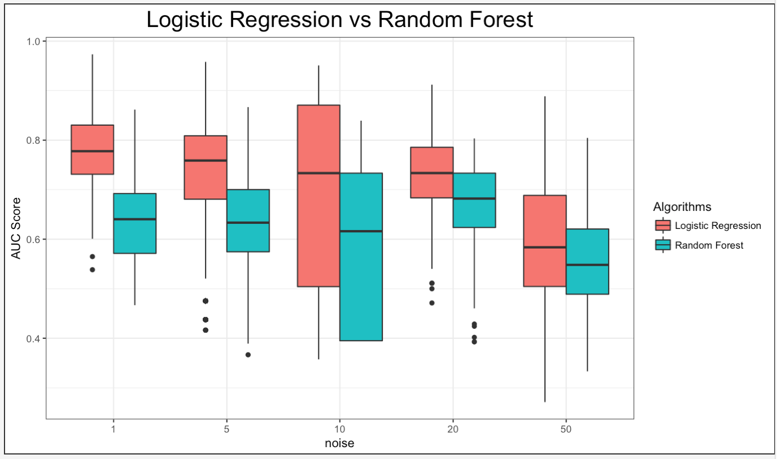
Case 2: 1000 sims, 1000 data points, 5 Ex Vars

Slide 10
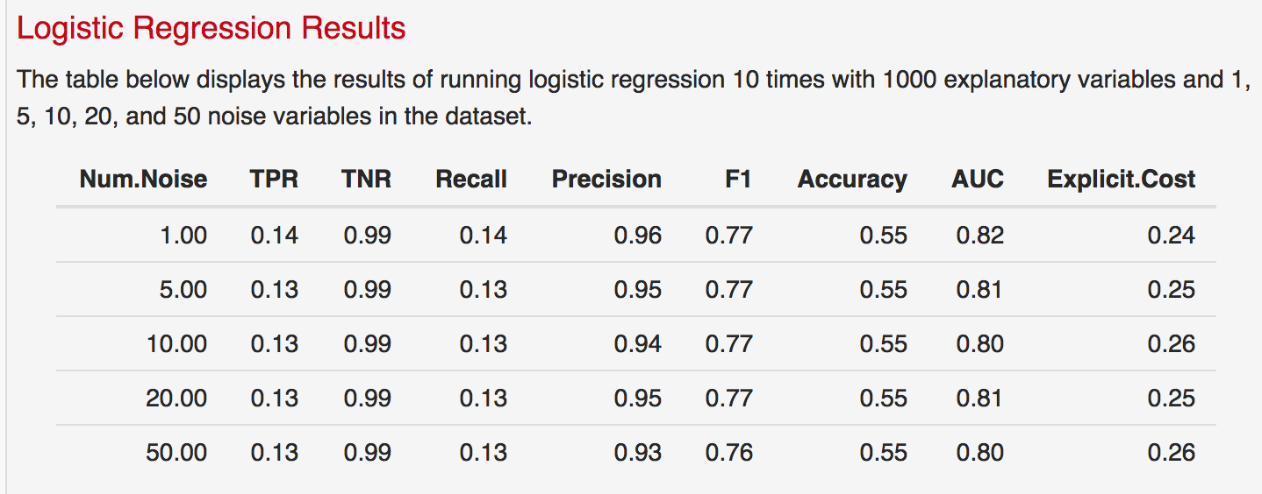
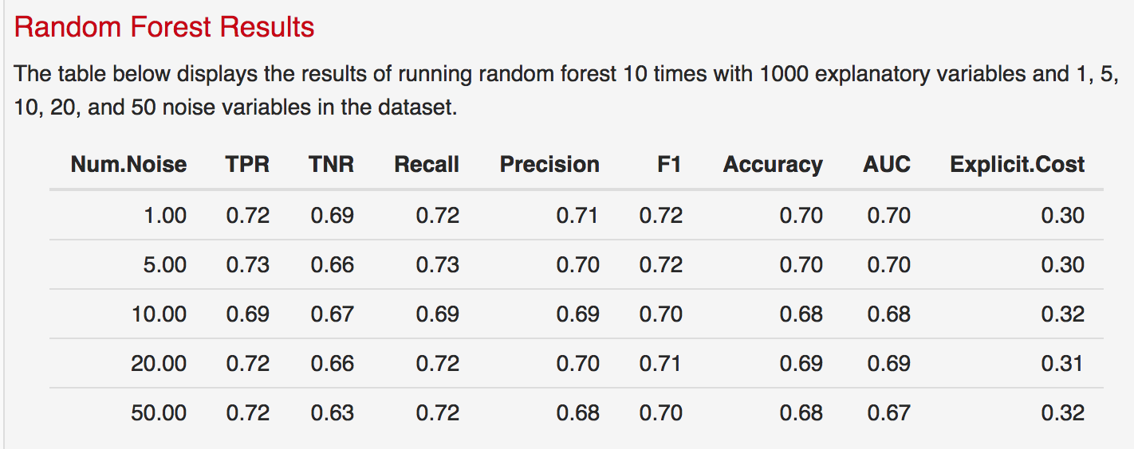
Case 2: 1000 sims, 1000 data points, 10 Ex Vars
*Description is hardcoded
*TPR for LR is the only one that is incorrect – reran to fix it

Slide 11
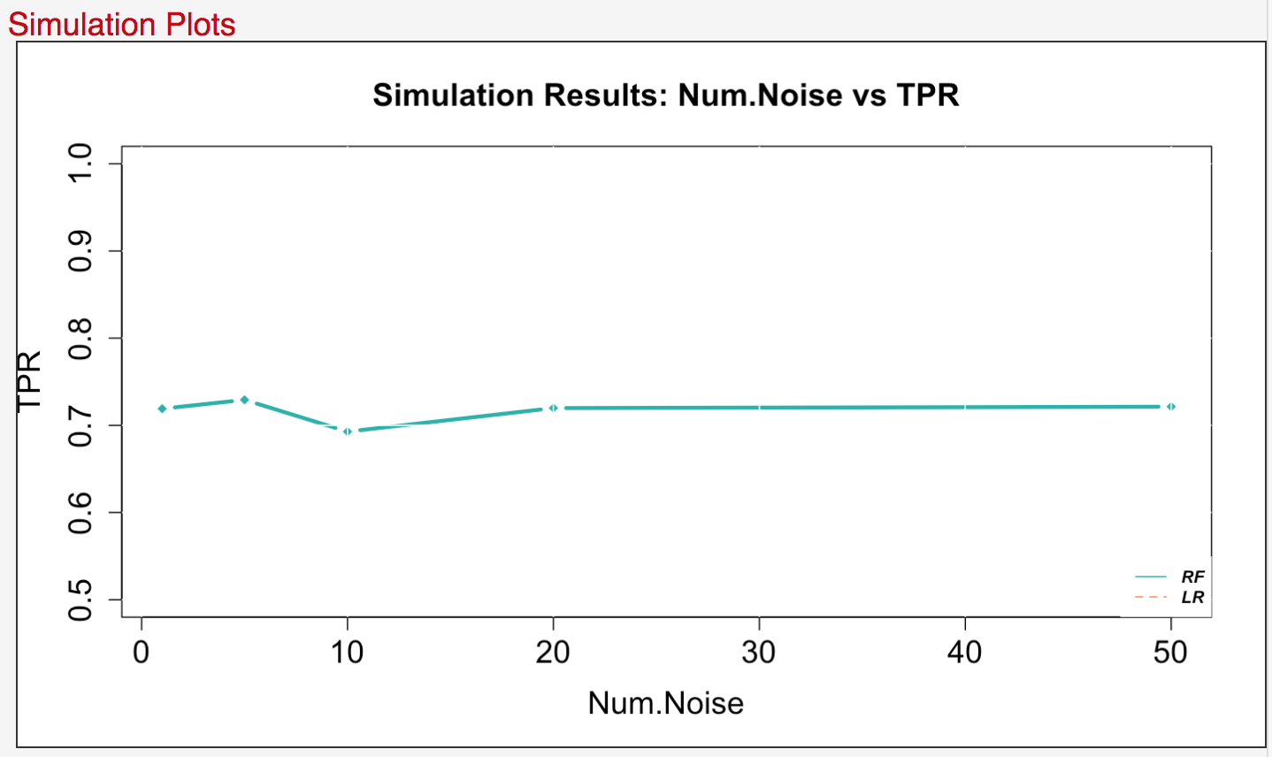
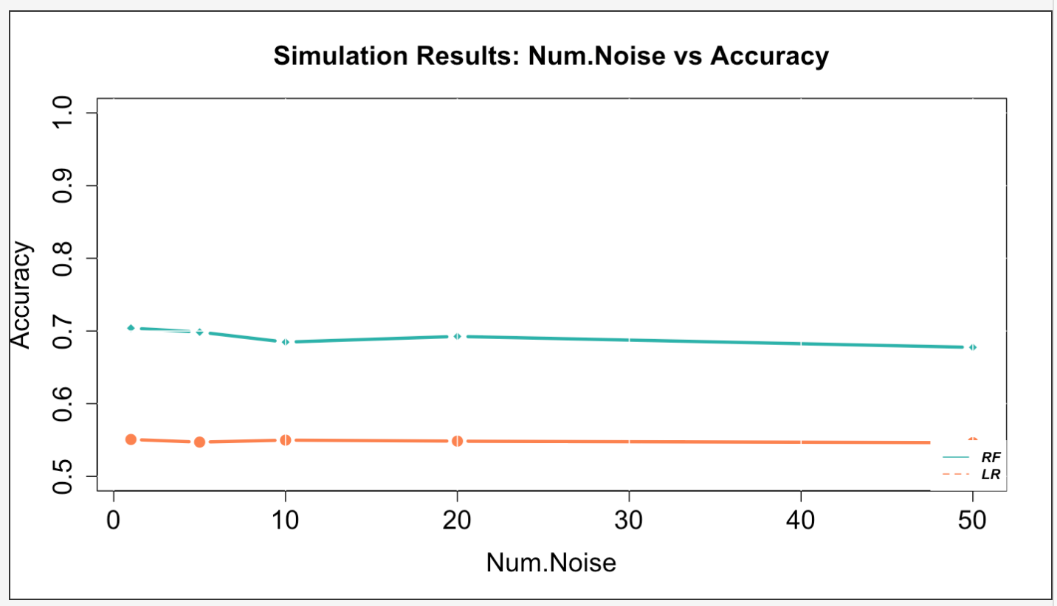
Case 2: 1000 sims, 1000 data points, 10 Ex Vars
*TPR for LR is the only one that is incorrect – reran to fix it

Slide 12
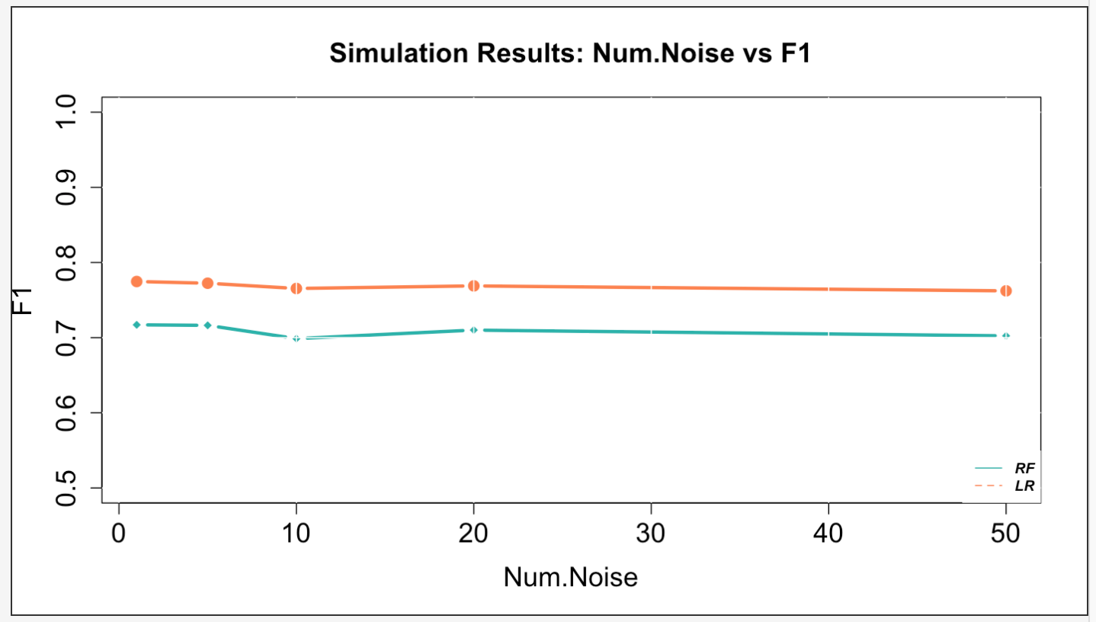
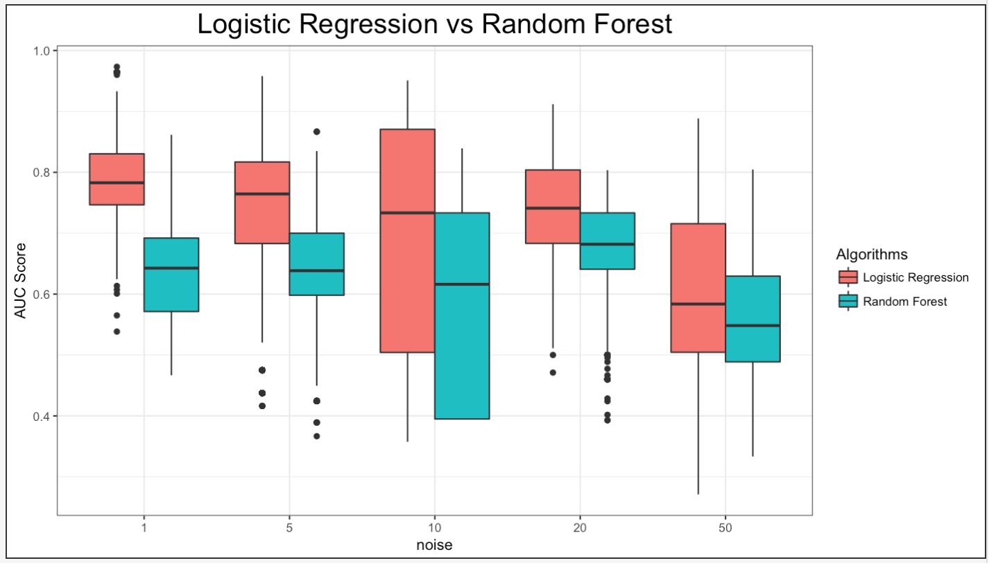
Case 2: 1000 sims, 1000 data points, 10 Ex Vars

Slide 13
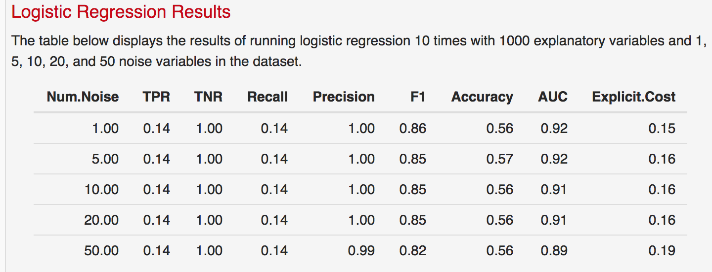
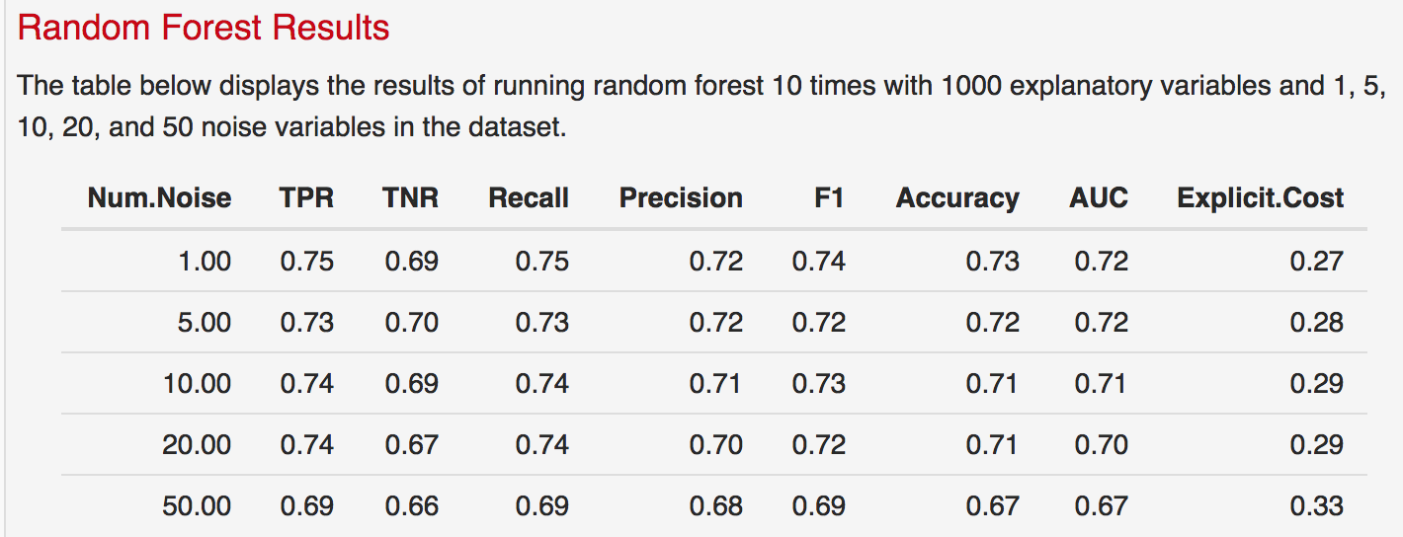
Case 2: 1000 sims, 1000 data points, 50 Ex Vars

Slide 14
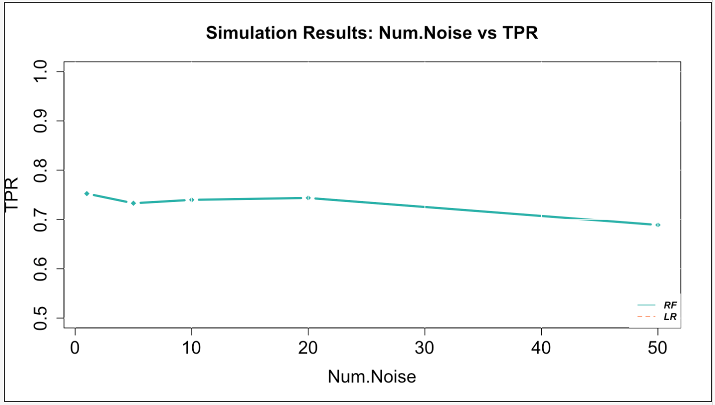
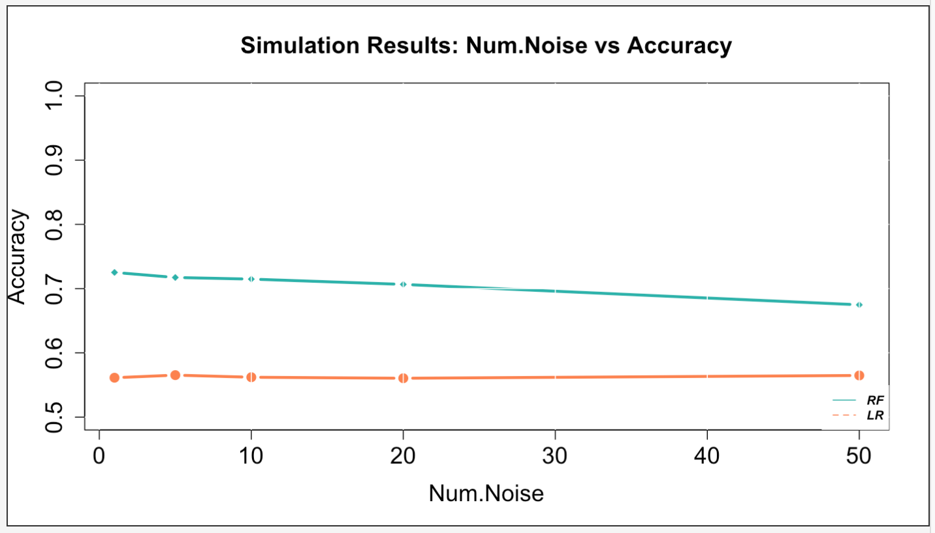
Case 2: 1000 sims, 1000 data points, 50 Ex Vars

Slide 15
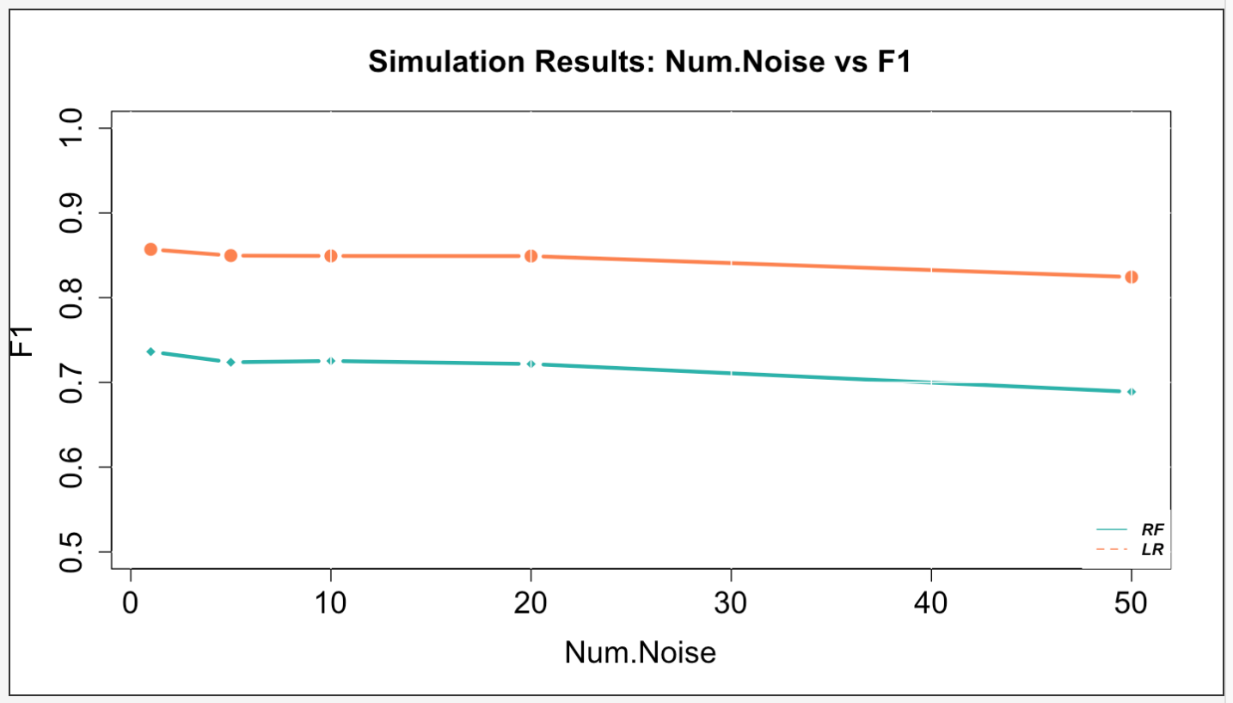
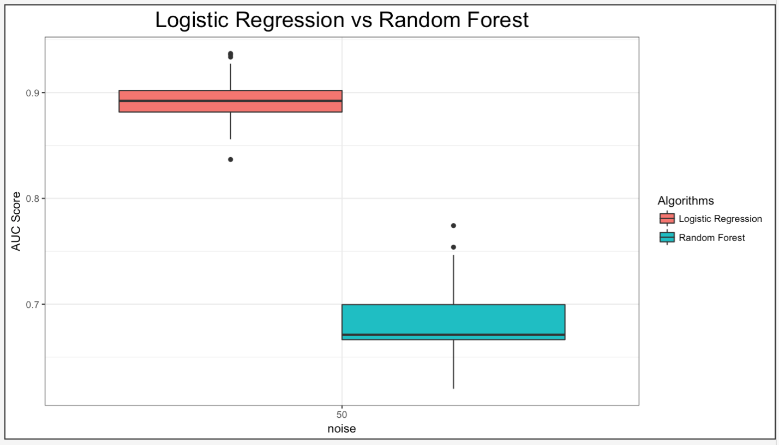
Case 2: 1000 sims, 1000 data points, 50 Ex Vars

Slide 16
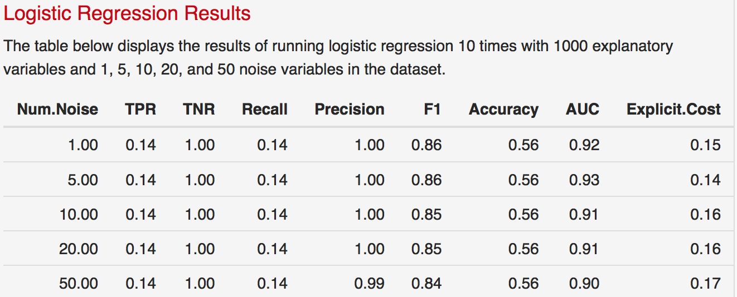
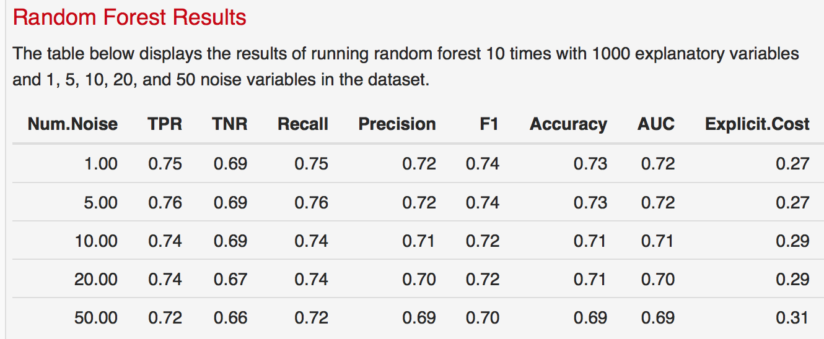
Case 2 – Run 2: 1000 sims, 1000 data points, 50 Ex Vars

Slide 17
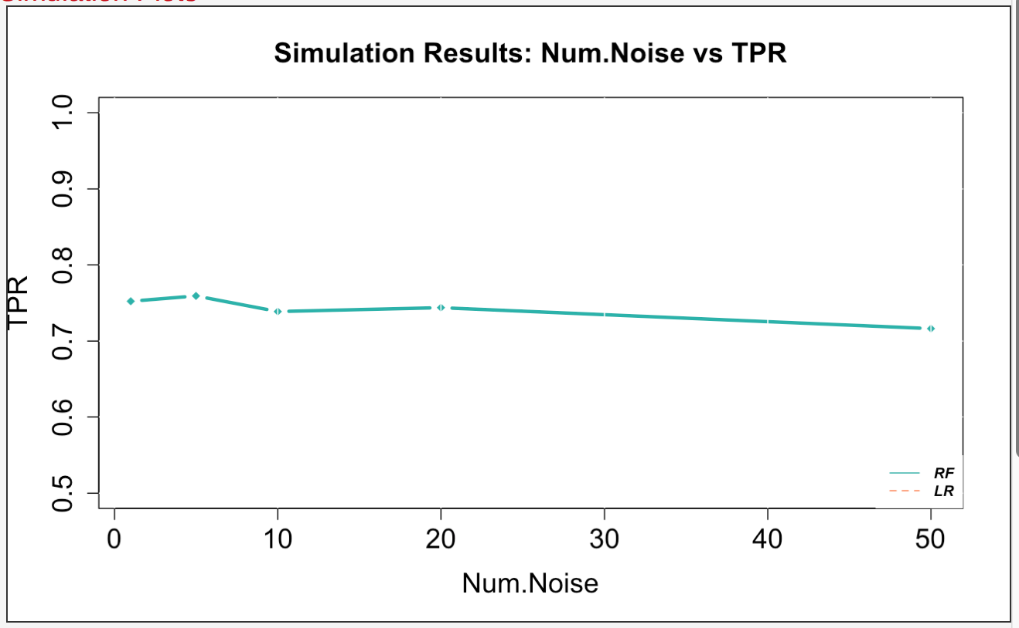
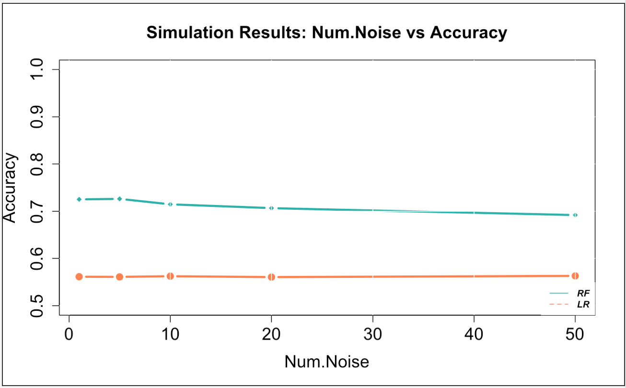
Case 2 – Run 2: 1000 sims, 1000 data points, 50 Ex Vars

Slide 18
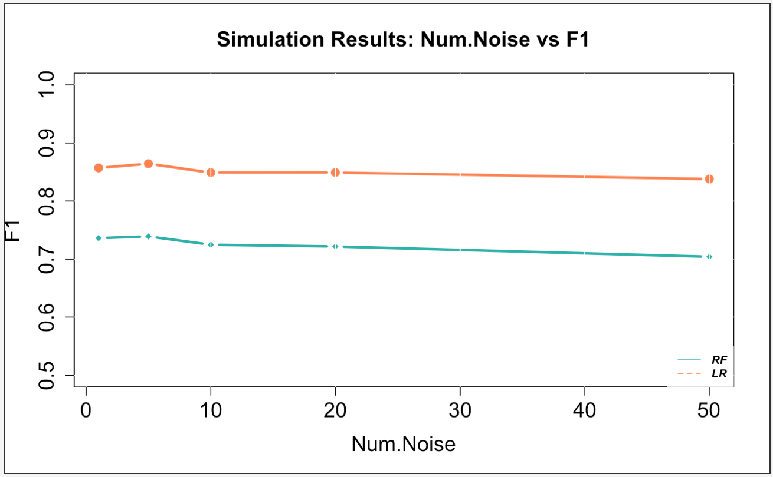
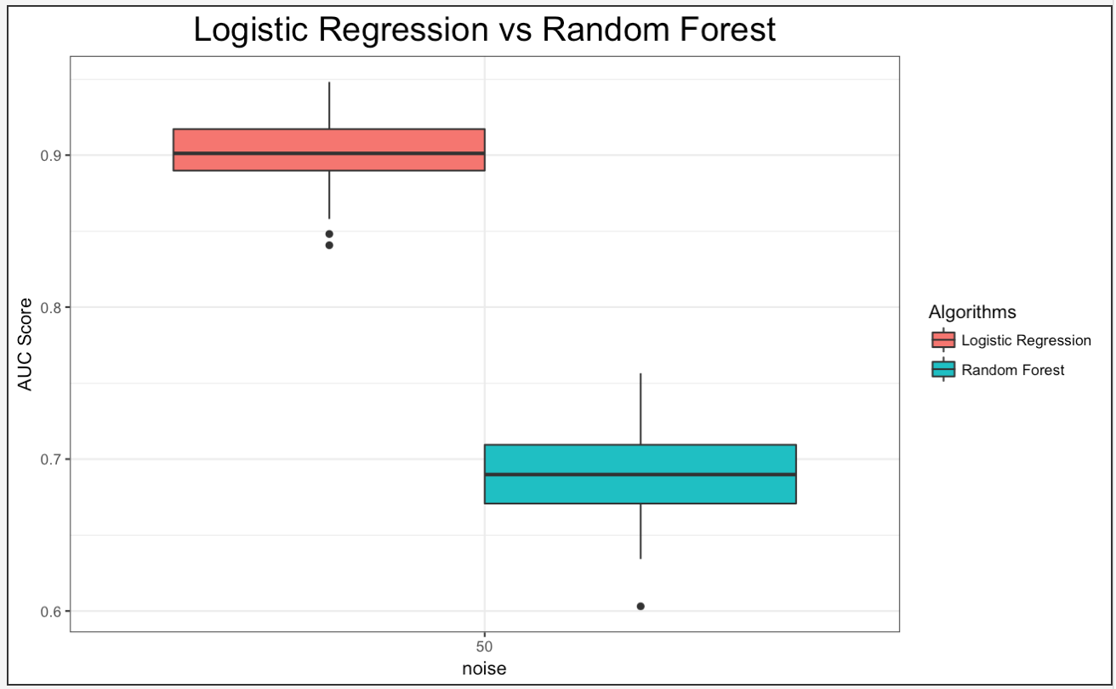
Case 2 – Run 2: 1000 sims, 1000 data points, 50 Ex Vars

Slide 19
Case 2: 1000 sims, 100,000 data points, 5 Ex Vars

Slide 20
Case 2: 1000 sims, 100,000 data points, 5 Ex Vars

Slide 21
Case 2: 1000 sims, 100,000 data points, 5 Ex Vars

Slide 22
Case 2: 1000 sims, 100,000 data points, 10 Ex Vars

Slide 23
Case 2: 1000 sims, 100,000 data points, 10 Ex Vars

Slide 24
Case 2: 1000 sims, 100,000 data points, 10 Ex Vars

Slide 25
Case 2: 1000 sims, 100,000 data points, 50 Ex Vars

Slide 26
Case 2: 1000 sims, 100,000 data points, 50 Ex Vars

Slide 27
Case 2: 1000 sims, 100,000 data points, 50 Ex Vars

