Slide 1
June 30 results

Slide 2
Case 2
In this case, we simulate the dataset and set the number of noise variables to 1, 5, 10, 20, and 50 and display the results of each simulation
Run 1000 sims with 1000 data points
5, 10, 20, 50 explanatory vars

Slide 3
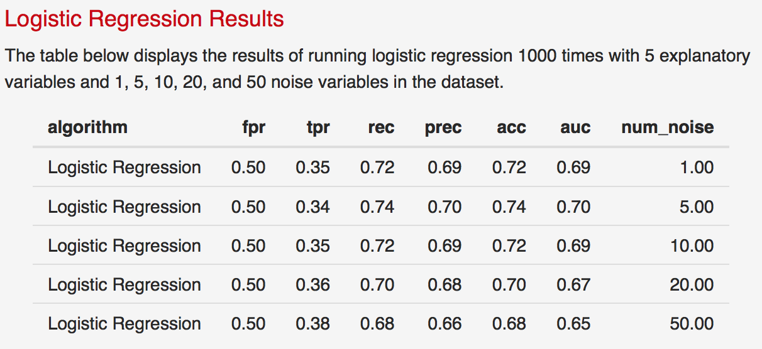
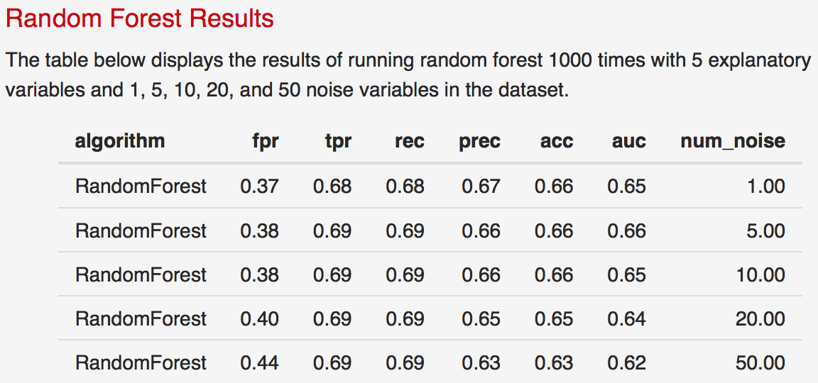
Case 2: 5 ex vars, 1000 sims, 1000 obs

Slide 4
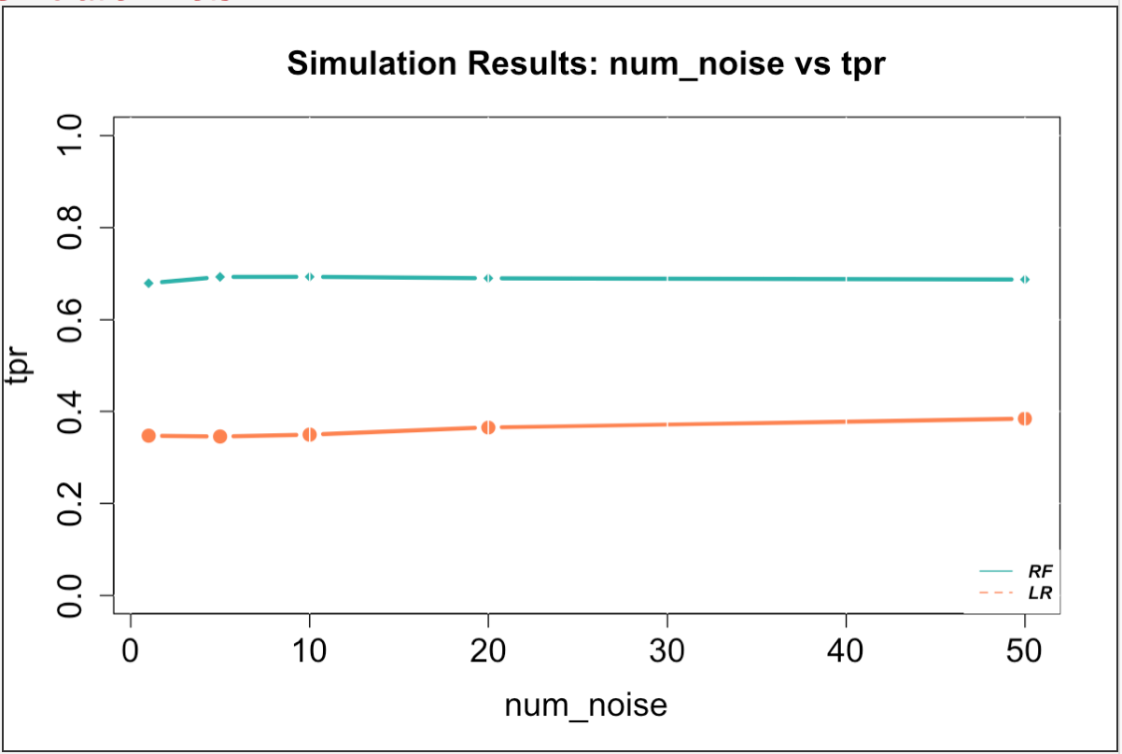
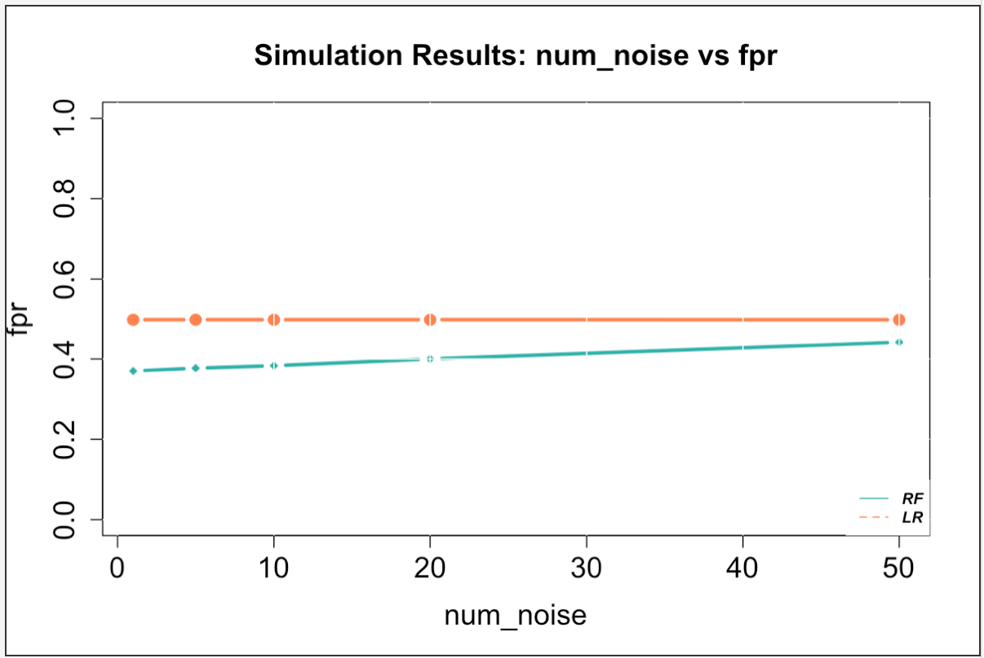
Case 2: 5 ex vars, 1000 sims, 1000 obs

Slide 5
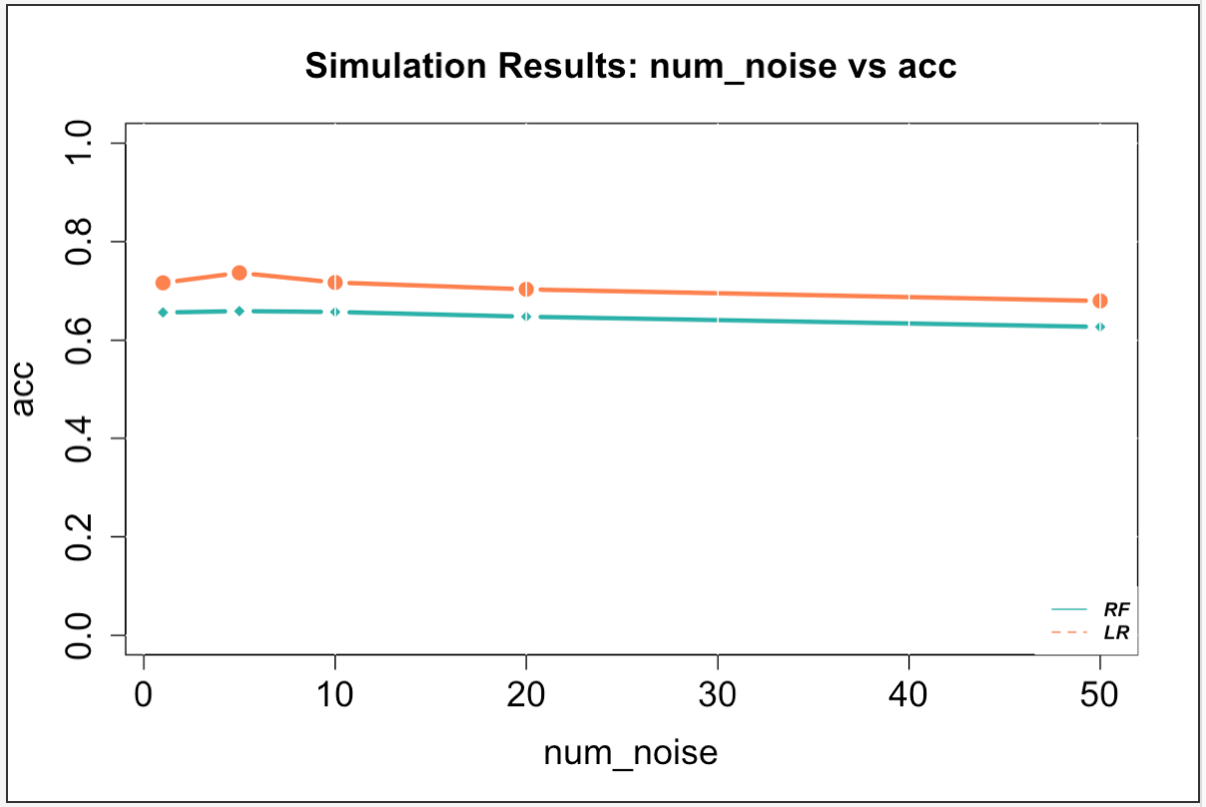
Case 2: 5 ex vars, 1000 sims, 1000 obs

Slide 6
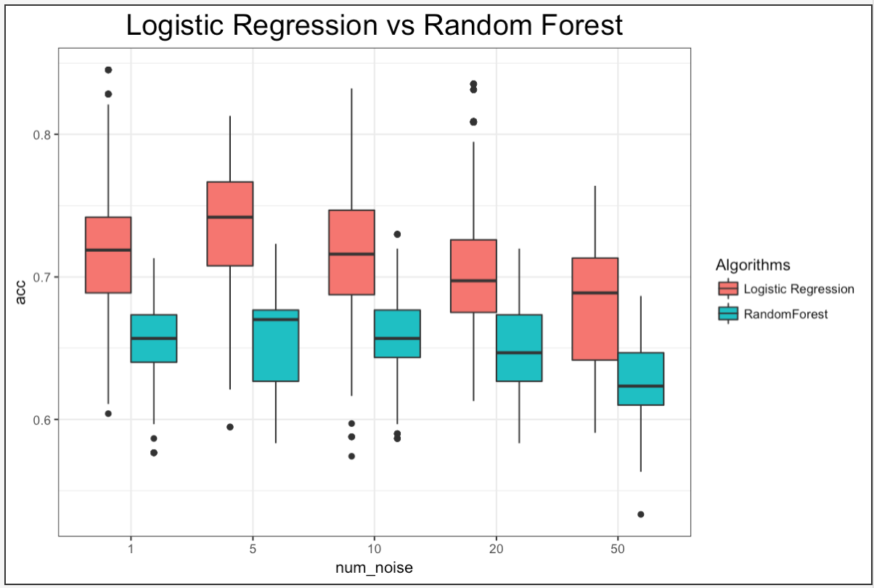
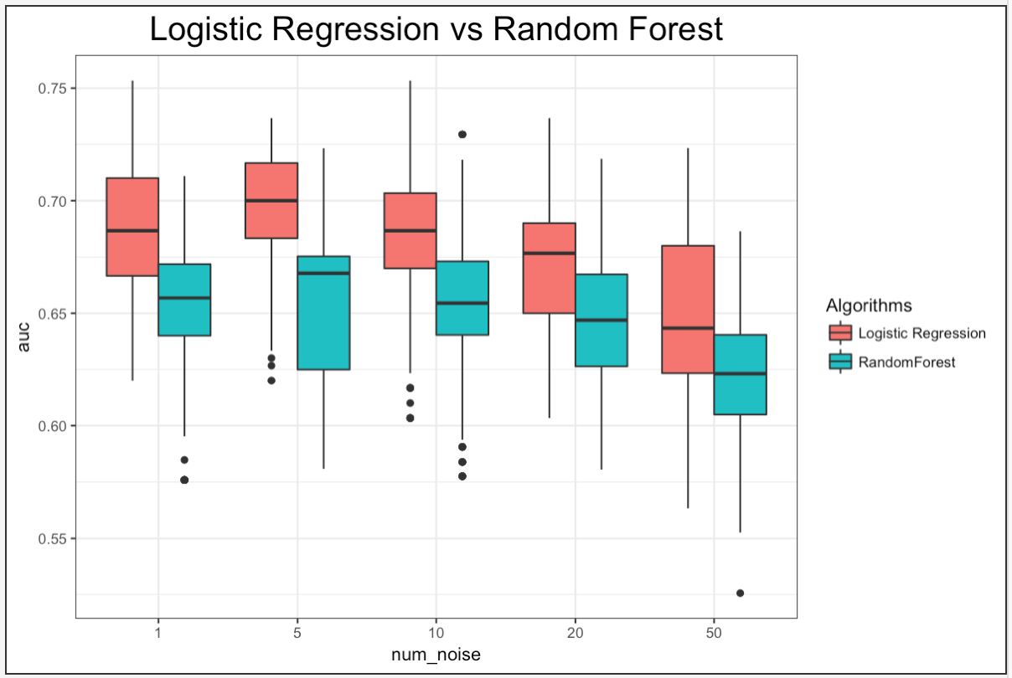
Case 2: 5 ex vars, 1000 sims, 1000 obs

Slide 7
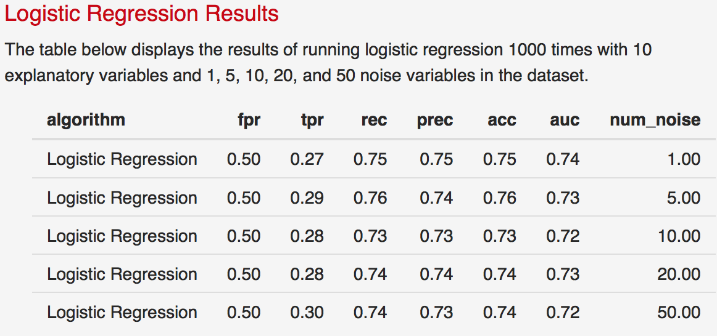
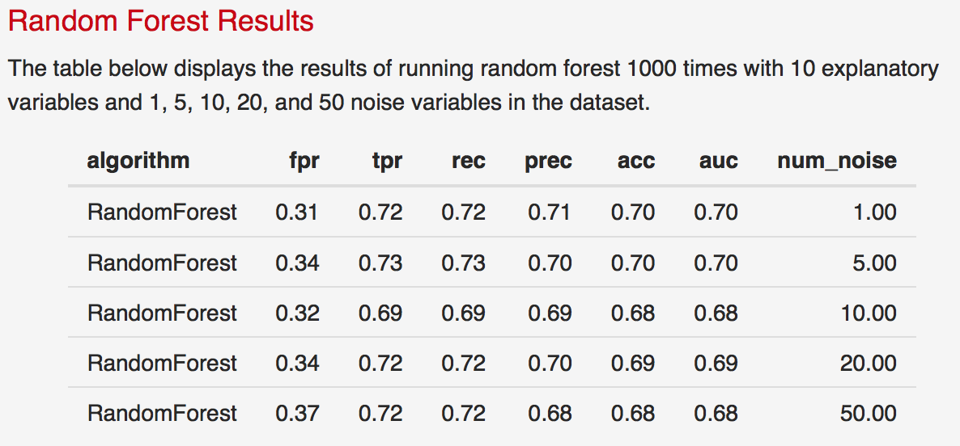
Case 2: 10 ex vars, 1000 sims, 1000 obs

Slide 8
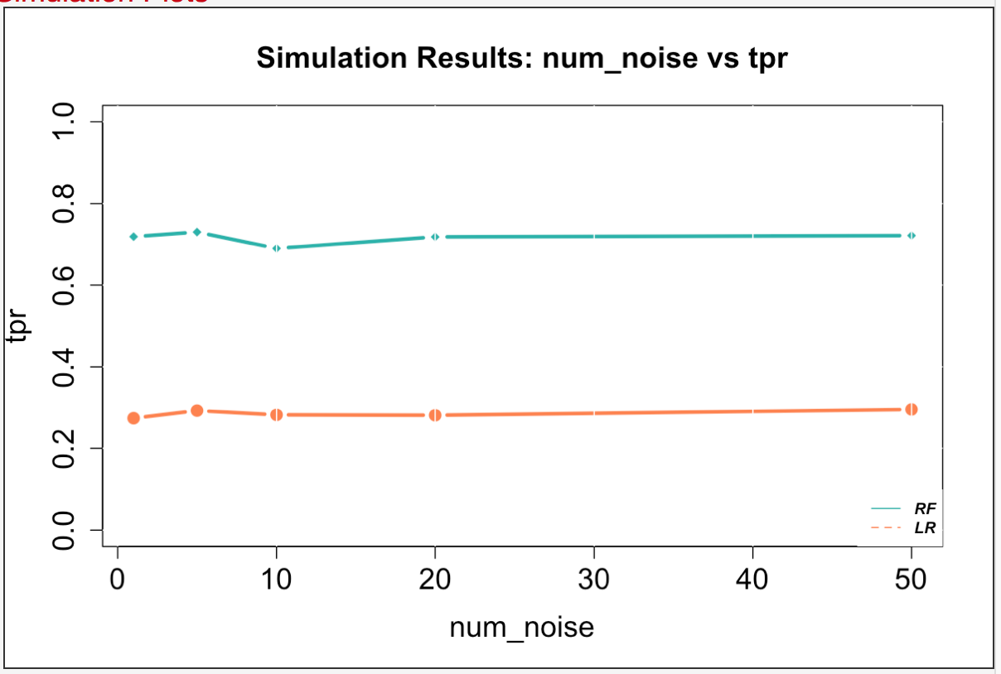
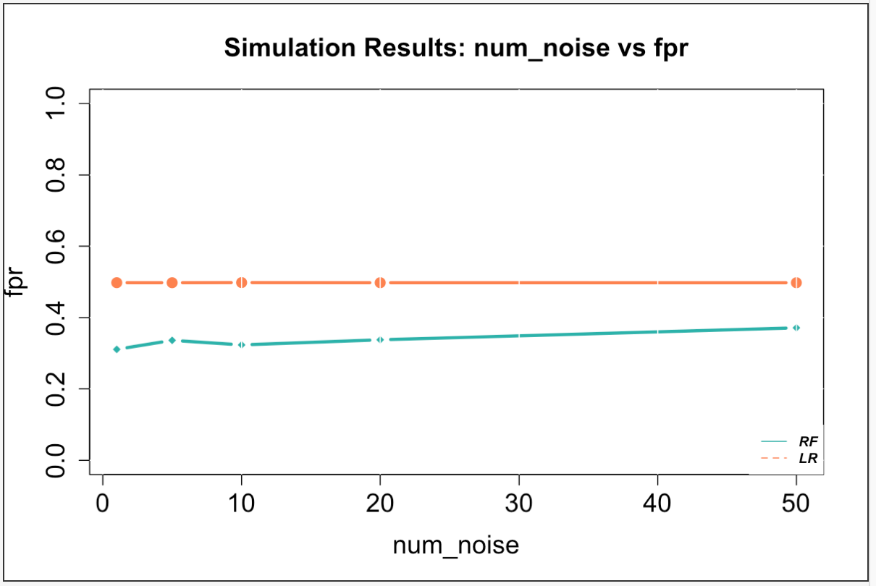
Case 2: 10 ex vars, 1000 sims, 1000 obs

Slide 9
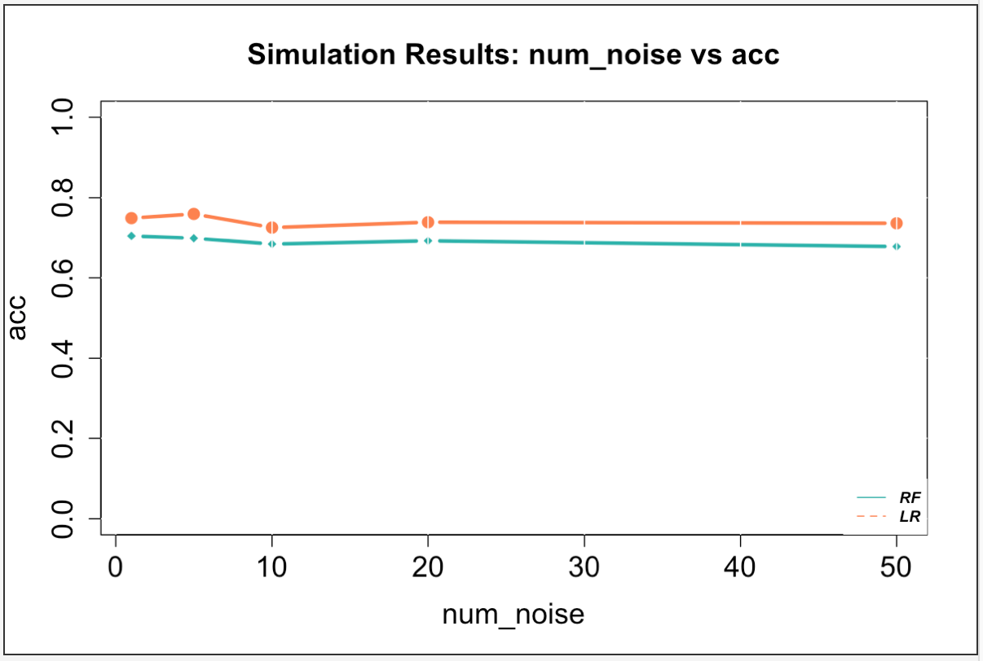
Case 2: 10 ex vars, 1000 sims, 1000 obs

Slide 10
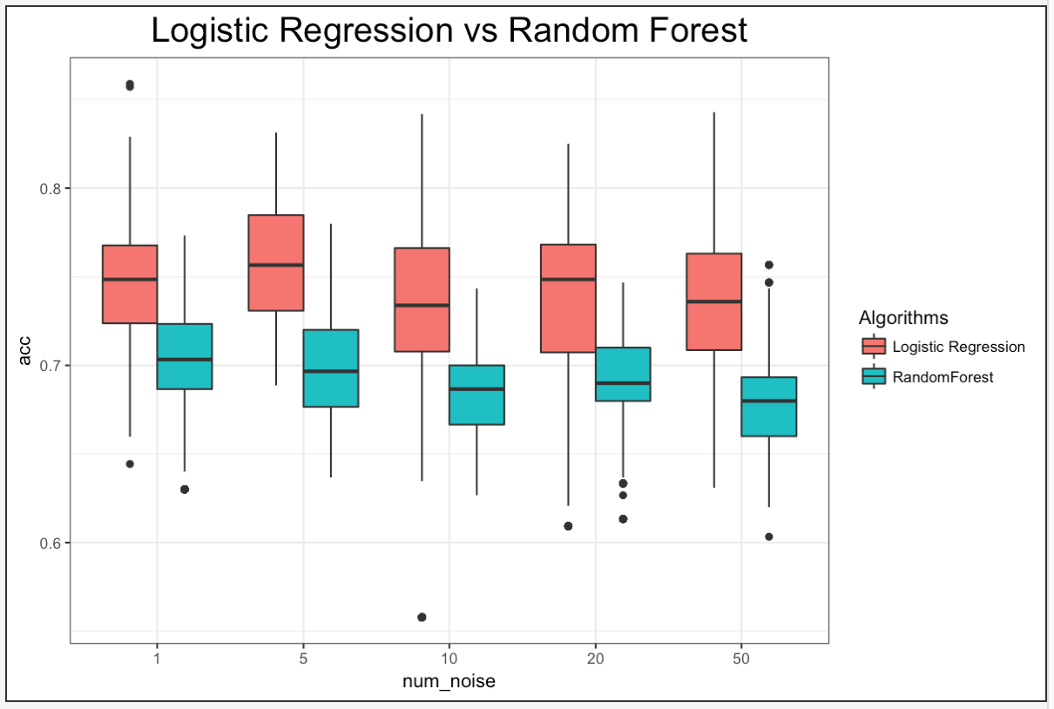
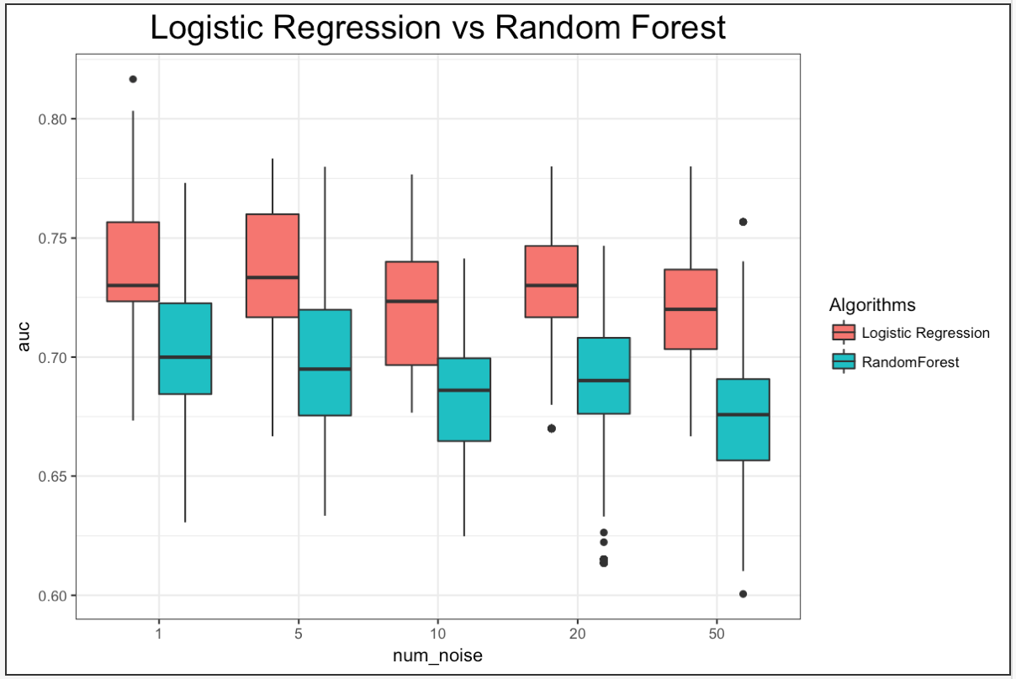
Case 2: 10 ex vars, 1000 sims, 1000 obs

Slide 11
Case 2: 10 ex vars, 5000 sims, 5000 obs

Slide 12
Case 2: 10 ex vars, 5000 sims, 5000 obs

Slide 13
Case 2: 10 ex vars, 5000 sims, 5000 obs

Slide 14
Case 2: 10 ex vars, 5000 sims, 5000 obs

Slide 15
Case 3
Run 1000 sims with 1000 data points
5, 10, 20, 50 noise vars

Slide 16
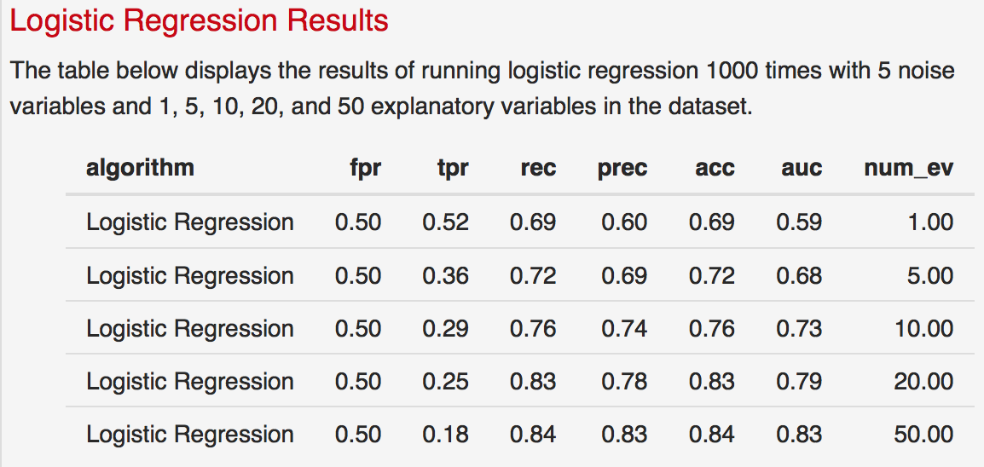
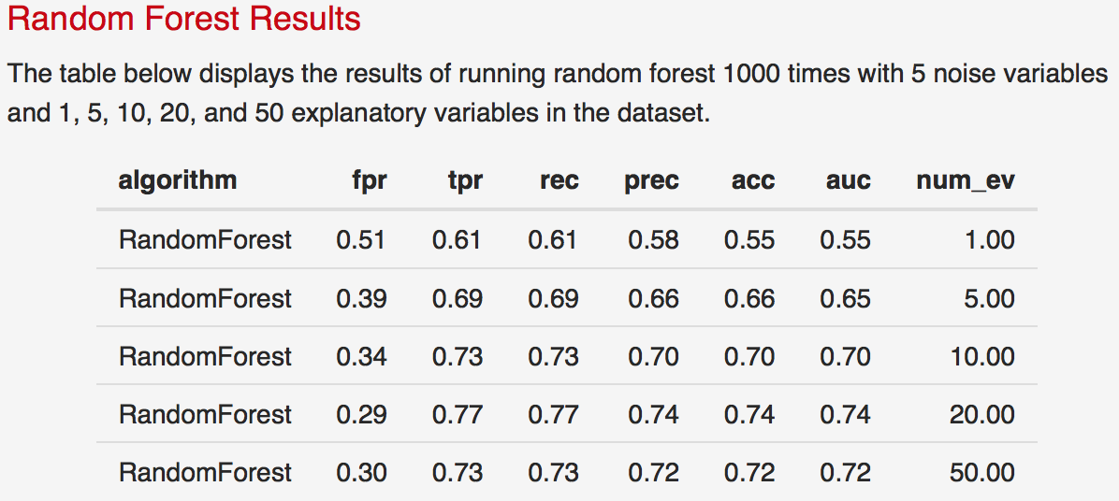
Case 3: 5 noise vars, 1000 sims, 1000 obs

Slide 17
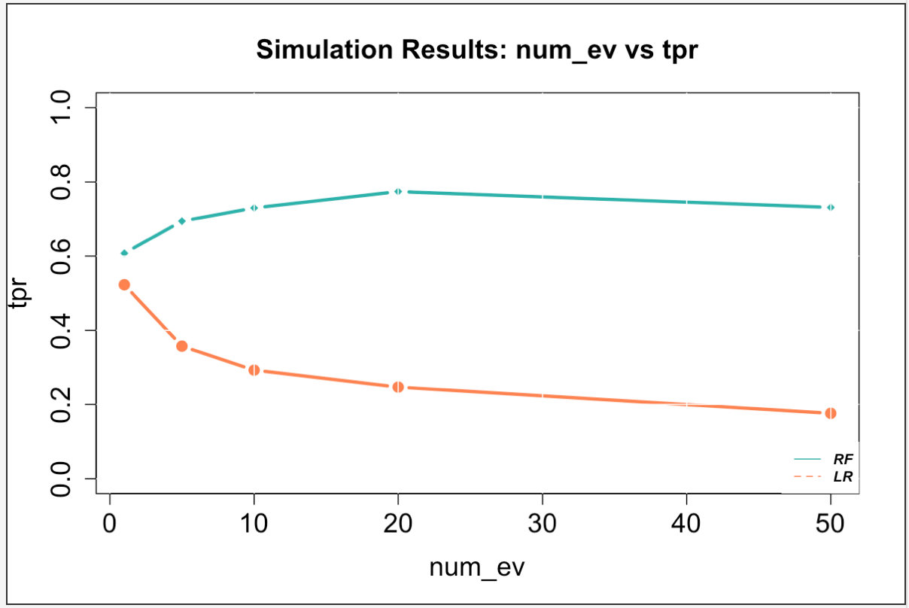
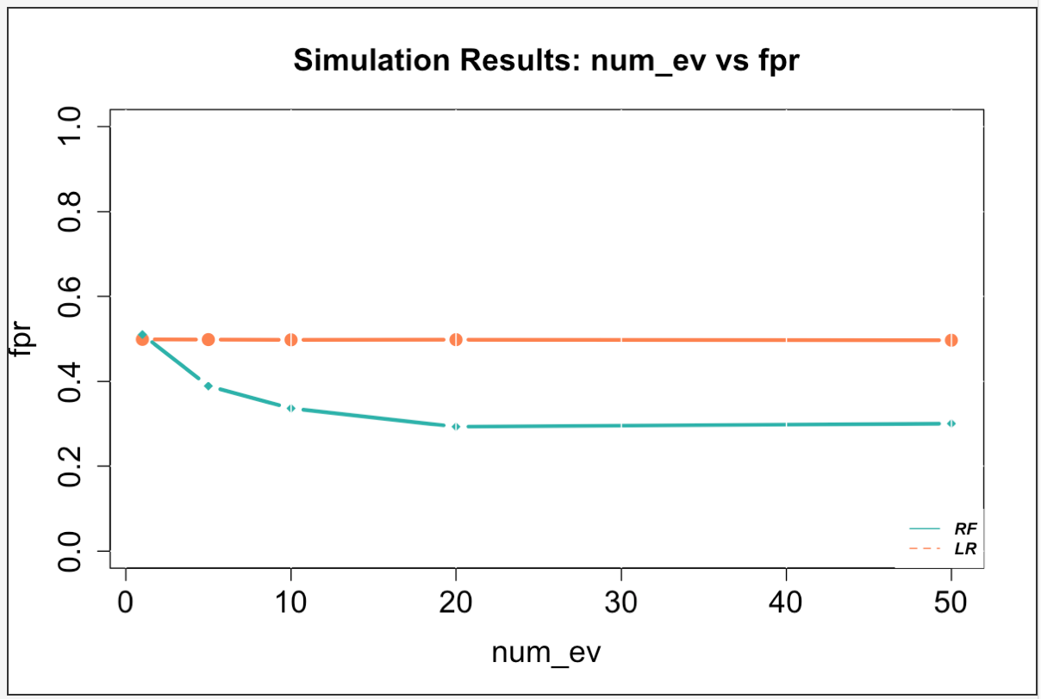
Case 3: 5 noise vars, 1000 sims, 1000 obs

Slide 18
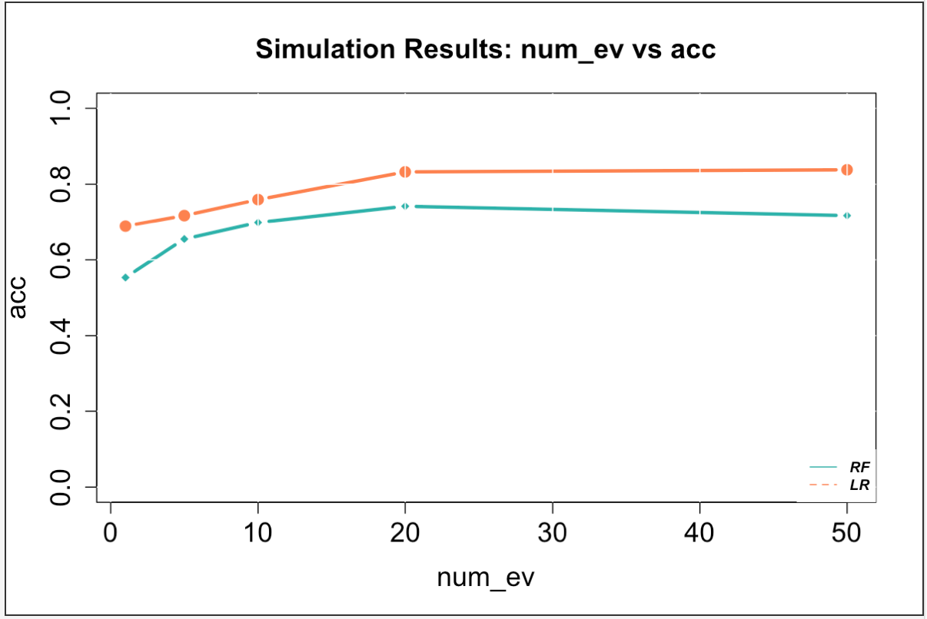
Case 3: 5 noise vars, 1000 sims, 1000 obs

Slide 19
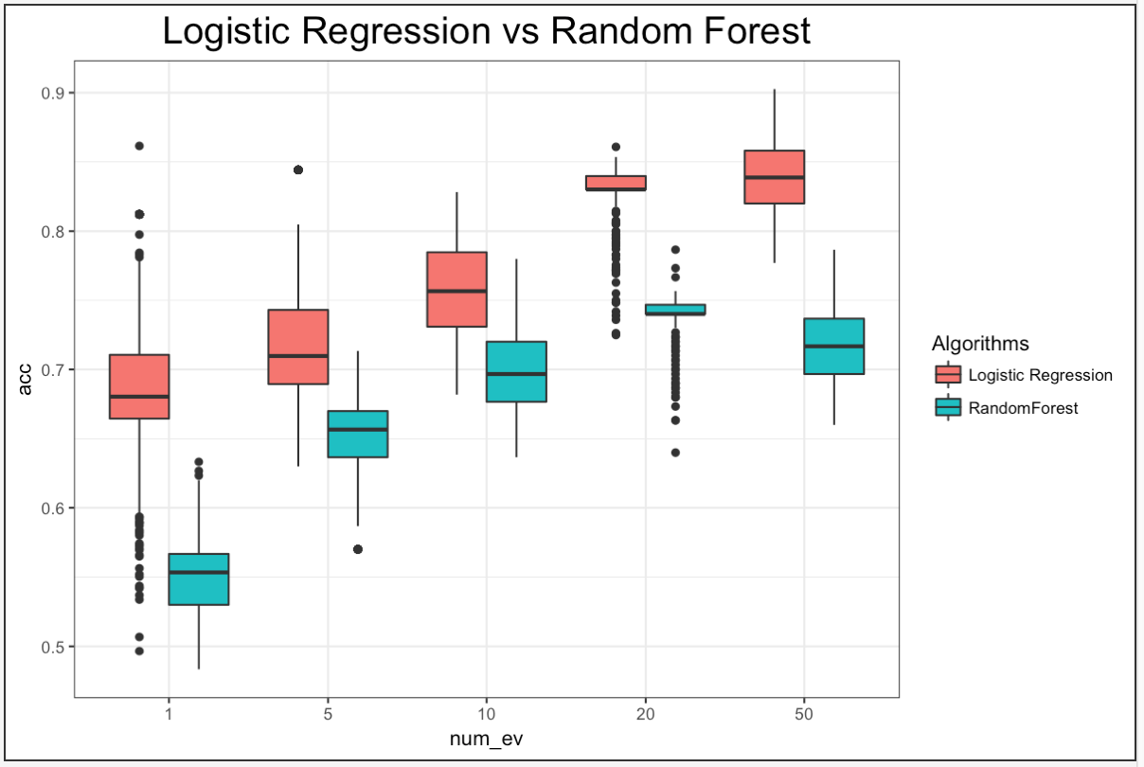
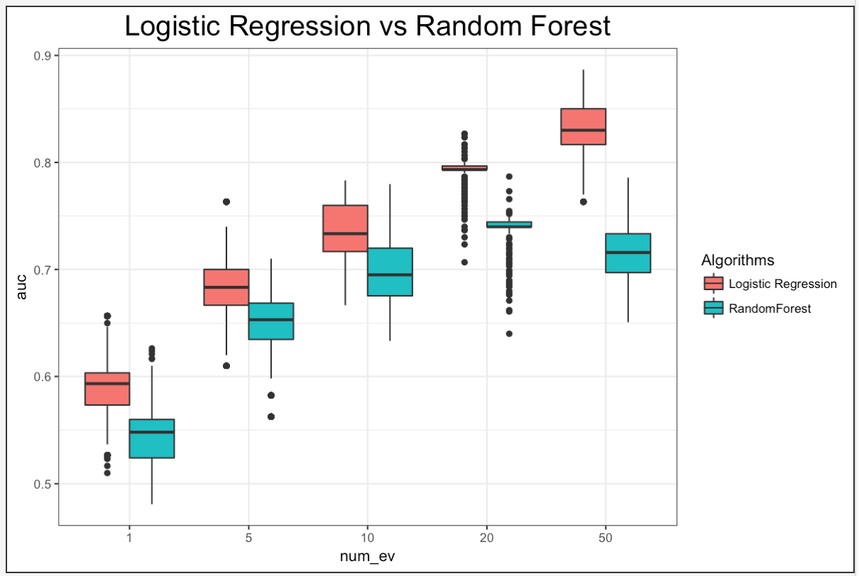
Case 3: 5 noise vars, 1000 sims, 1000 obs

Slide 20
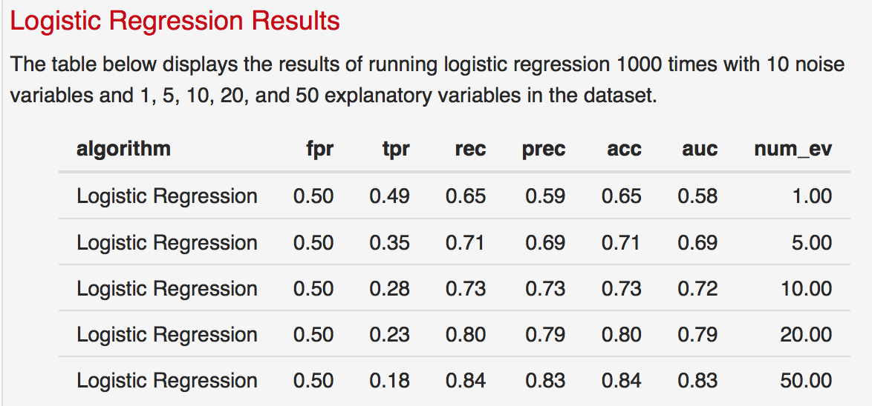
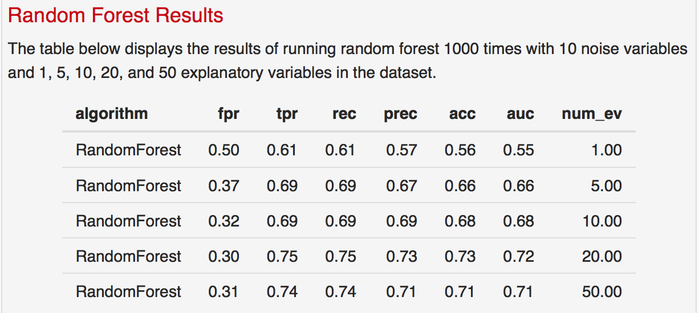
Case 3: 10 noise vars, 1000 sims, 1000 obs

Slide 21
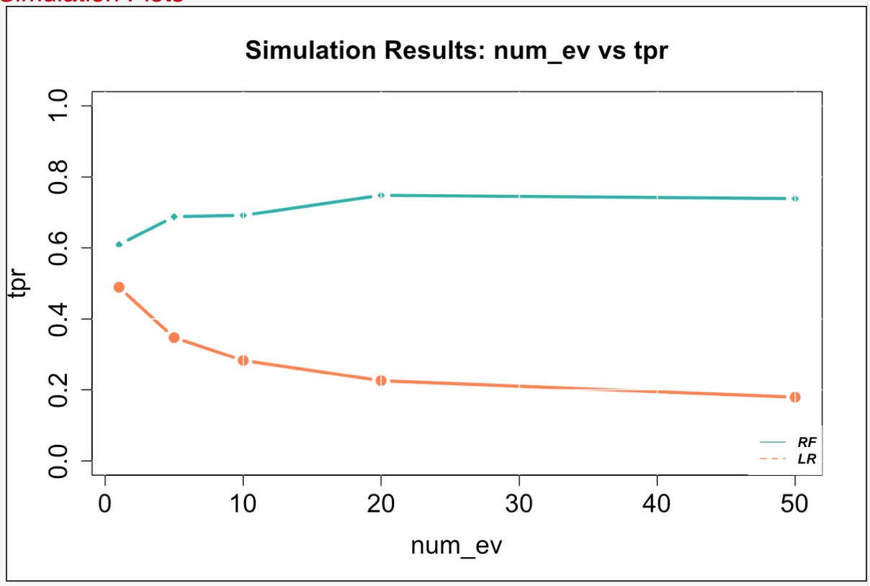

Case 3: 10 noise vars, 1000 sims, 1000 obs

Slide 22
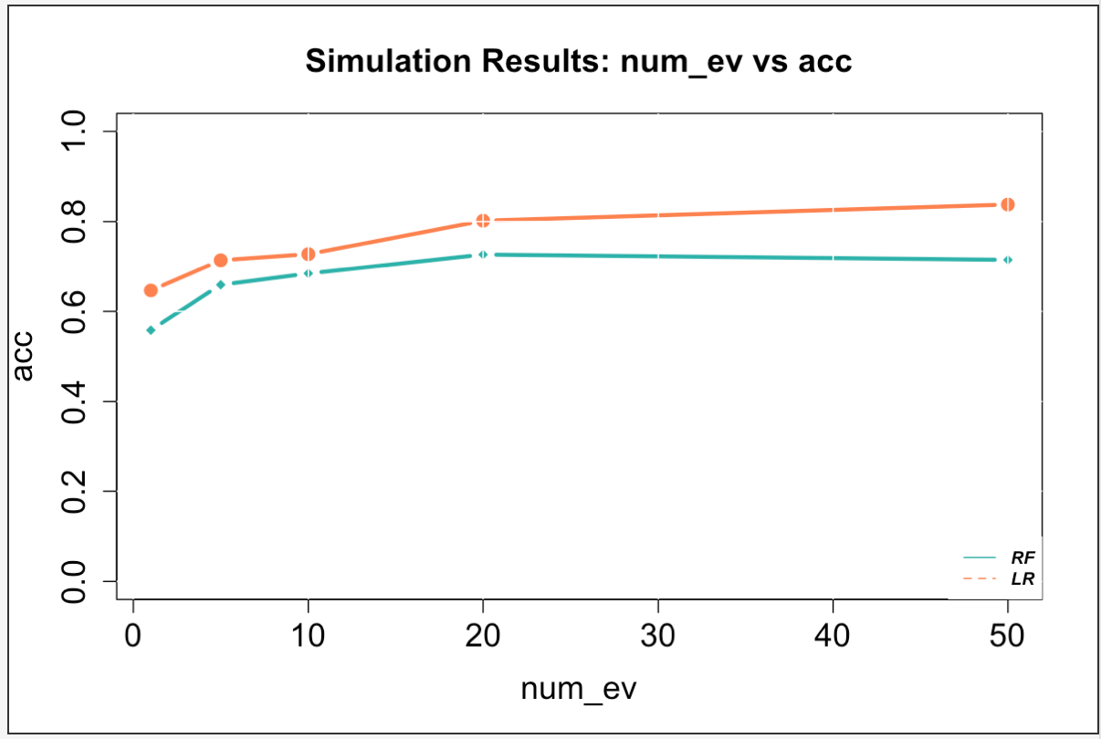
Case 3: 10 noise vars, 1000 sims, 1000 obs

Slide 23
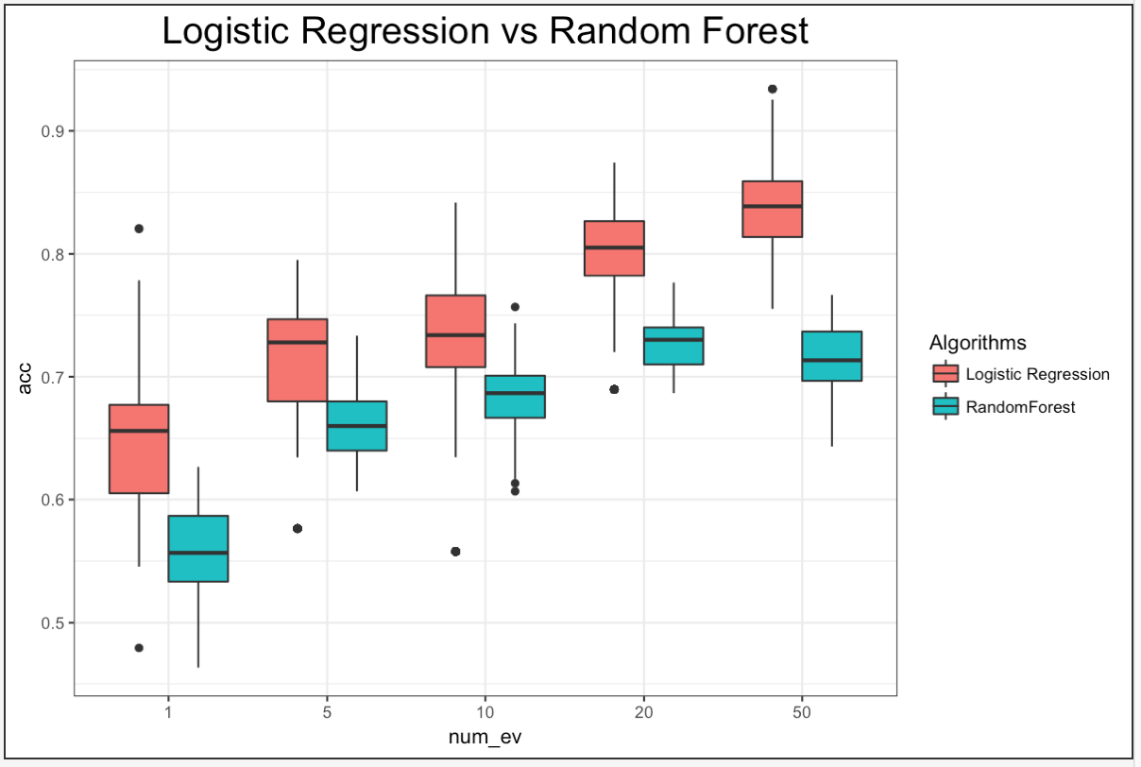
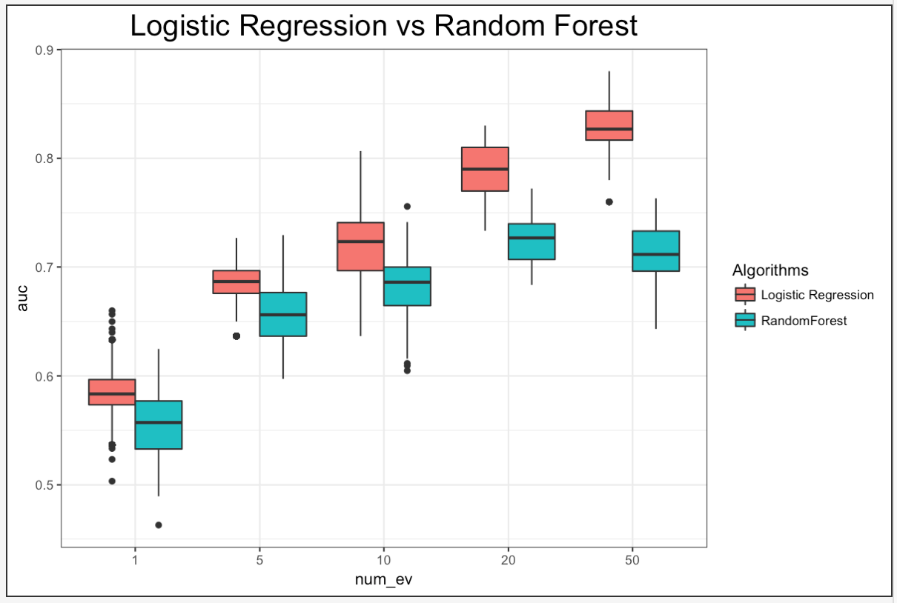
Case 3: 10 noise vars, 1000 sims, 1000 obs

