Slide 1
2-4-18 Capstone A
Jacob, Kaitlin, Trace

Slide 2
Clean data
Missing age values set to mean age
Strip to keep independent/ dependent vars
Removed "PassengerId", "Name", "Ticket", "Embarked", "Cabin”
Sex as 0 or 1
If any more missing values omitted – count 0

Slide 3
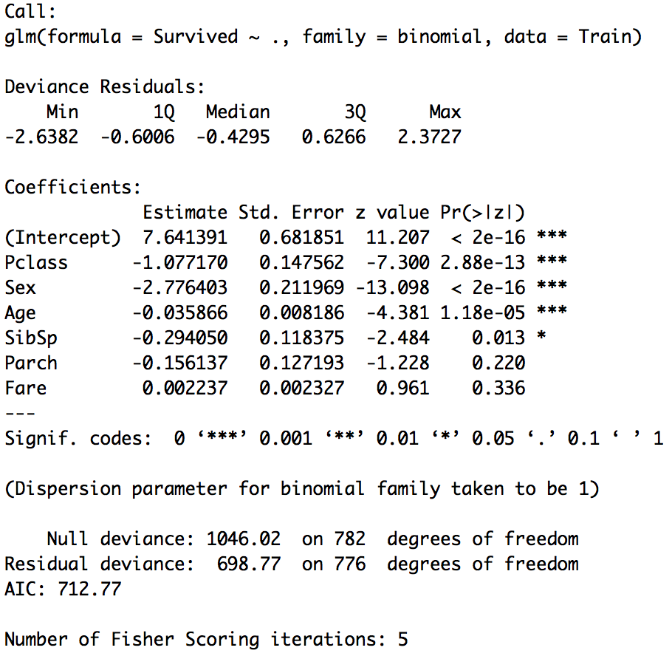
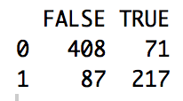
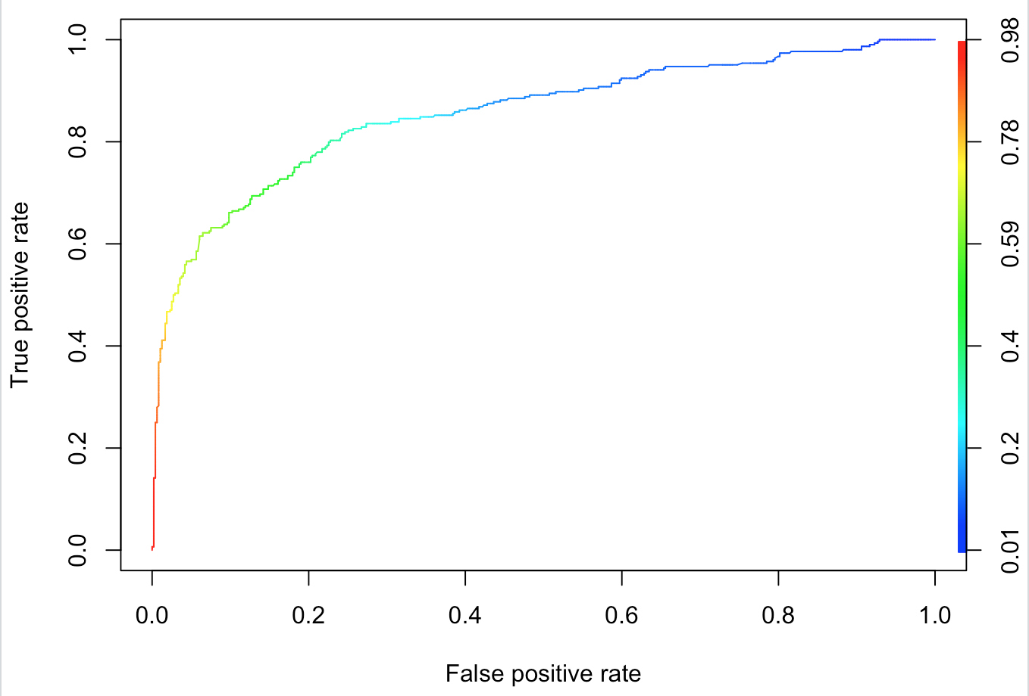
Logistic model 1
~ 79.82%

Slide 4
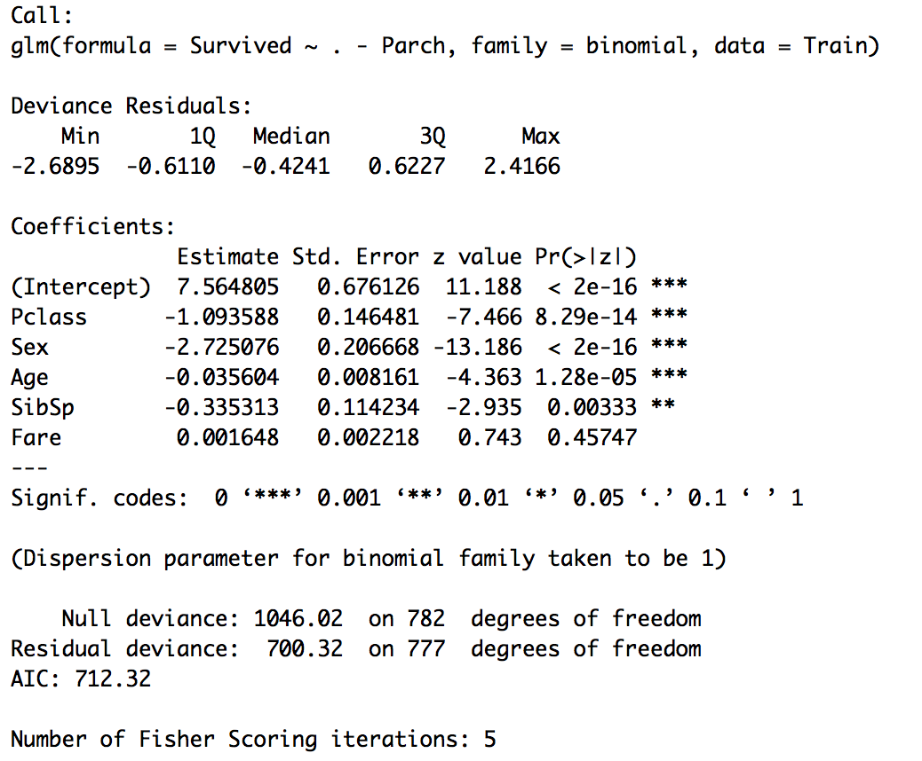
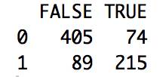
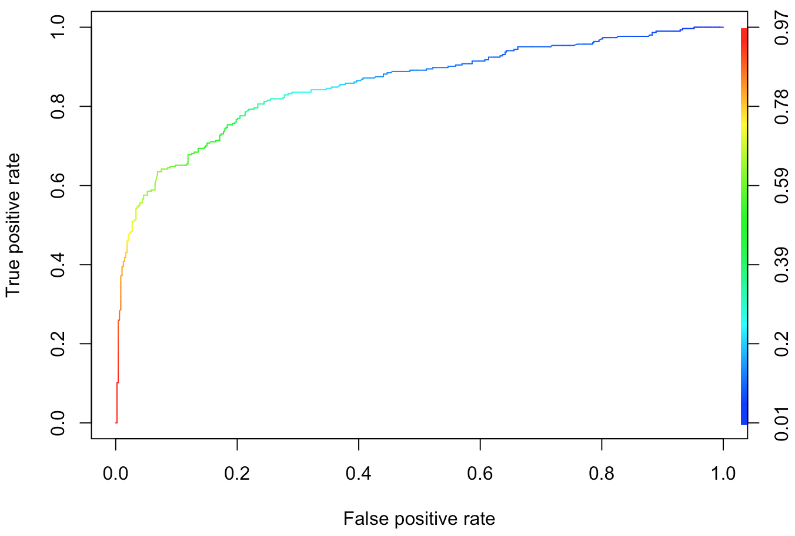
Model 2
~ 79.18%

Slide 5
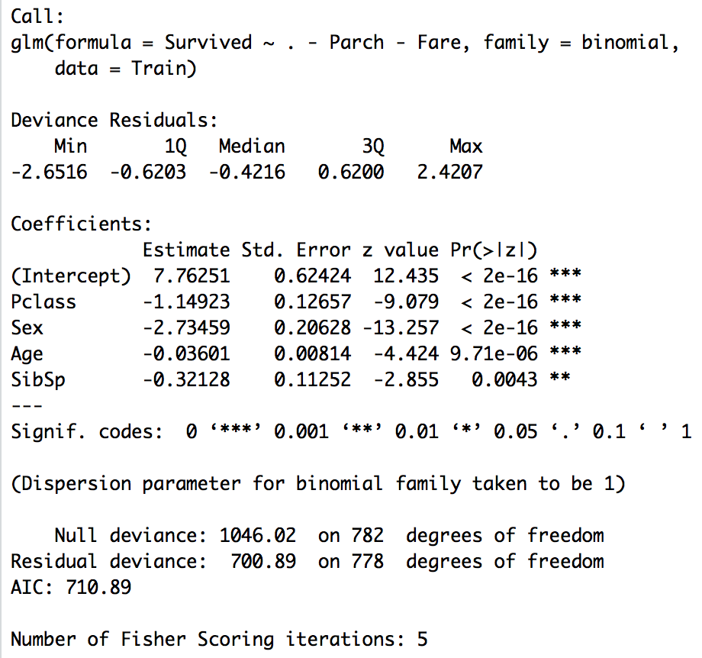
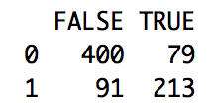
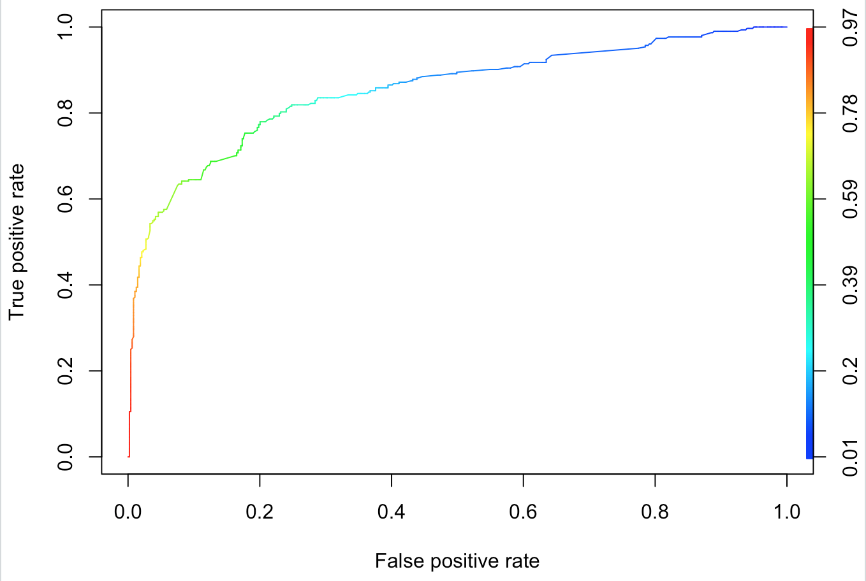
Model 3
~ 78.29%

