Slide 1


Movie Recommendation System
Capstone Project
Student - Tsogt Batjargal
Teacher – JayDeep Chakraborty
Date - – 30 Apr 2022
MovieLens dataset
Notes:
Hello, My Name is Tsogt. Today I will present my Capstone Project which named Movie Recommendation System. Rapid growth of data collection has led to a new era of information. Data is being used to create more efficient systems and this is where Recommendation Systems come into play.

Slide 2
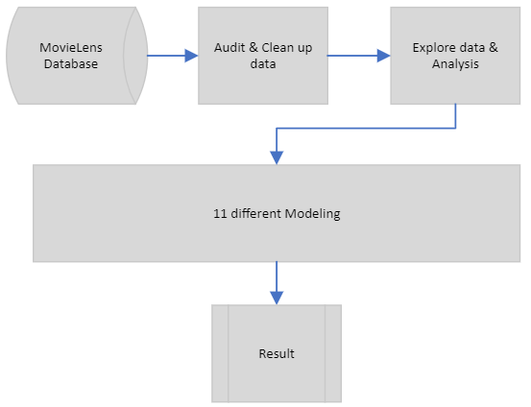
Project overview
Notes:
This project provides information obtained through data analysis, regarding the creation of a movie recommendation system using the MovieLens dataset.

Slide 3
Project overview
Simple
Complicated
Base Line Models x 3
Liner Models x 2
Liner Models with Regularized x 2
Collaborative Filtering x 2
Matrix Factorization x 2
Notes:
Let me do more clarification on our modeling. Firstly, I will introduce and create these type model approaches and models.
Then we will see each models result. As you can see these models getting complicated from simple dummy model

Slide 4
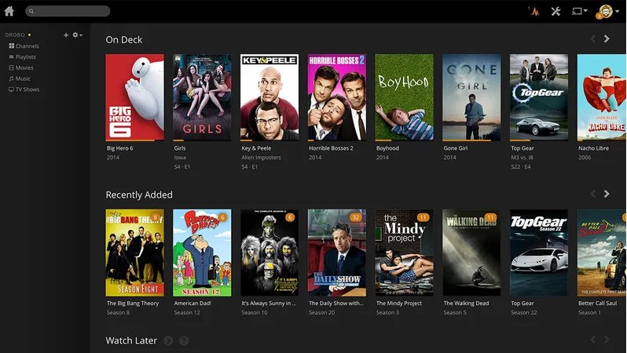
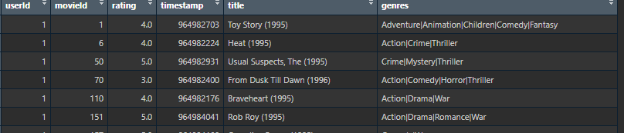
Data structure
Notes:
Okay Recommendation Systems are a type of information filtering systems as they improve the quality of search results and provides items that are more relevant to the search item or are relevant to the search history of the user. They are used to predict the rating <click>or preference that a user would give to an item. Almost every major tech company has applied them in some form or the other: Amazon uses it to suggest products to customers, YouTube uses it to decide which video to play next on autoplay, and Facebook uses it to recommend pages to like and people to follow. Moreover, companies like Netflix and Spotify depend highly on the effectiveness of their recommendation engines for their business and success.

Slide 5
Data audit & Data cleaning
train.dtS + validationS = 91103 + 9724 observations (6 variables)
Timestamp – format change
Title – we don’t this for modelling
Genres – convert to dummy variables
Notes:
The first dataset train.and.test downloaded, comprises of 91103 observations and 6 variables, further divided into TWO smaller dataset called train.dtS and validationS. The structure of the data is similar for all of the datasets.
Before analysis we need some cleaning staff. Also we should remove unnecessary rows in case of modeling calculation.

Slide 6
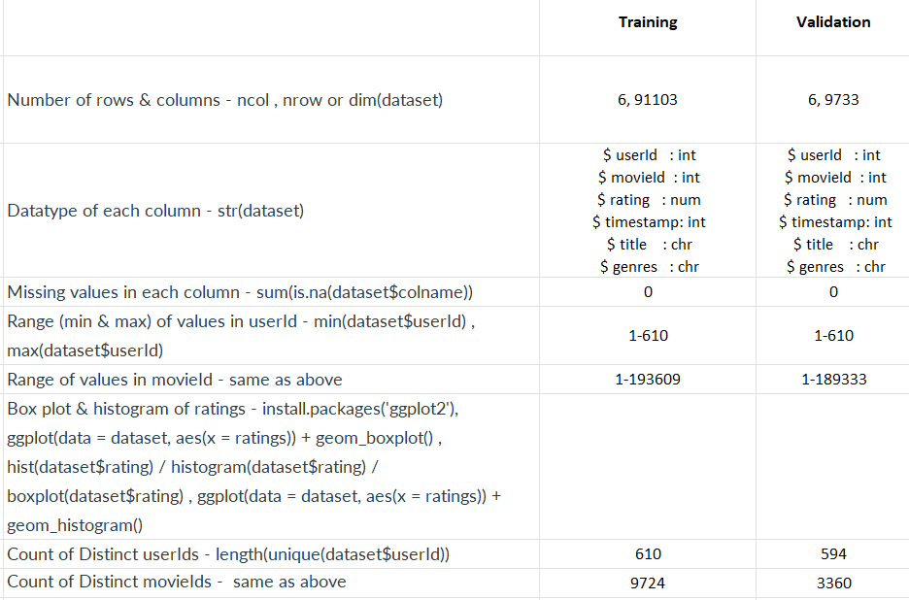

Slide 7
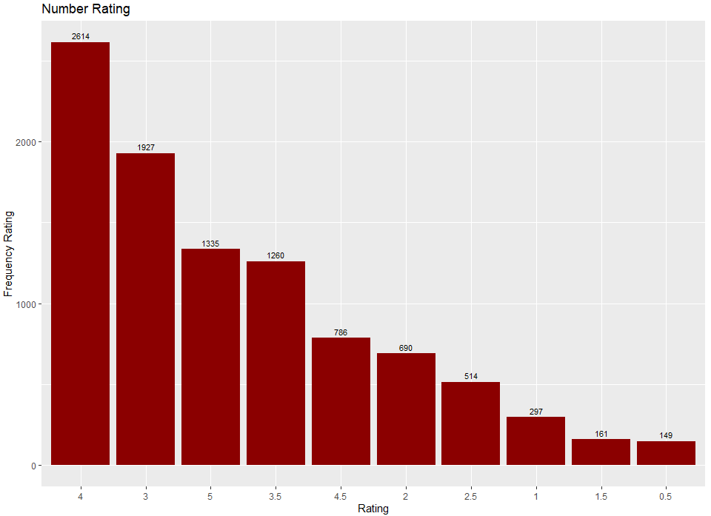
Data Audit
By far the most popular movie rating were 4 with 2614 ratings followed by 3 at 1927.
The 1.5 and 0.5 were far less popular at around 161 and 149 thousand, respectively.
Notes:
Lets quick analysis on ratings.

Slide 8
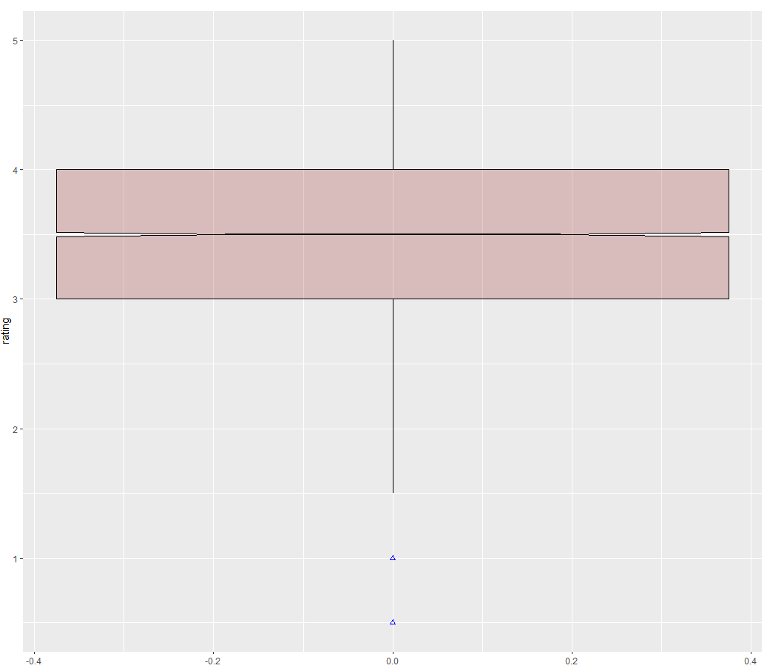
Data Audit
We are not going to treat outliers as those doesn't represent a significative count
Notes:
This boxplot shows there is little a bit of significate observations. That’s good.

Slide 9
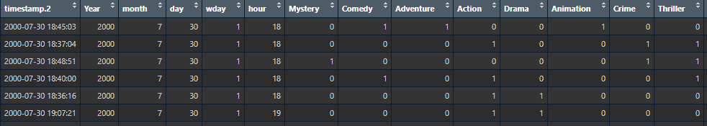
Data Cleanup
Once we created dummy variables and fixed date format on Training and Validation dataset. We can continue to explore.

Slide 10
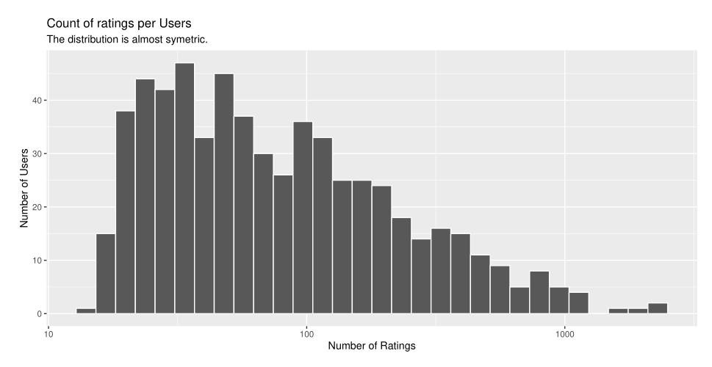
Exploratory data analysis
Overall, Most of the users tend to rate less than 100 movies.
Notes:
Roughly 80% of count of rating comes from only 20% of users. When I see these graph. Pareto principle is everywhere specially in this movie dataset. We will see next slides.

Slide 11
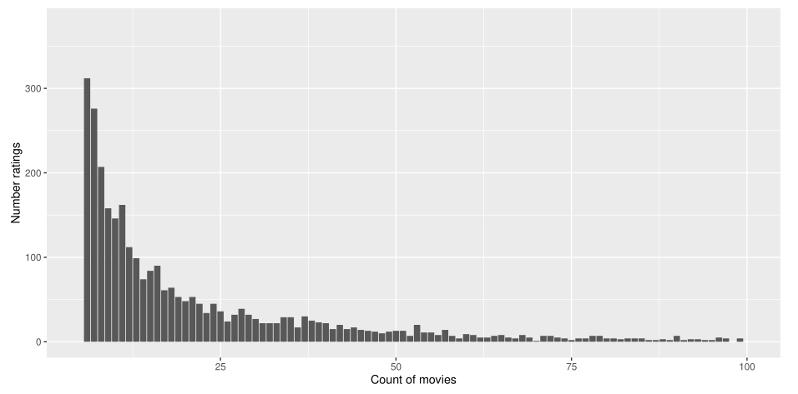
Exploratory data analysis
In the same trend, Some of the movies had been rated more than others.
Notes:
Less than 25 movies have almost 90% of ratings count. We might know that movies later.
Pareto principle - roughly 80% of count of ratings for only 20% of movies

Slide 12
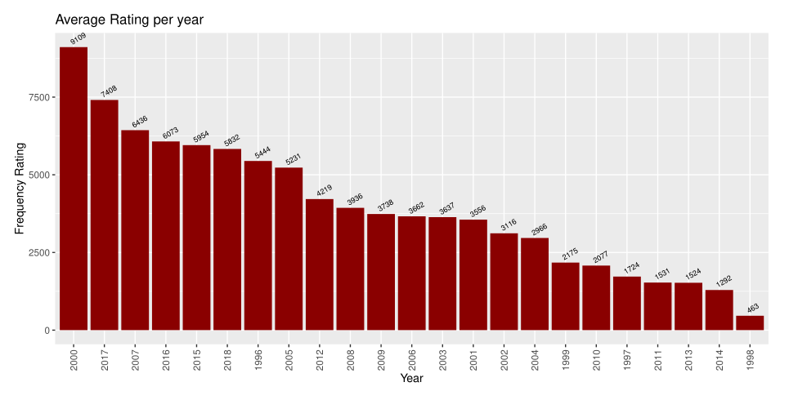
Exploratory data analysis
As is seen, in the year 2000 movies have a higher average rating, followed by
2017 and 2007 respectively.
The rating period was
collected over almost 22 years.
Notes:
I investigated which movies released in 2000. There were a lot of interesting released. Maybe effect our rating count.

Slide 13
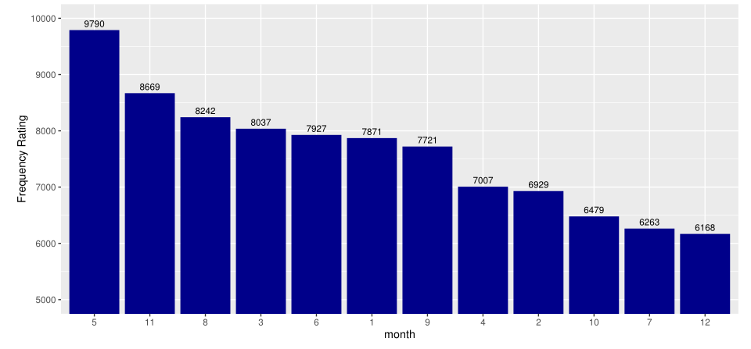
Exploratory data analysis
The month of May count with the highest average rating per month, almost 3700 higher than the average for November.
The second and third highest rates were given November and August, roughly 8700 and 8200
respectively.

Slide 14
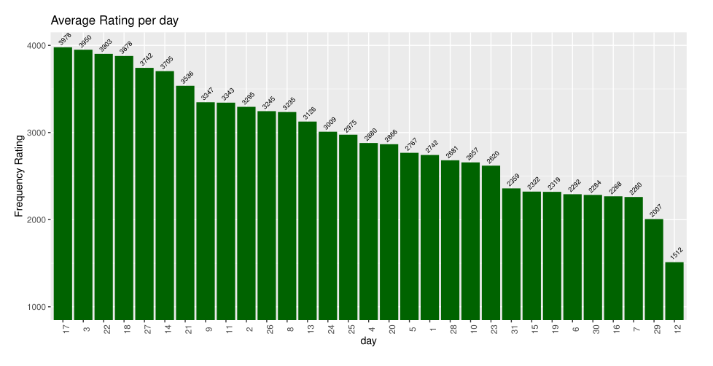
Exploratory data analysis
The average rating per day went higher on days 17, 3 and 22 with small differences, while was lower for 12 with almost 2.500 reviews. People tend to rate movies more often on the second haft of the month

Slide 15
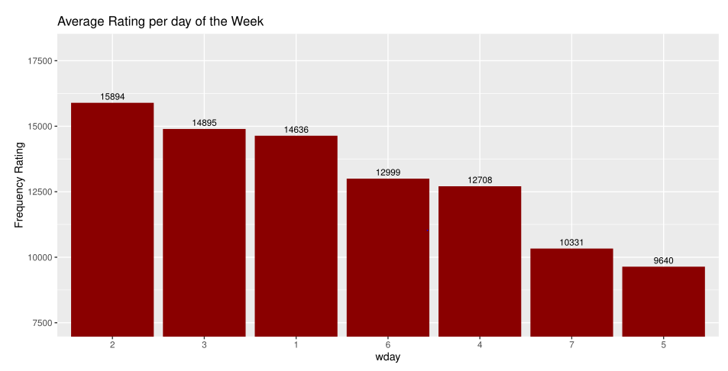
Exploratory data analysis
Monday is by far the day with the most number of ratings listed with 15,894, opposite than Thursday when ratings decreased in 6,254. About 90 % of the days ratings are over thousand a day.

Slide 16
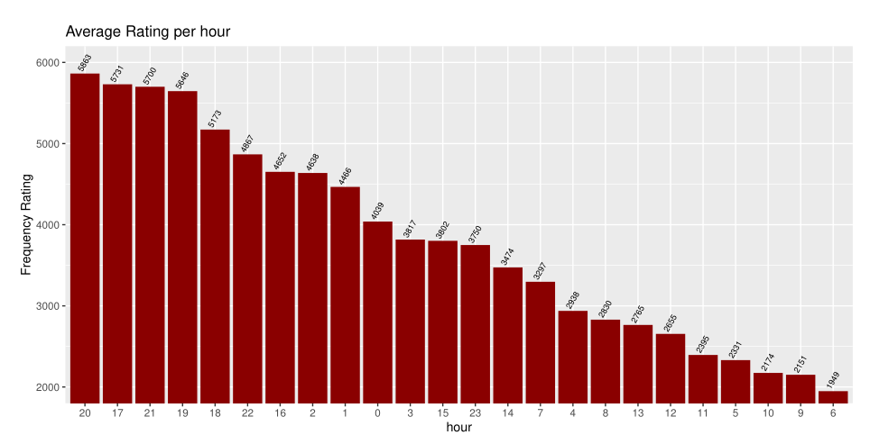
Exploratory data analysis
Overall, the highest hours in average rating are in night time or early morning before 3. At 20:00
and 17:00 lead the category.

Slide 17
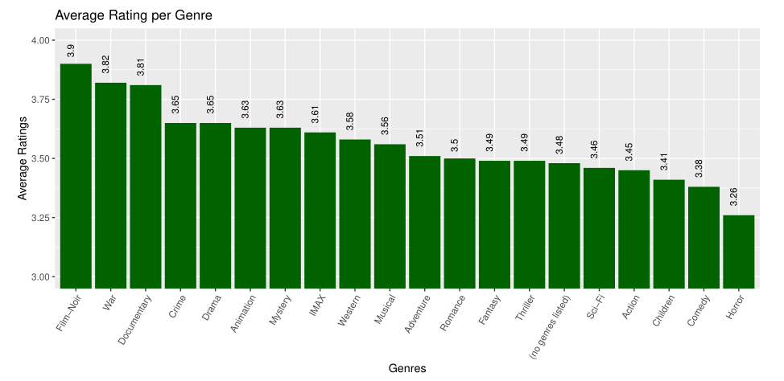
Exploratory data analysis
Film-Noir is the highest-average rated genre followed by War and Documentary. Average Genre Ratings range from 3.26 to 3.9.
Notes:
But we can’t say Film-Noir is best genry everyone love it something like.

Slide 18
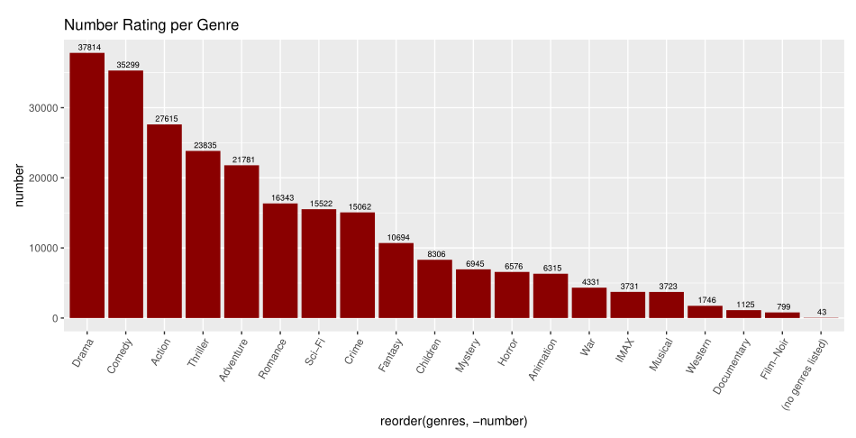
Exploratory data analysis
More than 37 thousand ratings was for Drama and that was higher
Than Comedy and Action with a difference of 2.628 and 10.233 respectively.
Notes:
In here is Film-Noir has lowest count of feedback.
Pareto principle - roughly 80% of count of ratings for only 20% of Drama and Comedy.

Slide 19
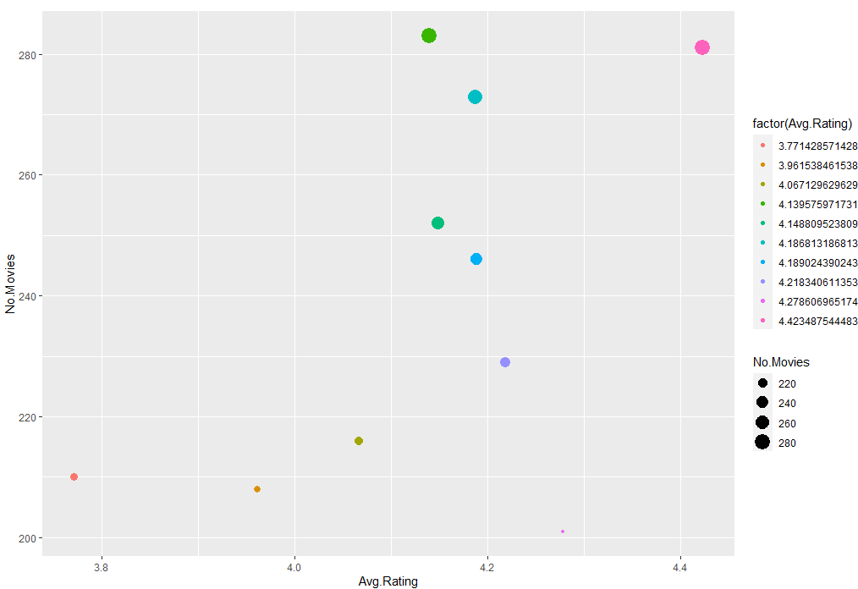
Exploratory data analysis
There are listed in table 2 and table 3, the top and bottom average movies Id ranking depending on count of rating, respectively.

Slide 20
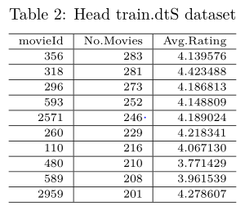
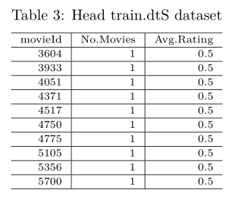
Exploratory data analysis
There are listed in table 2 and table 3, the top and bottom average movies Id ranking depending on count of rating, respectively.

Slide 21
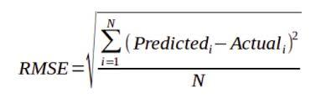
Date model metric
1. R Square/Adjusted R Square
2. Mean Square Error(MSE)/Root Mean Square Error(RMSE)
3. Mean Absolute Error(MAE)
Root Mean Square Error(RMSE) is the square root of MSE. It is used more commonly than MSE because firstly sometimes MSE value can be too big to compare easily. Secondly, MSE is calculated by the square of error, and thus square root brings it back to the same level of prediction error and makes it easier for interpretation.
Notes:
Before move on to Modeling. We have one question we gonna measure our models are good fitting or find best one from them. There are 3main metrics for model evaluation. …
R square is good measure to determine how well the model fits the dependent variables. However, it doesn’t take into consideration of overfitting problem. Also we need some additional steps on correlations. Then we don’t use it.
Mean Absolute Error its no good out modeling it has some disadvantage on Big dataset.
Last not least we have Mean Square Error – this is relative measure of how well the model fits dependent variables and it is absolute measure of the goodness for the fit. But we gonna use Root Mean Square Error its square root MSE. Sometimes MSE value can be too big to compare easily. Also thus square root brings it back to the same level of prediction error and makes it easier for interpretation. There our main role is RMSE

Slide 22
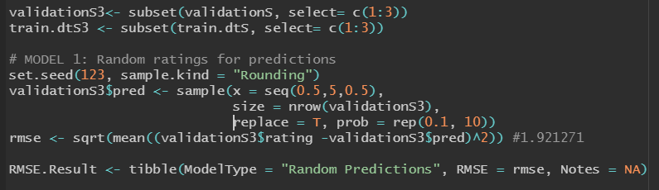
Modelling approaches–BaseLine Model
Random ratings for predictions
The first model randomly predicts the ratings using the observed probabilities in the training set.
We compare the predicted ratings with
the actual ratings on the test data to calculate the RMSE.
The project goal is achieved the lowest RMSE. This model obtain a RMSE of 1.921271.

Slide 23
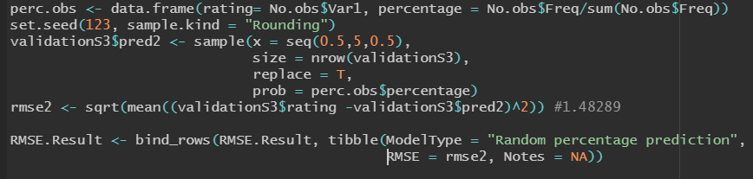
Modelling approaches–BaseLine Model
Random percentage prediction
We consider the current distribution (% of observations) of every rating in training data, as the probability of predicted ratings on the test data.
This model obtained a RMSE of 1.48289.

Slide 24
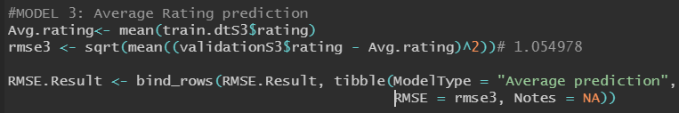
Modelling approaches–BaseLine Model
Average Rating prediction
The final baseline model will be a model with average ratings. First, We calculate the average of all ratings in training data. Then, On the test data predict all the ratings with just the mean rating.
We calculated the RMSE of 1.054978 for this model.

Slide 25
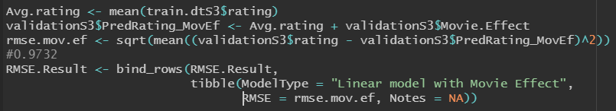
Modelling approaches-Liner Model
Linear model with Movie Effect
For this model, we took into consideration movie effect which is the Average of errors in every movie. Then we Add the movie effects to the average predictions in validation data, and finally we calculate the RMSE.
This model obtained a RMSE of 0.9732.

Slide 26
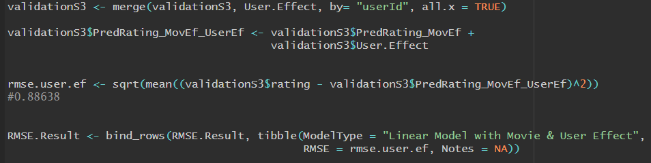
Modelling approaches-Liner Model
Linear Model with Movie & User Effect
We calculated, movie effect as we did in Linear Model with Movie. Then, we find User Effect by taking into consideration the average of errors for every users.
This model obtained a RMSE of 0.8863

Slide 27
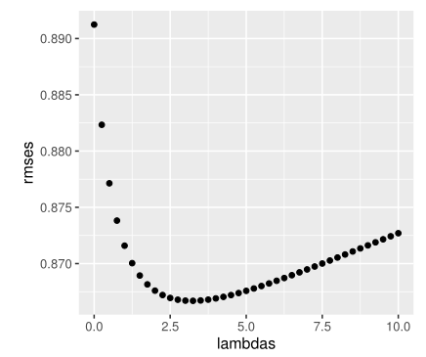
Modelling approaches-Liner Models Regularization
Linear Model with Movie Effect and User Effect Regularized
Sum of Errors
Model Avg Error =
Count of Errors
+ LAMBDA
LAMBDA – Regularization Factor
Notes:
How to improve previous model. We can tune or regularize it on Model Average Error. How we gonna do that. We just add some constant number in count of errors. Then it should decrease the error. Let’s call that constant number as Lambda. Then next question how we know Lambda. Basically, we just try out using some range of numbers. One by one. In this case we use 0 – 10 numbers increased by 0.5 steps. After which lambda lowest RMSE. We can choose this Lambda for our modeling( Validation and Training as well)

Slide 28
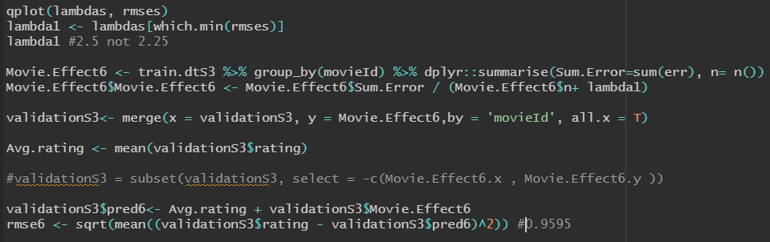
Modelling approaches-Liner Models Regularization
Linear Model with Movie Effect Regularized
For model regularized, we calculate the movie effect with the best regularization parameter, Lambda. With this model we improved the RMSE result, with a minimum lambda of 2.5
This model obtained a RMSE of 0.9595.

Slide 29
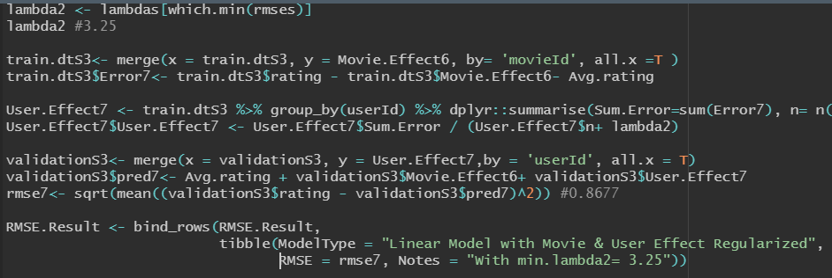
Modelling approaches-Liner Models Regularization
Linear Model with Movie & User Effect Regularized
We calculated the movie effect and user Effect with the best regularization parameter, Lambda. With this model we got the best improvement of the model with the minimum lambda of 3.25
We calculated the RMSE of 0.8677 for this model.
Notes:
Even better performance

Slide 30
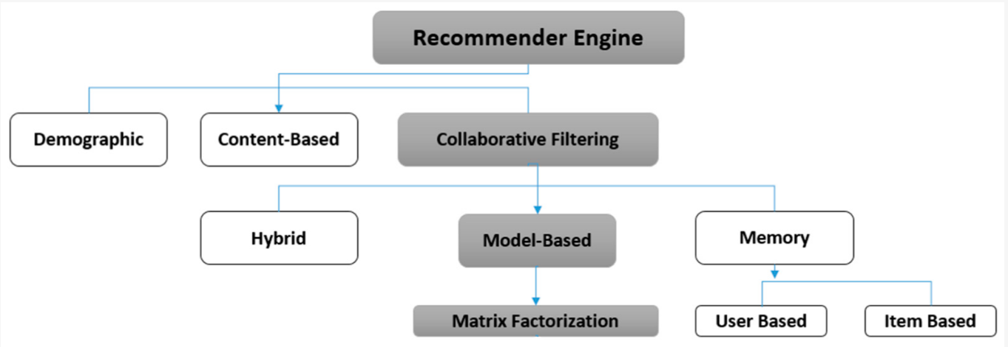
Modelling approaches-Collaborative Filtering
Notes:
We gonna use most popular approach which is Collaborative Filtering. It has 2 type of filtering methods. Model based and Memory based. These 2 has own advantage and disadvantage for example. I will talk about later. If we mix these 2 methods. It will be Hybrid method.

Slide 31
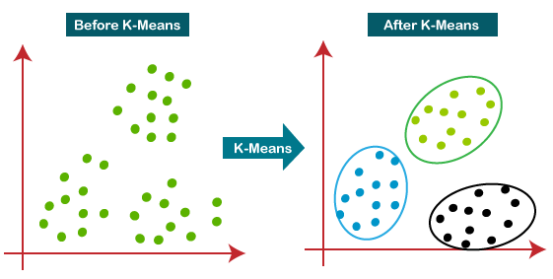
Modelling approaches-Collaborative Filtering
Notes:
Lets get start with one of most popular method Memory Base Filtering. As said before these method or algorithms have own advantage and disadvantage for example. Memory based Filtering is much faster than Matrix Factorization ( because its similar with Distance based Clustering. Find neighborhood. However it’s not so efficient when new user or item registered on system. Which means calculation works only historic data only. You see in here our model filtered when a movie repeated more than 50 times. It will be grouped otherwise we don’t take it. Also we select only user who has given more than 20 ratings. If less ratings give it we can’t group it. But how about rest of movies or users. We will discuss about it later.

Slide 32
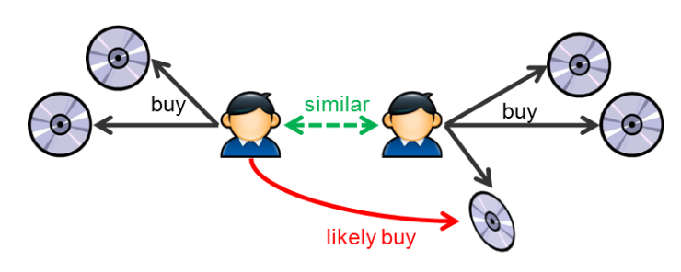
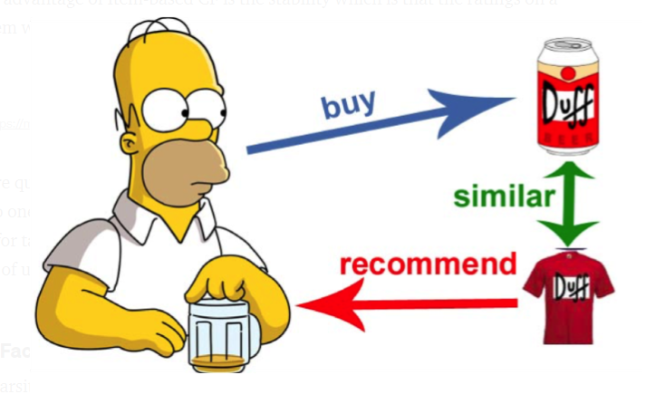
Modelling approaches-Collaborative Filtering What’s User-based CF and Item-based CF?
Collaborative Filtering involves suggesting movies to the users that are based on collecting preferences from many other users.
Notes:
So memory based algorithms. Which is user-based and item-based algorithms. Basically, We will find similarities between target user and all other users for their average ratings and then we make separate groups them. While different people may have different baselines when giving ratings, some people tend to give high scores generally, some are pretty strict even though they are satisfied with movies. <Click> Moreover, we say 2 items are similar when they received similar ratings from a same user. Then, we will make prediction for a target user on movie by calculating average of ratings on most similar movies from this user. One key advantage of Item-based CF is the stability which is that the ratings on a given item will not change significantly overtime, unless customer behavior is changed. You know human being is unpredictable.

Slide 33
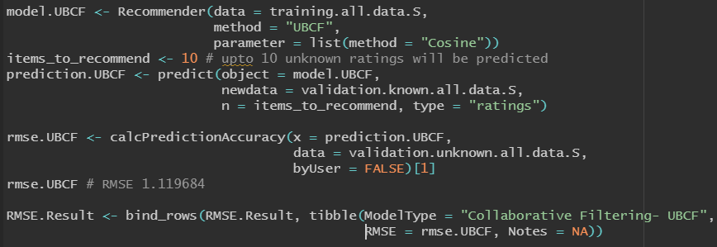
Modelling approaches-Collaborative Filtering
Collaborative Filtering UBCF
Therefore, recommending movies is dependent on creating a relationship of similarity between the two users.
We use for this model the method User-Based Collaborative Filtering.
We got a RMSE of 1.119684

Slide 34
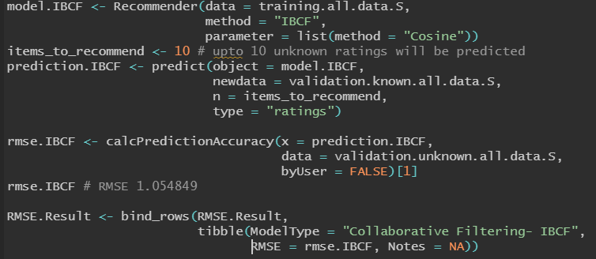
Modelling approaches-Collaborative Filtering
Collaborative Filtering- IBCF
Item-based collaborative filtering algorithm fundamentally has the same scheme with user-based collaborative filtering in terms of using user’s rating score. Instead of the nearest neighbors, It looks into a set of items.
This model obtained a RMSE of 1.05849
Notes:
As said before. Collaborative filtering has own disadvantage which is “cold start” . It will show bad result when there are less data of user or movie. Even worst then linear model performance.
!!!
When a new item coming in, until it has to be rated by substantial number of users, the model is not able to make any personalized recommendations . Similarly, for items from the tail that didn’t get too much data, the model tends to give less weight on them and have popularity bias by recommending more popular items.

Slide 35


MODEL-BASED CF
Factorization
Notes:
So that’s why we have to talk about model-based CF on our dataset. Matrix factorization is one of the most accuracy and effectiveness techniques in the movie recommendation system. Luckily somebody already created and prepared us for our job done easily this package which is named “ Recosystem” Library.

Slide 36
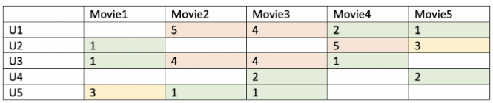
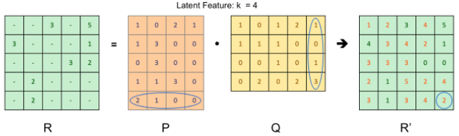
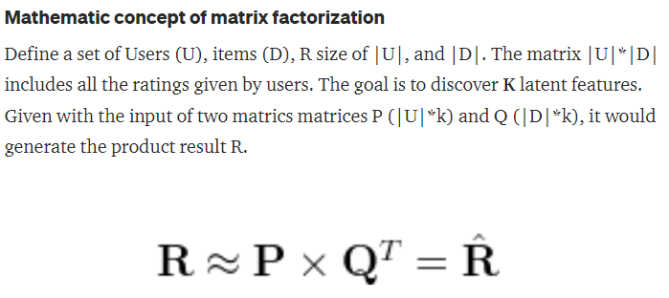
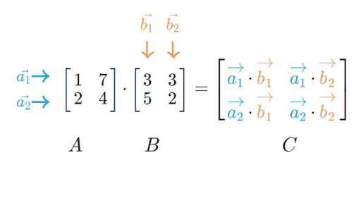
Modelling approaches-Collaborative Filtering
Matrix Factorization with Stochastic Gradient Descent
Notes:
Actually, these modeling needed some mathematical calculation. Like Matrix multiply. Basically it takes a while and use a lot of your machine resource. That’s why we have to do minimize our dataset as possible. Maybe you remember before we filtered dataset for popular users and popular movies previous modeling. Now it is time to calculate rest of unpopular items or users. Using this algorithm.

Slide 37
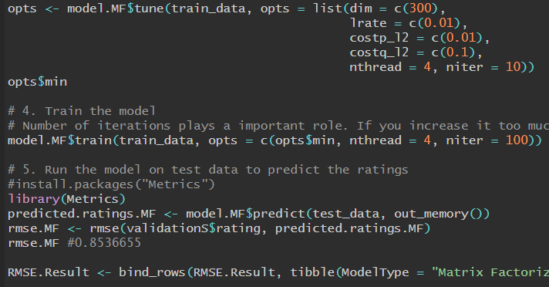
Modelling approaches-Collaborative Filtering
Matrix Factorization with Stochastic Gradient Descent
Among the numerous solutions for matrix factorization, Stochastic Gradient Descent
(SGD) is one of the most widely used algorithms.
This model have been using in this project and performance the best RMSE result, with 0.8536655
Notes:
Its showing perfect performance. Actually we can use it whole dataset or other large datasets. But there is a problem that is as I said before. It takes a lot time and load my computer CPU 100%. That’s why we can’t use it all the time.

Slide 38
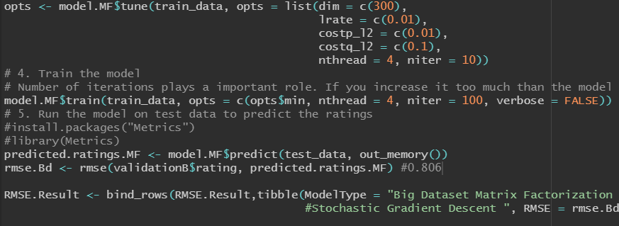
Final model with 10 million dataset
Since the set is the entire population dataset, it provides a better approach of RMSE. As we can see from the result, Matrix Factorization with Stochastic Gradient Descent in 10Mn dataset achieved the target RMSE of 0.806
Notes:
Once completed in small set. Lets try it out in larger dataset. 10million observations. We used old constants right up there. When you see result of RMSE. Its less than 0.80 which is good.

Slide 39
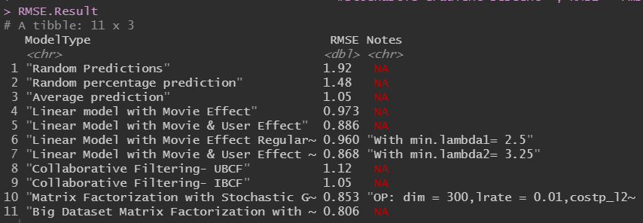
Notes:
Some machine learning algorithms are tested and have been compiled in the followed table with the respective RMSE result. Two predictors are used, the movie and user information, not considering other features.
The best RSME value was for Matrix Factorization with Stochastic Gradient Descent.

Slide 40
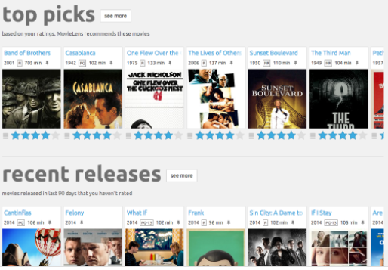
Conclusion
We have stated our project by collecting, preparing, cleaning the dataset train.dtS for analysis. Then we explored the information seeking for insights that might help during the model building. At the end we ran the model with the lowest RMSE using the 10 million dataset.
Our objective was finding the best Root Mean Square Error (RMSE) that tells you how concentrated the data is around the line of best fit. for this first we created a random model that predicts the rating based on the probability distribution of each rating This model gives the worst result.
Matrix Factorization with Stochastic Gradient Descent achieved the best RMSE result. Model adopted
by Netflix.

Slide 41
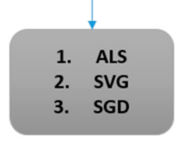
NEXT STEPS
Notes:
And now whats next steps. There is some options. First, we can minimize the errors and improve our performance using Alternative techniques. For example, Maybe you already realized that we could use Model-based and Memory algorithm together it provides more accurate data, and it is likely that it also resolved the problem of cold start.
After then content-based approach. You know Modern recommenders like Amazon to Netflix, Pandora, YouTube are using combine both approaches. Collaborative filtering methods are based on similarity from user interaction and content-based filtering methods calculate the similarity of attributes of an item. Next slide we will see other attributes. So again we might apply mixture of content-based and collaborative filtering in our system. Which is Demographic. Last but not least our next steps can be work on other matrix factorization for less error.

Slide 42
NEXT STEPS
Content-based approaches - attributes
Notes:
As mentioned before. This is our attribute to make use of Content-based approach. Moreover If its available to user feedback, previous search or history of user or profile information and on everything of user data. We could make another recommendation engine like based on the user’s behavior. It will be more independent of other user behaviors.

Slide 43

Thank you
Notes:
That’s it. Thank you for everything teacher

