Slide 1


Welcome to “Machine Learning for Earth and Environmental Sciences”!
ML for Earth & Env Sci (Chapter 2, FA26)
🤖
🌍
By the end of this twelve-week (5 ECTS!) course, you will be able to:
Name common ML algorithms and summarize their advantages and limitations, especially in the context of environmental science,
Implement them in Python (mostly using the Numpy/Scikit-Learn/ Keras/Tensorflow/PyTorch libraries in Google Colab notebooks),
Know from experience which algorithms are most appropriate for environmental applications you are passionate about.

Slide 2
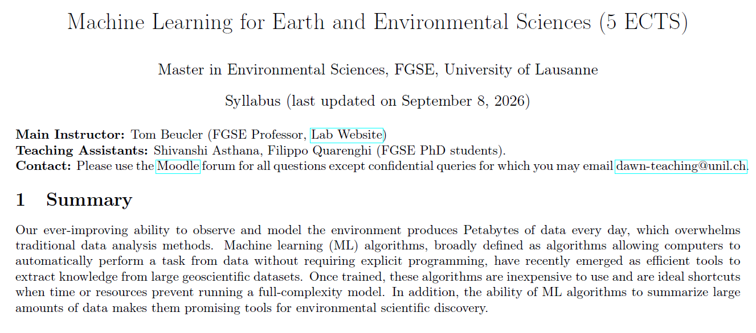
Min 15-30: Introductions, Moodle, and Syllabus
1) Instructor & TA
2) Open the course’s Moodle space: https://moodle.unil.ch/course/view.php?id=37058
3) Download the latest version of the syllabus

Slide 3





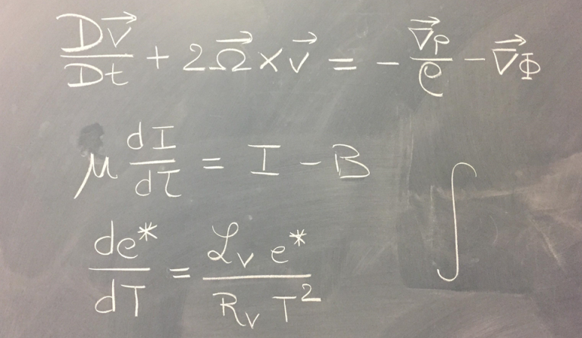
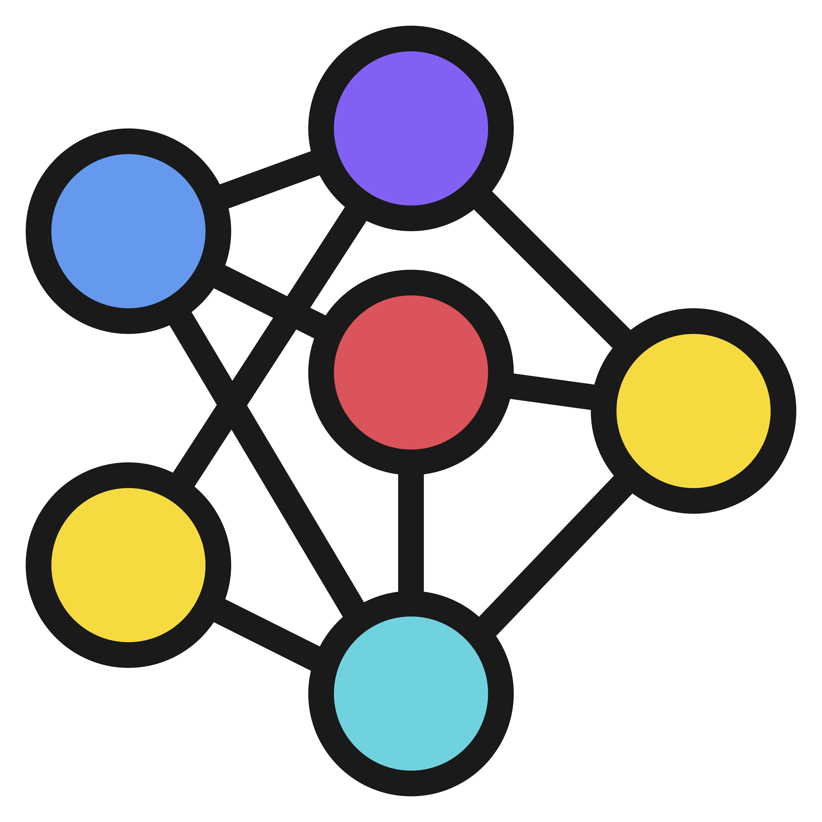

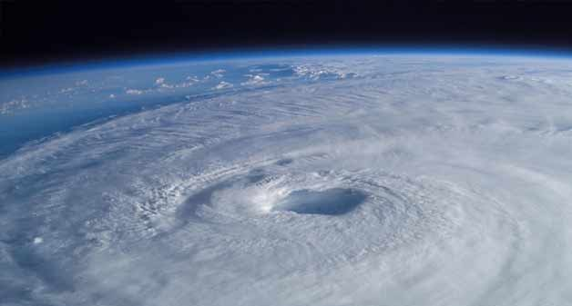
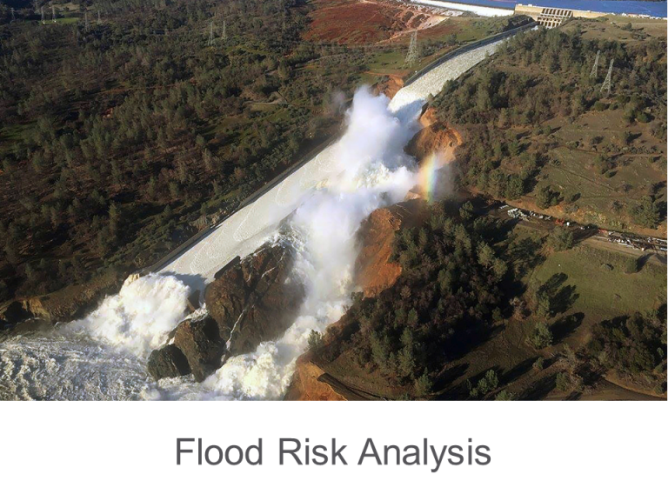
Atmospheric Physics + AI
Physics-Guided ML
Data-Driven Discovery
Extreme Weather Events
Forecasting,
Post-Processing,
Downscaling
Environmental
Data Science
Earth System Modeling
(Parameterization)
Image Sources: Adhithya Sandeep, John Lund, Cal. Dep. Wat. Res.
Notes:
EDS -> Methods developed general enough for wide geoscientific audience. Two-way interaction will also be outline of today’s talk.

Slide 4
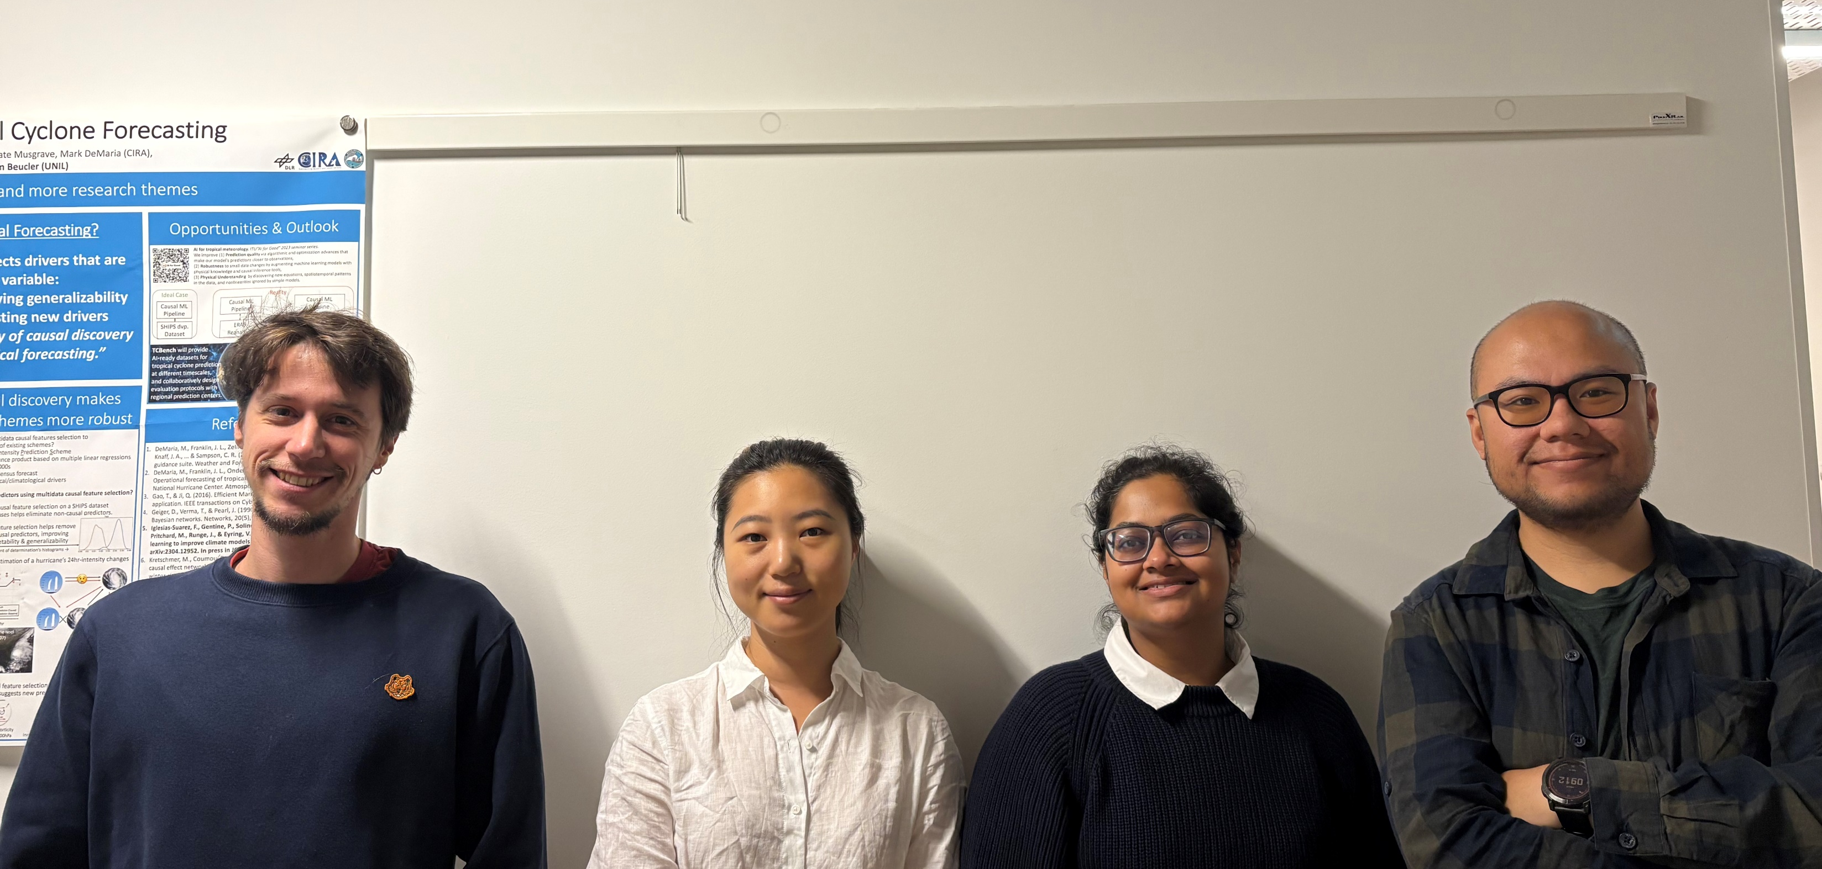
Filippo
Fei (substitute)
Frederick (substitute)
Shivanshi

Slide 5
Your final project 🤖💻🌳
The final project’s goal is to answer a well-defined scientific question by applying one of the ML algorithms introduced in class on an environmental dataset of your choice
(e.g., related to your Masters thesis or your PhD research).
Can you think of a large geoenvironmental dataset linked to a scientific question you are passionate about?
In the affirmative, how could you format the dataset to facilitate its manipulation in Python?
In the negative, consider browsing the class syllabus’ datasets
Come talk to us ☺
Notes:
Questions?

Slide 6
Min 30-45:
Introduction to Machine Learning
Learning Objectives (Géron Ch1+2):
Define Machine Learning
Distinguish supervised from unsupervised learning
Understand some key challenges of machine learning
Define training/validation/test sets
Define hyperparameters
Know the main steps of an ML project

Slide 7
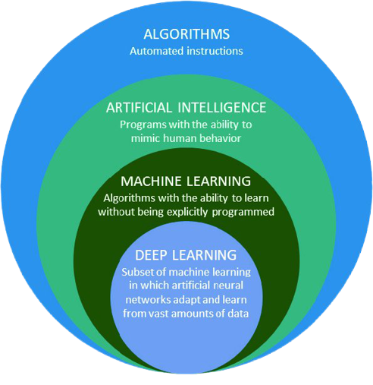

“[Machine Learning is the] field of study that gives computers the ability to learn without being explicitly programmed”
—Arthur Samuel, 1959
Source: Vrana et al. (2020). Géron et al. (2019)
Notes:
Define Machine Learning
Exclamation mark = Slight disagreement; AI = the theory and development of computer systems able to perform tasks normally requiring human intelligence, such as visual perception, speech recognition, decision-making, and translation between languages.

Slide 8
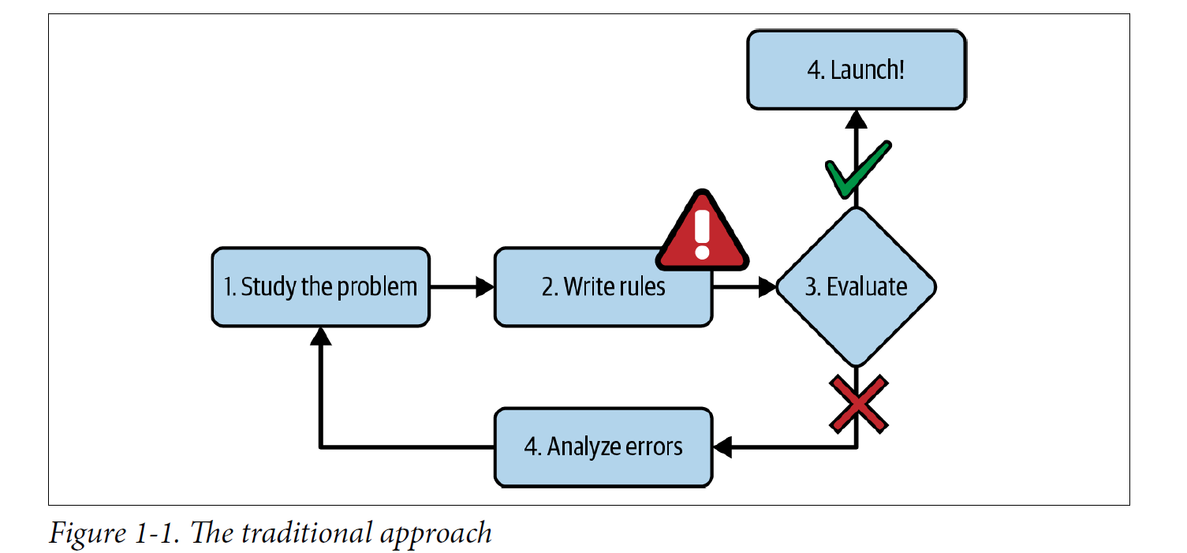
Source: Géron et al. (2022)

Slide 9
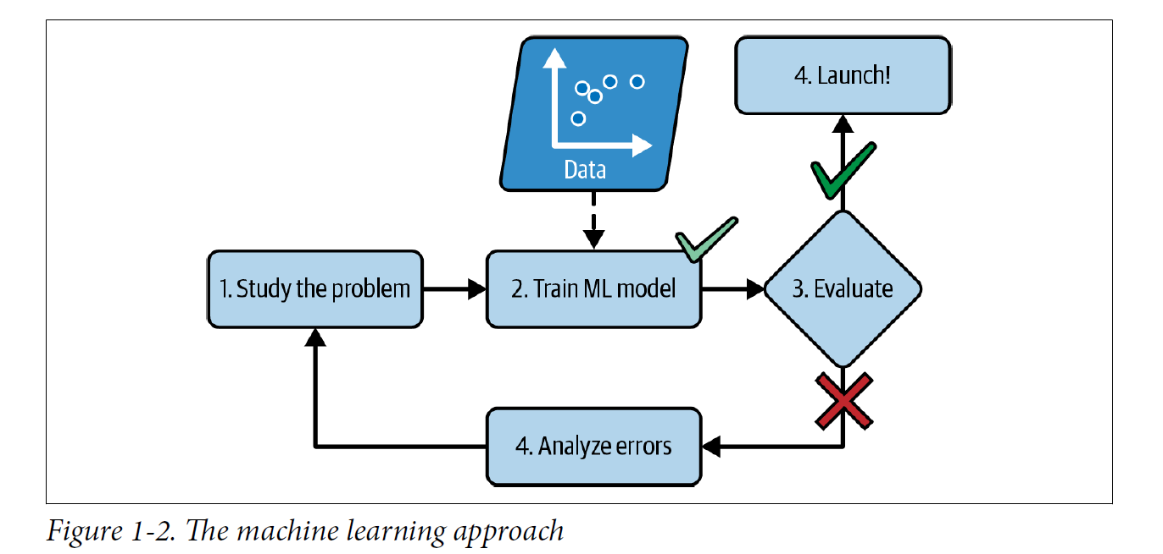
Source: Géron et al. (2022)

Slide 10
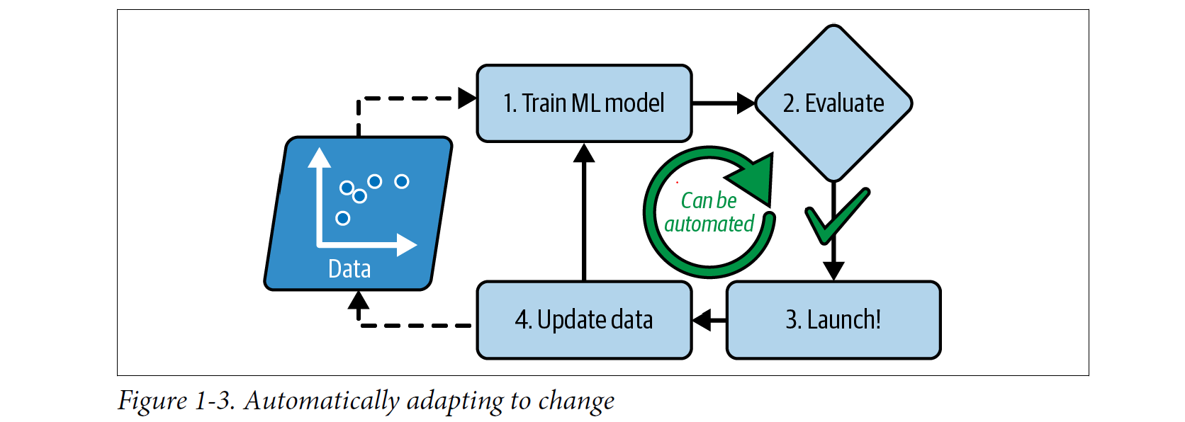
Source: Géron et al. (2022)

Slide 11
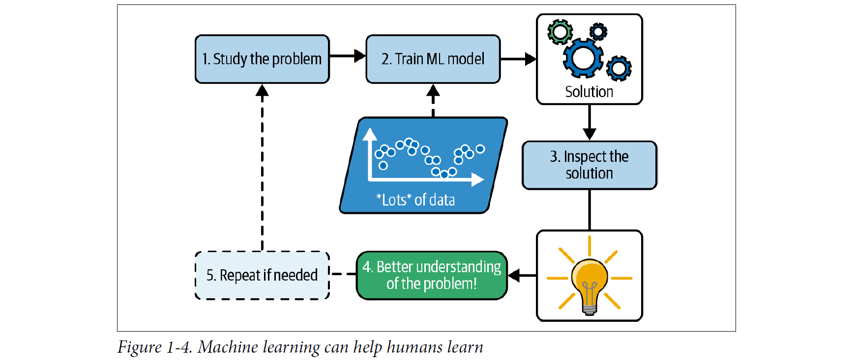
Source: Géron et al. (2022)

Slide 12


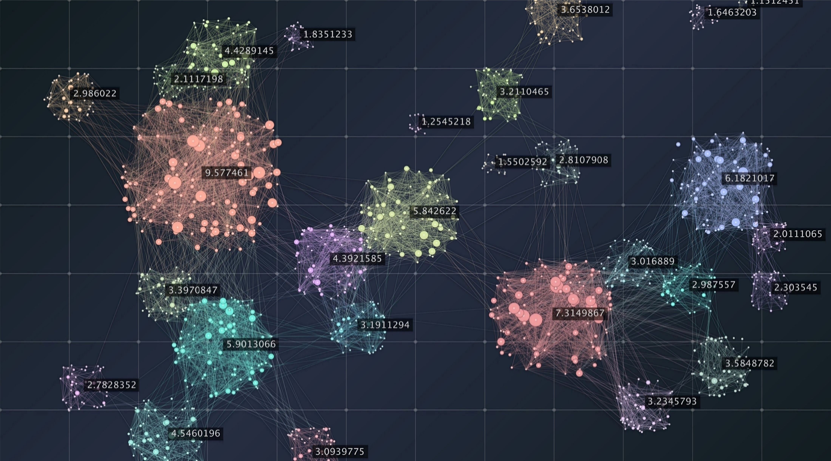
Examples of Applications:
Analyzing images of products on a production line to automatically classify them
Detecting tumors in brain scans
Automatically classifying news articles
Automatically flagging offensive comments on discussion forums
Summarizing long documents automatically
Creating a chatbot or a personal assistant
Forecasting your company’s revenue next year, based on many performance metrics
Making your app react to voice commands
Detecting credit card fraud
Segmenting clients based on their purchases so that you can design a different marketing strategy for each segment
Representing a complex, high-dimensional dataset in a clear and insightful diagram
Recommending a product that a client may be interested in, based on past purchases
Building an intelligent bot for a game
And so much more! ☺
Source: Géron et al. (2019); Image source: Astibuag, Andrey Popov, sudok1
Notes:
Big data complexity visual representation. Cluster analysis visualization. Advanced analytics. Beauty of data graphic abstract background.
Von Astibuag
Robot Playing Chess
Von Andrey Popov
MRI picture of a human brain with the red area
Von sudok1

Slide 13
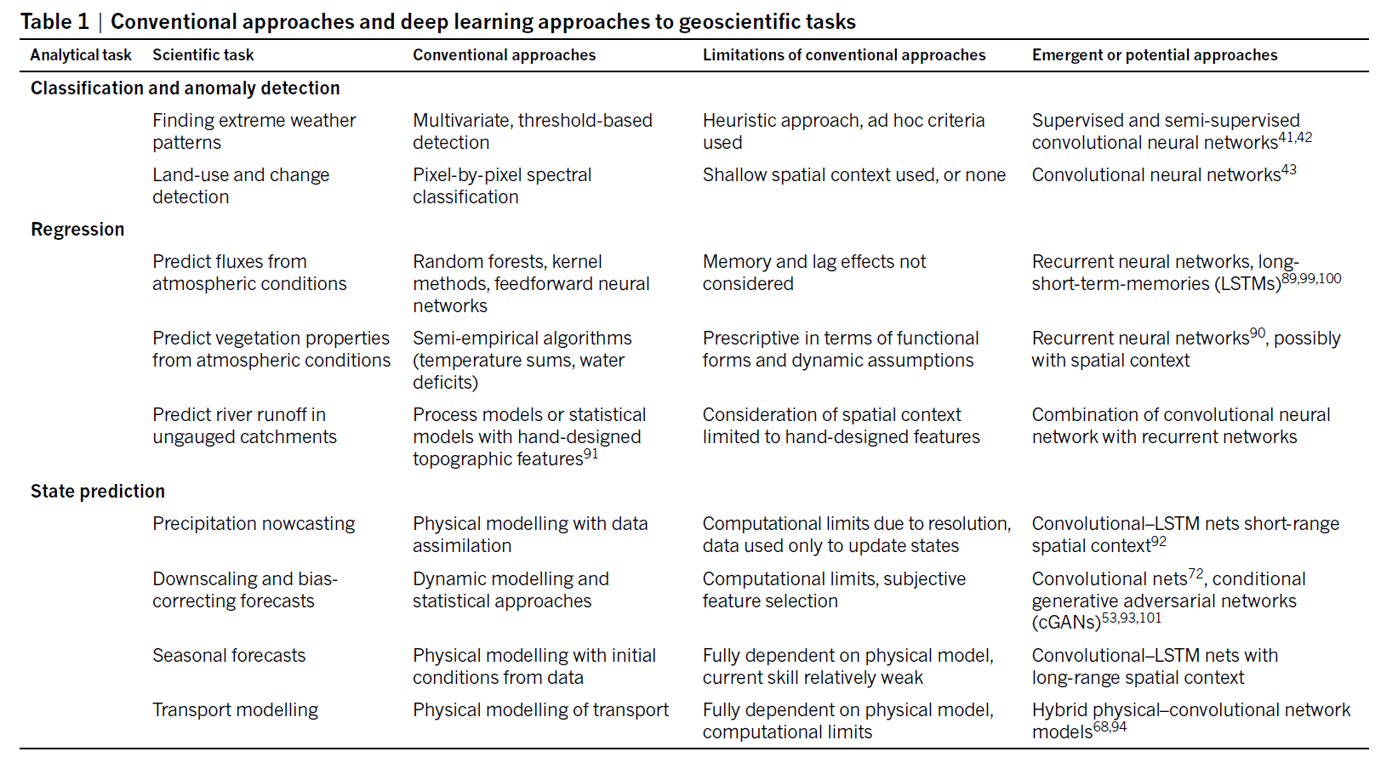
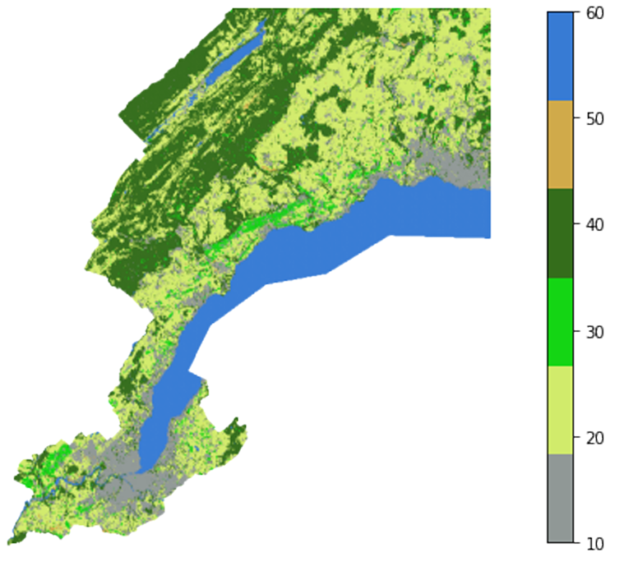
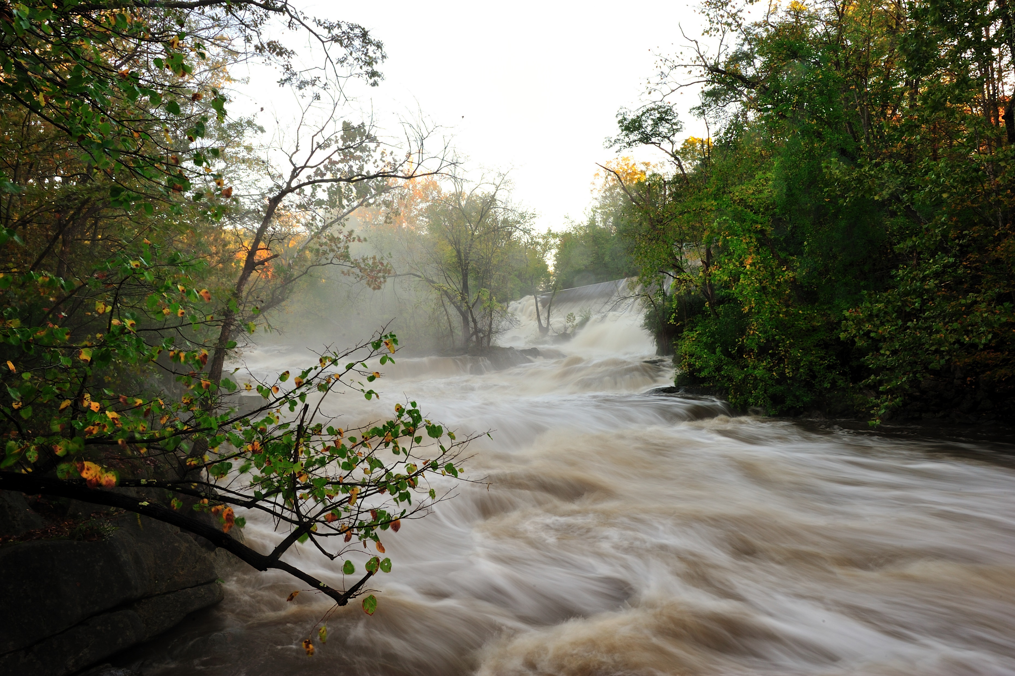
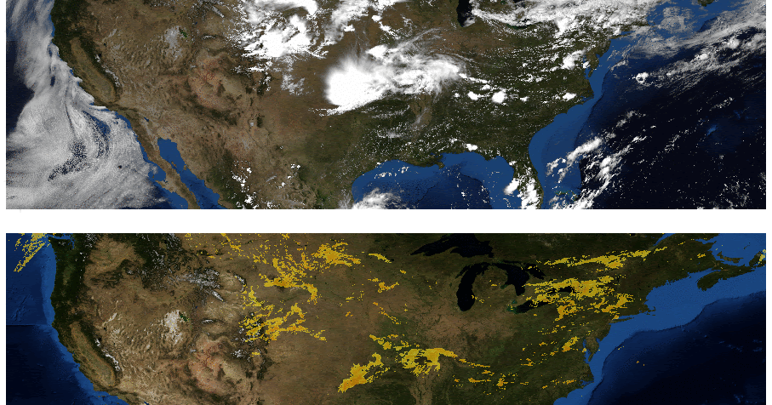
Source: Reichstein et al. (2019), Jorge Moro, Google AI Blog
Notes:
Conventional approaches & their limits = Particularly important for Earth and environmental sciences

Slide 14
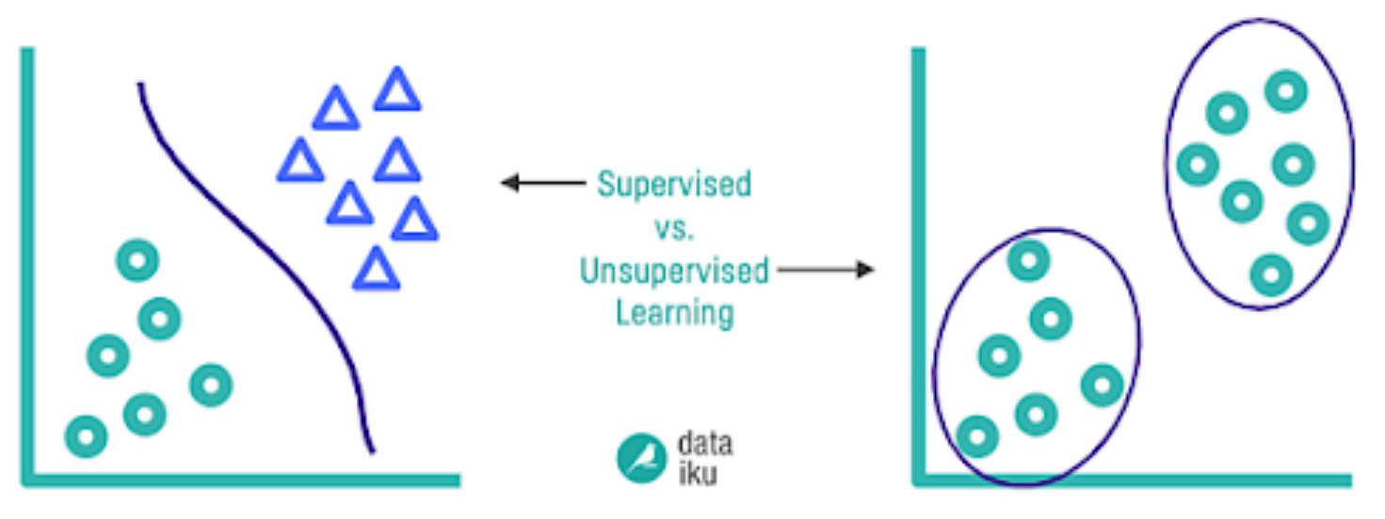
Supervised Learning:
Training set includes desired solutions (labels)
Unsupervised Learning:
Training data is unlabeled
“Learning without a teacher”
Source:
Notes:
2) Distinguish supervised from unsupervised
See Géron Ch2 for semisupervised learning, reinforcement learning
Offline vs Online learning
Instance-based vs model-baed learning

Slide 15
Key Challenges of ML
Insufficient Quantity of Training Data
Notes:
3) Understand some key challenges of machine learning

Slide 16
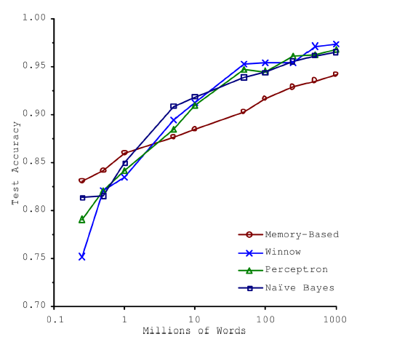
Key Challenges of ML
Insufficient Quantity of Training Data
Source: Banko and Brill (2001)
Notes:
Natural Language disambiguation problem

Slide 17
Key Challenges of ML
Insufficient Quantity of Training Data
Nonrepresentative Training Data (e.g., sampling bias)

Slide 18
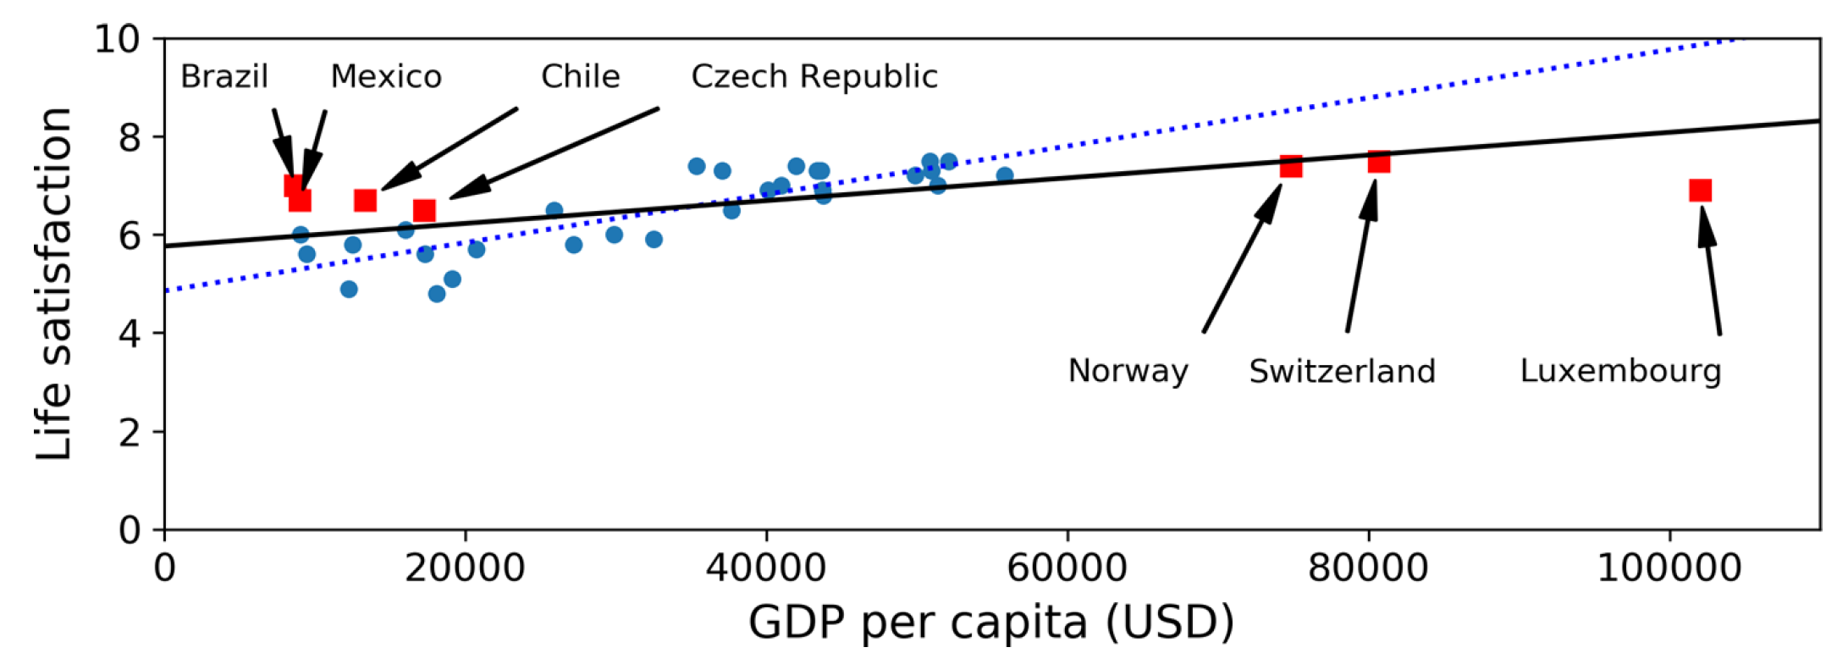
Key Challenges of ML
Insufficient Quantity of Training Data
Nonrepresentative Training Data (e.g., sampling bias)
Source: Géron (2019)

Slide 19
Key Challenges of ML
Insufficient Quantity of Training Data
Nonrepresentative Training Data (e.g., sampling bias)
Poor-Quality Data
Irrelevant Features
Overfitting

Slide 20
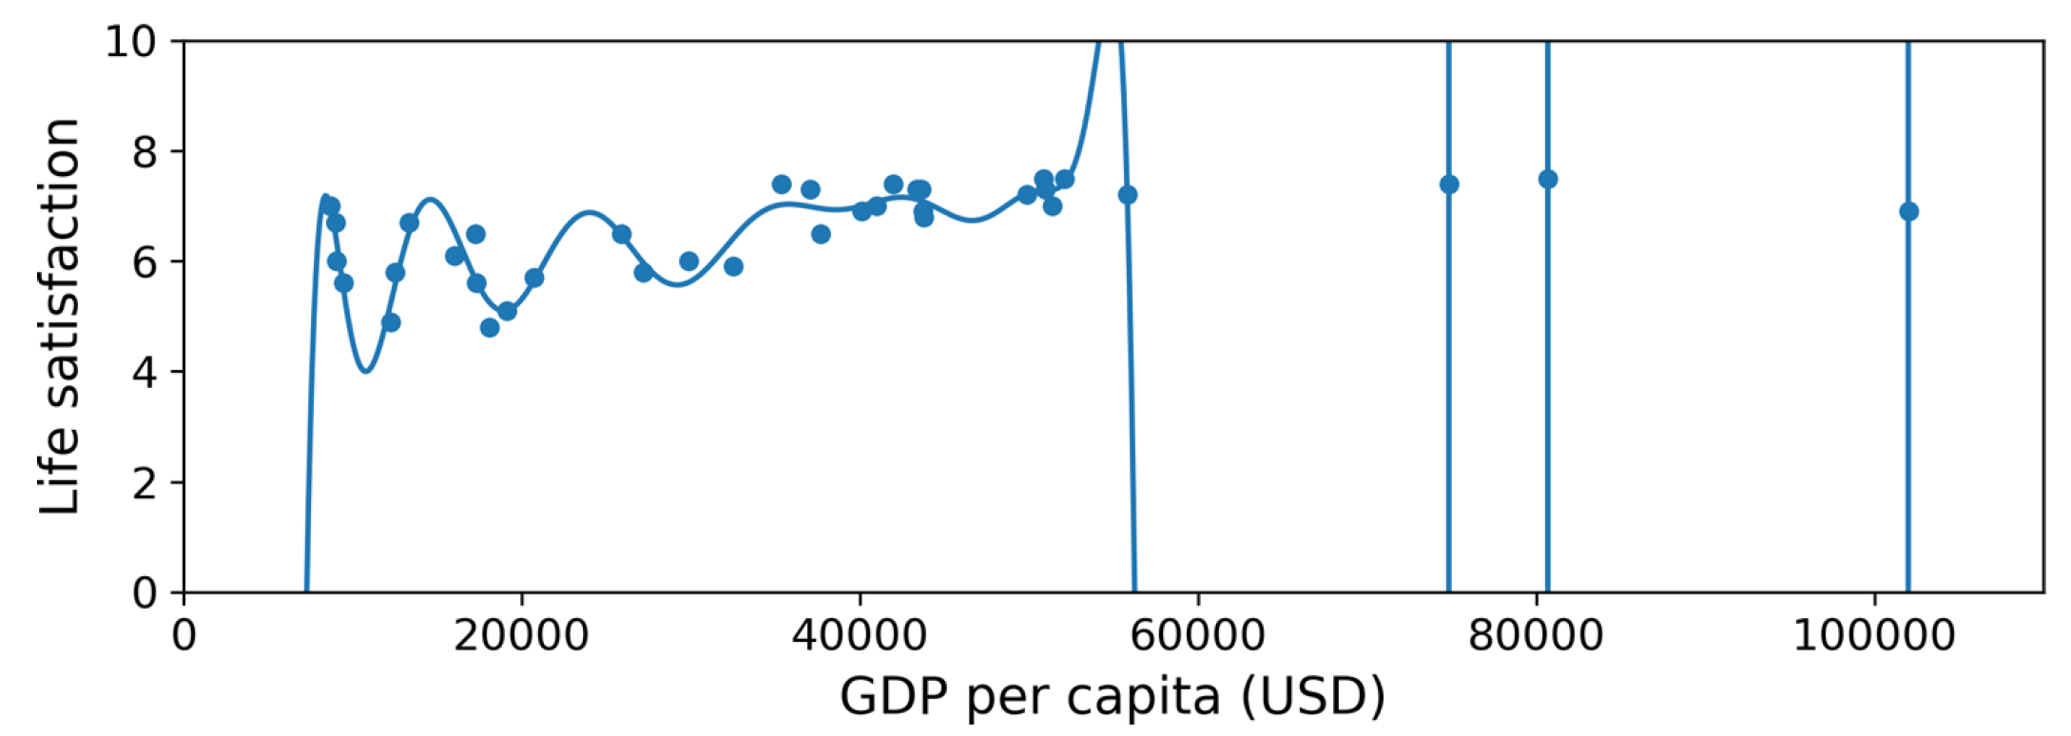
Key Challenges of ML
Insufficient Quantity of Training Data
Nonrepresentative Training Data (e.g., sampling bias)
Poor-Quality Data
Irrelevant Features
Overfitting

Slide 21
Key Challenges of ML
Insufficient Quantity of Training Data
Nonrepresentative Training Data (e.g., sampling bias)
Poor-Quality Data
Irrelevant Features
Overfitting
Underfitting

Slide 22
Splitting data into training, validation & test sets
Optimize the model’s parameters
Evaluate the final model on data it has never seen before
(ideally, a generalization test)
Notes:
Introduce cross-validation
4) Define training/validation/test sets

Slide 23
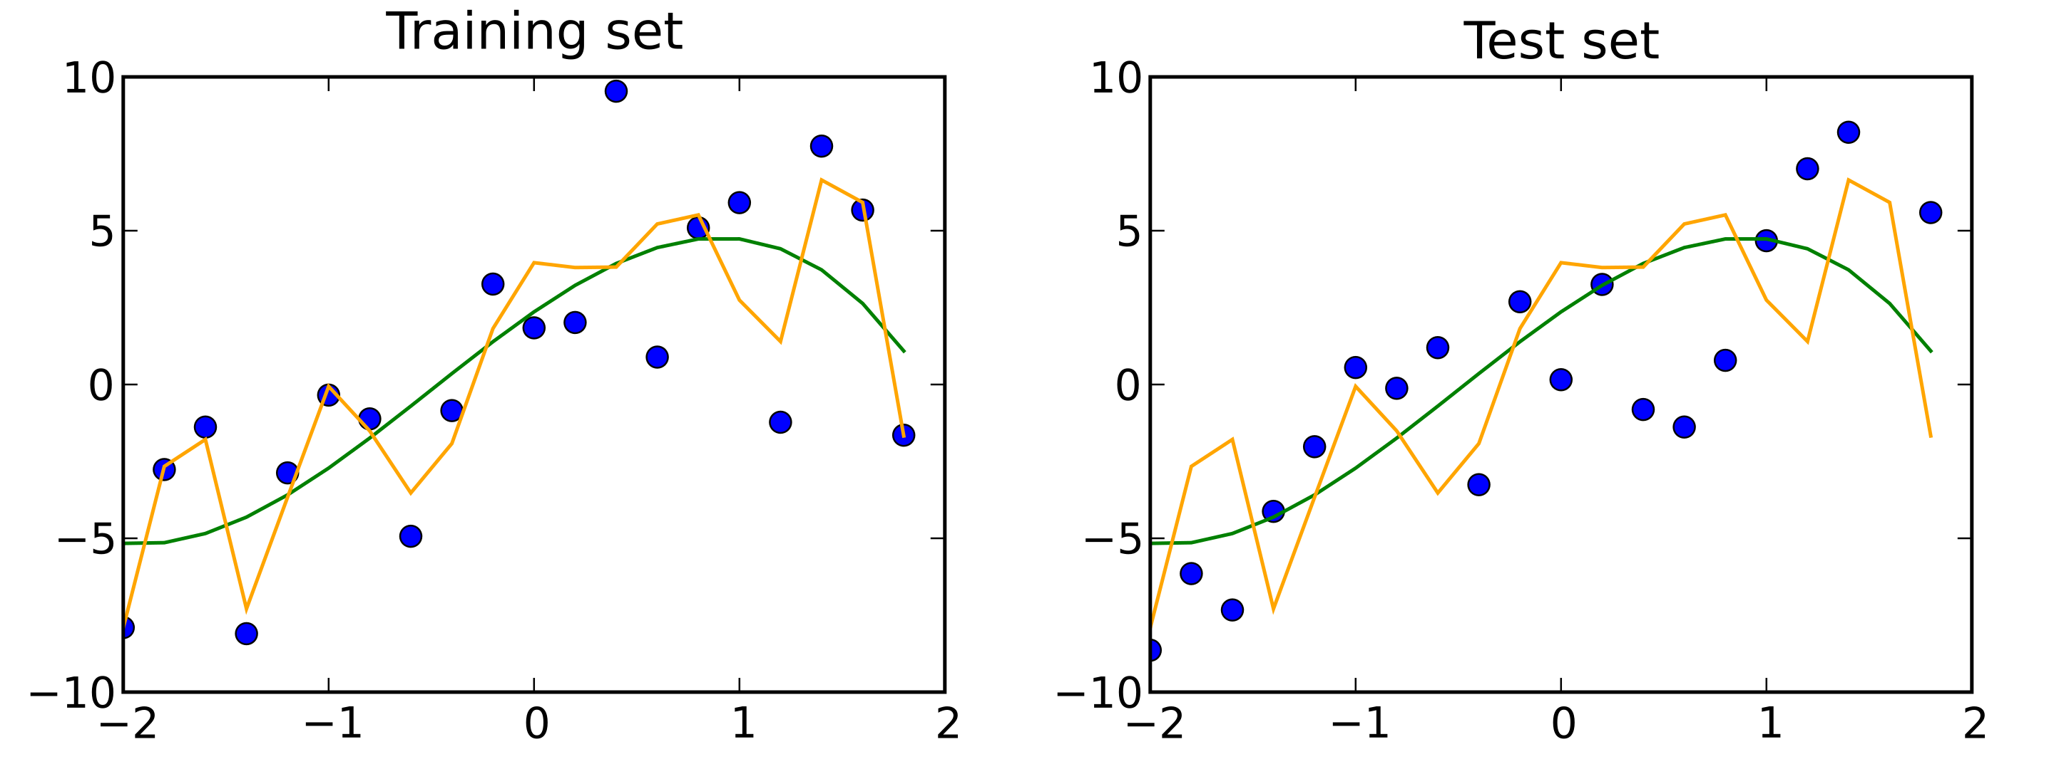
Splitting data into training, validation & test sets
MSE = 4
MSE = 9
MSE = 15
MSE = 13
Source: Wikipedia (Skbkekas)
Notes:
Question = Can you guess which model will do best on a test set?
4) Define training/validation/test sets

Slide 24

Splitting data into training, validation & test sets
Optimize the model’s trainable parameters
Evaluate the final model on data it has never seen before
(ideally, a generalization test)
Notes:
What about the validation set?
4) Define training/validation/test sets
Question = I didn't understand if there is a good way to split the data into training set et test set

Slide 25
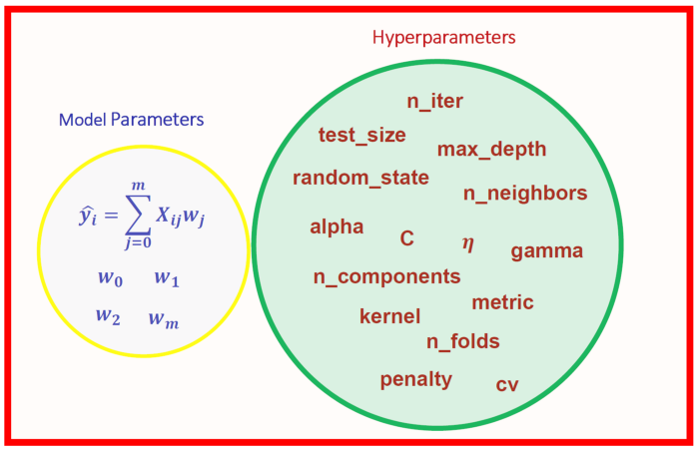
Unlike parameters whose values are optimized during training,
Hyper-parameters are set before training and remain constant during training
Hyperparameters can be “tuned” manually or
Formally, e.g., using grid or random searches
Source: towardsdatascience (Benjamin Obi Tayo)
Notes:
5) Define hyperparameters

Slide 26
Splitting data into training, validation & test sets
Optimize the model’s trainable parameters
Optimize the model’s hyperparameters
& detect overfitting
Evaluate the final model on data it has never seen before
(ideally, a generalization test)
Notes:
4) Define training/validation/test sets

Slide 27
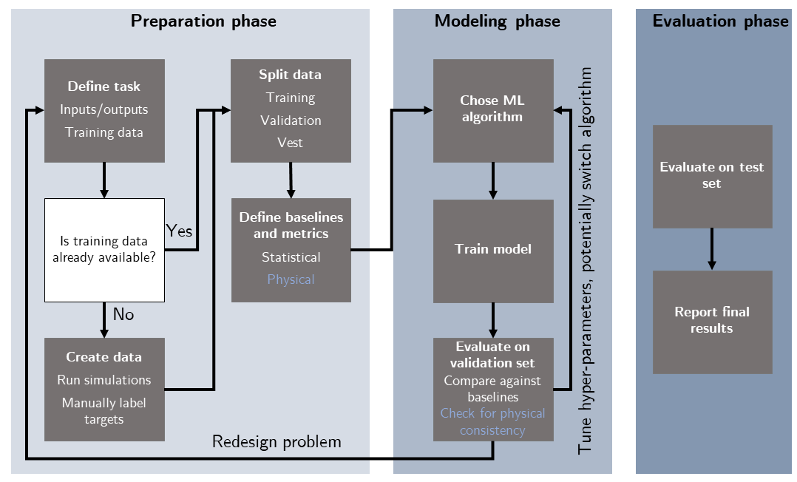
Workflow for an ML project in env. sciences
Source: Beucler et al. (2021)
Notes:
6) Know the main steps of an ML project

Slide 28
Min 45-60:
Moodle Quiz to register & practice
(Not graded)
Notes:
Questions?
Not graded

Slide 29

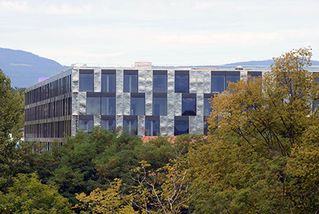
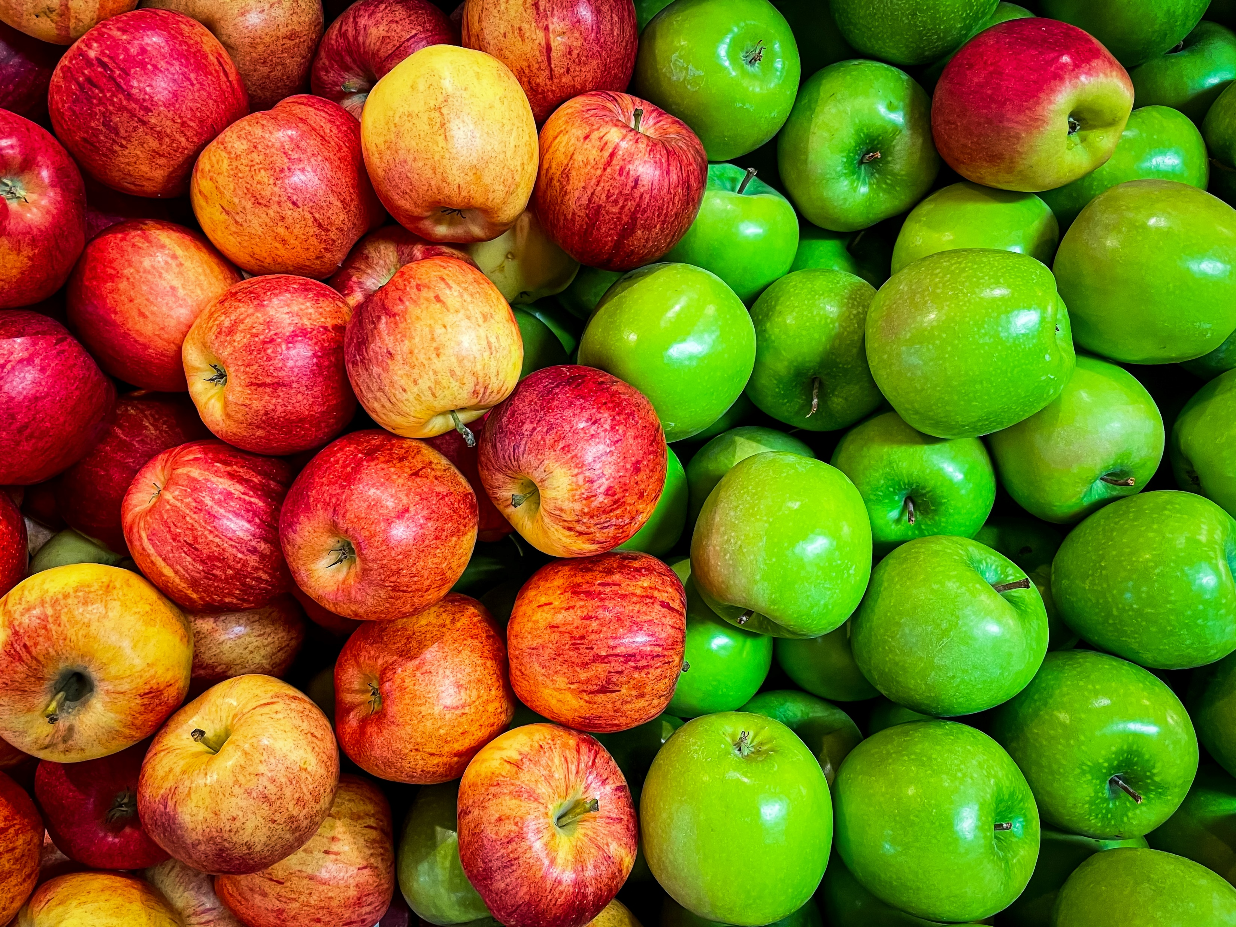
Min 60-75: Break

Slide 30
Min 75-95: Logistic Regression for Classification
Learning Objectives (Géron Ch3+4):
Distinguish classification from regression
Define a loss/cost function
Understand how to train a logistic/softmax regression for binary/multiclass classification
Know how to benchmark a classifier

Slide 31

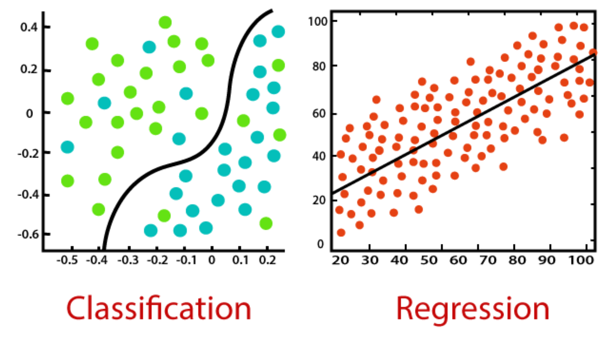
Categorical variables
Continuous variables
Source: www.javatpoint.com
Notes:
1) Distinguish classification from regression

Slide 32
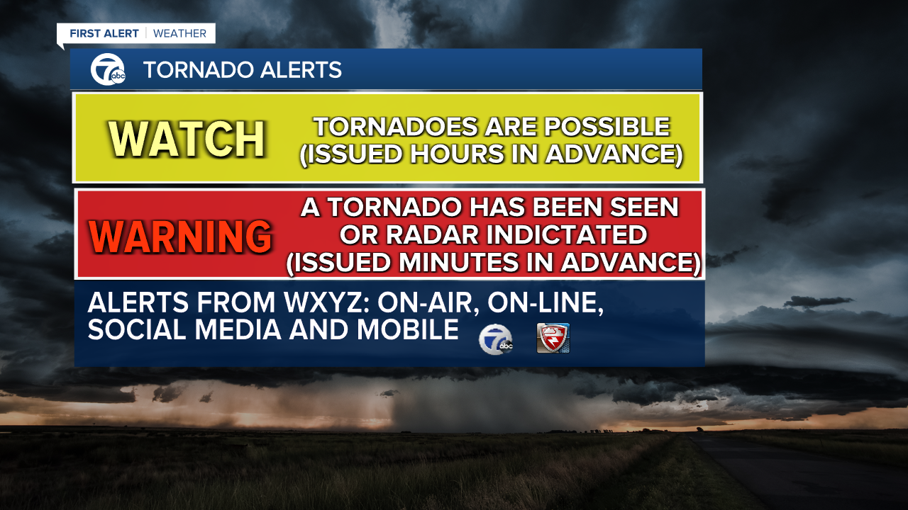
Binary Classification
Source: WXYZ Detroit

Slide 33
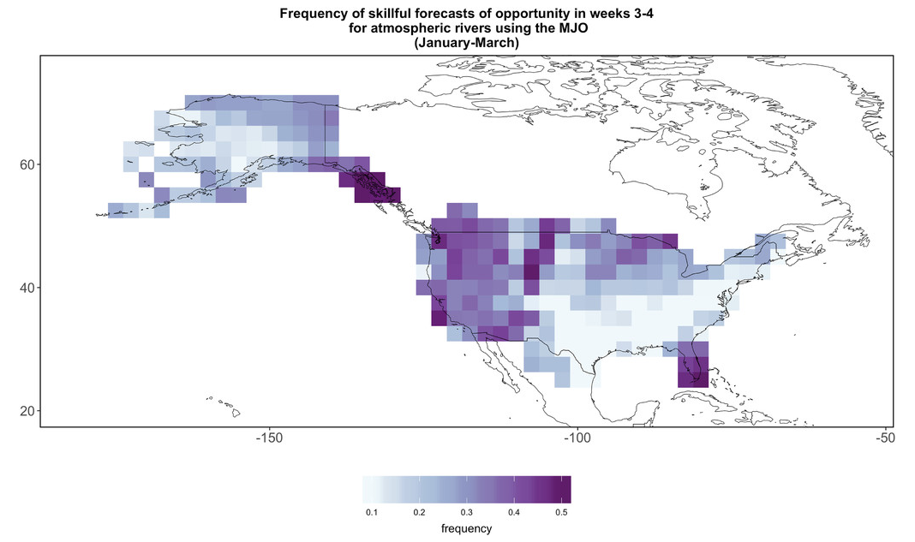
How can we frame realistic physical questions in a way that can be handled with a binary classifier?
Realistic question:
Where is it possible to improve forecasts?
Binary classifier:
Based on Tropics, will there be an atmospheric river?
Source: Windows of Opportunity for
Skillful Forecasts (Mariotti et al.)

Slide 34
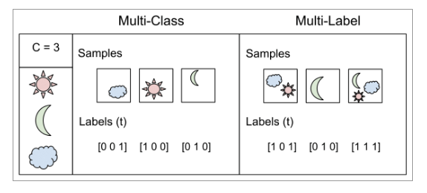
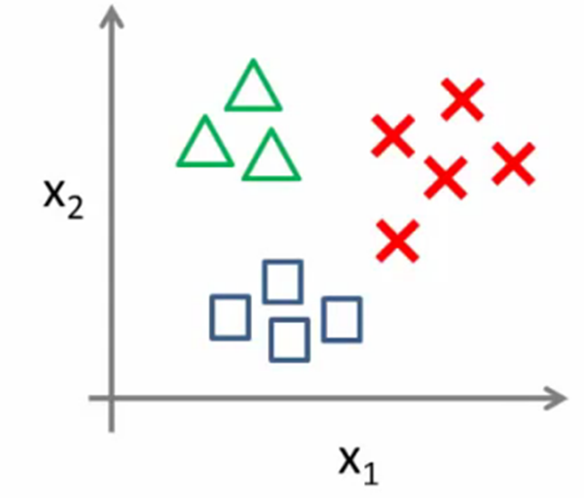
Multiclass ≠ Multilabel < Multioutput
Assign several non mutually-exclusive
labels (true/false)
to each instance
Assign several non mutually exclusive labels
(several possible values)
to each instance
Assign to one of several mutually-exclusive classes
Image Source: Pritish Jadhav, DataDrivenInvestor
Notes:
Lots of questions about multiclass/multi-label
Image source: Pritish Jadhav, DataDrivenInvestor
Image source: Rolof computer academy

Slide 35

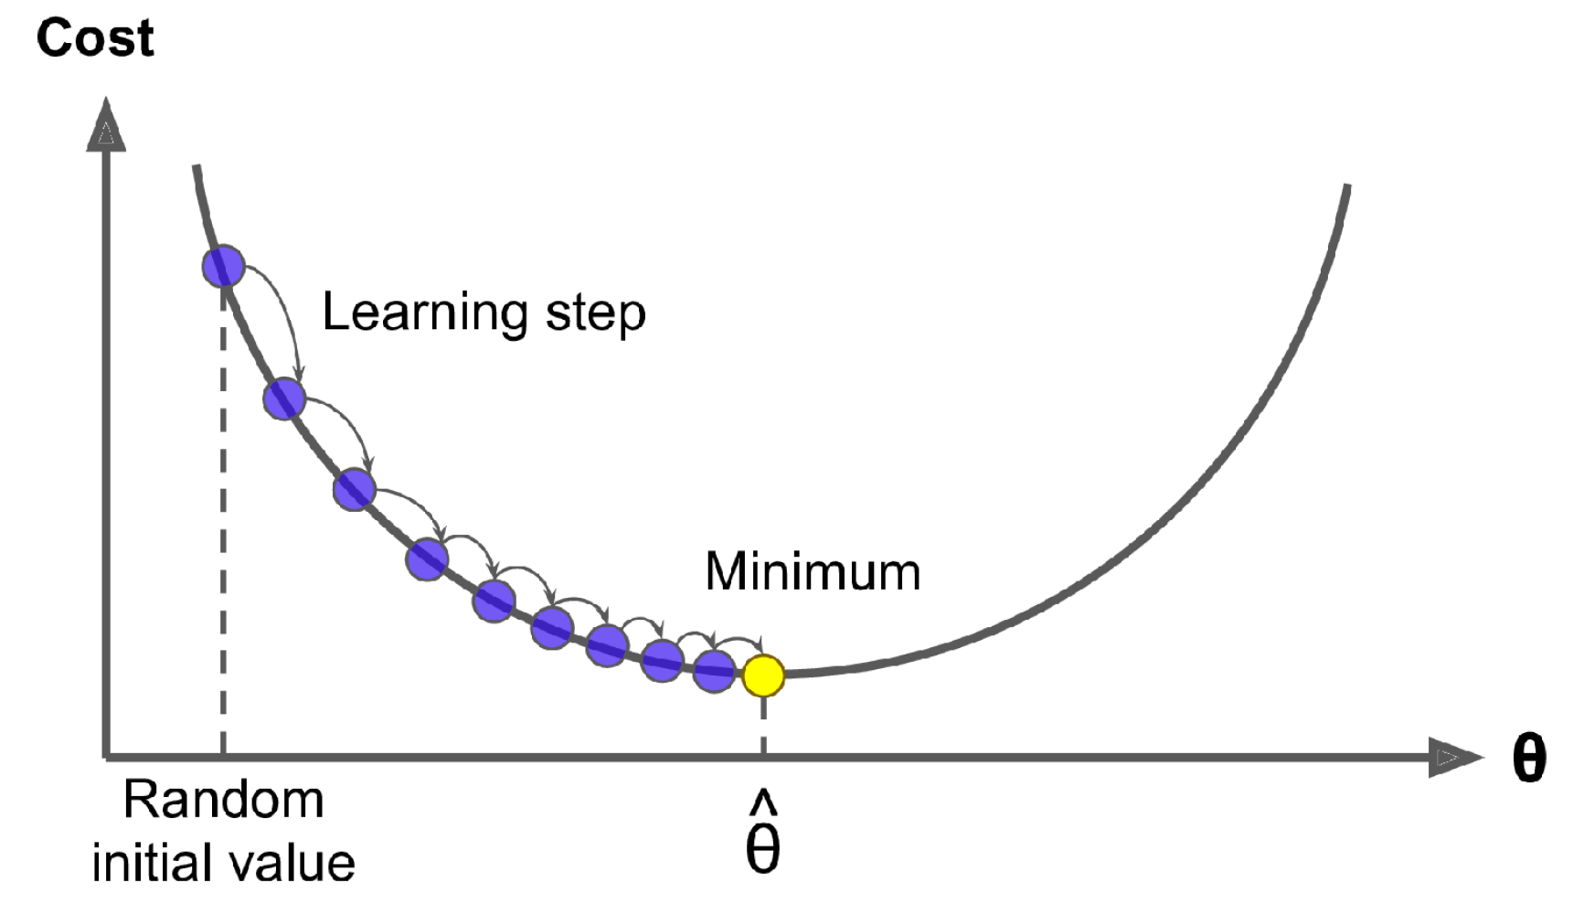
2) What is a cost/loss/error function?
Function: (Predictions, [Truth], [Inputs]) (Cost/Loss/Error to minimize)
For complex data, usually minimized using gradient descent:
Notes:
2) Define a loss/cost function

Slide 36
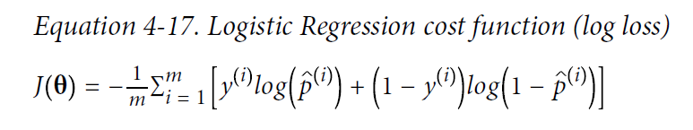
2) Example for binary classification:
Binary Cross-Entropy
Sum over all instances in batch
y = 1 if in the class
y = 0 otherwise
p = Probability of belonging to class

Slide 37
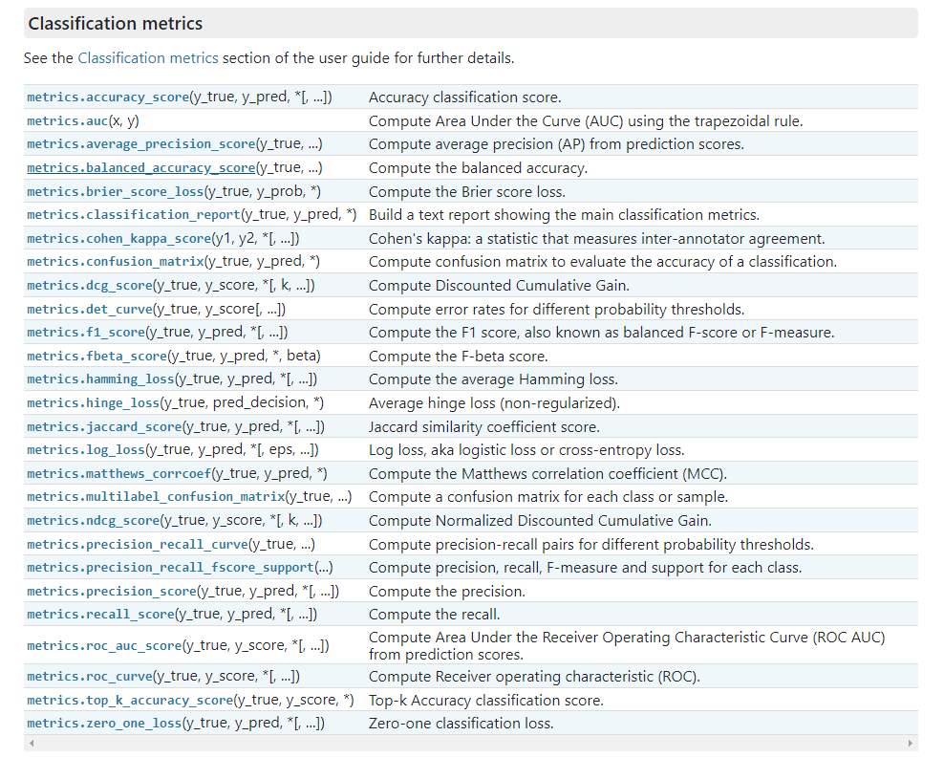
2) Many options to train (and benchmark) classifiers!
Source: scikit-learn

Slide 38
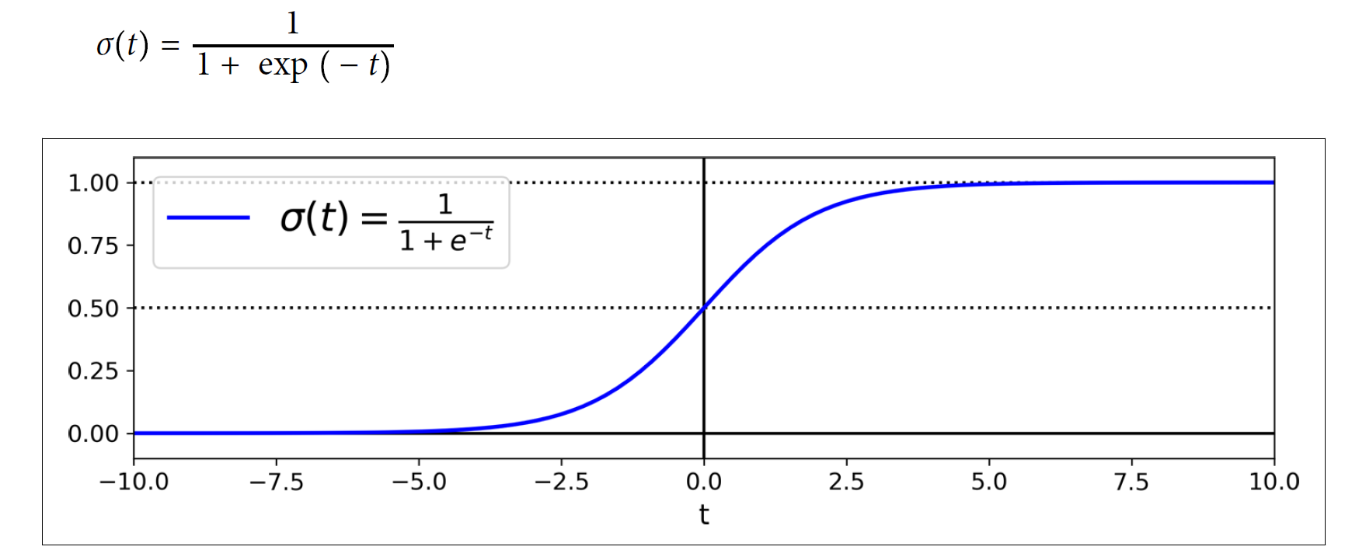
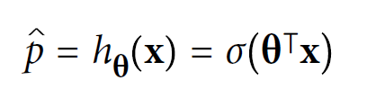
3) Logistic Regression for Binary Classification
Logistic Regression:
Logistic Function

Slide 39
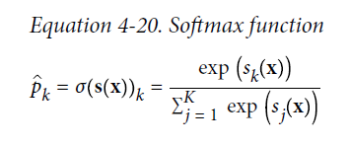
3) Softmax Regression for Multiclass Classification
Generalization of the logistic regression for multiple classes
Predicted probabilities sum to 1 over all classes 👍

Slide 40
3) Softmax Regression for Multiclass Classification:
Environmental and Geographical Applications
Determine the land use category a satellite imagery would most likely belong to
To recognize different types of plants in a specific area
Predict a cloud type
Any kind of species classification (mutually exclusive).
to classify images such as image processing for earth observations
Classifying satellite imagery into land cover
Classify rock samples
identifying invasive species in a plot
Determine the category of a hurricane
Generalization of the logistic regression for multiple classes
Predicted probabilities sum to 1 over all classes 👍

Slide 41
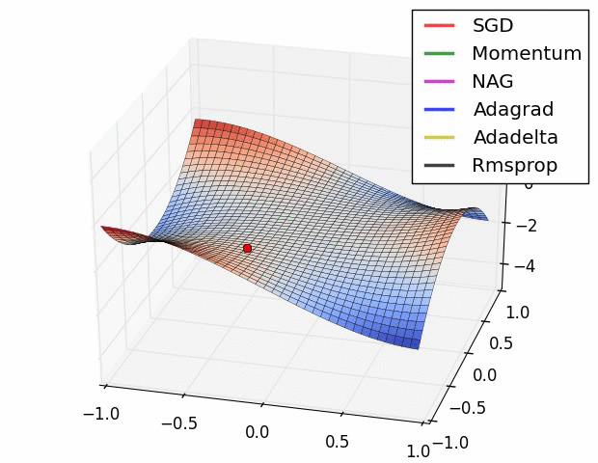
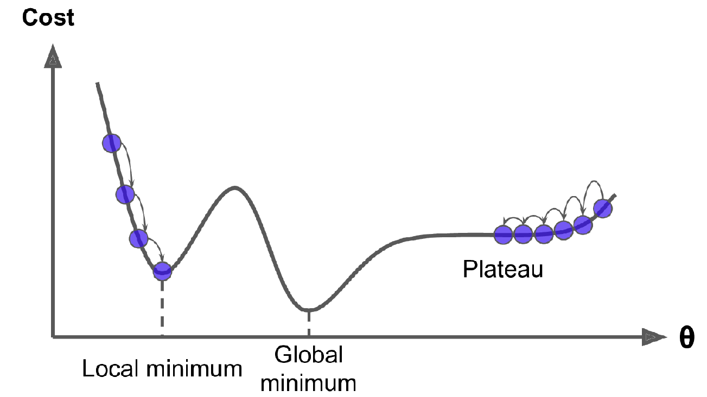
3) Training Logistic Regressions: Gradient Descent
Batch vs Stochastic vs Mini-Batch
Gradient Descent
Source: Computational Optimization (Cornell University)
Notes:
Question: does it mean that the global minimum won't necessarily be reached every time?
For batch, mini-batch gradient descent, refer to Géron

Slide 42
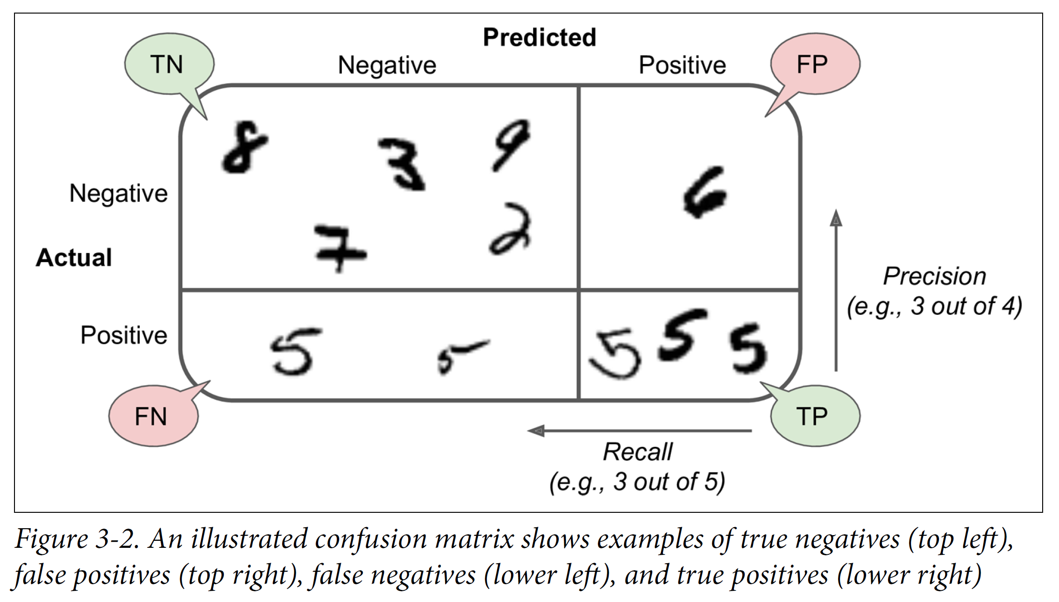

4) Confusion Matrix of the task: Is the digit 5?
Accuracy:

Slide 43
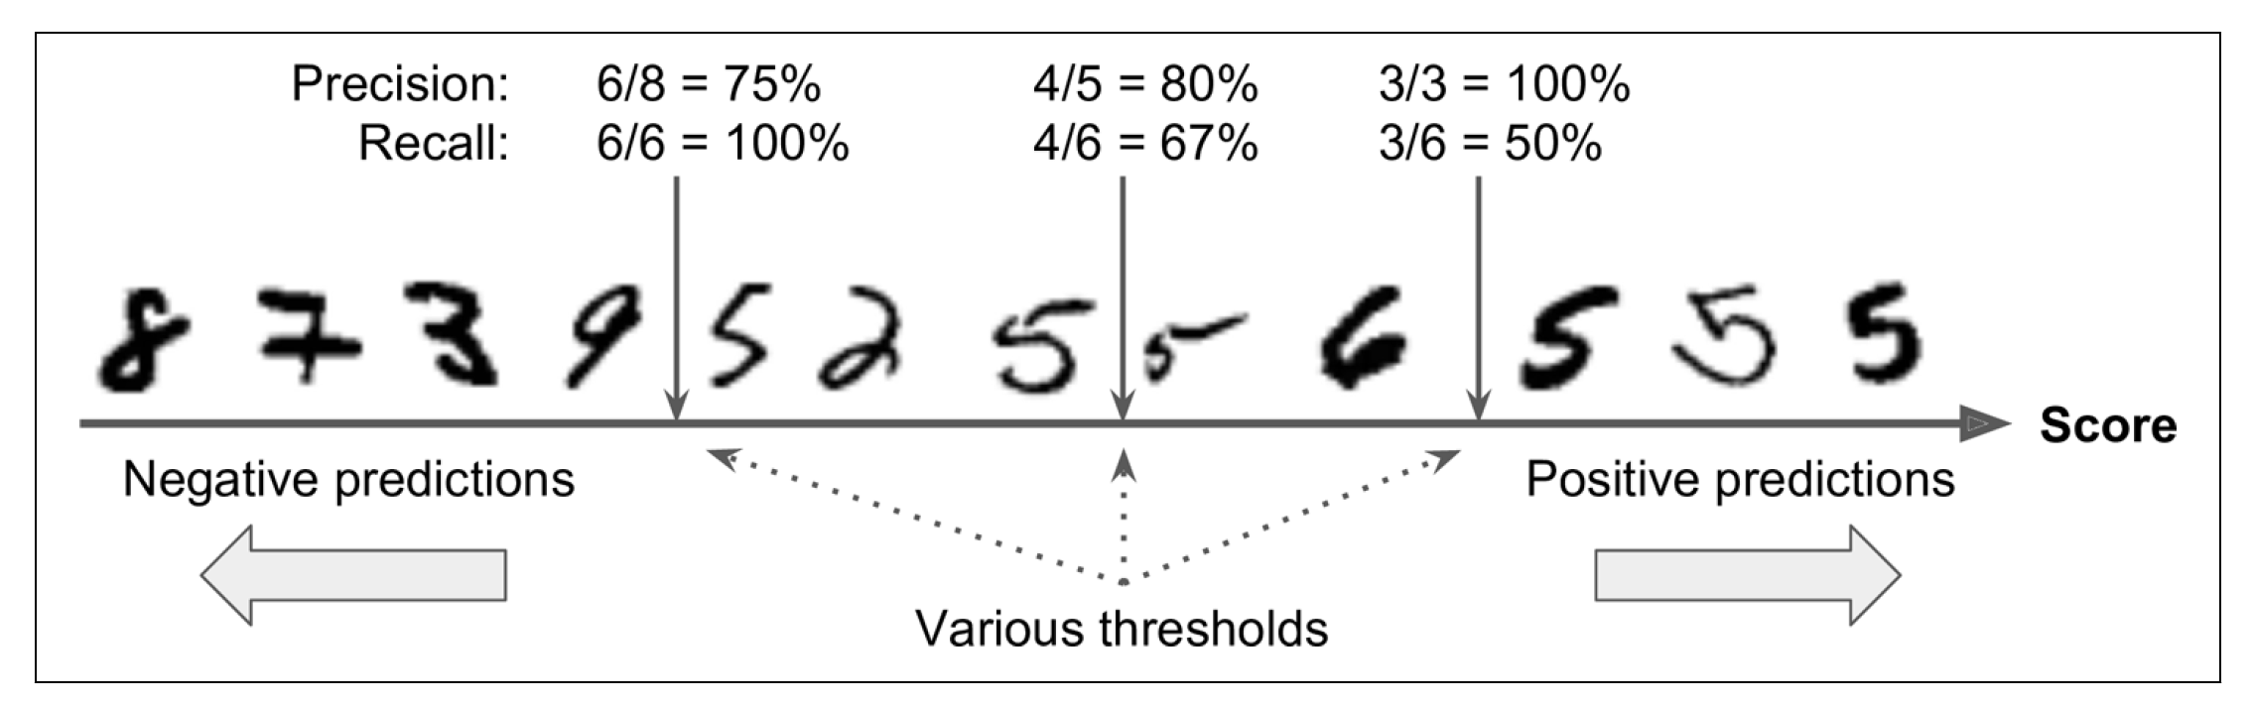
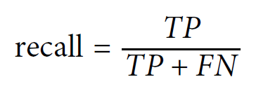
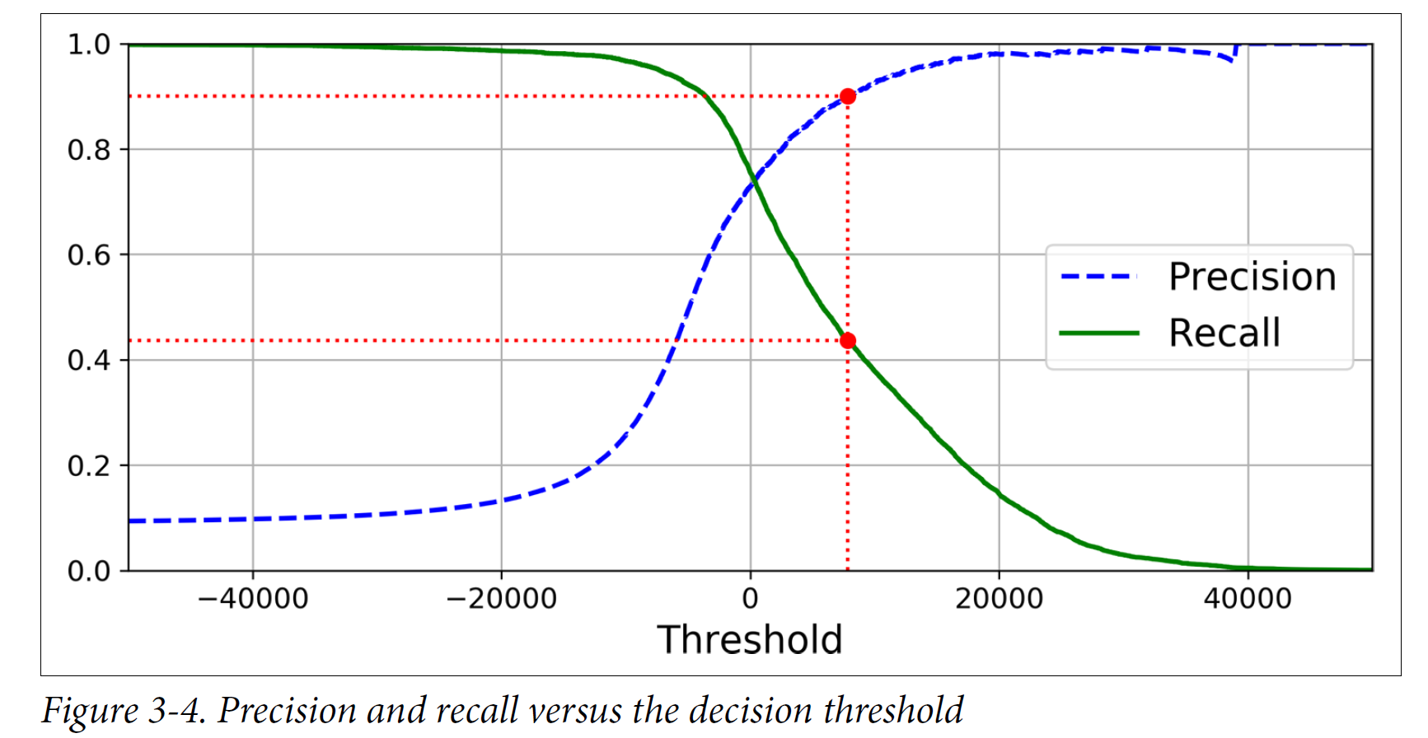


Slide 44
4) When do we want high recall (sensitivity)?
High recall = We tolerate false positives
but try to have as few false negatives as possible
Let’s say we were trying to detect if a soil sample was polluted or not. In this case, we would want to reduce the number of False Negatives because we hope to not miss any polluted sample in the batch.
To detect dangerous storms: It is fine if the classifier has less precision as long as it has a high recall, there would be a few false alerts but almost all dangerous storms will be detected.

Slide 45
4) When do we want high precision?
High precision = We tolerate false negatives
but try to have as few false positives as possible
In surveying the potential distribution of permafrost in mountain regions, where the accuracy of the prediction of positives is important. If the model classifies the presence of permafrost at one point, then it must be there. False positives must be reduced.
Searching for oil. We would rather be certain that there is oil before spending a lot on drilling and miss a few reserves rather than drilling for nothing
Notes:
Add
Accuracy reminder
F_score: F_beta score gives beta more importance to recall over precision

Slide 46
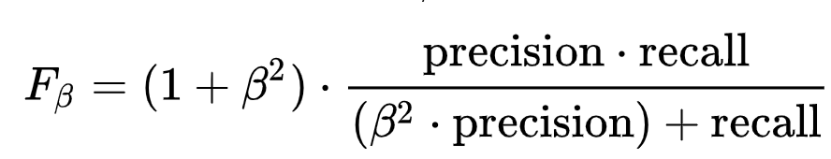
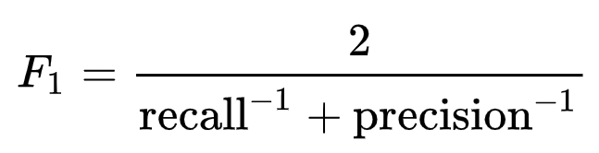
4) What if we want good precision and recall?
β is chosen such that recall is β more important than precision
Source: Wikipedia (F-Score)
Notes:
Accuracy reminder
F_score: F_beta score gives beta more importance to recall over precision

Slide 47
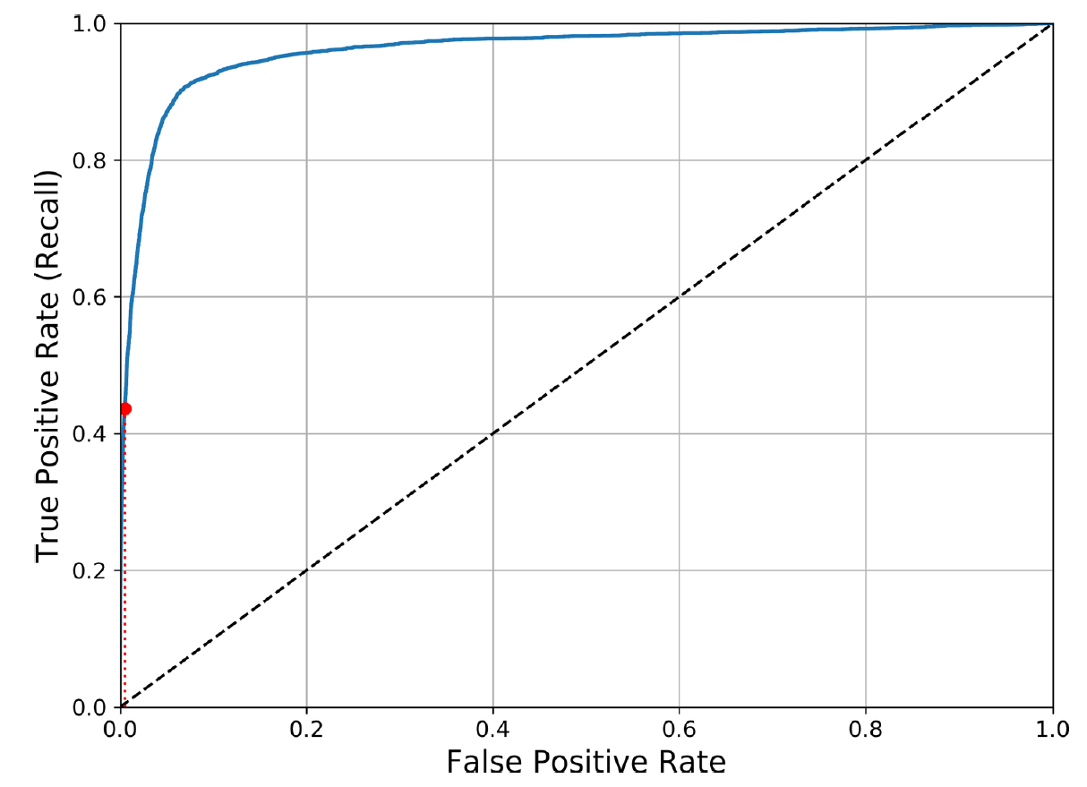
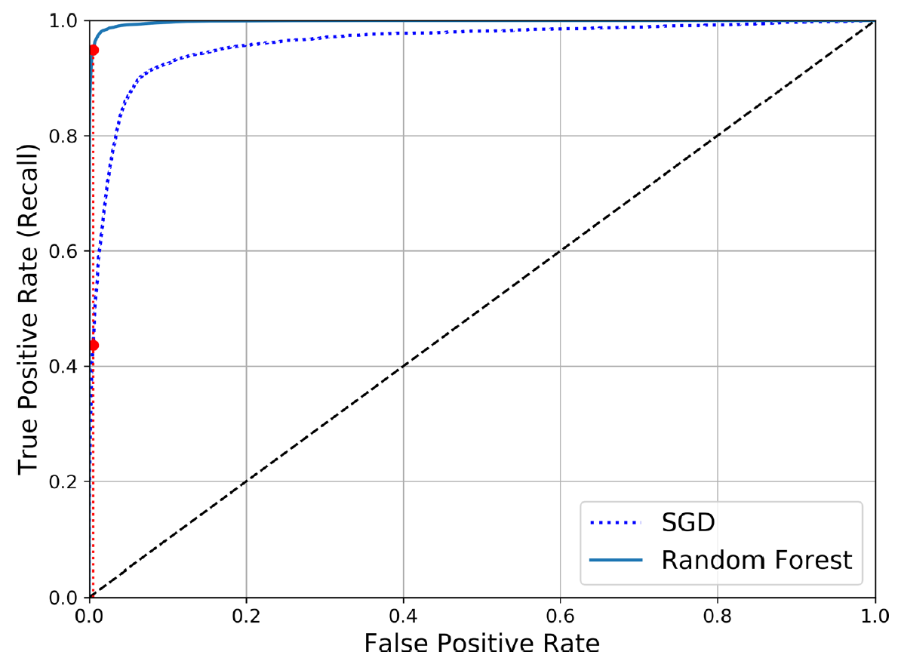
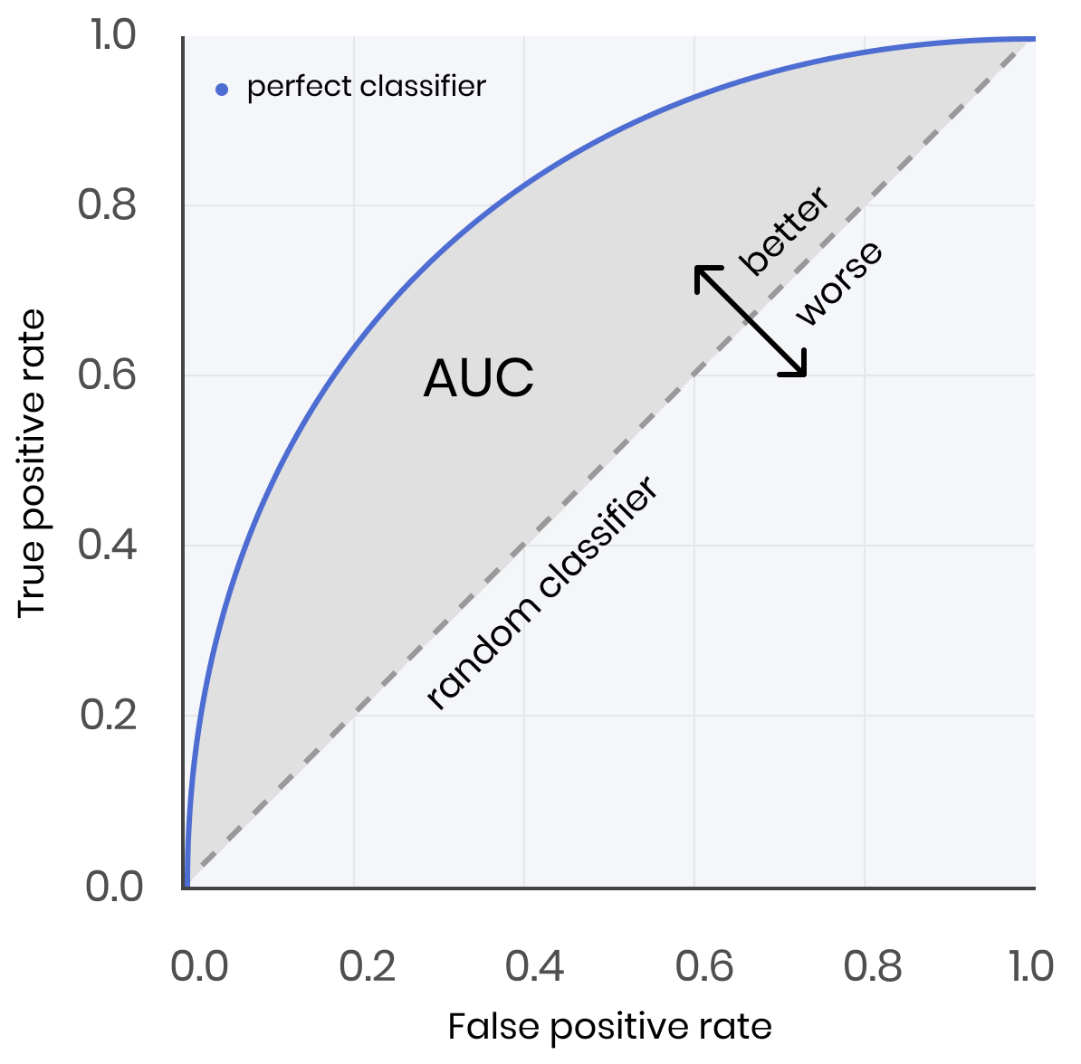
Receiver Operating Characteristic (ROC)
No skill
Source: evispot.ai

Slide 48
Min 95-110: Regression Models
E.g.: Multiple Linear Regression
Learning Objectives (Géron Ch3+4):
Distinguish classification from regression
Define a loss/cost function
Understand how to train a (multiple) linear regression
Know how to benchmark a regression model

Slide 49
Categorical variables
Continuous variables
Source: www.javatpoint.com
Notes:
1) Distinguish classification from regression

Slide 50
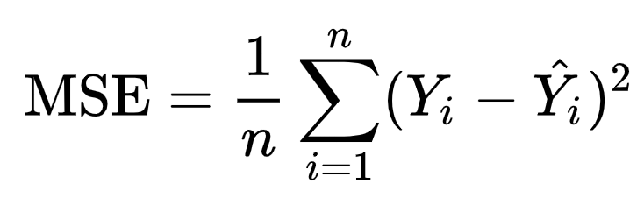
2) Loss/Cost/Error Functions for Regression Models
Mean Squared Error:
For environmental applications:
Root-Mean-Square Error (RMSE)
Mean Absolute Error
Are popular because they preserve units!
“Truth”
Pred.

Slide 51
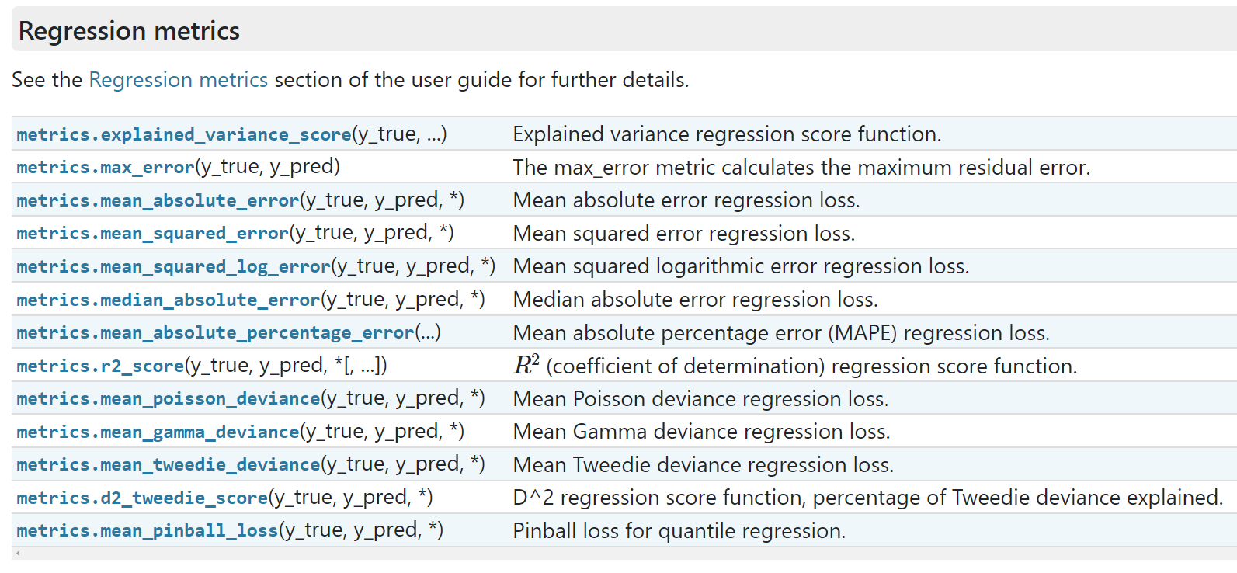
2) Many options to train (and benchmark) regression models!
Source: scikit-learn

Slide 52
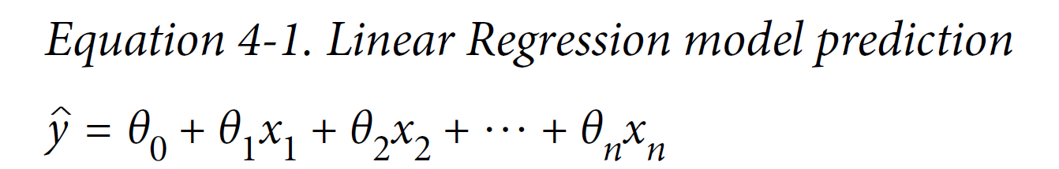

3) Multiple Linear Regression
Weights (Slope)
Intercept (Bias)
+ b

Slide 53
Note: Polynomial Regressions can always be phrased as Multiple Linear Regression
+ b
x₁², x₁x₂, x₂², …
+ b
Trick: Append polynomial features to the input vector x (PolynomialFeatures)

Slide 54

3) Why Gradient Descent over the Normal Equation?
Gradient descent makes model optimalization manageable if the size of the input data makes matrix manipulation unfeasible
(Gradient descent) is better suited for cases where there are a large number of features or too many training instances to fit in memory
(1) Gradient descent is very good with large number of features.
(2) There isn't necessary to handle non-invertibility case.
Notes:
Bottom: Student responses from previous years

Slide 55

How can ML best practices help us consistently assess the performance of our three models?
Which model would you choose in practice? Why?
The quadratic model because the polynomial regression model is overfitting the training data and the linear model is underfitting the training data.

Slide 56

How can ML best practices help us consistently assess the performance of our three models?

Slide 57


A solution: Learning Curves & 2-Fold Cross-Validation
Linear Regression: Underfitting
High-degree Polynomial: Overfitting
Notes:
Good training curve (quadratic model) would be similar for training and validation

Slide 58



4) How to benchmark a regression model?
Step 1: Pick performance metrics (MSE, RMSE, MAE, etc.)
Coefficient of determination (between -∞ and 1):
Sum of squared errors (proportional to MSE)
Total Sum of squares (proportional to true variance)
≠ Pearson
Coefficient of correlation:
(between -1 and 1)
Notes:
Know how to benchmark a regression model

Slide 59
4) How to benchmark a regression model?
Step 2: Report mean performance over training, validation, and test sets
Training Set
Validation Set
Test Set
RMSE
(kg)
10
11
50
Coefficient of
Determination
0.6
0.45
-2
Notes:
Know how to benchmark a regression model

Slide 60


Question
Lasso: Penalizes the absolute value of the weights (L1 norm)
≠
Ridge: Penalizes the squares of the weights (L2 norm)
Regularization
Performance

Slide 61
Lab 1: Linear & Logistic Regression
Week 1 Reading
ML textbook reading: Chapter 3+4 of Géron textbook
Environmental reading: Statistical forecasting (Wilks)
Advice: Form a reading group
Bonus: Make git pull requests/email us to improve the e-book
Read the “GitHub Tutorial” on Moodle
Follow Chapter 2’s lab “Week_1_Lab_Notebook”
Notes:
OK to look things up/Specificity of this course

Slide 62
Workload and schedule
Wed 23rd Sept
In class:
- Intro (Ch 1+2)
- Class. + Regr. (Ch. 3+4)
At home:
- Read Ch. 3+4
- Read Wilks paper
- (GitHub tutorial)
Wed 30th Sept
In class:
- Quiz
- Lab Ch. 2
At home:
- Finish Lab Ch. 2
- (Optional) Think about final project
Thu 1st Oct
In class:
- Activities
- Ch. 5+6+7
At home:
- Read Ch. 5+6+7
- Read wildfires paper

Slide 63
Workload and schedule
Wed 23rd Sept
In class:
- Intro (Ch 1+2)
- Class. + Regr. (Ch. 3+4)
At home:
- Read Ch. 3+4
- Read Wilks paper
- (GitHub tutorial)
Wed 30th Sept
In class:
- Quiz
- Lab Ch. 2
At home:
- Finish Lab Ch. 2
- (Optional) Think about final project
Thu 1st Oct
In class:
- Activities
- Ch. 5+6+7
At home:
- Read Ch. 5+6+7
- Read wildfires paper

Slide 64

Workload and schedule
Wed 23rd Sept
In class:
- Intro (Ch 1+2)
- Class. + Regr. (Ch. 3+4)
At home:
- Read Ch. 3+4
Read Wilks paper
- (GitHub tutorial)
Wed 30th Sept
In class:
- Quiz
- Lab Ch. 2
At home:
- Finish Lab Ch. 2
- (Optional) Think about final project
Thu 1st Oct
In class:
- Activities
- Ch. 5+6+7
At home:
- Read Ch. 5+6+7
- Read wildfires paper

Slide 65
Bonus/Legacy Slides
Mostly based on previous years’ questions

Slide 66
Multiclass ≠ Multilabel
Multiclass classification, as the name suggests, involves more than two classes (e.g., glacier, rock glacier, landslide). The classification assigns each sample to only one category, e.g., a debris accumulation may be a rock glacier or a landslide, not both.
Multilabel classification gives each sample a different set of labels, which are not mutually exclusive. For example, a satellite image may contain agricultural areas, residential areas, industrial areas.
Multiclass classification makes the assumption that each sample is assigned to one and only one label : a rock can be either a granite or a quartz but not both at the same time.
Multilabel classification assigns to each sample a set of target labels. A written article might be about science, politics, finance or education at the same time or none of these.

Slide 67


Weighting labels using their support
Why? Rationale = Maximizing the average score

