Slide 1
DataFlow
Zach Chih
WISE-Cloud
Sept 28, 2018

Slide 2
Outline
DataFlow
Objectives
Overview
Traces
Analytics
Demo

Slide 3
OBJECTIVE

Slide 4
Objectives
The problems we faced before
Data Lost
Bottlenecks
How?
Traversals
Latency
Interval
Traces + Analytics

Slide 5
Objectives
DataFlow
A mechanism used to trace and perform analytics on our all kinds of data

Slide 6

Overview

Slide 7
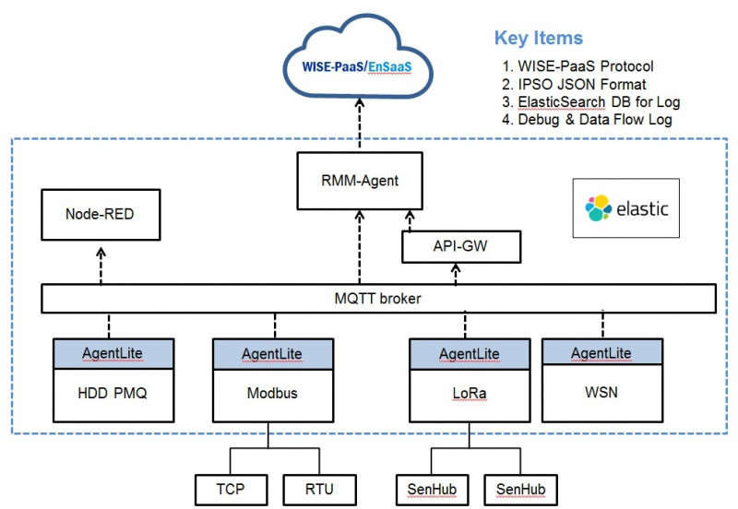
Overview

Slide 8
traces

Slide 9
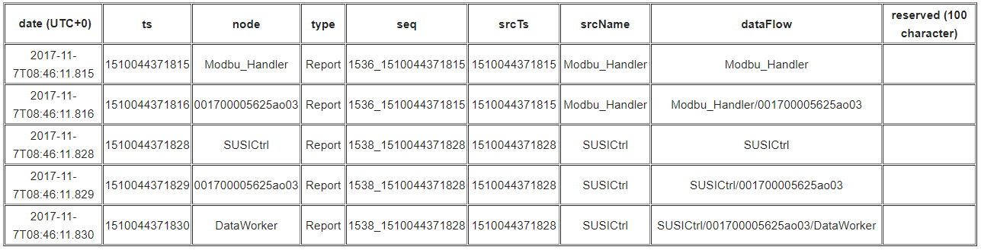
Traces

Slide 10
Analytics

Slide 11
Analytics
Raw Data
Debug
Future Use
Traversals
Potential Break Points
Performances
Latency
Interval

Slide 12
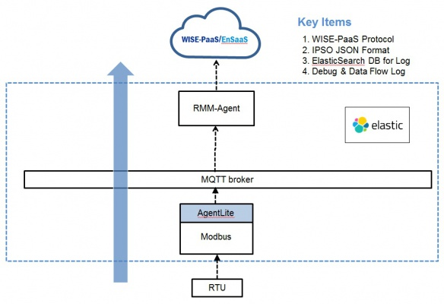
Analytics

Slide 13
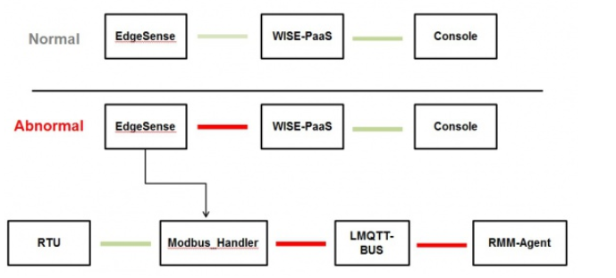
Analytics
Traversals

Slide 14
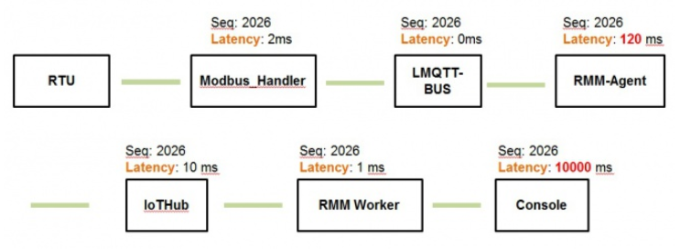
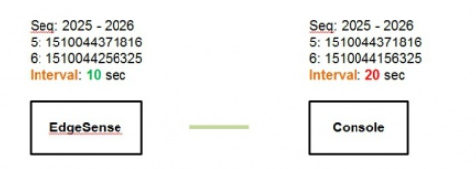
Analytics
Performance - Latency/Interval

Slide 15
demo

Slide 16
