Slide 1

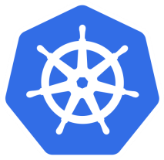
Introduction to Kubernetes (Target version 1.10)
Zach
V 1.10
https://www.iconfinder.com/icons/1149942/cargo_container_delivery_industry_port_ship_shipping_icon

Slide 2
Agenda
Brief in containers.
What is Kubernetes (aka k8s)?
Kubernetes architecture overview.
How to talk to Kubernetes.
Concepts in Kubernetes.
What’s next?

Slide 3
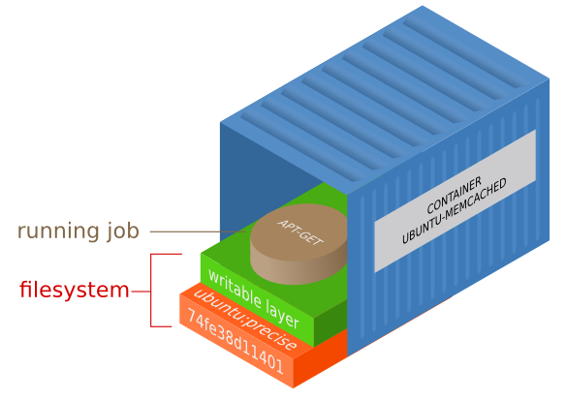
Brief In Containers
https://medium.com/@nagarwal/best-practices-for-working-with-dockerfiles-fb2d22b78186

Slide 4
Runtime Environment - Originally
App
bins/libs
Operating System

Slide 5
Runtime Environment - Originally
App
App
App
bins/libs
bins/libs
bins/libs
Operating System
Operating System

Slide 6
Runtime Environment - Originally
App
App
App
bins/libs
bins/libs
bins/libs
Operating System
Operating System

Slide 7
Runtime Environment - Originally
App
App
App
bins/libs
bins/libs
bins/libs
Operating System
Operating System

Slide 8
Runtime Environment - Virtualization
App
App
bins/libs
bins/libs
Operating System
(Guest)
Operating System
(Guest)
Hypervisor
Operating System
(Host)

Slide 9
Runtime Environment - Containerization
App
App
bins/libs
bins/libs
Container Runtime
(Docker / rkt)
Operating System

Slide 10
Runtime Environment - Containerization
App
App
App
App
bins/libs
bins/libs
bins/libs
bins/libs
Container Runtime
(Docker / rkt)
Operating System

Slide 11
Runtime Environments Comparison
Virtual Machines | Containers
Heavyweight | Lightweight
Limited performance | Native performance
Each VM runs its own OS | All containers share the host OS
Hardware-level virtualization | OS virtualization
Startup time in minutes | Startup time in milliseconds
Allocates required memory | Requires less memory space
Fully isolated, hence more secure | Process-level isolation, possibly less secure

Slide 12
NGINX With Docker
Search container image on Docker Hub (https://hub.docker.com)
Start the container via docker CLI $ docker run --name alex-nginx -p 80:80 -d nginx
Hit it in a browser, or via curl CLI (http://your-ip)
Stop the container via docker CLI $ docker stop alex-nginx
Argument | Description
docker run | Starts a docker container up
--name alex-nginx | Assign a name to the container
-p 80:80 | Publish a container's port(s) to the host
-d | Run container in background
nginx | Image name

Slide 13

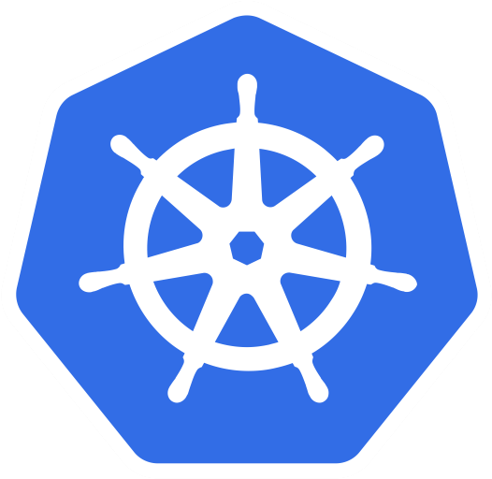
What Is Kubernetes (aka k8s)?
https://technologyadvice.com/blog/information-technology/kubernetes-vs-docker

Slide 14
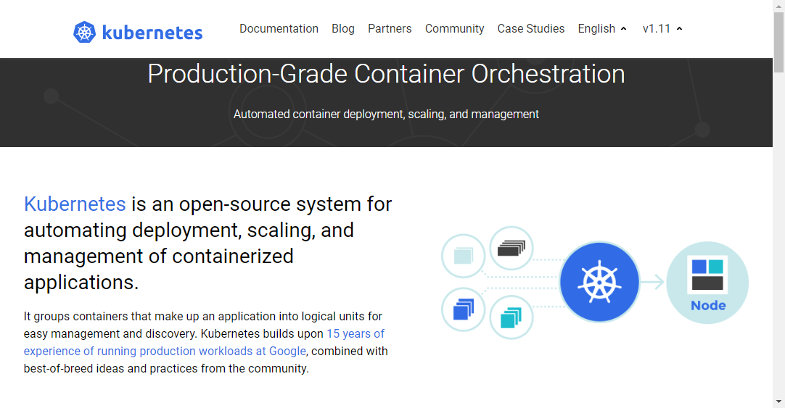
Kubernetes is
Production-Grade container orchestration.
An open-source system for automating deployment, scaling, and management of containerized applications.
https://kubernetes.io

Slide 15
NGINX With Kubernetes
Search container image on Docker Hub (https://hub.docker.com)
Define a pod YAML file
Run it onto Kunerbetes: $ kubectl create -f /path/to/the-file.yaml
Hit it in a browser, or via curl CLI $ curl http://your-ip
Stop it from Kubernetes $ kubectl delete -f /path/to/the-file.yaml
01 02 03 04 05 06 07 08 | apiVersion: v1 kind: Pod metadata: name: nginx spec: containers: - name: alex-nginx image: nginx
Notes:
$ kubectl create -f 02_nginx-with-k8s/pod.yaml
$ kubectl get pods -o wide
$ ssh lab-k[123]
$ curl http://<IP>
<CTRL><D>
$ kubectl delete -f 02_nginx-with-k8s/pod.yaml

Slide 16

Kubernetes Architecture Overview
https://brick.com/original-%E2%80%9Cgreen%E2%80%9D-building-material-brick

Slide 17
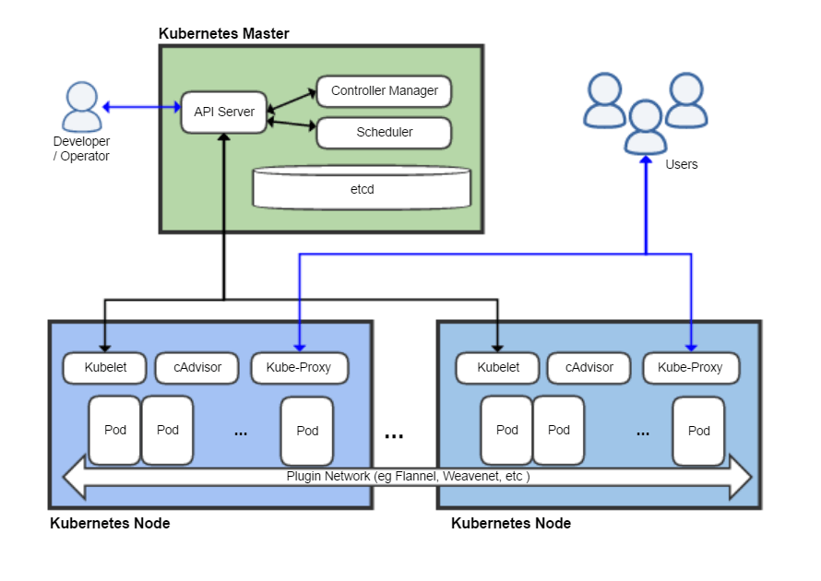
Kubernetes Architecture
https://en.wikipedia.org/wiki/Kubernetes

Slide 18
Kubernetes Architecture
Master (aka control plane)
The main controlling unit of the cluster that manages its workload and directs communication across the system.
Can run both on a single master node or on multiple masters supporting high-availability clusters.
Worker node (aka Minion)
A machine where containers (workloads) are deployed.
Every node in the cluster must run a container runtime such as Docker.

Slide 19
Kubernetes Components - Master
etcd
Consistent and highly-available key value store used as Kubernetes’ backing store for all cluster data.
API server
Component on the master that exposes the Kubernetes API. It is the front-end for the Kubernetes control plane.
Scheduler
Component on the master that watches newly created pods that have no node assigned, and selects a node for them to run on.
Controller manager
Component on the master that runs controllers.

Slide 20
Kubernetes Components - Node
Kubelet
An agent that runs on each node in the cluster. It makes sure that containers are running in a pod.
Kube-proxy
Enables the Kubernetes service abstraction by maintaining network rules on the host and performing connection forwarding.
Container runtime
The software that is responsible for running containers. Kubernetes supports several runtimes: Docker, rkt, runc and any OCI runtime-spec implementation.

Slide 21

How To Talk To Kubernetes?
https://sahabatnesia.com/unsur-unsur-komunikasi/

Slide 22
Kubernetes Command Line Interfaces
minikube
A tool that makes it easy to run Kubernetes locally.
kubeadm
It performs the actions necessary to get a minimum viable cluster up and running. By design, it cares only about bootstrapping, not about provisioning machines.
kops
Helps you create, destroy, upgrade and maintain production-grade, highly available, Kubernetes clusters from the command line.
AWS (Amazon Web Services) is currently officially supported, with GCE in beta support , and VMware vSphere in alpha, and other platforms planned.
kubectl
A command line interface for running commands against Kubernetes clusters.
create, delete, exec, get, logs, replace

Slide 23

Concepts In Kubernetes
https://study.com/academy/course/fundamental-chemistry.html

Slide 24
Kubernetes Concepts
Essential
Pod
Label
Service
ReplicaSet (manipulated by Deployment)
Deployment
Advanced
Pod, more than those
ConfigMap
Secrets
StatefulSet
DaemonSet

Slide 25
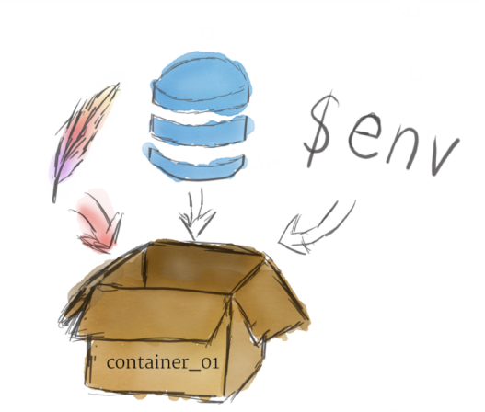
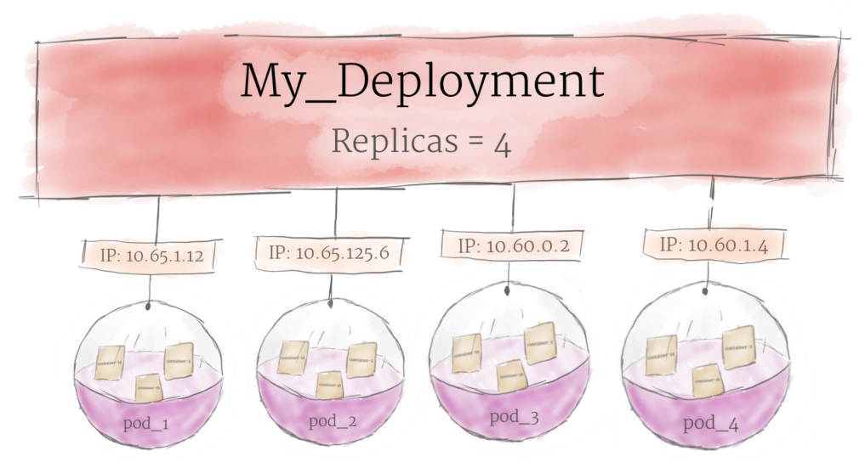
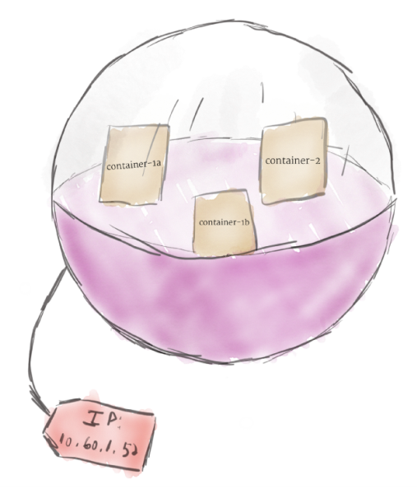
Essential Concepts In Kubernetes
container
Deployment
Pod
https://medium.com/google-cloud/kubernetes-101-pods-nodes-containers-and-clusters-c1509e409e16

Slide 26
Kubernetes Concept - Pod
The smallest and simplest unit in the Kubernetes object model that you create or deploy.
Contains one or more containers, with shared storage/network, and a specification for how to run the containers. In a pre-container world, they would have executed on the same physical or virtual machine.
Every container in a pod shares
Network namespace, including the IP address and network ports. That is, they can communicate with one another using localhost.
Storage volumes. All containers in the Pod can access the shared volumes, allowing those containers to share data.

Slide 27
Pod
01 02 03 04 05 06 07 08 | kind: Pod apiVersion: v1 metadata: name: nginx spec: containers: - name: nginx image: nginx
$ kubectl create -f 03_pod/pod.yaml
$ kubectl get pods -o wide --show-labels
Notes:
$ kubectl create -f 03_pod/pod.yaml
$ kubectl get pods -o wide --show-labels
$ ssh lab-k[123]
$ curl http://<IP>
<CTRL><D>
$ kubectl delete -f 03_pod/pod.yaml
===============================
*** Re-create again to see the allocated IP, it should be different from the last one. This is why we introduce Service next!!!

Slide 28
Kubernetes Concept - Service
An abstraction which defines a logical set of Pods and a policy by which to access them - sometimes called a micro-service.
Is usually determined by a Label Selector.
Support 4 types:
ClusterIP
Exposes the service on a cluster-internal IP. ClusterIP makes the service only reachable from within the cluster. This is the default type.
NodePort
Exposes the service on each node’s IP at a static port (default port range 30000-32767). You’ll be able to contact the service, from outside the cluster, by requesting <NodeIP>:<NodePort>.
LoadBalancer
Exposes the service externally using a cloud provider’s load balancer.
ExternalName (requires kube-dns version 1.7 above)
Maps the service to the contents of the externalName field (e.g. foo.bar.example.com), by returning a CNAME record with its value.

Slide 29
Service, NodePort
01 02 03 04 05 06 07 08 09 10 | kind: Pod apiVersion: v1 metadata: name: nginx labels: app: nginx-server spec: containers: - name: nginx image: ecgwc/http-server
01 02 03 04 05 06 07 08 09 10 11 12 13 | kind: Service apiVersion: v1 metadata: name: web-server spec: type: NodePort selector: app: nginx-server ports: - protocol: TCP port: 80 targetPort: 80 # specific, no random nodePort: 32109
$ kubectl create -f 04_service-nodeport/pod.yaml
$ kubectl create -f 04_service-nodeport/service.yaml
$ kubectl get services -o wide
$ curl http://61.218.118.227:32109
Notes:
$ kubectl create -f 04_service/pod.yaml
$ kubectl create -f 04_service/node-port.yaml
$ kubectl get services -o wide
$ curl http://61.218.118.22[789]:32109
============================
$ kubectl delete -f 04_service/pod.yaml
$ kubectl create -f 04_service/pod.yaml
$ curl http://61.218.118.22[789]:32109
============================
$ kubectl exec nginx -it -- bash # to enter the container
# curl http://web-server
# curl http://web-server:32109
============================
$ kubectl delete -f 04_service/node-port.yaml
$ vi 04_service/node-port.yaml # remove [nodePort]
$ kubectl create -f 04_service/node-port.yaml # to see the random generated port number

Slide 30
Service, ExternalName
01 02 03 04 05 06 07 | kind: Service apiVersion: v1 metadata: name: search spec: type: ExternalName externalName: google.com
$ kubectl create -f 04_service/external-name.yaml
$ kubectl get services -o wide
$ kubectl exec nginx -it -- bash
# ping search
Notes:
$ kubectl create -f 04_service/external-name.yaml
$ kubectl get services -o wide
$ kubectl exec nginx -it -- bash # to enter the container
# ping google.com
# ping search

Slide 31
Kubernetes Concept - Deployment
A deployment provides declarative updates for Pods and ReplicaSets.
Normally used for stateless applications.
Manage updating and scaling with ease.

Slide 32
Depolyment
01 02 03 04 05 06 07 08 09 10 11 12 13 14 15 16 17 18 1920 21 22 23 24 | kind: Deployment apiVersion: apps/v1 metadata: name: nginx-cluster spec: replicas: 5 # how many pods to run selector: matchLabels: app: nginx strategy: type: RollingUpdate rollingUpdate: maxSurge: 3 # default value is 25% maxUnavailable: 1 # default value is 25% template: metadata: labels: app: nginx spec: containers: - name: nginx image: ecgwc/http-server:1.0.0 ports: - containerPort: 80
Notes:
$ kubectl create -f 05_deployment/deployment.yaml
$ kubectl create -f 05_deployment/service.yaml
$ kubectl get pods
=======================
http://61.218.118.227:32109 # F5 to see IP
=======================
$ kubectl delete pod xxxxx # to see k8s create another one automatically
=======================
$ vi 05_deployment/deployment.yaml # change replicas from 5 to 10
$ kubectl replace -f 05_deployment/deployment.yaml
$ vi 05_deployment/deployment.yaml # remove 1.0.0 version
$ kubectl replace -f 05_deployment/deployment.yaml # to see rolling update

Slide 33
Kubernetes Concept - More About Pod
Init containers
Always run to completion.
Each one must complete successfully before the next one is started.
Volume - emptyDir
Created when a Pod is assigned to a node, and exists as long as that Pod is running on that node.
Containers in the Pod can all read and write the same files in the emptyDir volume.
When a Pod is removed from a node for any reason, the data in the emptyDir is deleted forever.
Volume - hostPath
Mounts a file or directory from the host node’s filesystem into the Pod.
Accessing to Docker internals (/var/lib/docker)
Volume – rbd
An rbd volume allows a Rados Block Device volume to be mounted into your Pod. Unlike emptyDir, which is erased when a Pod is removed, the contents of a rbd volume are preserved and the volume is merely unmounted. This means that a RBD volume can be pre-populated with data, and that data can be “handed off” between Pods.

Slide 34
Init Containers
01 02 03 04 05 06 07 08 09 10 11 12 13 14 15 16 17 | kind: Pod apiVersion: v1 metadata: name: myapp-pod labels: app: myapp spec: containers: - name: nginx image: nginx initContainers: - name: init-myservice image: alpine command: ['sh', '-c', 'until nslookup myservice; do echo waiting for myservice; sleep 2; done;'] - name: init-mydb image: alpine command: ['sh', '-c', 'until nslookup mydb; do echo waiting for mydb; sleep 2; done;']
Notes:
$ kubectl create -f 06_init-containers/pods.yaml
$ kubectl get all -o wide
$ kubectl describe -f 06_init-containers/pods.yaml
$ kubectl logs myapp-pod -c init-myservice -f # should be waiting for init
================================
$ kubectl create -f 06_init-containers/service.yaml

Slide 35
Persistent Volumes (PV/PVC)
PersistentVolume (PV)
is a piece of storage in the cluster that has been provisioned by an administrator or dynamically provisioned using Storage Classes.
PersistentVolumeClaim (PVC)
is a request for storage by a user. It is similar to a pod. Pods consume node resources and PVCs consume PV resources.

Slide 36
PVC
01 02 03 04 05 06 07 08 09 10 11 12 13 14 15 16 17 18 19 20 21 | apiVersion: v1 kind: PersistentVolumeClaim metadata: labels: app: minio chart: minio-2.3.8 heritage: Tiller release: es-minio name: es-minio namespace: default spec: accessModes: - ReadWriteOnce resources: requests: storage: 128Gi storageClassName: rbd
Notes:
$ kubectl -f 07_volume/empty-dir.yaml
$ kubectl get pods -o wide
$ kubectl exec -it empty-dir -c nginx -- bash # watch /N1
$ kubectl exec -it empty-dir -c mysql -- bash # watch /N2

Slide 37
emptyDir
01 02 03 04 05 06 07 08 09 10 11 12 13 14 15 16 17 18 19 20 21 22 | kind: Pod apiVersion: v1 metadata: name: empty-dir spec: containers: - name: nginx image: nginx volumeMounts: - mountPath: /N1 name: cache-volume - name: mysql image: mysql volumeMounts: - mountPath: /N2 name: cache-volume env: - name: MYSQL_ROOT_PASSWORD value: root2@sx volumes: - name: cache-volume emptyDir: {}
Notes:
$ kubectl -f 07_volume/empty-dir.yaml
$ kubectl get pods -o wide
$ kubectl exec -it empty-dir -c nginx -- bash # watch /N1
$ kubectl exec -it empty-dir -c mysql -- bash # watch /N2

Slide 38
hostPath
01 02 03 04 05 06 07 08 09 10 11 12 13 14 15 16 | kind: Pod apiVersion: v1 metadata: name: host-path spec: containers: - name: nginx image: nginx volumeMounts: - mountPath: /ZZZ name: test-volume volumes: - name: test-volume hostPath: path: /etc type: Directory
Reference
https://v1-10.docs.kubernetes.io/docs/concepts/storage/volumes/
Notes:
$ kubectl create -f 07_volume/host-path.yaml
$ kubectl get all -o wide
$ kubectl exec -it host-path -- bash # Check /ZZZ dir

Slide 39
Kubernetes Concept - ConfigMap
Decouple configuration artifacts from image content to keep containerized applications portable.
Use cases are
Pod environment variables.
Configuration files used by applications.

Slide 40
ConfigMap (environment variables)
01 02 03 04 05 06 07 | kind: ConfigMap apiVersion: v1 metadata: name: cm-env data: SPECIAL_LEVEL: very SPECIAL_TYPE: charm
01 02 03 04 05 06 07 08 09 10 11 12 13 14 15 16 17 18 19 20 21 22 | kind: Pod apiVersion: v1 metadata: name: cm-pod spec: containers: - name: nginx image: nginx envFrom: - configMapRef: name: cm-env env: - name: ALEX_LEVEL valueFrom: configMapKeyRef: name: cm-env key: SPECIAL_LEVEL - name: ALEX_TYPE valueFrom: configMapKeyRef: name: cm-env key: SPECIAL_TYPE
Notes:
$ kubectl create -f 08_config-map/env.yaml
$ kubectl get all -o wide
$ kubectl exec -it cm-pod -- bash
## check all available environment variables

Slide 41
ConfigMap (configuration file)
01 02 03 04 05 06 07 08 09 10 11 12 13 | kind: ConfigMap apiVersion: v1 metadata: name: server-config data: config: | <?xml version="1.0" encoding="UTF-8"?> <Configuration> <WebServer> <IP>127.0.0.1</IP> <HTTPPort>8080</HTTPPort> </WebServer> </Configuration>
01 02 03 04 05 06 07 08 09 10 11 12 13 14 15 16 17 18 | kind: Pod apiVersion: v1 metadata: name: cm-pod spec: containers: - name: nginx image: nginx volumeMounts: - name: config mountPath: /etc/rmm volumes: - name: config configMap: name: server-config items: - key: config path: Server_Config.xml
Configuration can be dynamically changed by such means.
Notes:
$ kubectl create -f 08_config-map/configuration.yaml
$ kubectl exec -it cm-pod -- bash
# cd /etc/rmm
# cat Server_Config.xml
==================
$ kubectl replace -f 08_config-map/new-configuration.yaml
$ kubectl exec -it cm-pod -- bash
# while true; do cat /etc/rmm/Server_Config.xml; sleep 2; done

Slide 42
Kubernetes Concept - Secret
A Secret is an object that contains a small amount of sensitive data such as a password, a token, or a key.
Can be used
As files from a Pod.
From environment variables.

Slide 43
Secret
01 02 03 04 05 06 07 08 09 10 | kind: Secret apiVersion: v1 type: Opaque metadata: name: mysecret data: # echo -n 'admin' | base64 username: YWRtaW4= # echo -n ‘P@ssw0rd' | base64 password: UEBzc3cwcmQ=
01 02 03 04 05 06 07 08 09 10 11 12 13 14 15 16 17 18 19 20 21 22 23 24 25 | kind: Pod apiVersion: v1 metadata: name: secret-pod spec: containers: - name: nginx image: nginx env: - name: LOGIN_PASSWD valueFrom: secretKeyRef: name: credential key: password volumeMounts: - name: secret-volume mountPath: /etc/secret readOnly: true volumes: - name: secret-volume secret: secretName: credential items: - key: username path: login/username
Notes:
$ kubectl create -f 09_secret/partial.yaml
$ kubectl exec -it secret-pod -- bash
# echo $LOGIN_PASSWD
# cd /etc/secret
# ls
# more login/username
# kubectl delete -f 09_secret/partial.yaml
==============================
$ kubectl create -f 09_secret/all.yaml
$ kubectl exec -it secret-pod -- bash
# echo $LOGIN_PASSWD
# cd /etc/secret
# ls
# more username
# more password

Slide 44
Kubernetes Concept - StatefulSet
Used for applications that require
Persistence unique network identifiers across Pod (re)scheduling.
Persistence storage across Pod (re)scheduling.
Ordered deployment and scaling, deletion and termination, automated rolling updates.
Limitations
The storage for a given Pod must either be provisioned by a PersistentVolume Provisioner based on the requested storage class, or pre-provisioned by an admin.
Require a Headless Service to be responsible for the network identity of the Pods.
Examples
MongoDB https://wiki.shileizcc.com/confluence/pages/viewpage.action?pageId=27000909
Cassandra https://v1-10.docs.kubernetes.io/docs/tutorials/stateful-application/cassandra/
ZooKeeper https://v1-10.docs.kubernetes.io/docs/tutorials/stateful-application/zookeeper/

Slide 45
Live Demo - Headless Service
01 02 03 04 05 06 07 08 09 10 11 12 13 14 15 16 17 | kind: Deployment apiVersion: apps/v1 metadata: name: nginx-cluster spec: replicas: 3 selector: matchLabels: app: nginx template: metadata: labels: app: nginx spec: containers: - name: nginx image: nginx
01 02 03 04 05 06 07 08 09 10 11 12 | kind: Service apiVersion: v1 metadata: name: web-server spec: selector: app: nginx-server ports: - protocol: TCP port: 80 targetPort: 80 clusterIP: None
If you don’t need or want load-balancing and a single service IP.
Can be created by specifying “None” for the cluster IP (.spec.clusterIP)
Notes:
$ kubectl create -f 10_service/headless.yaml
$ kubectl get all -o wide
$ kubectl exec -it nginx-cluster-xxx -- bash
$ nslookup web-server

Slide 46
Kubernetes Concept - DaemonSet
A DaemonSet ensures that all nodes run a copy of a Pod. As nodes are added to the cluster, Pods are added to them. As nodes are removed from the cluster, those Pods are garbage collected. Deleting a DaemonSet will clean up the Pods it created.
Typical use cases are
Running a cluster storage daemon, such as glusterd, ceph, on each node.
Running a logs collection daemon on every node, such as fluentd or logstash.
Running a node monitoring daemon on every node, such as Prometheus Node Exporter, collectd, Datadog agent, New Relic agent, or Ganglia gmond.
Examples
Fluentd https://v1-10.docs.kubernetes.io/docs/concepts/workloads/controllers/daemonset/#writing-a-daemonset-spec

Slide 47

What’s Next?
https://www.ecampusnews.com/2018/03/23/whats-next-higher-ed/

Slide 48
Nice To Have Relevant Skills
Dockerfile
Provide the instructions to build container image automatically.
Ingress
Manages external access to the services in a cluster, typically HTTP.
Helm
A package manager for Kubernetes, analogous to Yum or Apt.
Role-Based Access Control (RBAC)
A method of regulating access to computer or network resources based on the roles of individual users within an enterprise.
Repositories

Slide 49

https://steemit.com/life/@liger12/thanks-on-100-post-thanksnotes

