Slide 1
Others
Zach Chih, RD, Embedded-IoT
May 14, 2019

Slide 2
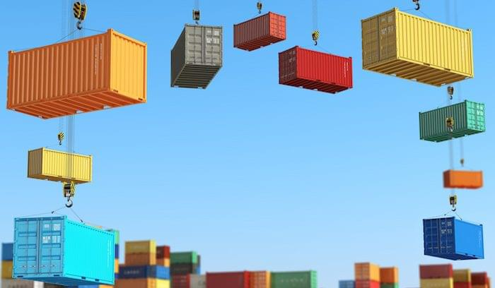
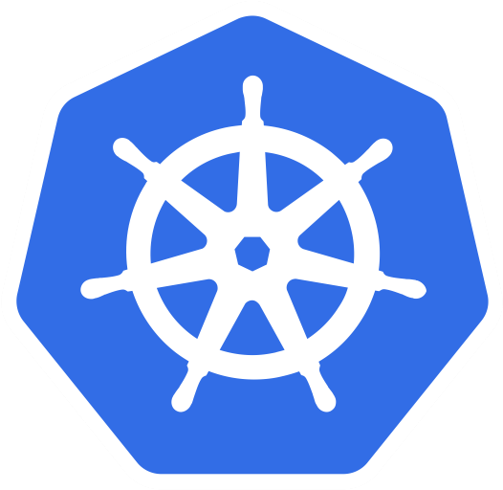
How to install your apps onto Data Service Server
https://technologyadvice.com/blog/information-technology/kubernetes-vs-docker

Slide 3
Preparing Images
Creating your first Dockerfile, image and container
https://www.freecodecamp.org/news/a-beginners-guide-to-docker-how-to-create-your-first-docker-application-cc03de9b639f/
https://www.youtube.com/watch?v=YFl2mCHdv24
https://www.youtube.com/watch?v=hnxI-K10auY

Slide 4
Preparing Helm Charts
How To Create Your First Helm Chart
https://docs.bitnami.com/kubernetes/how-to/create-your-first-helm-chart/

Slide 5
References
What is a Container?
https://www.docker.com/resources/what-container
What is Kubernetes?
https://kubernetes.io/
https://kubernetes.io/docs/concepts/overview/what-is-kubernetes/
Helm
https://github.com/helm/helm
https://helm.sh/docs/using_helm/#installing-helm
Helm Charts
https://helm.sh/docs/developing_charts/#charts
Docker for beginer
https://docker-curriculum.com/
DockerFile
https://docker-curriculum.com/#dockerfile
https://kapeli.com/cheat_sheets/Dockerfile.docset/Contents/Resources/Documents/index
Docker Hub: Search for container application
https://hub.docker.com/
Kubeapps
https://hub.kubeapps.com/

Slide 6
Go Together,
We Go Far and Grow Big

