Slide 1
Data Service Server
From 1 to 1+
Zach Chih, Advantech

Slide 2

Outline
1 Node
1+ Nodes
1 to 1+
Delivery
Consulting/Support (WISE-Point)
Tasks

Slide 3
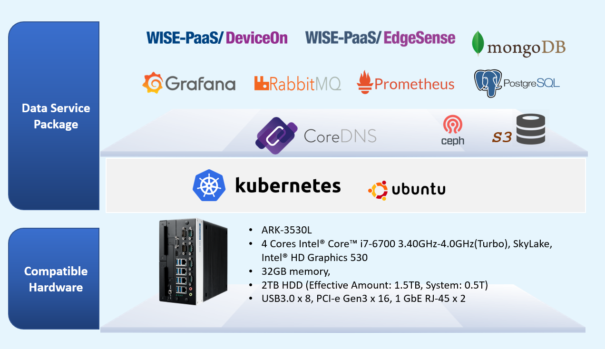
1 Node
Packages
  EdgeSense
  RabbitMQ/Postgres/Mongo/Prometheus
  Monitoring
Memory
  ~23MB
Disk
  ~1.4T to 2T
Resource Exhausted

Slide 4
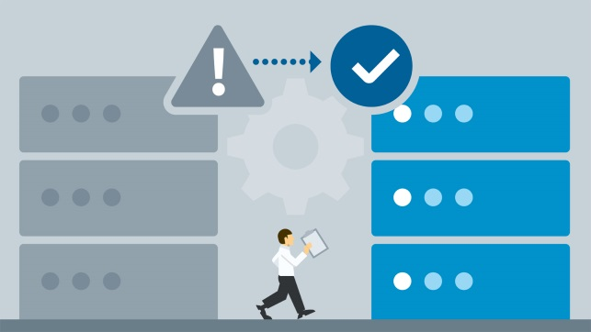
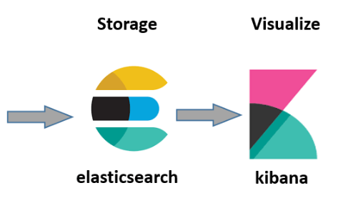

1+ Node
Packages
  EdgeSense
  RabbitMQ/Postgres/Mongo/Prometheus
  Monitoring
  Add-ons
    AI
    Logging – EFK (fluentd/fluent-bit)
    InfluxDB
Memory
  TBD
Disk
  TBD
Four Directions
  Pure Memory/CPU/PV Usage
  HA (Replicas)
  Add-ons (AI/Logging/InfluxDB)
  Deploy what you want

Slide 5

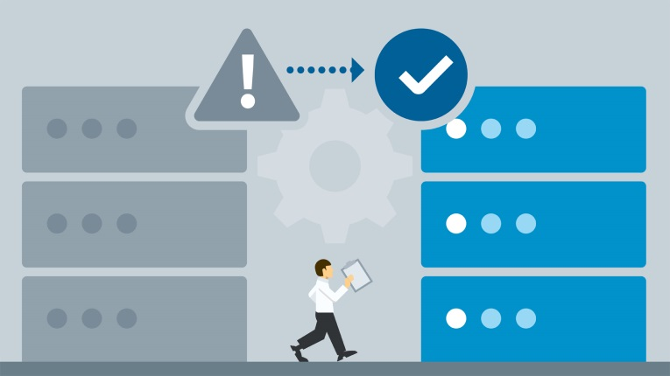
1 to 1+ Node
Four Directions
  Pure Memory/CPU/PV Scaling
  HA (Replicas)
  Add-ons (AI/Logging/InfluxDB)
  Deploy what you want

Slide 6
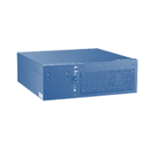
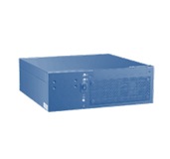
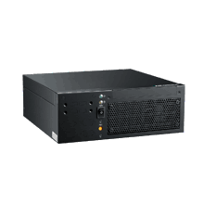
Product SKU Offering
SKU/Config. | Server Quantity | Compute (vCPU) | Memory (GB) | Physical Storage (TB)
Entry | *Master/Node x1 | 8 | 32 | 2
Medium | *Master/Node x3 (w/ HA) | 24 | 96 | 6
Expand | Node x1 | 8 | 32 | 2
Master
Master
Master
Master
Node
*Converged (Master) node running Kubernetes master and worker node on the same machine.

Slide 7


方案服務取得和訂購
200 Points / master node
* 1 Point = 10 USD
Data Server Package
買斷式授權
Included 10 EdgeSense/DeviceOn license and 3 months S/W service fee
*SW service included SW consulting and package upgrade

Slide 8
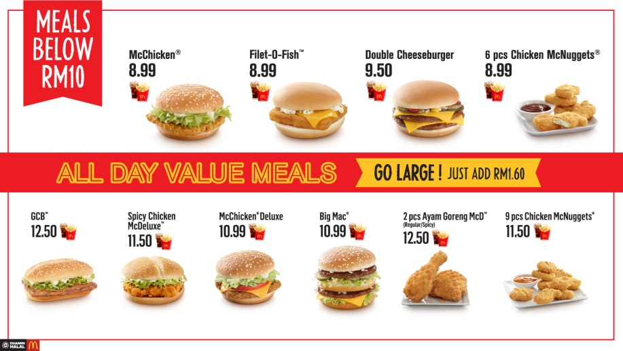
Delivery
1 to 1+ AND 1+
  Sets
    Pure Memory/CPU/PV Scaling
      Set 1 (Mongo RAM10GB PV2TB, RabbitMQ RAM10GB PV1TB..)
      Set 2 (Mongo RAM12GB PV3TB, RabbitMQ RAM12GB PV2TB..)
    HA (Replicas)
      Set 1 (Two Replicas) – 1M/2N
      Set 2 (Three Replicas) – 1M/3N

Slide 9
Delivery
1 to 1+ AND 1+
  Sets
    Add-ons
      Set 1 (AI/Logging/InfluxDB…..)
      Set 2 (AI/Logging/ElasticSearch….)
    Combination
      A little Scaling with Add-ons
    Deploy what you want
      Free Resource

Slide 10

Consulting/Support (WISE-Point)
Management
  Change IP
1
  Resource Update
  Troubleshooting
1+
  Resource Update
  Troubleshooting
  Play on your own (free Resource)

Slide 11
Consulting/Support (WISE-Point)
1 to 1+
  Resource Update
  Troubleshooting
  Pure Memory/CPU/PV Scaling
  HA (Replicas)
  Add-ons (AI/Logging/InfluxDB)
  Play on your own (free resource)

Slide 12
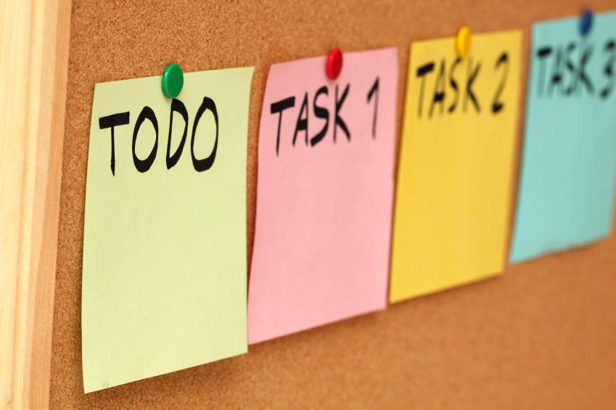
Tasks
Let’s see.

Slide 13
Go Together,
We Go Far and Grow Big

