Slide 1
Nginx-Ingress
Zach Chih
WISE-Cloud
Oct 19, 2018

Slide 2

nginX

Slide 3

Nginx
A free, open-source, high-performance HTTP server, reverse proxy and load balancer.

Slide 4
nginX-Ingress-Controller

Slide 5
Nginx-Ingress-Controller
The daemon monitors Ingress resources (requests for external connectivity) for services deployed in Kubernetes.
It then automatically configures NGINX to route and load balance traffic to these services.

Slide 6
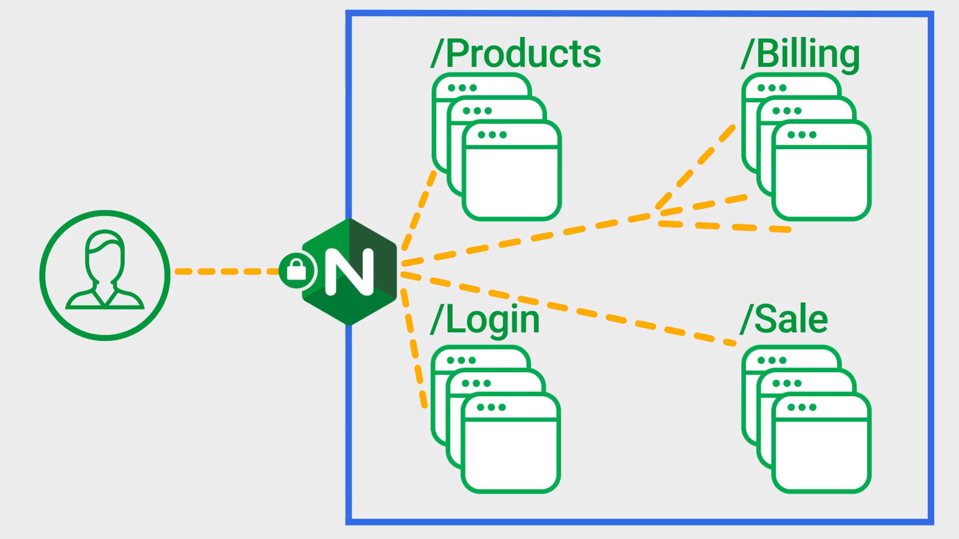
Nginx-Ingress-Controller

Slide 7
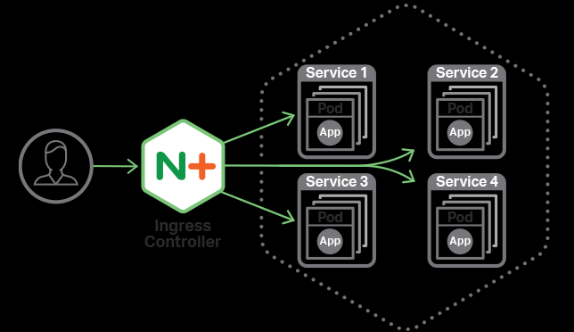

Nginx-Ingress-Controller

Slide 8
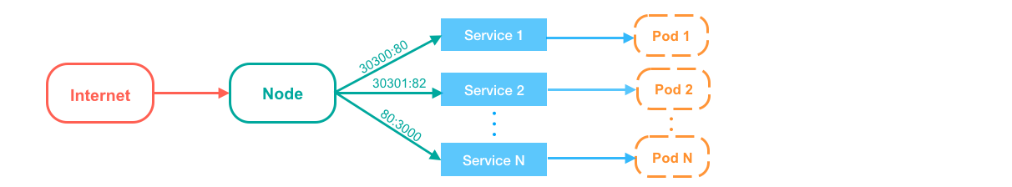
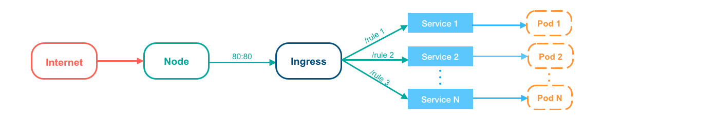
Overview

Slide 9
GOROUTER VS. NGINX-INGRESS

Slide 10
GoRouter vs. Nginx-Ingress
GoRouter
Cloud Foundry L7 HTTP router and reverse proxy
Health Check
Load balancing
TLS/SSL
Nginx - Ingress
L7 HTTP and reverse proxy server
L4 TCP/UDP proxy server
Health Check
Load balancing
TLS/SSL

Slide 11


