Slide 1
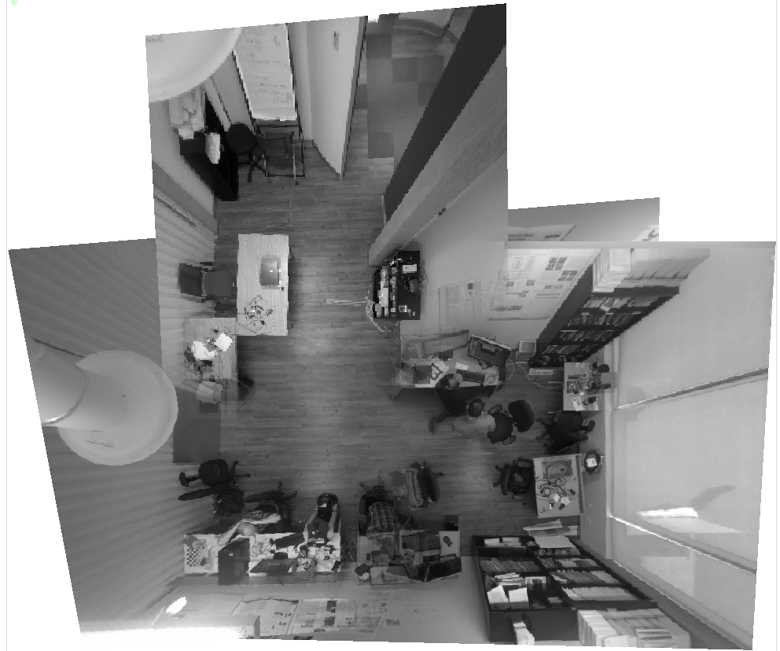

Remote pozyx
x6115
3V
1V
2V
x6121
1H
2H
x6109
x6157

Slide 2
Remote pozyx
x6115
L= 1 m
x6121
H= 1 m
x6109
x6157

Slide 3
Remote pozyx
x6115
x6121
x6109
x6157

Slide 4
x6115
x6157
Remote pozyx
4V
3V
2V
1V
x6109
2H
1H
x6121

Slide 5
x6157
Remote pozyx
x6115
x6109
x6121

Slide 6
