Slide 1
A cross-like hierarchical porous lithium-rich layered oxide with (110)-oriented crystal planes as a high energy density cathode for lithium ion batteries
IF 9.2

Slide 2
簡介

Slide 3
LLO intro
Advantage
Large specific capacity (<250mAh/g)
High discharge voltage
Disadvantage
Low rate capability
Poor cycling
Rapid voltage decay

Slide 4
strategies
strategies
Surface coating
element doping
nano crystallization
morphology control
short ion transport paths
efficient active mass–electrolyte contact
releases the strain during charge/discharge processes.
reduces agglomeration upon cycling
decreases interfacial contact resistance

Slide 5
To improve material
Preferential oriented crystal planes
(110) planes provide a channal for ion transfer
Beneficial morphyology

Slide 6

Preparation of CHP-LMNO
5 mL 0.15 M MnCl_{2.}4H₂O
+0.05 M Ni(NO₃)_{2.}6H₂O
Added
dropwise
30 min
1 hr
became
16 hr
5 g CTAB
150 mL cyclo- hexane
+ 5 mL of n-pentanol
5 mL of a 0.8 M
H₂C₂O₄.2H₂O_{(aq)}
dissolved
Stirring
Stirring
transparent
Stirring
Fltering
MC₂O_{4.}H₂O
vacuum
calcine
Manganese-Nickel
oxide
CHP-LNMO
800 C for 12 h
Washing
120 C for 10 h
450 C for 5 h
5wt% excess CH₃COOLi.H₂O

Slide 7
物性分析

Slide 8
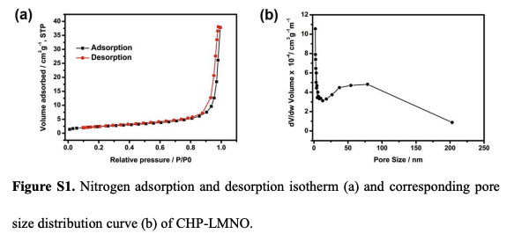
BET
The pore sizes are distributed from 2 nm to 200 nm

Slide 9
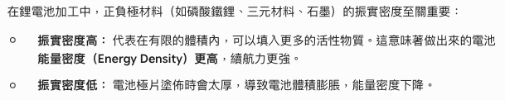
Tap density
The tap density of the as-prepared cross-like hierarchical porous LLO is ~2.0 g cm⁻³, higher than that of the conventional counterpart sample of ~1.8 g cm⁻³ described in the following Experimental section.

Slide 10
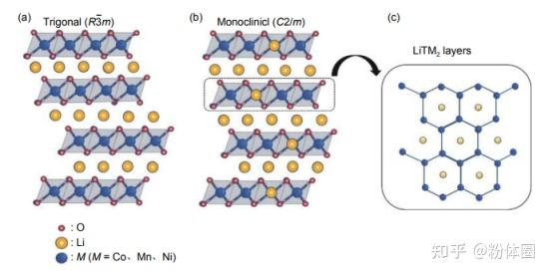
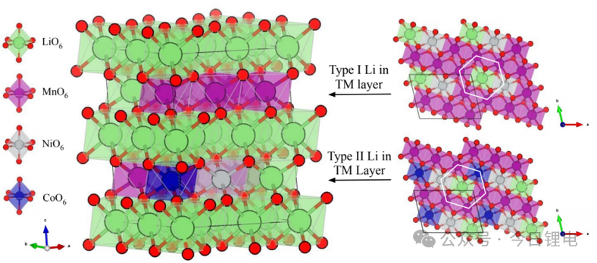
結構示意圖

Slide 11
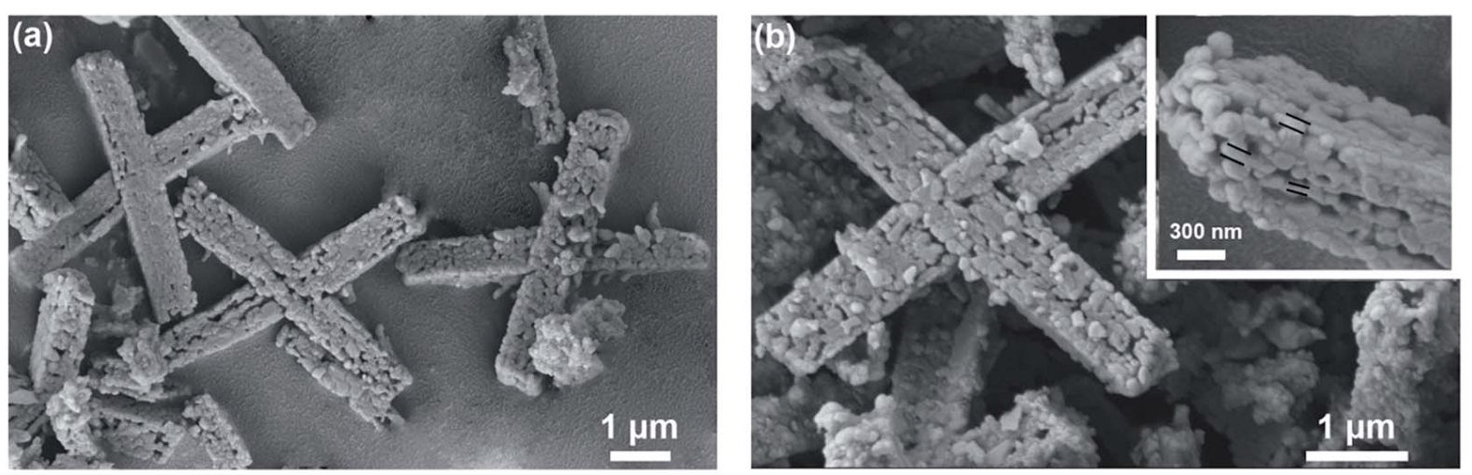
SEM
(a and b) SEM images of CHP-LMNO
Normally LLM exhibits spherical-like and rod-like morphologies.
Study exhibits a unique cross-like hierarchical porous architecture.
Cross-like LLOs with an average length of about 5 micro m and width of roughly 800 nm, consisting of numerous subunit nanoparticles of approximately 100 nm.

Slide 12
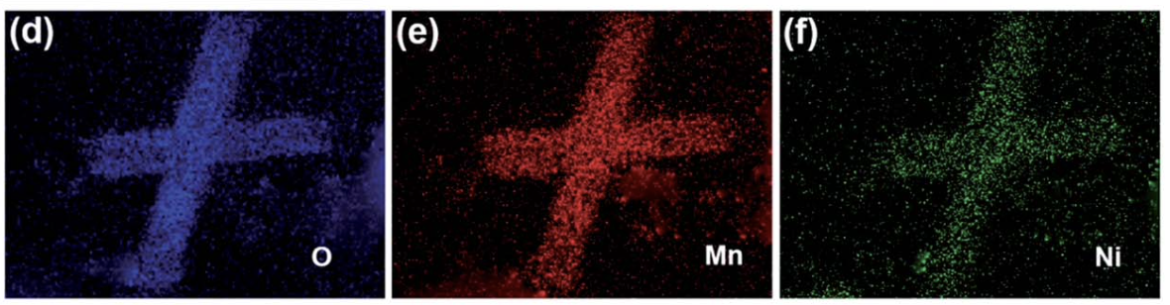
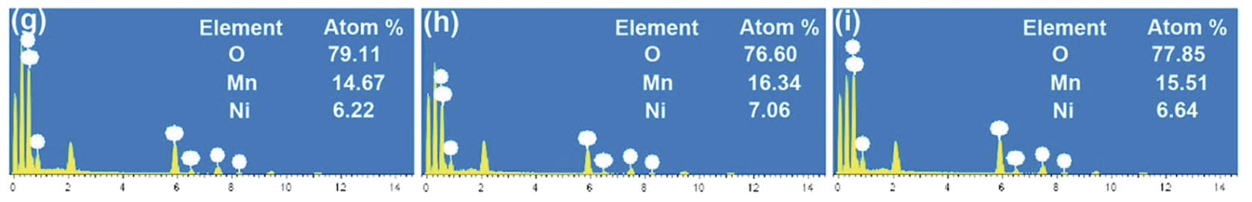
EDS
(d–f) element maps,
(g–i) EDS results of CHP-LMNO in three selected areas of 1, 2 and 3
Uniform distribution of Mn, Ni, and O elements.
Agree with the results from ICP- AES (The atomic ratios Mn : Ni =2.3 : 1 )

Slide 13
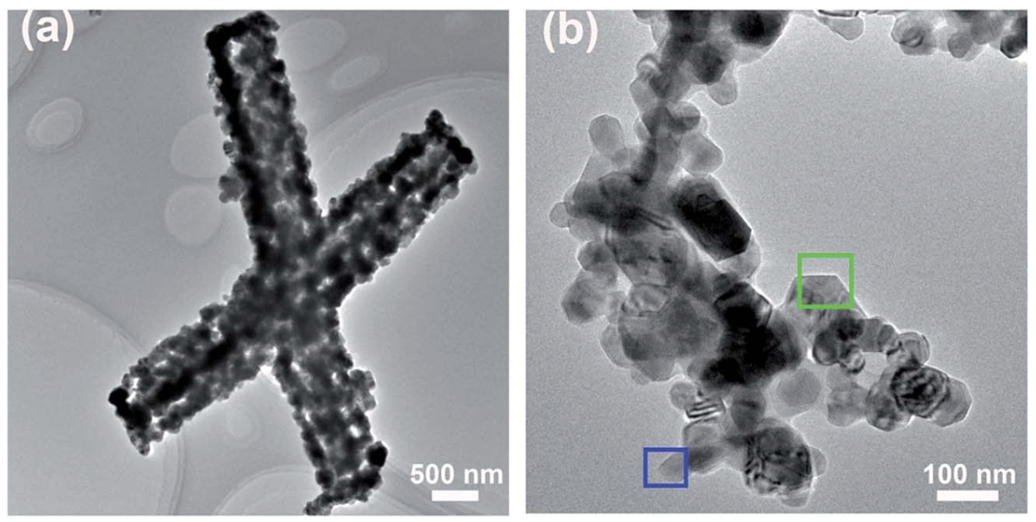
TEM
(a and b) TEM images of CHP-LMNO; the green and blue rectangular areas in (b) show the frontal and lateral planes of a single nano- particle,
Shows the resulting LLOs with a hierarchical porous cross-like structure.
The primary nano- particles in the magniged TEM image (Fig. 2b) have a hexagonal shape with a particle size of 100 nm and the edge of each particle is clear.
Notes:
Microstructure investigate

Slide 14
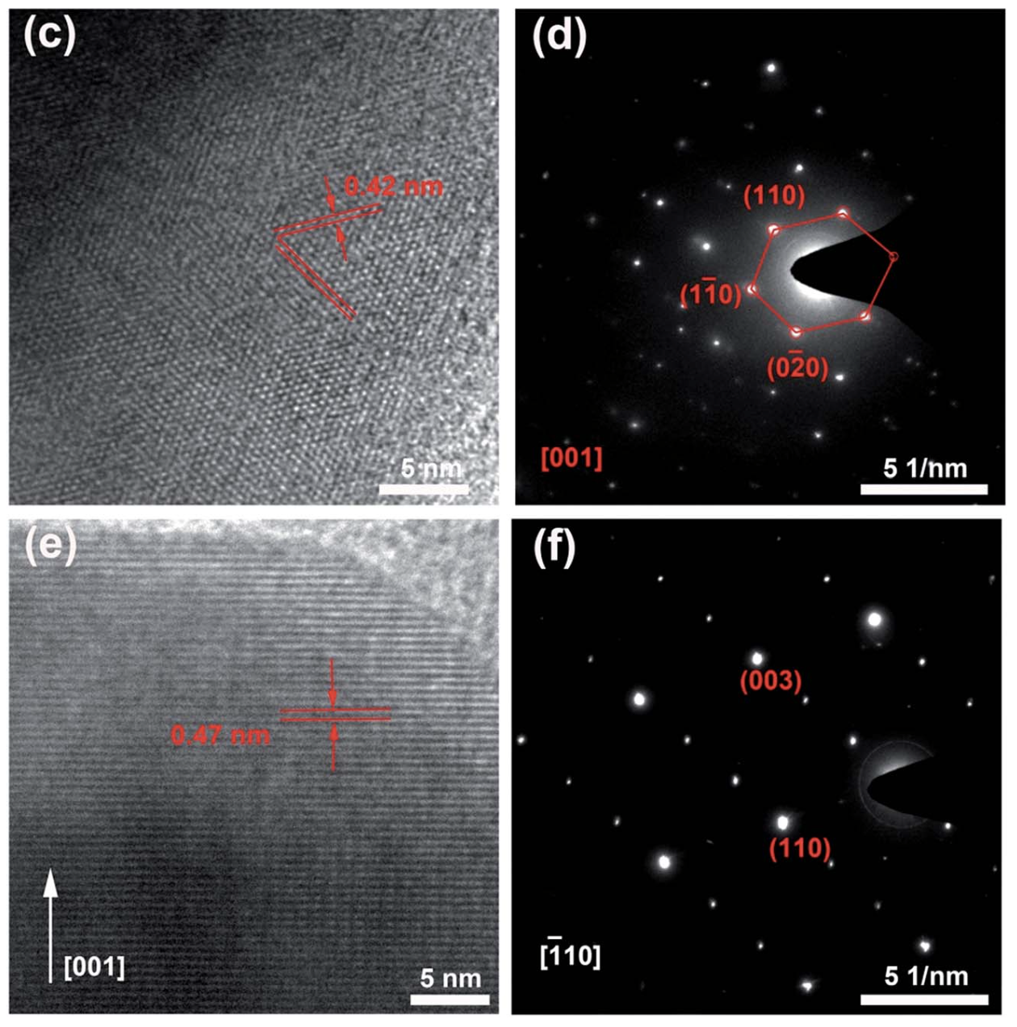
HRTEM
1. 證明材料正面為傳統的雙相共存結構
透過觀察顆粒「正面」的 HRTEM 影像（圖 2c），量測到 0.42nm的晶格條紋，這對應了單相c的 (020) 晶面。
對應的正面 SAED 繞射圖（圖 2d）呈現了六方晶系 R3m 相與單斜晶系 C2/m 相圖譜的疊加，反映了鋰離子與過渡金屬陽離子的交替有序排列。這證明了顆粒的正面為傳統的 (003) 與 (001) 晶面。
2. 核心賣點：證明側面高度暴露了 (110) 晶面
為了證明結構設計的優勢，作者分析了顆粒的「側面」（圖 2e），HRTEM 顯示出 0.47nm 的晶格間距，這歸因於沿 [001] 方向的過渡金屬層間距。
配合側面的 SAED 繞射圖（圖 2f）進一步判定，強烈證明了這些奈米顆粒的側面屬於 {010} 晶面族，且明確就是 (110) 晶面。
(c) the HRTEM image and (d) SAED pattern of the frontal plane shown in the green rectangular area, and (e) the HRTEM image and (f) SAED pattern of the lateral plane shown in the blue rectangular area.
Notes:
Microstructure investigate

Slide 15
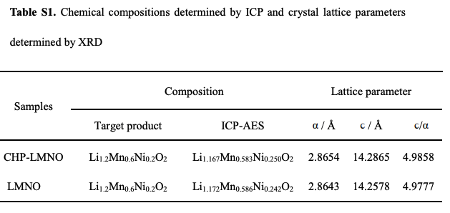
AES-ICP
Notes:
71;21;8

Slide 16
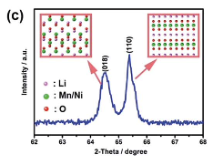
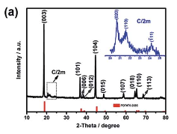
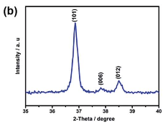
XRD
XRD patterns of CHP-LMNO and
local magnification (b and c and inset in a)
(a).
Pattern of two structure can be observed, reflecting the ordering of lithium ions in the TM layer.
(C).
The (110) plane has an open layered interspace for Li+ ions to intercalate into the bulk of LLOs, but there is no straight tunnel for the (018) plane due to the dense stacking of atoms in this plane
Notes:
The hierarchical porous CHP- LMNO with active planes will provide a more unhindered pathway for Li+ transport, thus enhancing the reactive kinetics and the porous structure accommodates enough space to buffer volume changes during repeated cycling.

Slide 17
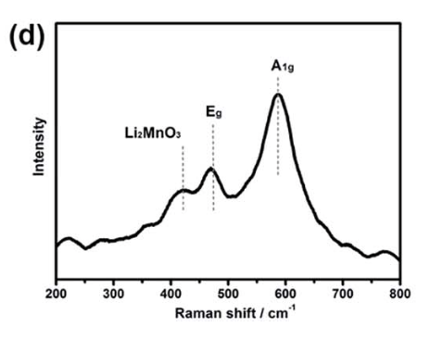
Raman
Three peaks near 600, 484 and 432 cm⁻¹, which correspond to two Raman active vibrations of A1g and Eg in LLOs with R-3m symmetry and a fingerprint vibration of the superlattice, respectively.
In general, A1g represents the symmetrical stretching of M–O and Eg represents symmetrical deformation.
Originating from Mn-rich region in the Li2MnO3-like C2/m structure, the strongest peak near 605 cm⁻¹ corresponds to A1g without any splitting indicating a uniform layered structure in CHP-LMNO.
Notes:
Layer structure investigate
在結晶學中，如果材料內部混雜了不同的相、或者金屬離子排列極度混亂導致周圍化學環境差異過大，該振動頻率就會產生分歧，導致原本的一個峰裂變成兩個以上的重疊峰。

Slide 18
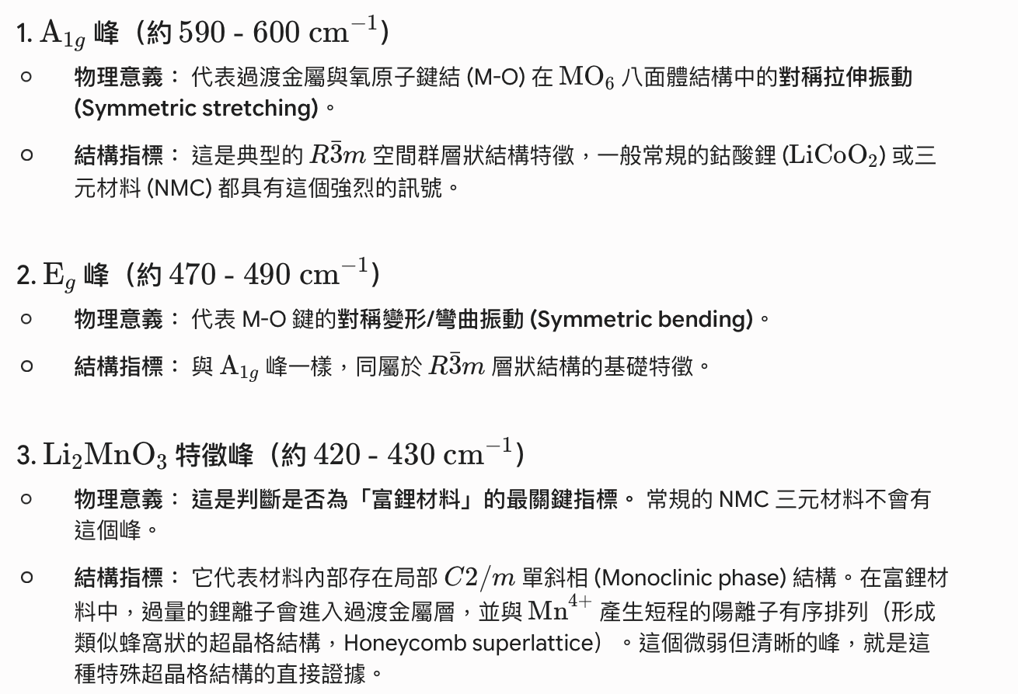
Raman
Notes:
Layer structure investigate

Slide 19
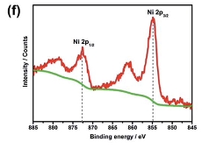
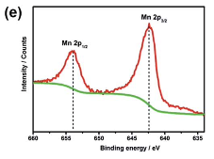
XPS
The observed peak bonding energies of Ni 2p and Mn 2p are 854.9 eV and 642.3 eV, respectively, which are in good agree- ment with Ni2+ and Mn4+ reported in the LLOs
Notes:
Chemical states of the resulting composition

Slide 20
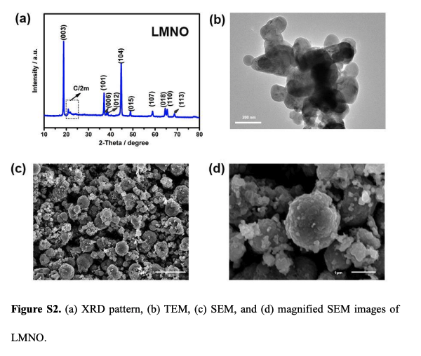
Normal LLO
It can be found that there are no obviously oriented crystal planes in the LMNO sample.
As seen in ICP , there is no significant difference in chemical composition between LMNO and CHP-LMNO.
Therefore, any differences in electrochemical performance between the two samples should be attributed to their different structure.

Slide 21
十字型之合成

Slide 22
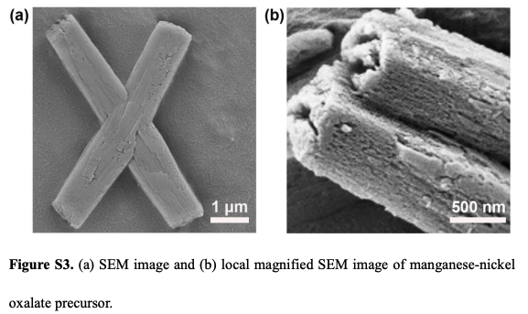
Formation of structure

Slide 23
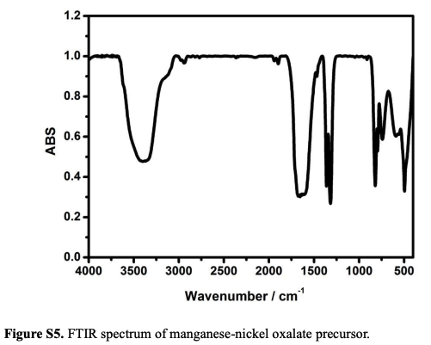
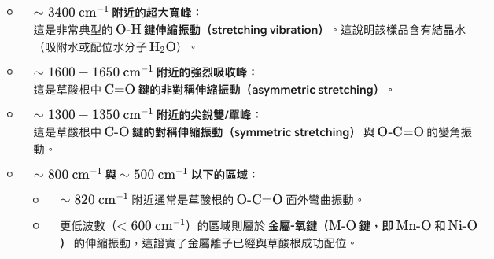
Formation of structure

Slide 24
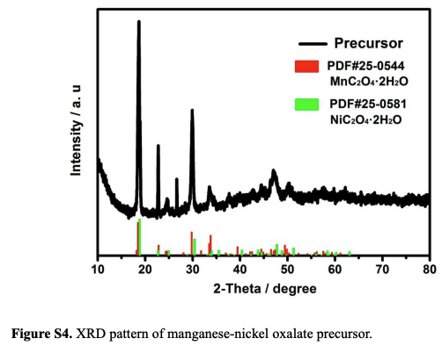
Formation of structure

Slide 25
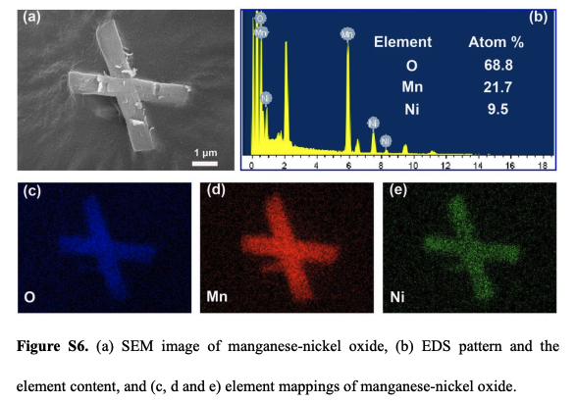
Formation of structure
uniformly distributed.
The Mn : Ni ratio in the oxides from EDS is about 2.3 : 1, which is well in agreement with the results of ICP and final product but lower than the mole ratio of MnCl2 (0.15 M) : Ni(NO3)2 (0.05 M) for the preparation of oxalates. =>（由於草酸錳和鎳溶解度差異造成錳流失）

Slide 26
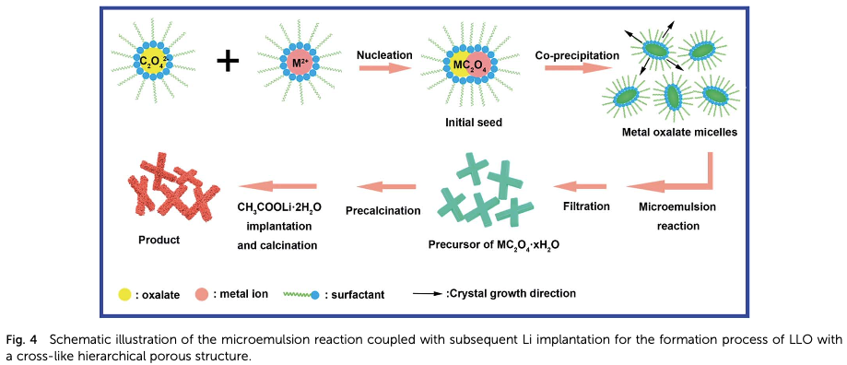
mechanism

Slide 27
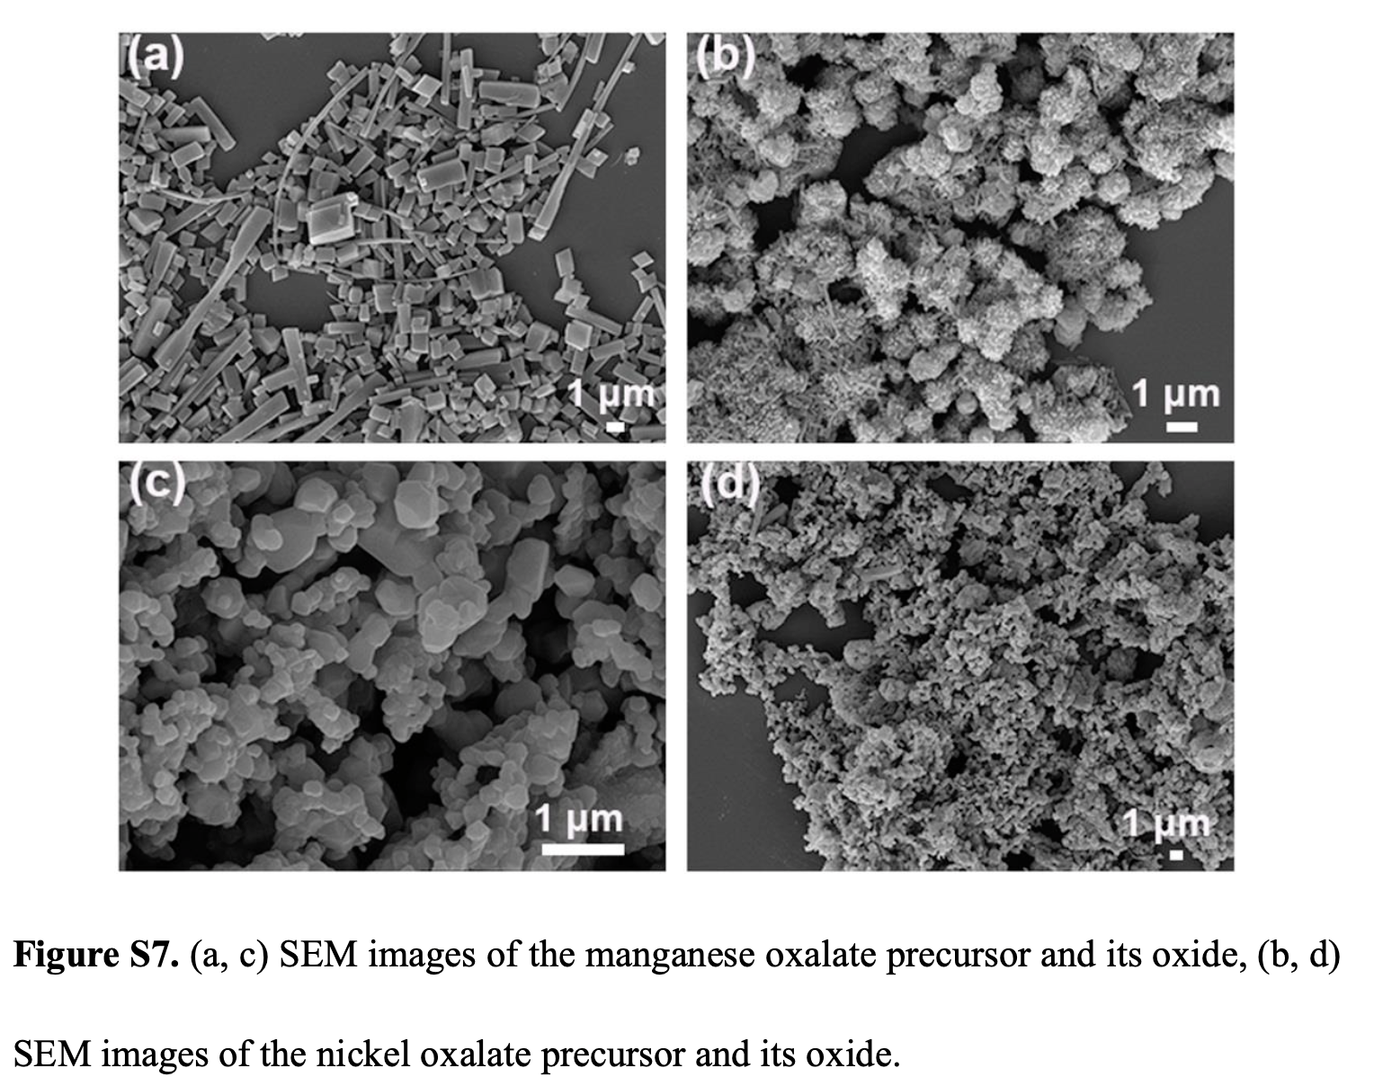
mechanism
兩者的共同存在對於形成十字交叉狀形態是不可或缺的。在生長方向上可能存在不同的吸引交互作用，且金屬草酸鹽直接的非等向性（各向異性）生長動力學，促進了在微乳液反應/合成過程中十字交叉形狀的形成。
特定的晶面定向可歸因於界面活性劑十六烷基三甲基溴化銨 (CTAB)，其親水基團吸附在某些結晶面上，進而改變了表面能。
由於金屬草酸鹽奈米結構的定向生長動力學，加上 CTAB 的表面鈍化作用，本研究中的十字交叉結構被認為是這兩者協同作用的結果。

Slide 28
電性分析

Slide 29
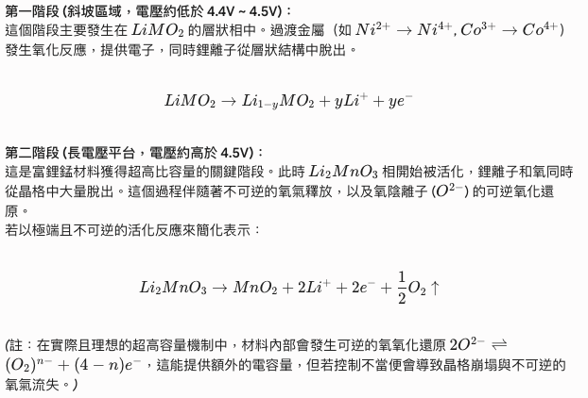
富鋰錳電池反應

Slide 30
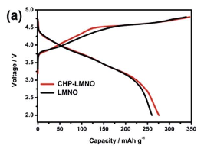
Charge discharge plot
276 mAhg⁻¹ at 0.1C (where 1C= 250 mAg⁻¹)
a slope region below 4.5 V, assigned to Li⁺ extraction from the LiMO₂ phase accompanied by the oxidation of Ni^{2+/}Ni^{3+/}Ni⁴⁺
a long plateau region around 4.5 V, corresponding to the activation of Li2MnO3 accompanied by the irreversible loss of oxygen.

Slide 31
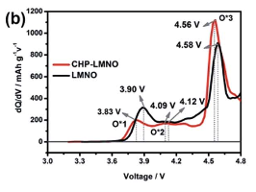
differential charge curves
the first oxidation peak at around 3.83 V is ascribed to the oxidation process of Ni2⁺ to Ni3⁺
the following peak at around 4.09 V is assigned to the oxidation of Ni3⁺ to Ni4⁺
the third sharp oxidation peak at 4.56 V is normally associated with irreversible oxidation and decomposition of the electrolyte.
However, all oxidation peaks of LMNO shift slightly towards high voltage, which indicates that LMNO suffers a more serious polarization compared with the CHP-LMNO.

Slide 32
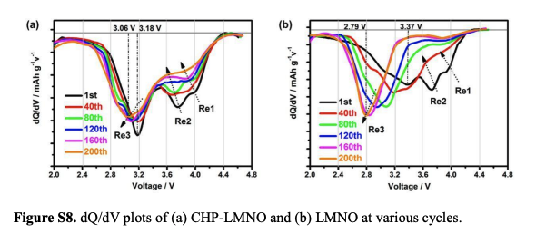
differential charge curves
The first reduction peak (Re1) around 4.5 V involves the reduction of O_{n} (n < 2)
the second reduction peak (Re2) around 3.5 V is related to the reduction of Ni4+/Ni2+, corresponding to Li occupation in octahedral sites
the third reduction peak (Re3) less than 3.5 V can be explained by the reduction of Mn4+/Mn3+. The Re3 peaks in LMNO obviously shift to low voltage, which is also attributed to more serious structural transformation from layers to spinel. (MnO₂)

Slide 33
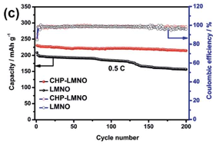
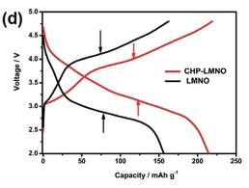
0.5C for 200 cycles
The CHP-LMNO sample can deliver a discharge capacity of 231 mAhg⁻¹ and maintain a capacity retention of 94% after 200 cycles
In the charge/discharge curve profiles of the 200th cycle (Fig. 5d), the gap between the charge and discharge plateau in CHP-LMNO is obviously smaller than that in LMNO.
The much smaller gap of CHP- LMNO implies lower polarization and minor structural transformation, indicating that the material can achieve better electrochemical performance.

Slide 34
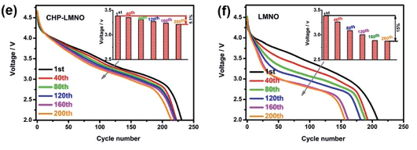
0.5C for 200 cycles
The specific discharge curves and voltage decay are clearly exhibited in Fig. 5e and f. The sample of CHP-LMNO shows a much slower voltage decay percentage of 5.1% compared with the 15% of LMNO from the initial to terminal cycle.

Slide 35
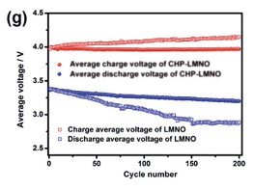
0.5C for 200 cycles
Fig. 5g, the average charge voltage of LMNO is higher than that of CHP-LMNO and gradually increases with cycling, while its average discharge voltage is lower than that of CHP-LMNO and decays seriously, indicating the lower polarization and the better structural stability of CHP- LMNO.

Slide 36
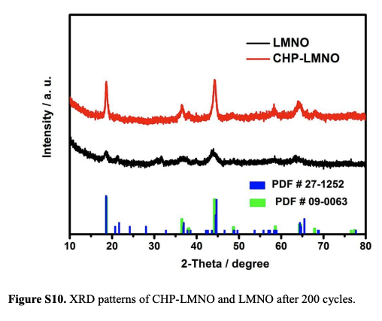
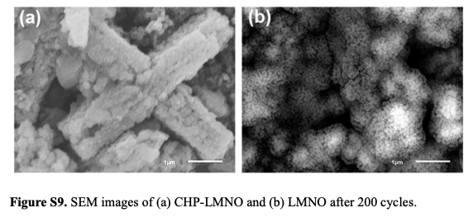
0.5C for 200 cycles
Compared with standard diffraction, the peaks around 20–25 degree disappear for both samples, which could be explained by the initial irreversible oxygen loss.
For the other peaks, CHP-LMNO displays more pronounced peaks than LMNO, especially for peaks (003) and (104), indicating that LMNO undergoes more severe destruction in structural integrity.
For LMNO, the morphology becomes indiscernible and the aggregated particles crack into a few pieces. However, CHP-LMNO preserves the essential cross- like morphology after long cycling

Slide 37
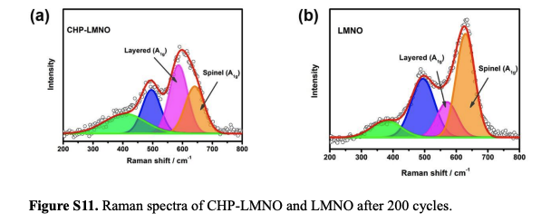
0.5C for 200 cycles
As seen from Fig. S11, the symmetrical stretching peak for A1g of the cycled samples shifts to a higher wavelength than that for the fresh material (Fig. 3d). This peak can be split into two peaks around 630 cm1 and 580 cm1, corresponding to the A1g vibration mode in the spinel and layered structure, respectively.
Based on the peak area, the contents of these phases can be estimated. The spinel in the cycled LMNO constitutes 43% but constitutes only 24% in the cycled CHP- LMNO.

Slide 38
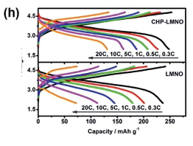
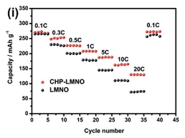
Different rate
The capacity drops in CHP-LMNO at high current rates are much gentler when compared with those in LMNO.
The discharge capacities of the CHP-LMNO are higher than those of LMNO

Slide 39
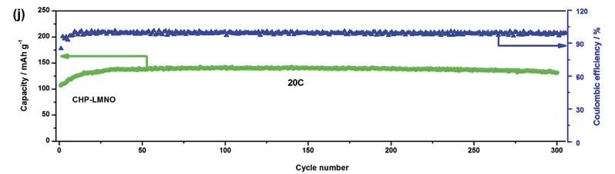
20C 300cycle
The CHP-LMNO can achieve the highest discharge capacity of 143 mA h g⁻¹ at 20C.
A capacity retention of 92% relative to the highest capacity after 300 cycles.
The coulombic efficiency of CHP-LMNO is retained at more than 99%

Slide 40
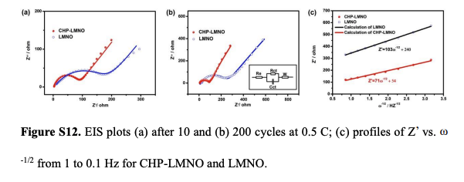
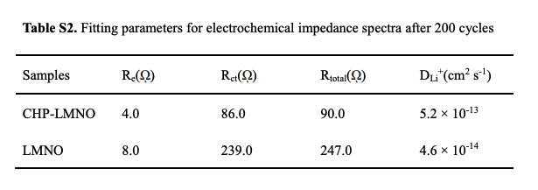

EIS
Notes:
低頻率為鋰離子擴散，10圈200圈CHP幾乎不變，顯示良好擴散速率
原本的大幅增加，顯示良好保持率

Slide 41
全電池

Slide 42
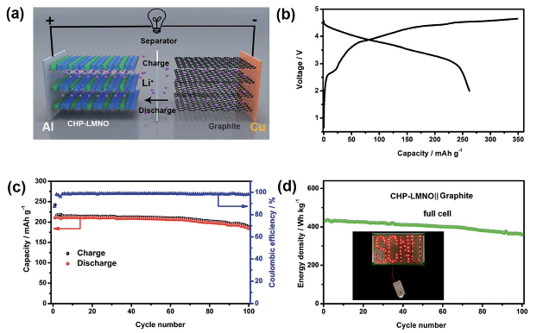
全電池
CHP-LMNO was coupled with a graphite anode to assemble the full cell.
Fig. 6 (a) Schematic representation of the full cell (CHP-LMNO-graphite); (b) the initial charge/discharge plot of the full cell at 0.1C (1C = 200 mA h g-1) in the voltage range of 2.0–4.65 V; (c) the cycling performance and coulombic efficiency of the full cell at 1C. (d) Energy density and lighting demonstration of the full cell.

Slide 43
全電池
Fig(b) 262 mAhg⁻¹ with an initial coulombic efficiency of 75%
Deintercalation (充電) behavior => The plot also exhibits a slope region below 4.45 V and a plateau region around 4.5 V
Fig (c) The full cell can deliver a high capacity of 213 mAhg⁻¹, corresponding to an energy density of 436 W h kg⁻¹ (based on the mass of cathode and anode active materials) at 1C and a capacity retention of 83% after 100 cycles.

Slide 44
結論
the unique hierarchical structure can enhance the surface area thus providing sufficient active sites;
the porous structure facilitates electrolyte infiltration and provides more buffer space;
the highly (110)- oriented plane enables much easier Li+ migration

Slide 45
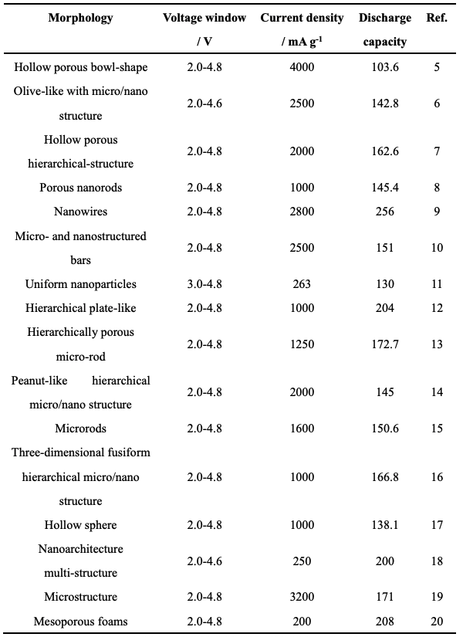
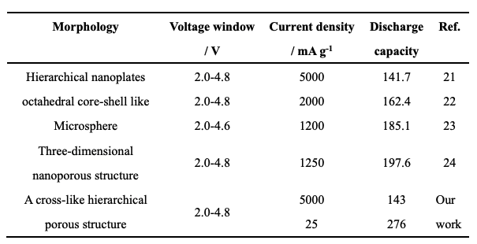
comparison

