Slide 1
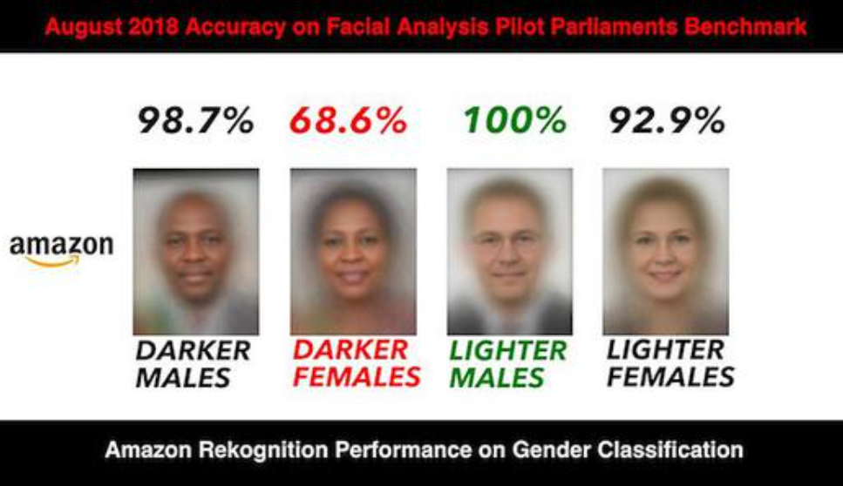
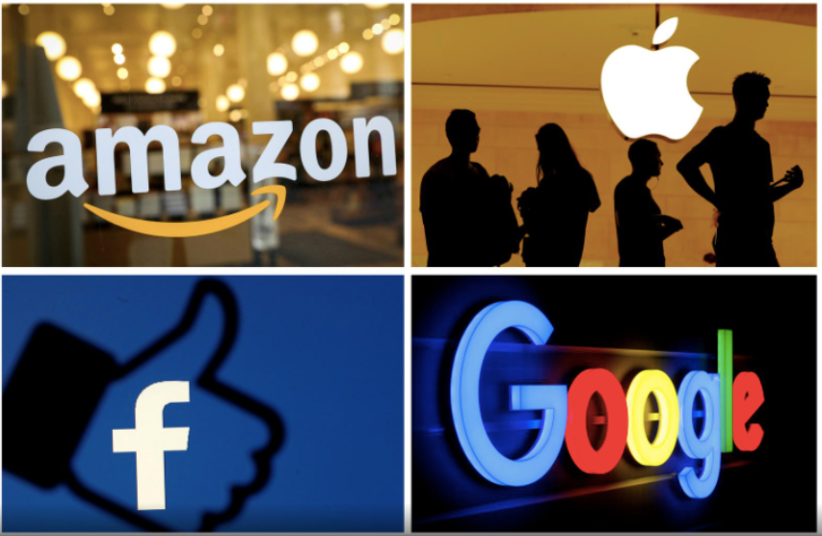
1: Inequality in the Technical Coding Layer
Algorithmic bias may lead to the systematic neglect or discrimination against minority groups.
Technological monopolies enable a handful of giants to control both data and computing power.
Noble, S. U. (2018). Algorithms of oppression: How search engines reinforce racism. New York University Press.URL: https://nyupress.org/books/9781479837243/
Sadowski, J. (2020). Too smart: how digital capitalism is extracting data, controlling our lives, and taking over the world. (1st ed.) The MIT Press. https://doi.org/10.7551/mitpress/12240.001.0001

Slide 2
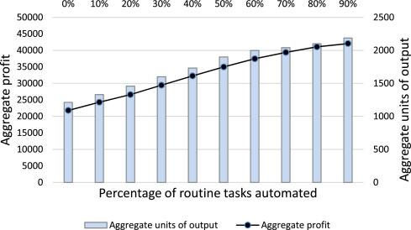
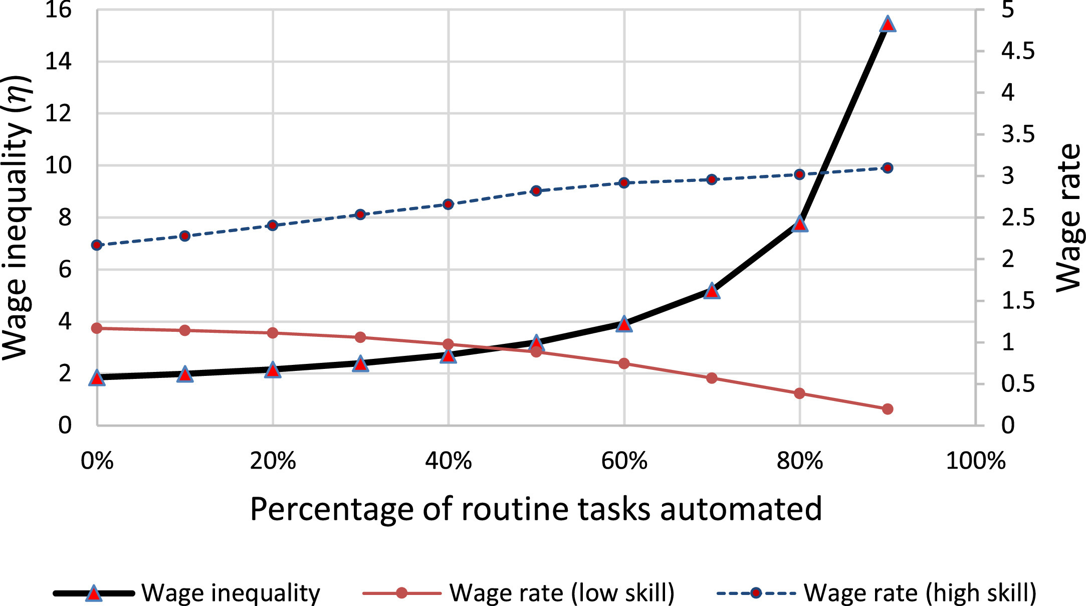
2.Inequality in the Employement Layer
Automation of routine tasks increase the profit of company.
Effect on employment with automating: wage rate of low skill decreasing. wage rate of high skill increasing. wage inequality increasing.
Upreti, A., & Sridhar, V. (2024). Effect of automation of routine and non-routine tasks on labour demand and wages. IIMB Management Review (Elsevier Science), 36(4), 289–308. https://doi.org/10.1016/j.iimb.2024.09.001

Slide 3
3.Inequality in the Social Power layer.
Personalized learning
Automated grading
Predictive systems that identify at-risk students.
Toczauer, C. (Unknown). How to combat AI bias in the classroom. OnlineEducation.com. Retrieved April 1, 2025, from https://www.onlineeducation.com/features/artificial-intelligence-biases-in-education

