Slide 1
PHP and AJAX
Eman Gumayagay

Slide 2
What is AJAX
AJAX (Asynchronous JavaScript and XML) is a technique for creating fast and dynamic web pages.
It allows web pages to update asynchronously by exchanging data with a server behind the scenes.
This means parts of a page can be updated without reloading the entire page.

Slide 3
How AJAX Works
A user triggers an event (e.g., clicking a button).
JavaScript sends an HTTP request to the server (usually using XMLHttpRequest or Fetch API).
The server (PHP) processes the request and returns data.
JavaScript processes the response and updates the page dynamically.

Slide 4
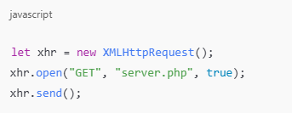
What is XMLHttpRequest?
XMLHttpRequest (XHR) is an API used to send and receive data asynchronously from a server.
It allows JavaScript to communicate with the server without refreshing the page.

Slide 5
WHAT is HTTP?
HyperText Transfer Protocol (HTTP) is the foundation of data communication on the web.
It enables the transfer of data between clients (browsers) and servers.
Eg: http://localhost/phpmyadmin

Slide 6
WHAT is HTTPS?
HyperText Transfer Protocol Secure (HTTPS) is an encrypted version of HTTP.
It uses SSL/TLS encryption to secure data from hackers.
Eg: https://facebook.com/profile.php

Slide 7

HTTP Methods: GET
GET is used to request data from the server.
Data is sent in the URL (query string).
Best for:
✅ Fetching data
✅ Search queries
✅ Simple requests

Slide 8
HTTP Methods: GET
GET is used to request data from the server.
Data is sent in the URL (query string).
Best for:
✅ Fetching data
✅ Search queries
✅ Simple requests

Slide 9
HTTP Methods: POST
POST is used to send data to the server.
Data is sent in the request body (not visible in URL).
Best for:
✅ Submitting forms
✅ Secure data transfer
✅ Large data submission

Slide 10
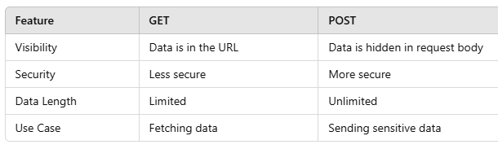
GET vs POST

Slide 11
GET vs POST

Slide 12
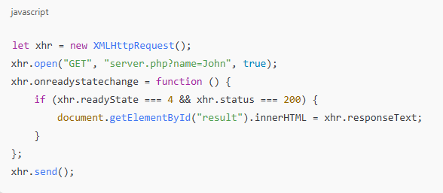
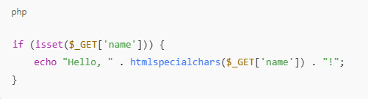
Simple PHP & AJAX Example: GET
Here were getting DATA from a website php page using XMLHttpRequest(), and were passing the name value as John, PHP file will verify and will echo and AJAX will return the value as a result.

Slide 13
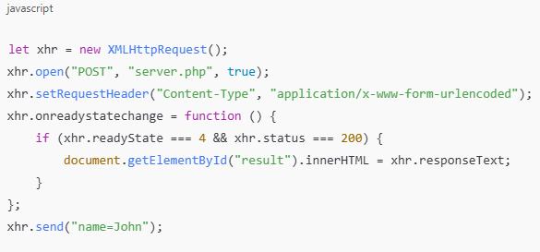
Simple PHP & AJAX Example: POST
Here were getting DATA from a website php page using XMLHttpRequest(), and were passing values from a query string, as a FORM, PHP will process it and returns a value

Slide 14
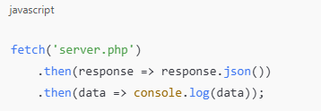
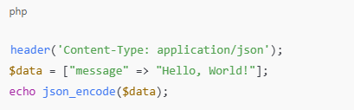
AJAX Fetch API
We can also use fetch api to make an AJAX Request to the server, it helps returns the data without reloading the site.

Slide 15
Advantages of Using PHP with AJAX
✔️ Faster Performance – Only necessary data is updated.
✔️ Better User Experience – No page reloads.
✔️ Efficient Server Communication – Reduces server load.
✔️ Easy Integration – PHP handles data processing easily.

Slide 16
Real-World Applications
Live Search (Google Suggest)
Auto-Saving Forms
Real-Time Chat Applications
Dynamic Content Loading

Slide 17
APPLICATION
YEYYYYYYYYYYYYYYYYYYYYYYYYYYYYYYYYYYYYYYYYYYYYYYYYYYYYYYYYYY!!!!!!!!!!!!!

Slide 18
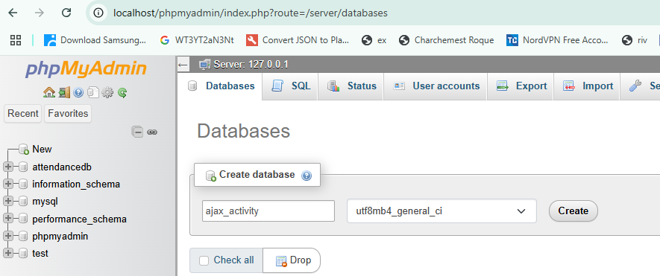
Create Database
Create new Database: phpmyadmin

Slide 19
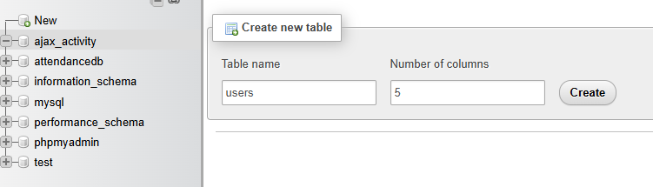
Create Users Table
Create new Table: users

Slide 20
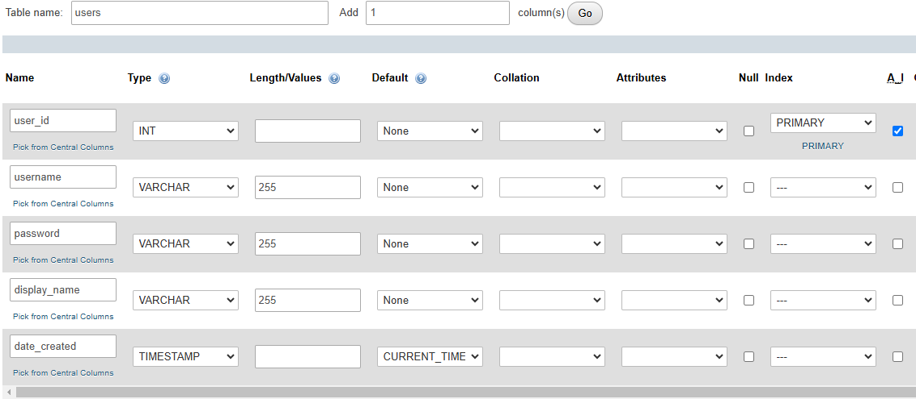
Create Columns Table
Don’t forget the A.I [AUTO INCREMENT] at user_id

Slide 21
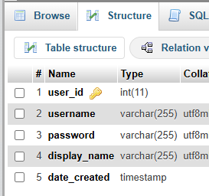
Create Columns Table
Don’t forget the A.I [AUTO INCREMENT] at user_id, after, save

Slide 22
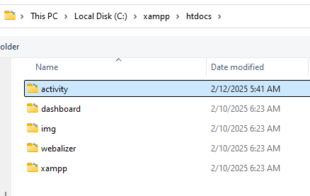
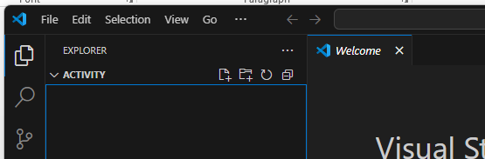
Create Activity Folder
On your File Explorer, create your folder inside, htdocs at XAMPP, after that open your folder at VS Code
Eg: C://xampp/htdocs/YOUR FOLDER

Slide 23
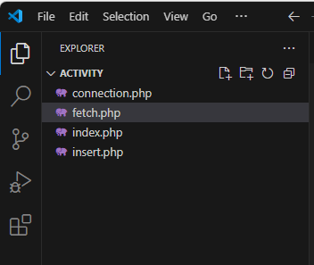
Create Files
Now on your VS Code,
Create multiple files
Connection.php – for our connection
Fetch.php – to fetch from database
Index.php – main file
Insert.php – to insert data

Slide 24
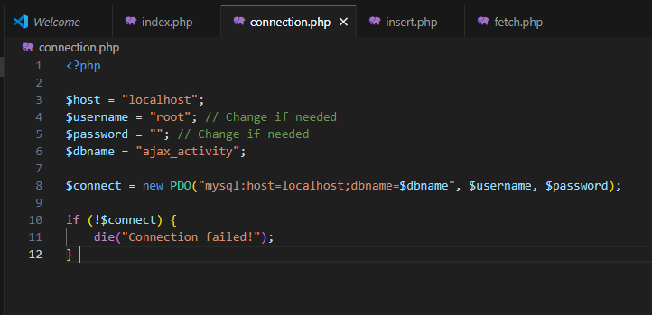
Connection.php
Now istablish your MySQL Connection in connection.php

Slide 25
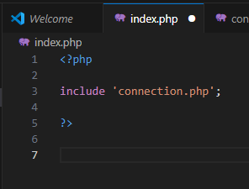
Index.php
Include your connection to you main File: index.php

Slide 26
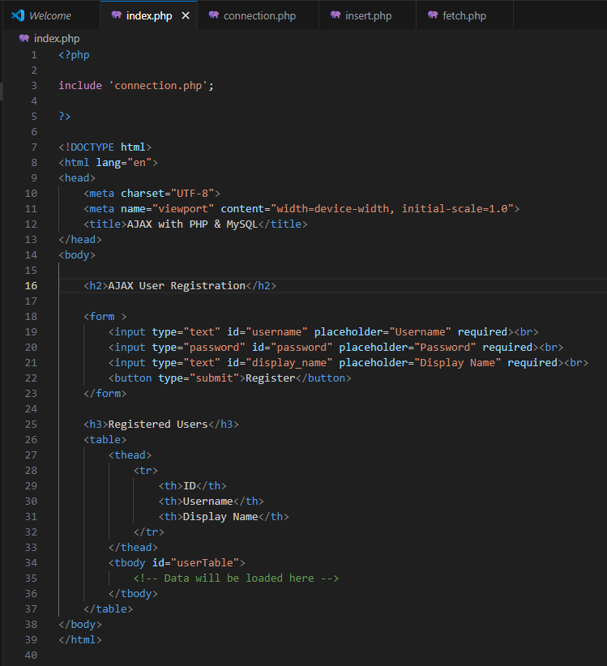
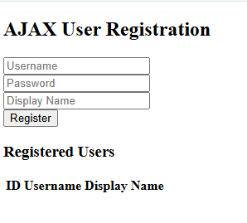
Create UI: HTML
Design your HTML Form, include fields username, password, display_name

Slide 27
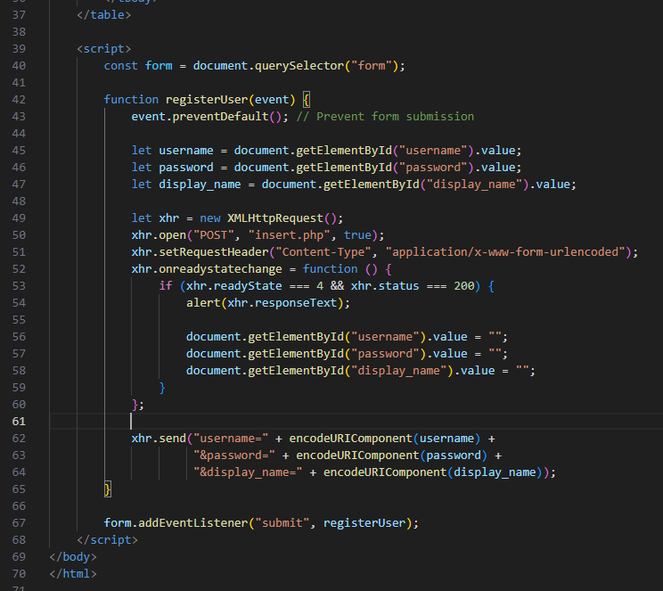
Add Scripts
Add JavaScript scripts, to integrate with PHP, insert.php
Were sending query string to the server

Slide 28
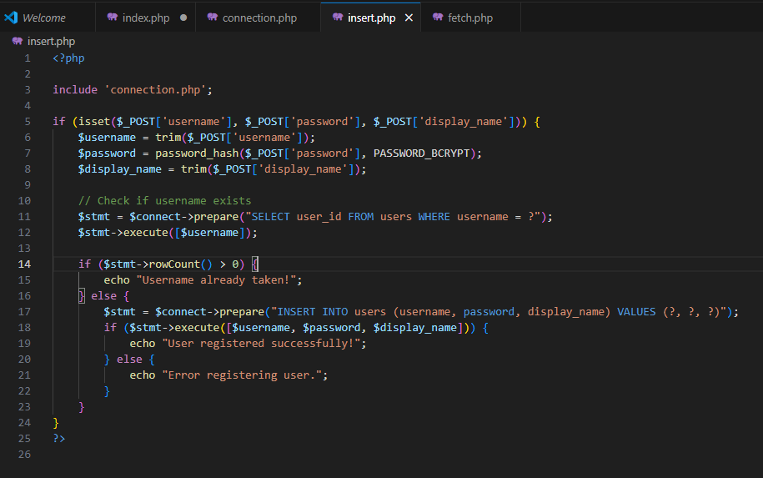
Registration
In your insert.php,
Create a query that will insert a user if it doesn’t exists yet! For added security.

Slide 29
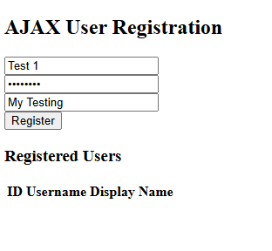
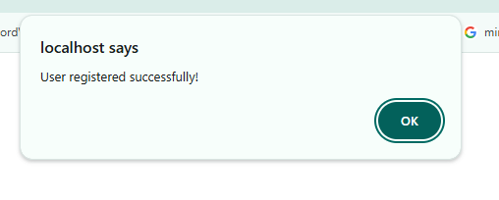
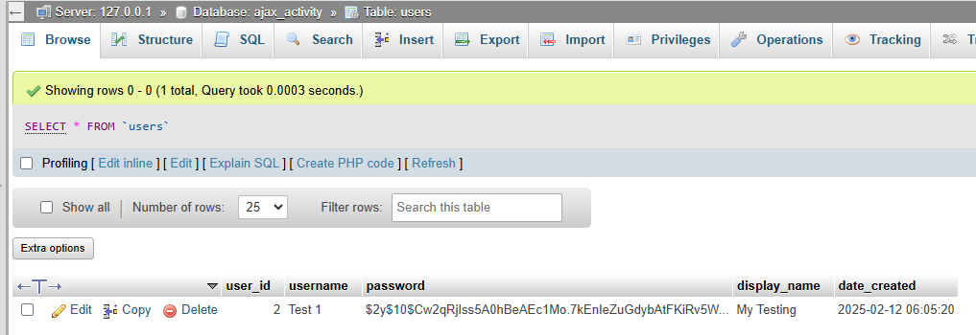
TEST
Now if we test at the browser, after submitting we can see a alert notif, and the data is being inserted on the background.

Slide 30
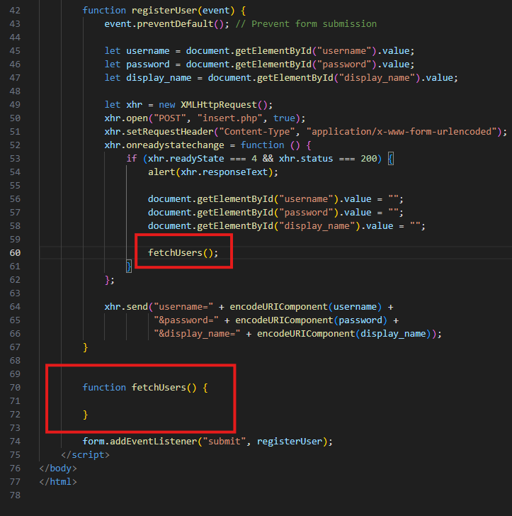
FETCHING in Background
After submitting the form, we want to update our table, so add another function that runs after the execution of registerUser

Slide 31
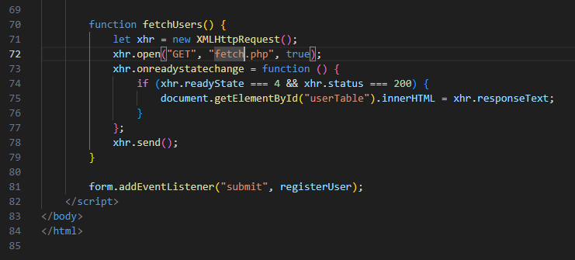
FETCHING in Background
Use GET XMLHttpRequest to request to server;
NOTE: WERE ONLY USING GET, IF WE DON’T HAVE ANY TO PASS FROM DATABASE.

Slide 32
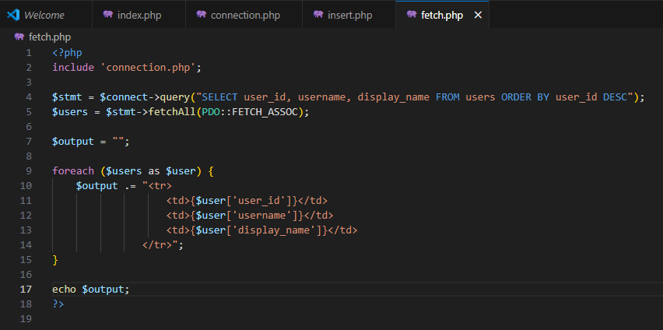
Fetch.php
Add background functionalities that gets user, and display to table.

Slide 33
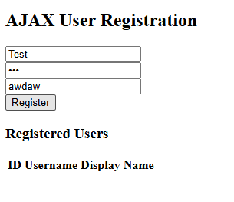
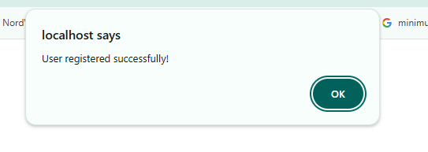
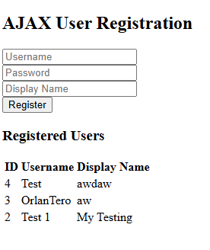
TEST
Test again,
After registering it will update our table.

Slide 34
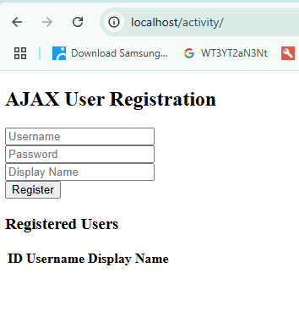
DISPLAY
As we can see here, when the page is loaded, the users isn’t loading yet, so we need to display them first.

Slide 35
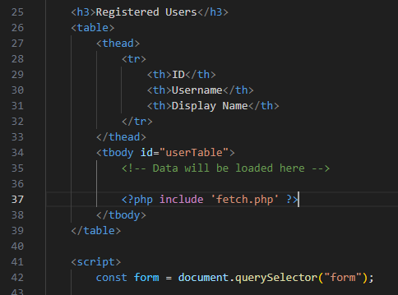
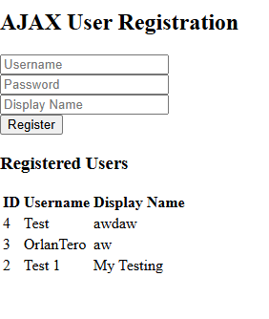
DISPLAY using Fetch
So include your fetch.php inside the tbody, it will run again the fetch and return it’s value, and then appended to the table.

Slide 36
YEYYYYYYYYYYYYYYYYYYYY
HAPPY CODING!

