Slide 1

zrsBot
created by: zrs

Slide 2
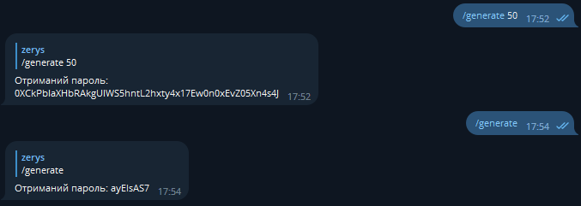
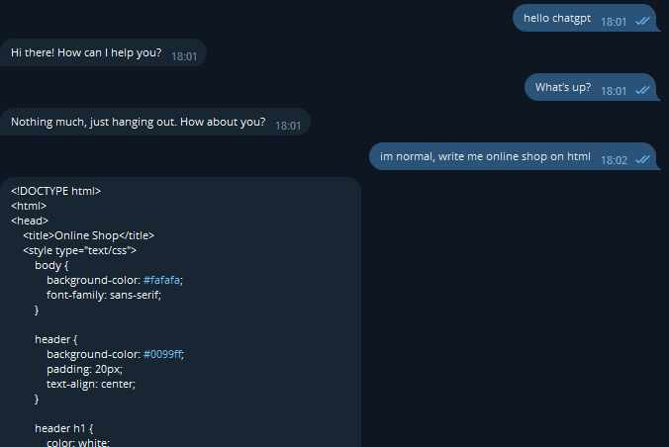
functions of this bot
Chatgpt
Password generator

Slide 3

Thank you for viewing the presentation
maksumtsumbala@gmail.com

