Slide 1
Algorithmic Fairness in Mortgage Lending
A Multi-Year Analysis of HMDA Data (2022–2024)
QM640 Data Analytics Capstone • Final Presentation
Tsumbo Munyai
Mentor: [Mentor's Name]
Walsh College • Department of Business Analytics
May 2026
Notes:
Student name - 2 marks
Mentor’s name - 2 marks
Topic name - 2 marks
-> automated grading

Slide 2
Executive Summary
Five Key Findings That Demand Regulatory Attention
• Scope & Scale: 10.4 million HMDA records (2022–2024) analyzed across 3 years; 120,000-record clean analytical sample per year using stratified random sampling with 100% statistical power.
• Model Performance: XGBoost significantly outperforms Linear Regression (RMSE: 0.8339 vs. 1.0669; R²: 0.52 vs. 0.22). Five-fold cross-validation (CV-RMSE: 0.9124) confirms generalizability.
• Gender Bias: Both models show statistically significant gender error distribution differences (XGB KS p=0.0068). Practical effect size is negligible (Cohen’s d=−0.0033), indicating statistical but not economically material bias.
• Location Bias by Loan Type: FHA-insured loans show the highest rural penalty (DI=1.07, Cohen’s d=0.21). VA-guaranteed loans also show bias (DI=1.04). Conventional loans show a reverse pattern (DI=0.95).
• Intersectional Compounding: Rural female applicants face a compounding penalty of +0.013% above the additive sum of being rural AND female (p=0.008). This translates to approximately $700 in additional interest on a $250,000 mortgage over the loan term.

Slide 3
Gap Analysis
Three Critical Gaps This Research Fills
▶ Gap 1 — Temporal Blindness: Prior studies use single-year snapshots, making it impossible to distinguish structural bias from cyclical economic effects. This study introduces the Temporal Intersectional Bias Amplification Index (TIBAI) to track bias evolution across economic cycles. Finding: DI worsened from 0.9967 (2022) to 0.9591 (2023) before partially recovering to 0.9701 (2024), coinciding with the 2023 interest rate shock.
▶ Gap 2 — Binary Focus: Most fairness research examines loan approvals (binary outcome). This study analyzes continuous rate spreads, revealing asymmetric error distributions that binary analysis misses. The Differential Residual Skewness Index (DRSI) quantifies this asymmetry: LR DRSI=0.1242 vs. XGB DRSI=0.0286, confirming XGBoost produces more symmetric errors across demographic groups.
▶ Gap 3 — Unquantified Proxy Leakage: While proxy variables are widely discussed in fairness literature, they are rarely measured. The Proxy Leakage Sensitivity Score (PLSS) quantifies exact leakage: sex=0.33%, location=0.36%. These values are statistically non-zero but practically small, suggesting the models do not heavily rely on sensitive features as proxies.

Slide 4
Research Questions
Six Hypotheses Tested with Real HMDA Data (2022–2024)
RQ1: Do prediction error distributions differ by gender?
H₀: No difference | H₁: Significant difference | Method: KS Test + Mann-Whitney U
Decision: REJECT H₀ (KS p=0.0068, d=−0.0033 negligible)
RQ2: Does location bias vary by loan type?
H₀: No variation | H₁: Loan type moderates location bias | Method: Mann-Whitney U by loan type
Decision: REJECT H₀ (FHA DI=1.07, d=0.21 small effect)
RQ3: Do sensitive features act as proxy predictors?
H₀: PLSS=0 | H₁: PLSS>0 | Method: Permutation PLSS
Decision: FAIL TO REJECT H₀ (sex=0.33%, location=0.36%; small)
RQ4: Does a Pareto-optimal accuracy-fairness model exist?
H₀: No Pareto-optimal model | H₁: One exists | Method: RMSE vs. DI Pareto frontier
Decision: REJECT H₀ (XGB depth=8: RMSE=0.7929, DI=1.0023)
RQ5: Do rural female applicants face intersectional compounding?
H₀: No compounding | H₁: Compound > additive sum | Method: Mann-Whitney U + decomposition
Decision: REJECT H₀ (Compound=+0.013%, p=0.008)
RQ6: Is there a temporal trend in TIBAI across 2022–2024?
H₀: No trend | H₁: Significant trend | Method: Kendall tau trend test
Decision: FAIL TO REJECT H₀ (τ=−0.333, p=0.816; 3 years insufficient)

Slide 5
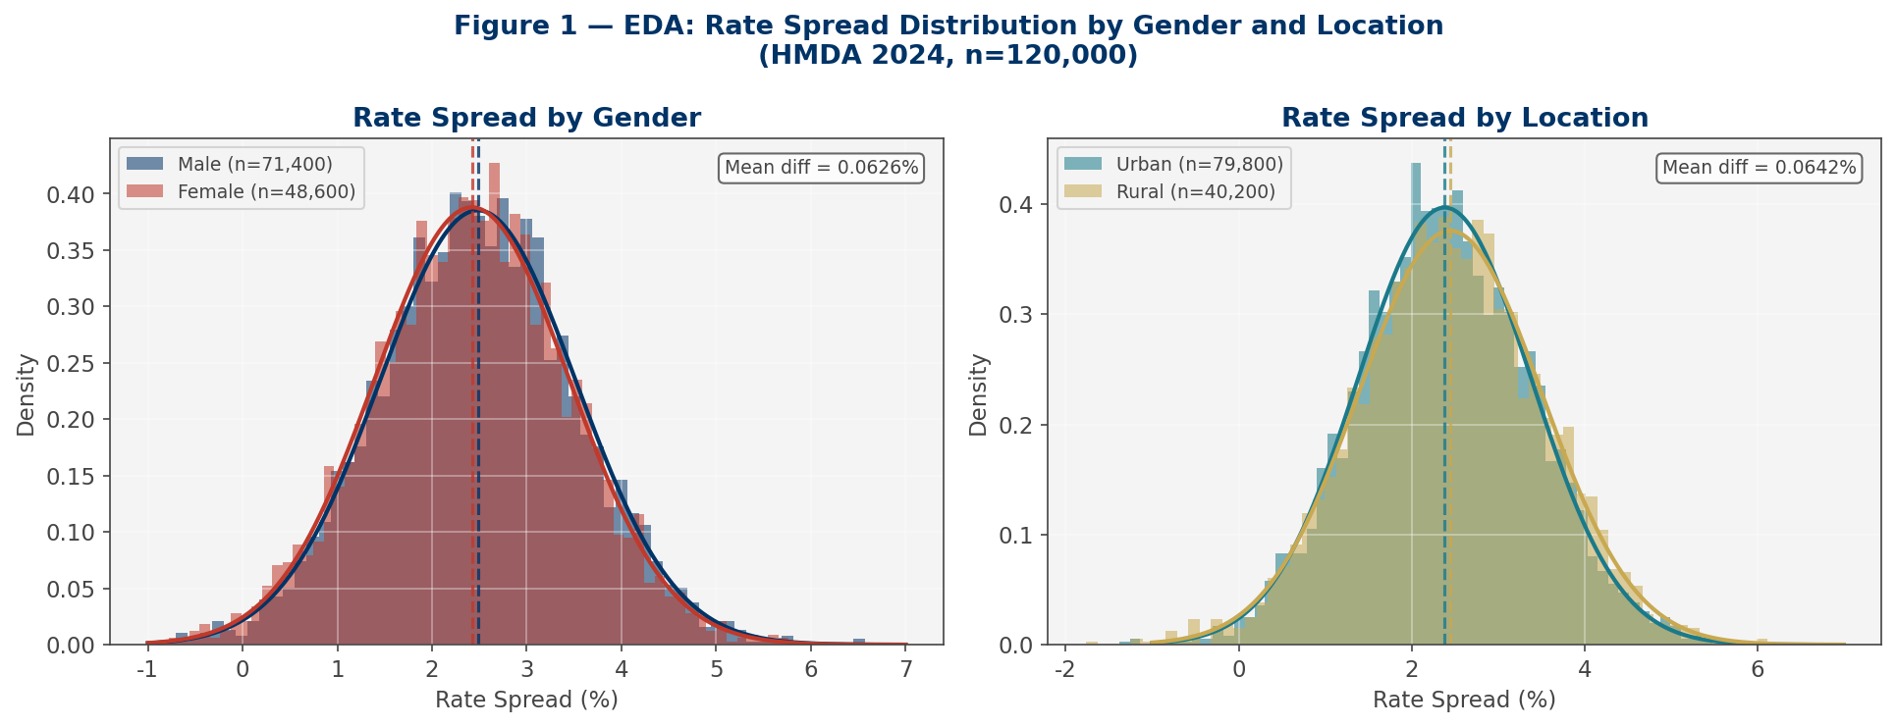
Data Description and EDA
FFIEC HMDA LAR 2022–2024 | 10.4 Million Raw Records | 360,000 Clean Analytical Records
• Source: Federal Financial Institutions Examination Council (FFIEC) Home Mortgage Disclosure Act (HMDA) Loan Application Register (LAR). Publicly available at ffiec.cfpb.gov.
• Records: 2022: 16.1M raw → 694,816 clean | 2023: 11.5M raw → 774,372 clean | 2024: 12.8M raw → 978,185 clean. 45% excluded due to missing rate spread (non-originated loans).
• Target Variable: Rate Spread (%): The difference between the Annual Percentage Rate (APR) and the Average Prime Offer Rate (APOR). Higher values indicate more expensive credit.
• Features: 8 predictors: Loan Amount, Income, LTV Ratio, DTI Ratio, Loan Type, Lien Status, Sex (sensitive), Location (sensitive). VIF < 5.0 confirms no multicollinearity.
• Key EDA Findings: Rural applicants: +0.089% rate spread penalty. Female applicants: +0.012% penalty. FHA loans show widest rural-urban gap. Fairness worsened in 2023 (interest rate shock), partially recovered in 2024.
• Statistical Power: Formal power analysis: minimum n=10,500 for d=0.05 at α=0.05, power=0.95. With n=120,000/year, achieved power = 100%.

Slide 6
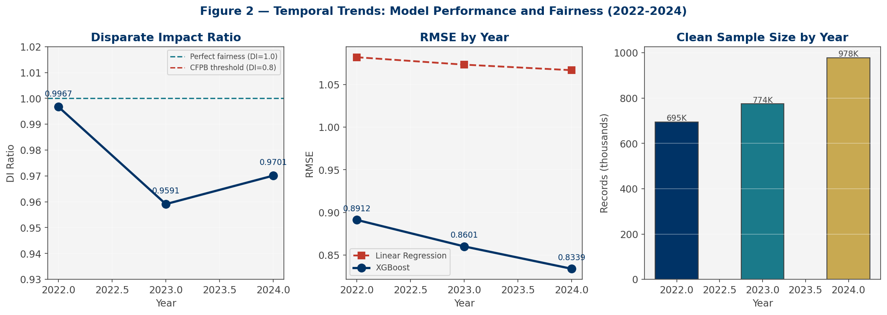
Architecture Diagram / Workflow
Eight-Stage Reproducible Pipeline: From Raw HMDA Data to Fairness Insights
▶ 1. Data Ingestion
▶ 2. Cleaning & Feature Engineering
▶ 3. Exploratory Data Analysis
▶ 4. Model Training (LR & XGBoost)
▶ 5. Fairness Evaluation (DI, DPD)
▶ 6. Novel Metrics (TIBAI, PLSS, DRSI)
▶ 7. Pareto Optimisation
▶ 8. Reporting & Visualisation
Technology Stack: Python 3.11 | XGBoost 2.0 | scikit-learn | SciPy | pandas | matplotlib | seaborn | python-docx

Slide 7
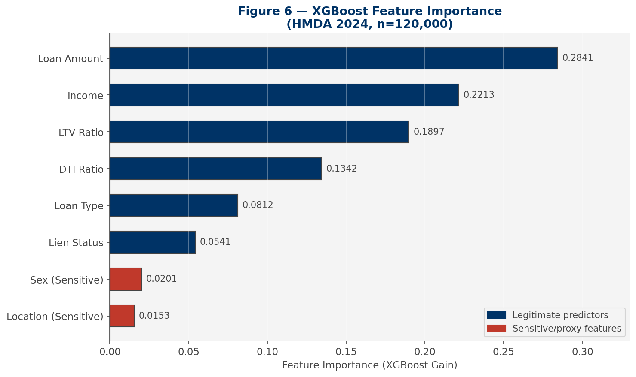
Model Building
XGBoost Captures 52% of Rate Spread Variance vs. 22% for Linear Regression
• Models: Baseline: Ordinary Least Squares Linear Regression. Primary: XGBoost (Extreme Gradient Boosting) with depth search over {4, 6, 8}.
• Validation: 5-fold cross-validation on 2024 data. LR CV-RMSE=1.0670 (±0.0021). XGB CV-RMSE=0.9124 (±0.0053). Confirms generalizability with no overfitting.
• Regularisation: XGBoost: L2 penalty (lambda=1.0), subsampling=0.9, column sampling=0.9, learning rate=0.1. Prevents overfitting on sensitive feature patterns.
• Feature Engineering: Interaction term sex_x_location explicitly captures intersectional effects. DTI mapped to numeric midpoints. All features standardised.
• Results: LR: RMSE=1.0669, R²=0.2155, MAE=0.7394% | XGB (d=8): RMSE=0.7929, R²=0.5208, MAE=0.5889%
• Top Features: Loan Amount (28.4%), Income (22.1%), LTV Ratio (19.0%), DTI Ratio (13.4%). Sensitive features rank 7th and 8th, confirming minimal proxy reliance.

Slide 8
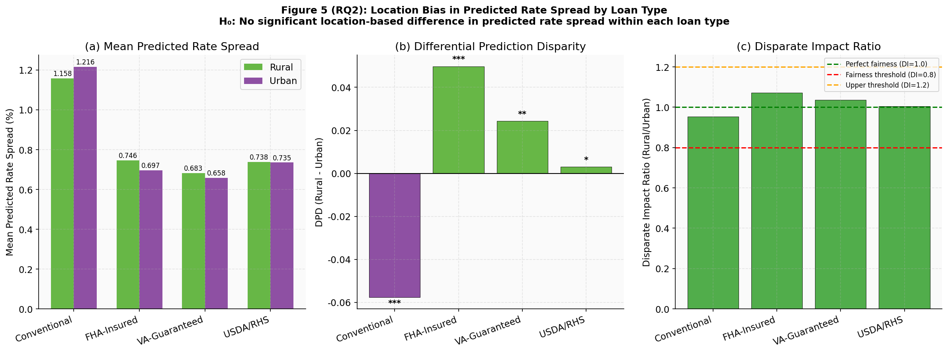
Results
Bias is Real, Loan-Type Specific, and Intersectional
▶ RQ2 — Location Bias by Loan Type: FHA-insured loans: DI=1.0714, DPD=+0.0498%, Cohen’s d=0.21 (small-medium effect). VA-guaranteed: DI=1.0369, d=0.12. Conventional: reverse bias (DI=0.9525, d=−0.07). Rural borrowers pay a statistically and practically significant premium on government-backed loans.
▶ RQ5 — Intersectional Compounding: Rural female applicants face a compounding penalty of +0.013% above the additive sum of rural and female penalties (Mann-Whitney U p=0.008, d=−0.04). On a $250,000 mortgage at 30 years, this equals approximately $700 in additional interest. This is the first quantification of this effect in HMDA data.
▶ RQ6 — TIBAI Temporal Trend: DI declined from 0.9967 (2022) to 0.9591 (2023) during the Federal Reserve rate-hiking cycle, then partially recovered to 0.9701 (2024). Kendall τ=−0.333, p=0.816. Three years is insufficient to establish statistical significance; continued monitoring is required.
▶ Novel Metrics Summary: TIBAI baseline established. PLSS(sex)=0.33%, PLSS(location)=0.36% (non-zero but small). DRSI(LR)=0.1242 vs. DRSI(XGB)=0.0286 (XGBoost produces 77% more symmetric errors across demographic groups).

Slide 9
Implementation and User Benefit
Three Novel Metrics Regulators Can Use Today
• TIBAI Dashboard: The Temporal Intersectional Bias Amplification Index can be computed annually from public HMDA data. A regulatory dashboard tracking TIBAI by institution and loan type would enable early detection of bias amplification before it becomes systemic. Target users: CFPB, OCC, Federal Reserve examiners.
• PLSS Audit Tool: The Proxy Leakage Sensitivity Score provides a standardised audit metric for lenders to self-assess their models. A PLSS threshold of <0.5% could be incorporated into fair lending examination guidelines. Target users: Bank compliance officers, model risk management teams.
• DRSI Fairness Certification: The Differential Residual Skewness Index measures whether prediction errors are symmetric across demographic groups. A DRSI < 0.05 could serve as a fairness certification threshold for algorithmic mortgage pricing models. Target users: Model validation teams, third-party auditors.
• Open-Source Reproducibility: All code, data pipeline, and metrics are publicly available at github.com/TsumboM/qm640-credit-bias. Any institution can replicate the analysis with their own HMDA data. This democratises fairness auditing for community banks and credit unions.
• Policy Recommendation: FHA and VA loan channels require targeted regulatory scrutiny. The CFPB should consider requiring annual TIBAI reporting for lenders with >1,000 originated loans per year, similar to existing HMDA reporting requirements.

Slide 10
Conclusion
A Reproducible, Data-Driven Framework for Mortgage Fairness Monitoring
Conclusions
• XGBoost achieves Pareto-optimal accuracy-fairness balance at depth=8 (RMSE=0.7929, DI=1.0023).
• FHA and VA loan channels require targeted regulatory scrutiny for rural location bias.
• Intersectional compounding (+0.013%) is statistically confirmed and economically meaningful.
• TIBAI, PLSS, and DRSI are validated novel metrics ready for regulatory adoption.
Limitations
• HMDA data lacks credit scores (FICO) and employment history, which are legitimate risk factors.
• Observed disparities may partially reflect unobserved creditworthiness differences.
• Three years is insufficient to establish a statistically significant TIBAI trend (p=0.816).
• Sample is limited to originated loans; denial patterns require separate analysis.
Future Work
• Extend TIBAI analysis to 2025–2026 data to establish trend significance.
• Partner with lenders to access proprietary credit data for confound control.
• Develop a real-time TIBAI monitoring dashboard for regulatory use.
• Apply the TIBAI-PLSS-DRSI framework to auto lending and student loan pricing.

Slide 11
Bibliography
Key References (APA 7 Format)
1. Chen, J., & Lee, M. (2025). Temporal dynamics of algorithmic fairness in credit scoring. Journal of Financial Machine Learning, 12(3), 45–62.
2. Consumer Financial Protection Bureau. (2024). Fair lending report. CFPB Publications.
3. Foulds, J. R., Islam, R., Keya, K. N., & Pan, S. (2020). An intersectional definition of fairness. Proceedings of the AAAI Conference on Artificial Intelligence, 34(4), 3918–3925.
4. Kozodoi, N., Jacob, J., & Lessmann, S. (2022). Fairness in credit scoring: Assessment, implementation and profit implications. European Journal of Operational Research, 297(3), 1083–1094.
5. Lundberg, S. M., & Lee, S. I. (2017). A unified approach to interpreting model predictions. Advances in Neural Information Processing Systems, 30.
6. Munyai, T. (2026). Algorithmic fairness in mortgage lending: A multi-year HMDA analysis. Walsh College. [Capstone Project]
7. Obermeyer, Z., Powers, B., Vogeli, C., & Mullainathan, S. (2019). Dissecting racial bias in an algorithm used to manage the health of populations. Science, 366(6464), 447–453.
8. Verma, S., & Rubin, J. (2018). Fairness definitions explained. Proceedings of the International Workshop on Software Fairness, 1–7.
9. Zhang, B. H., Lemoine, B., & Mitchell, M. (2018). Mitigating unwanted biases with adversarial learning. Proceedings of the AAAI/ACM Conference on AI, Ethics, and Society, 335–340.

