Slide 1
Final Report Project-I: High-order Data Reconstruction in Hydro
D12222010 陳樂仁
R12222048 郭存淞
B10204017 高子禹

Slide 2
Outline
Introduction of Piecewise-linear method (PLM) and our work.
Model paralleling with OpenMP
Performance and accuracy of paralleling with OpenMP.
Implementation of high-order data reconstruct methods.
Attempting utilize Piecewise Parabolic Method (PPM), Weighted Essentially Non-Oscillatory (Weno) and Gaussian Process (GP)
Conclusion and outlook

Slide 3
Introduction of Piecewise-linear method (PLM) and our work.

Slide 4
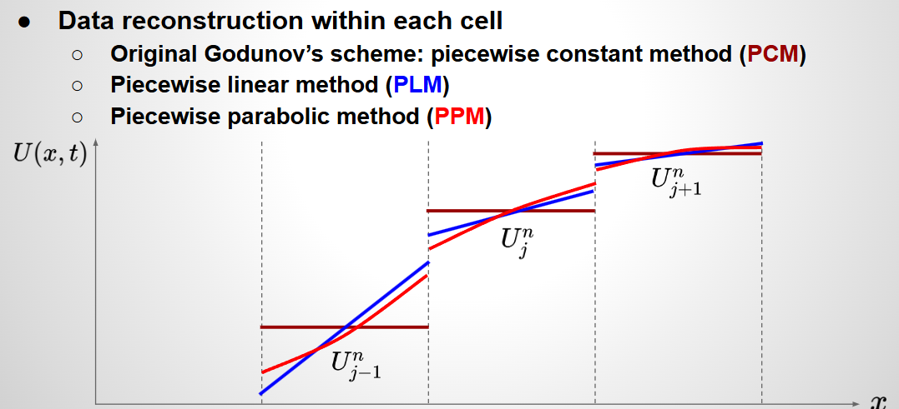
What is PLM?
Piecewise-Linear Method (PLM) or segmented function, is a real-valued function of a real variable, whose graph is composed of straight-line segments. -Wikipedia
From p.17 in lec03-slides02.pdf

Slide 5
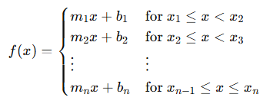
What is PLM?
It is a collection of intervals on each of which the function is an affine function.
It is simple and easy to implement , and also easy to understand .
However, it also highly depend on selection of points, and insufficient for highly non-linear functions.
Notes:
<編號>

Slide 6
The goal of this project.
Utilizing following high-order data reconstruct methods to improve the simulation result, as we encounter the highly non-linear functions.
- Piecewise Parabolic Method (PPM)
- Piecewise Cubic Method (PCM)
- Weighted Essentially Non-Oscillatory (WENO)
- Gaussian Process (GP)

Slide 7
The goal of this project.
Utilizing following high-order data reconstruct methods to improve the simulation result, as we encounter the highly non-linear functions.
- Piecewise Parabolic Method (PPM)
- Piecewise Cubic Method (PCM)
- Weighted Essentially Non-Oscillatory (WENO)
- Gaussian Process (GP)

Slide 8
Model parallel with OpenMP

Slide 9
Model parallel with OpenMP
Firstly, we parallel our origin PLM code with OpenMP, make it more robust against large segments number.
In the process, we transform origin PLM python code into cpp code, to ensure the compatibility with OpenMP or even MPI.
Notes:
<編號>

Slide 10
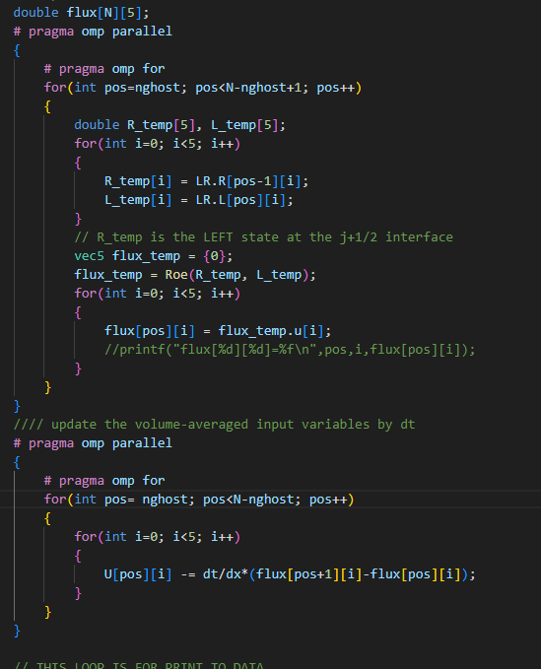
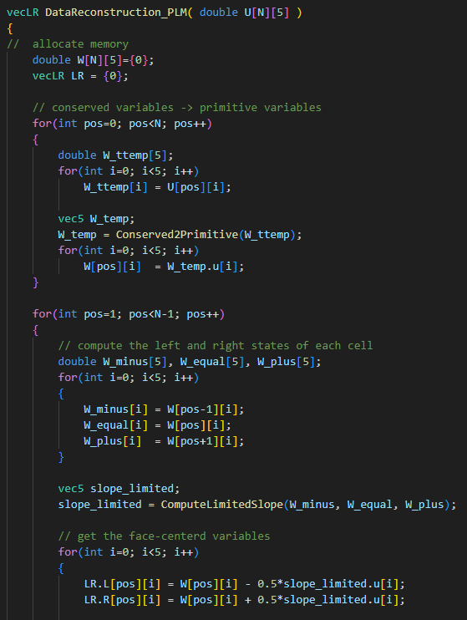
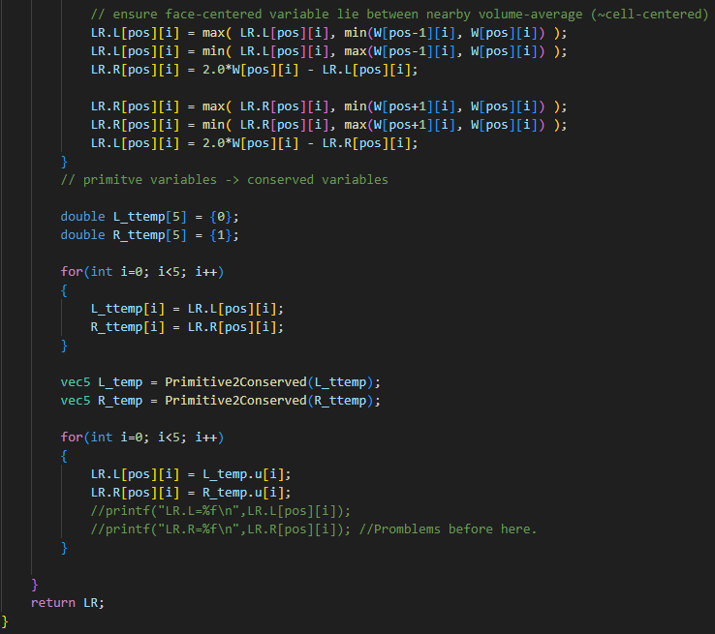
Model parallel with OpenMP

Slide 11
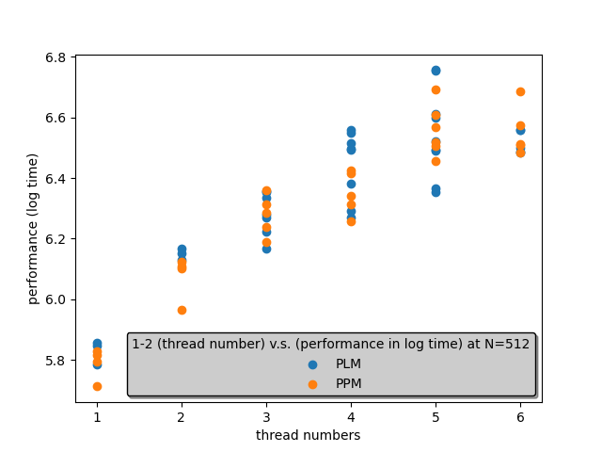
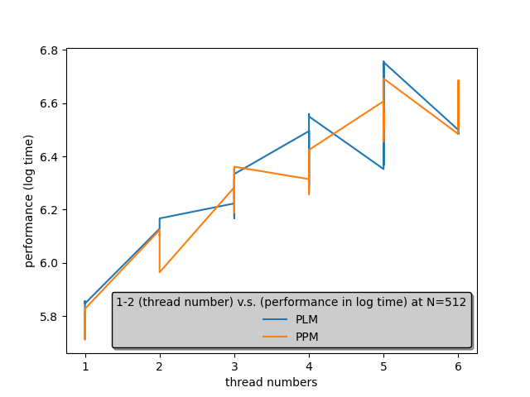
Performance and accuracy of paralleling with OpenMP.

Slide 12
Implementation of high-order data reconstruct methods.

Slide 13
Utilizing Piecewise Parabolic Method (PPM)
Step1: Find slope
Step2: Find the value between two points.
Step3: Find average value between two points
Step4: Calculate the next step value

Slide 14
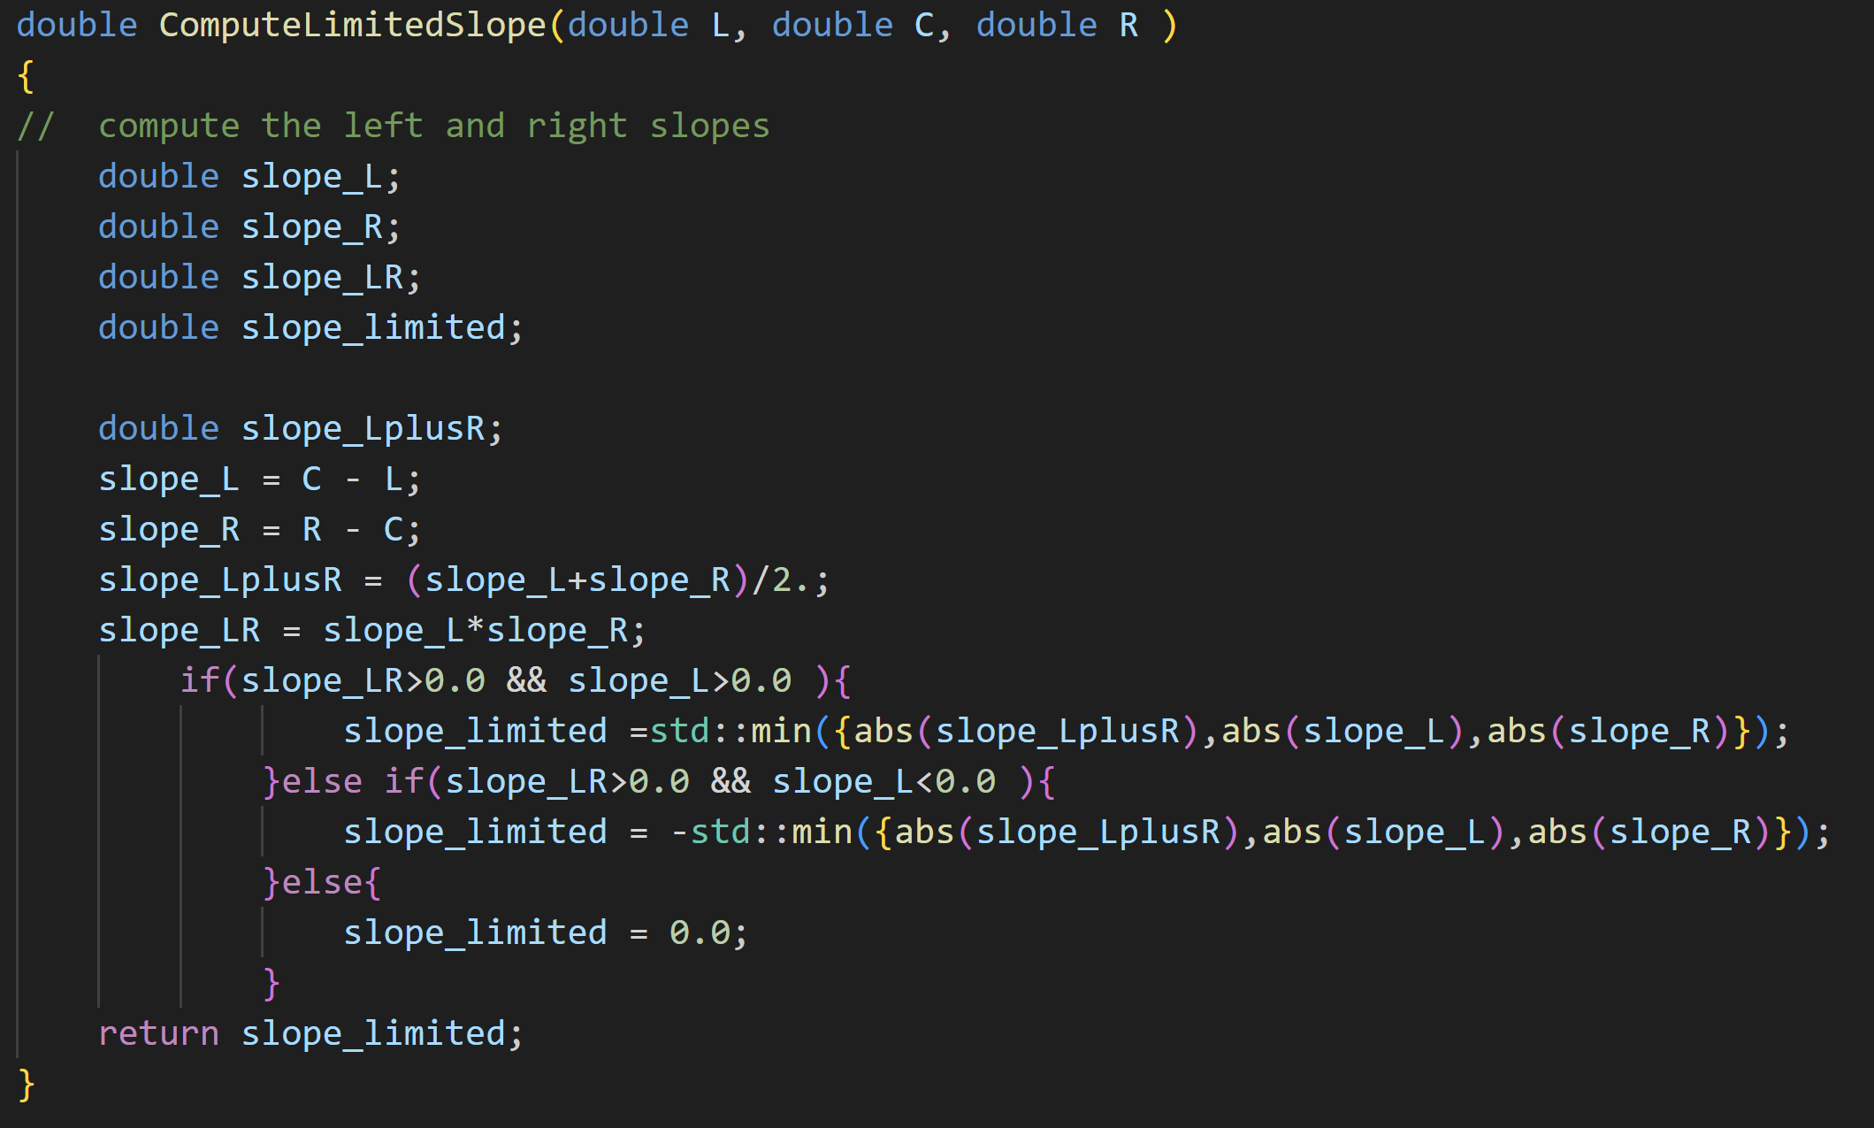
Utilizing Piecewise Parabolic Method (PPM)
Step 1: Find slope

Slide 15
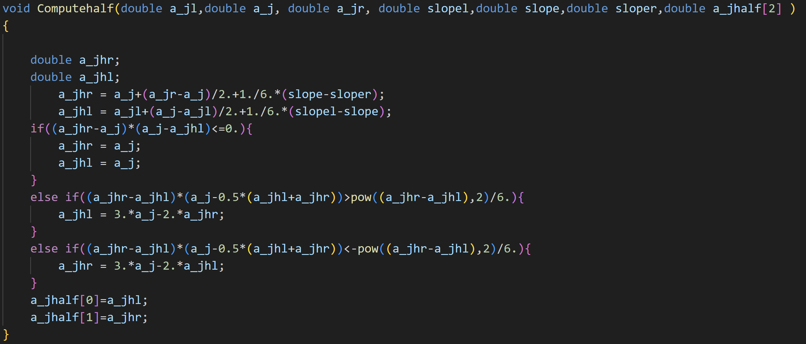

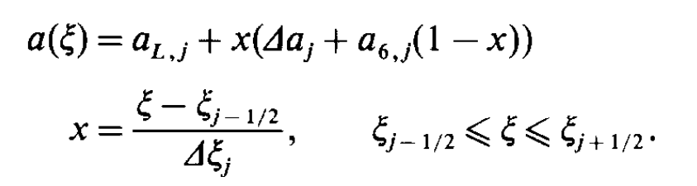
Utilizing Piecewise Parabolic Method (PPM)
Step2: Find the value between two points
Avoid a_j is a local maximum or minimum,
Avoid
From: Phillip Colella and Paul R. Woodward 1983
R-process duration
Initial Ye

Slide 16
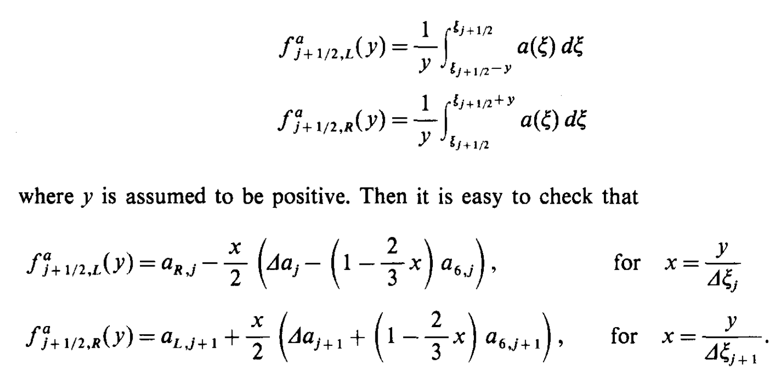
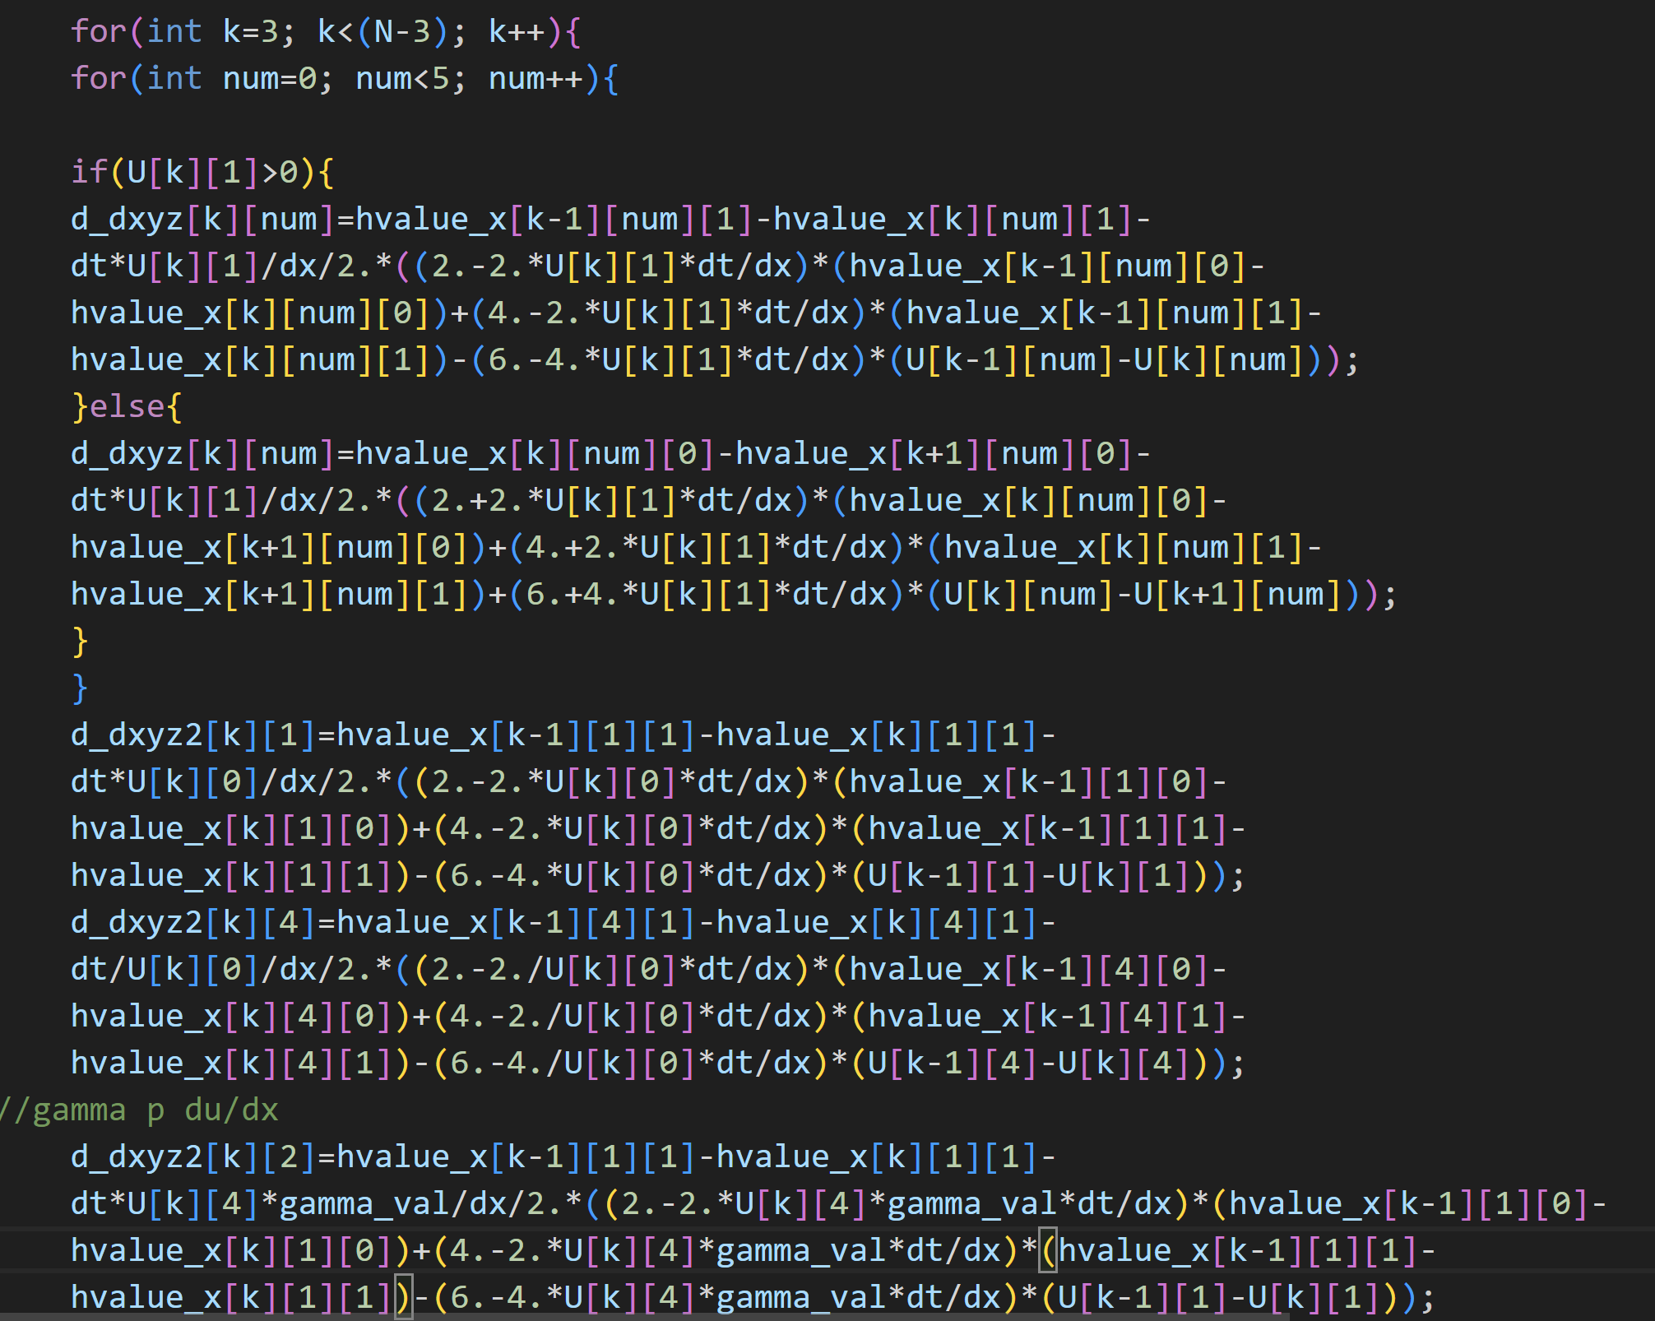
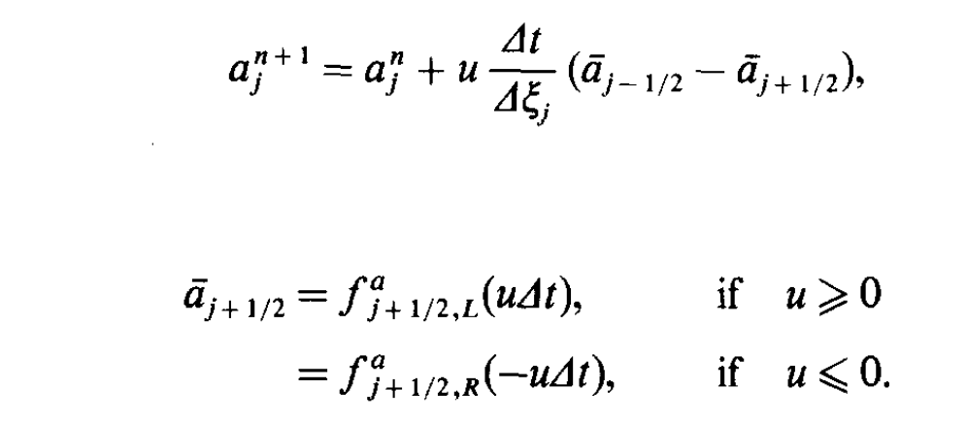
Utilizing Piecewise Parabolic Method (PPM)
Step3: Find average value between two points
From: Phillip Colella and Paul R. Woodward 1983
R-process duration
Initial Ye

Slide 17
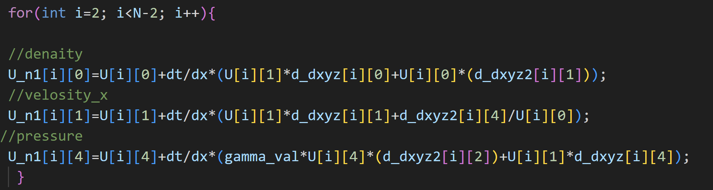
Utilizing Piecewise Parabolic Method (PPM)
Step4: Calculate the next step value
R-process duration
Initial Ye

Slide 18
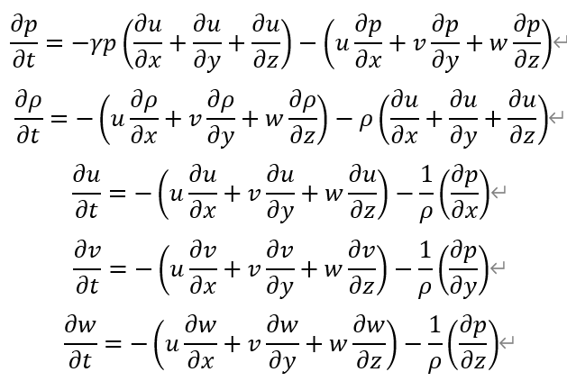
Utilizing Piecewise Parabolic Method (PPM)
Euler hydrodynamic
R-process duration
Initial Ye

Slide 19

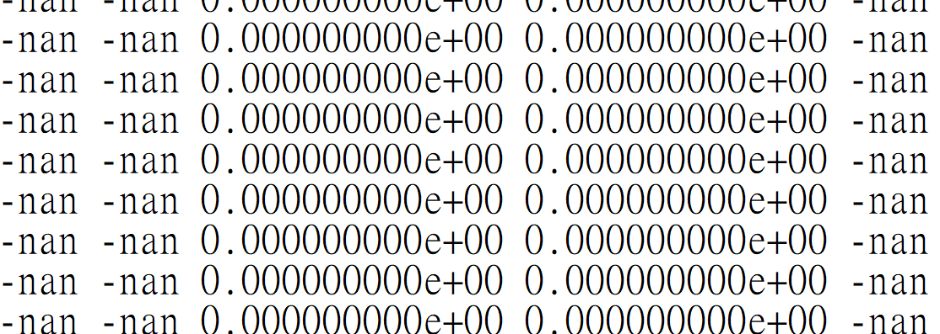
Utilizing Piecewise Parabolic Method (PPM)
Step1: Find slope
Step2: Find the value between two points.
Step3: Find average value between two points
Step4: Calculate the next step value
<-OpenMP
<-OpenMP
<-OpenMP
Error
<-OpenMP
Result:

Slide 20
Attempting utilize Weighted Essentially Non-Oscillatory (Weno) and Gaussian Process (GP)
Beside utilizing the Piecewise Parabolic Method, we also trying to implement Weighted Essentially Non-Oscillatory (Weno) method (not shown) and Gaussian Process (GP) method.
While we unable to embody these methods in our code successfully, we still had grasp some ideas about how they should be implemented.

Slide 21

Gaussian Process (GP)
Gaussian Process (GP) is used to predict uncertain functions or data. It’s a collection of random variables, so it involve amount of data training as we modeling the method.
It mainly compose by two function:
- Mean Function : f(x).mean
- Covariance Function with “Squared Exponential” (SE Kernel) : 𝑘(𝑥,𝑥′)
where variant Σ and lengthscale l are hyperparameters,
which we manually set their initial value.
From s10915-017-0625-2
A New Class of High-Order Methods for Fluid Dynamics Simulations Using Gaussian Process Modeling: One-Dimensional Case

Slide 22

Gaussian Process (GP)
Then through Cholesky decomposition of Kernel, we can eventually got the updated posterior mean function, which is core function of doing GP interpolation.
Where f_*.mean is prediction from right hand side interpolation.
From s10915-017-0625-2
A New Class of High-Order Methods for Fluid Dynamics Simulations Using Gaussian Process Modeling: One-Dimensional Case

Slide 23
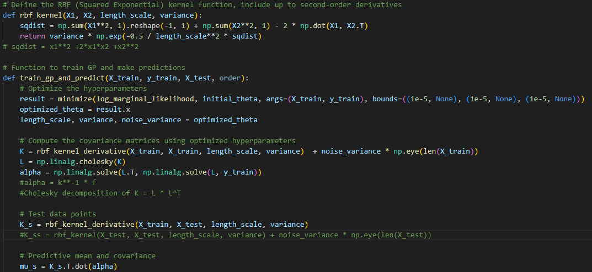
Gaussian Process (GP)
Kernel func.
Where f_*.mean is prediction from right hand side interpolation.
prediction.

Slide 24

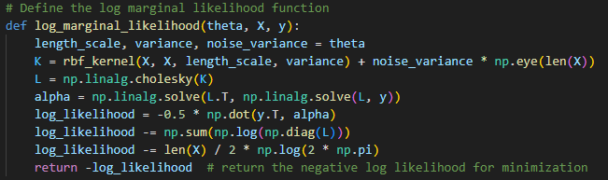
Gaussian Process (GP)
Hyperparameters will change with the training process, and they can be determined with the "likehood function". (this part I still have trouble to understand.)
From s10915-017-0625-2

Slide 25
Conclusion and outlook

Slide 26
Conclusion
1. Converting original python code to operational cpp code is a great strive during our PPM implementation.
2. Although we unable to implement GP and Weno into our code, however we still learned some key idea about how should we transform functions into code formulation.

Slide 27
Conclusion
3. The reason why our GP method fail, it might due to we lose some crucial evolving function. When we testing our GP method in Sod shock problem, we observed a smoothing in the oscillation region, which is confirm that GP is good at smoothing as kernel function inherently produce smooth functions, although it also potentially over smooth the predicted value.

Slide 28
Conclusion
4. Due to we take a short cut to directly implement the hyperbolic function and the weight function that shown in the paper into python format, we still not fully understand the physics behind this method, maybe the additional time is needed to more properly utilize this method.

Slide 29
The end

Slide 30
工作分配表
陳樂仁：PPT製作，口頭報告，Gauss Process and WENO implementation.
郭存淞：Code translating, parallelizing code, Github organized.
高子禹：Piecewise-Parabolic Method (PPM) analytical and numerical implementation.

Slide 31
Smoothing effect of GP method
To test our GP method, we firstly implemented both method into Lax-Friedrichs scheme and MUSCL-Hancock scheme.
While during the testing, the simulation code can't evolve toward both sides of figure, there're some smoothing effect appear at shock surface.

Slide 32
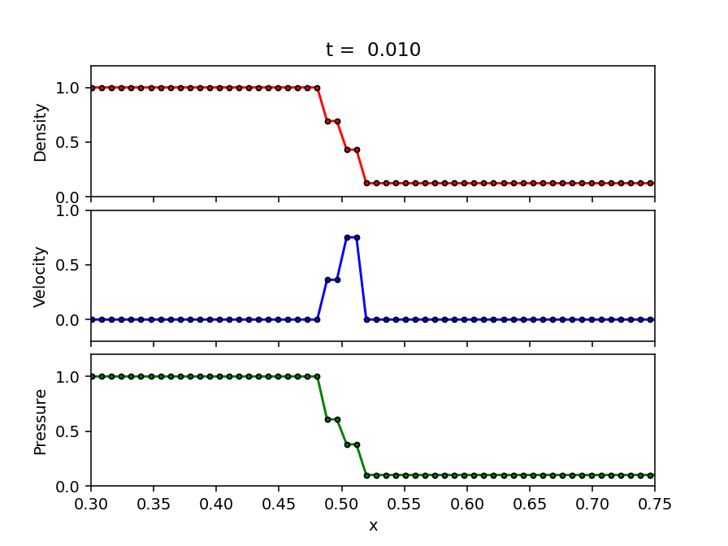
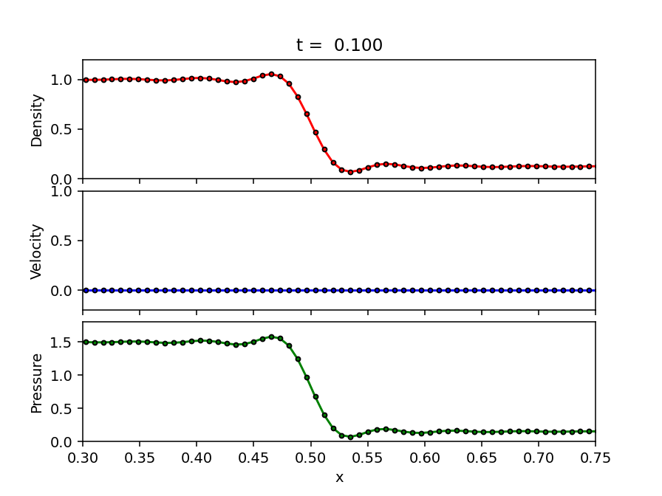
Smoothing effect of GP method In L-F scheme
From code GPLW.py

Slide 33
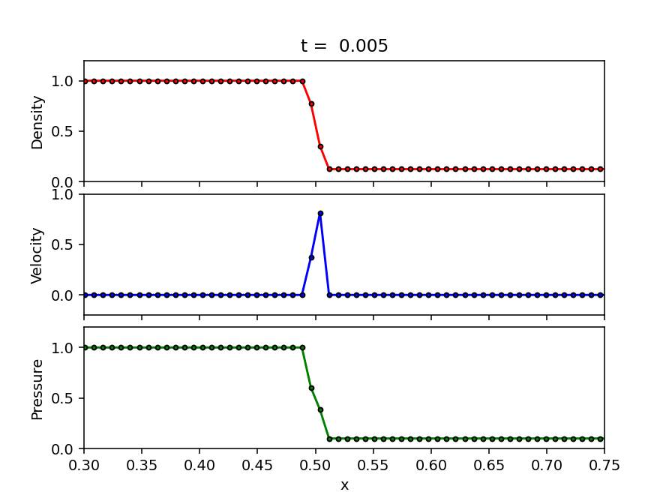
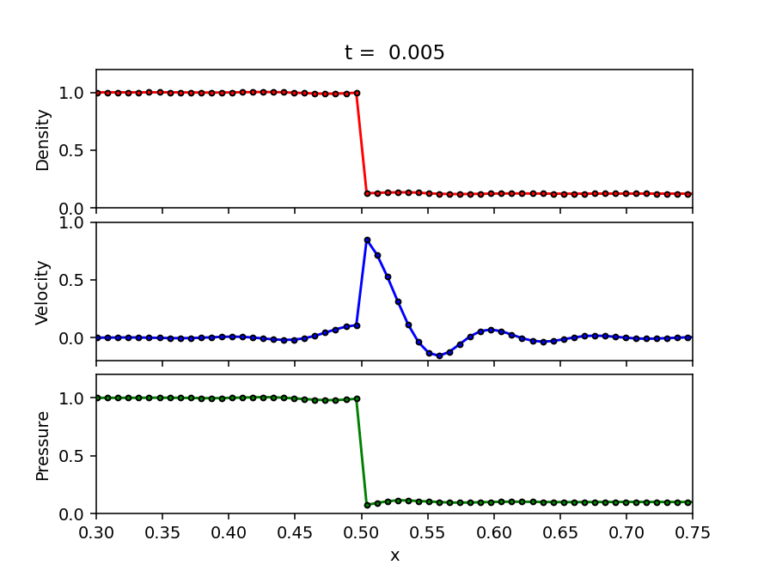
Smoothing effect of GP method In MUSCL-Hancock scheme
From code GPHK.py

Slide 34
Smoothing effect of GP method
Our GP method seemly at least inherent its smoothing nature at abrupt changed shock surface.
When we couple GP method with WENO method, the oscillating parts in the figure will be more smooth than pure GP method.

