Slide 1
Winger Crystal
Sep 14th 2026

Slide 2
Outline
Background
Experimental realization
Summary

Slide 3
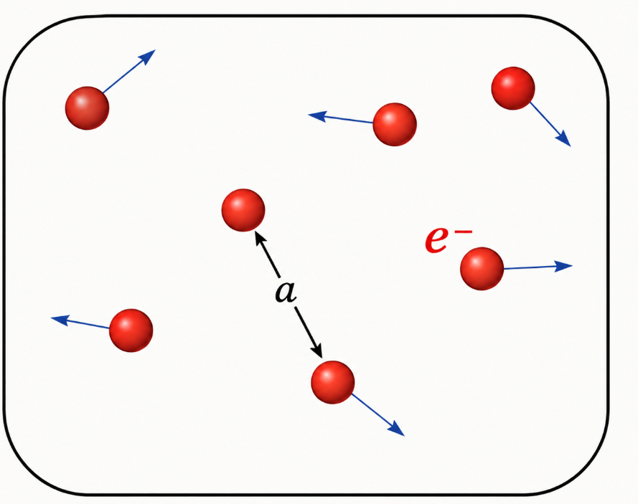
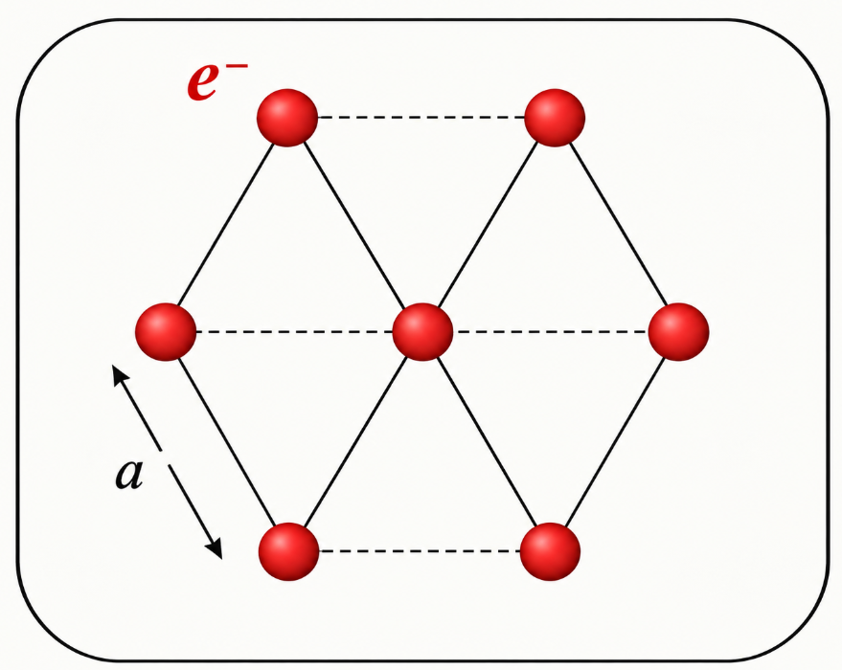
Background
2D electron gas
Gas, liquid
Winger crystal (Solid)
Kinetic energy dominate
Potential energy dominate

Slide 4
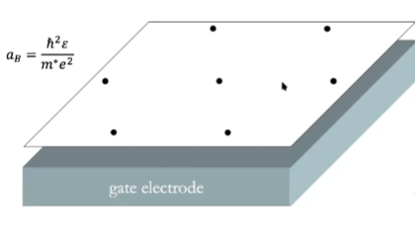

Slide 5
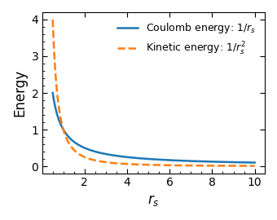
Conditions for Wigner crystallization:
Coulomb Potential Energy
Kinetic energy
Quantum
Classical
Wigner Crystals: A phase of electrons that occurs when the Coulomb potential between the electrons dominates over their kinetic energy. The electrons localize into a regular lattice structure to minimize their energy.

Slide 6
Low densities
Kinetic energy dominate
Electron gas
Intermediate densities
liquidlike
High densities
Potential energy dominate
Electron Solid

Slide 8
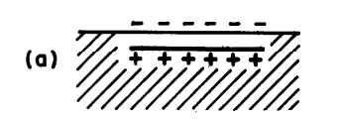
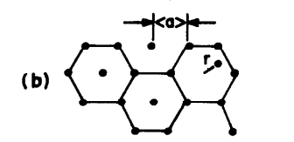
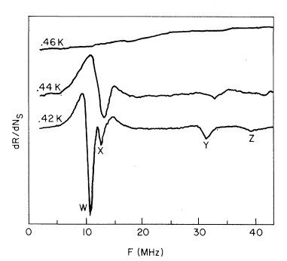
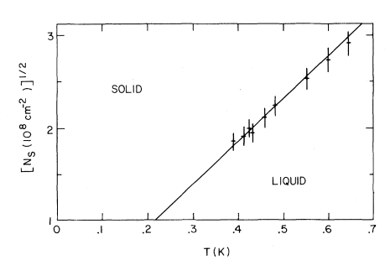
Experimental realization: Liquid helium

Slide 9
Experimental realization: Quantum Hall system
Plasmon
Add perpendicular magnetic field
Gapped in bulk
magnetophonon branch
gapless

Slide 10
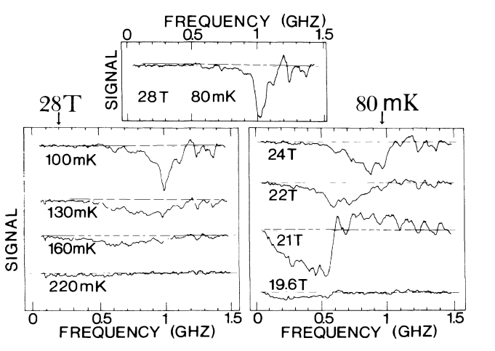
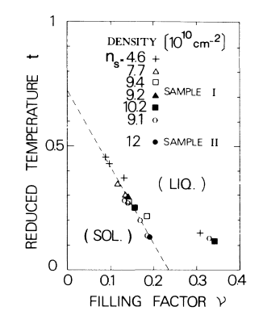
Experimental realization: Quantum Hall system

Slide 11
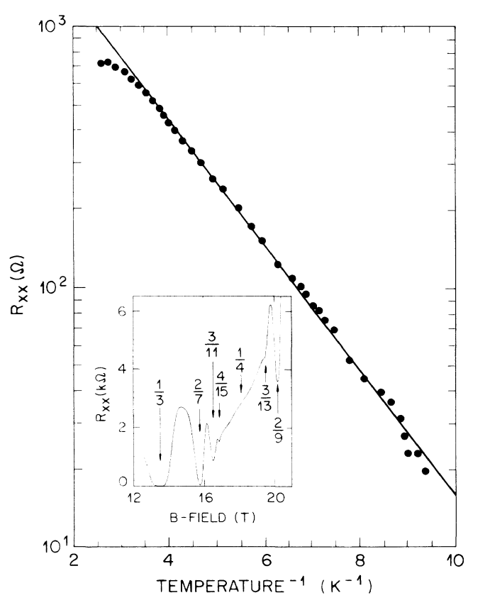
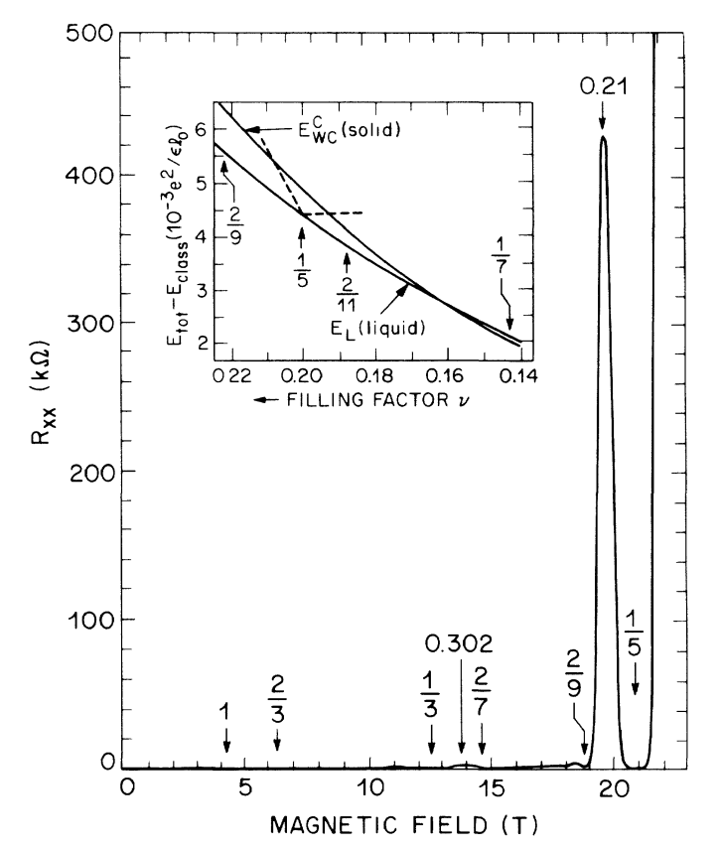
Experimental realization: Quantum Hall system

Slide 12
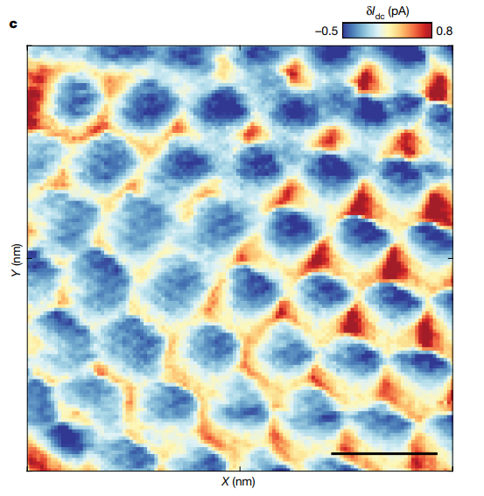
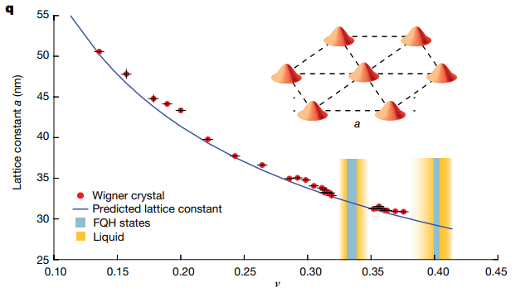
Experimental realization: Twisted bilayer graphene

Slide 17
Summary

Slide 18
References
Wigner, E. Phys. Rev. 46, 1002–1101 (1934)
Grimes, C. C. & Adams, G. Phys. Rev. Lett. 42, 795–798 (1979)
Andrei, E. Y. et al. Phys. Rev. Lett. 60, 2765–2768 (1988)
H. W. Jiang.et al. Phys.Rev.Lett.65. 633-636(1990)
Tsui, Y.-C. et al. Nature 628, 287–292 (2024)

Slide 19
Thank you for your attention!

