Slide 1
abcdefghijklm
fgdgdfg

Slide 2
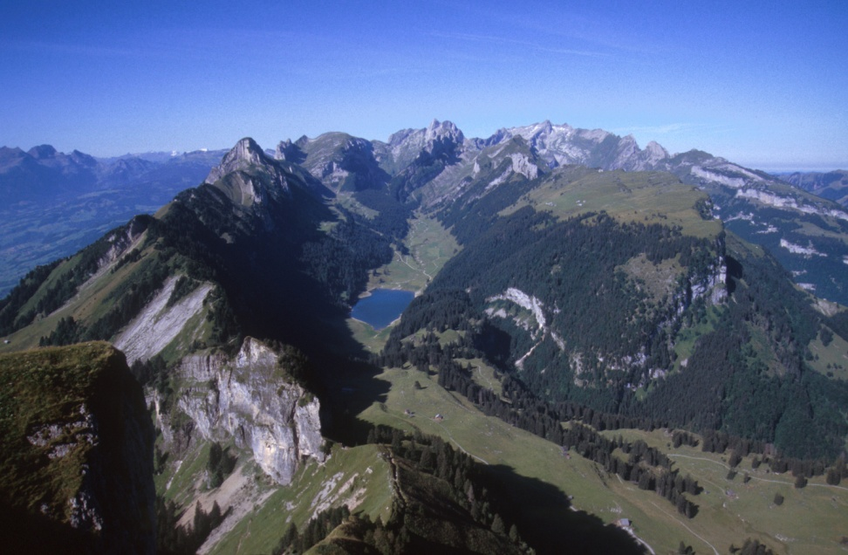

Slide 3
