Slide 1


Tsvetalin Yordanov & Kaloyan Todorov

Slide 2

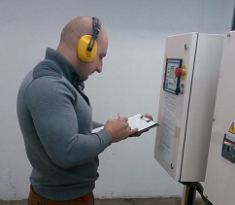
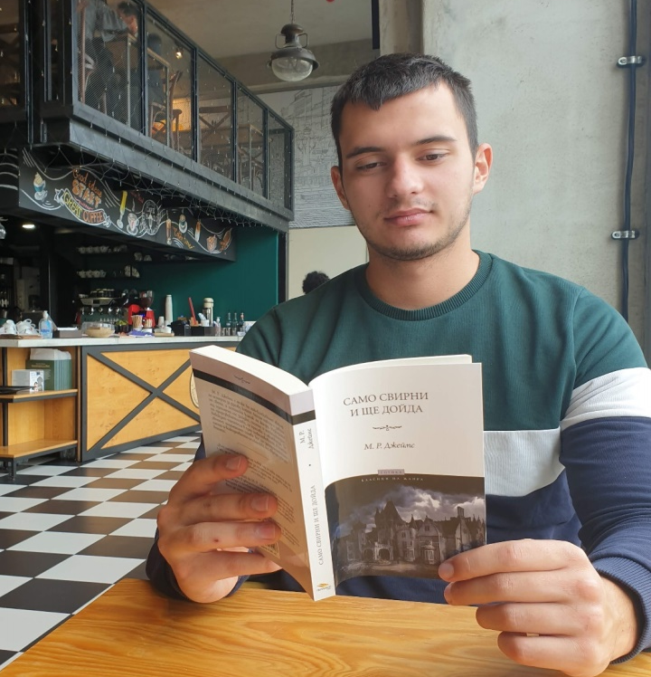
32 years old
Electrical engineer
Motorsport enthusiast
2121 years old
Student
Snowboard enthusiast

Slide 3
Main functionality
Create playlist
Add video to playlist
Remove video from playlist
Delete playlist
Registration
Email registration verification
Log in
Log out
Follow users
Follow category
View history and Delete history
Search videos, playlists and users by name
Watch video
Upload video
Upload video to Dropbox
Like and dislike Video
Add video to category
Add comment to video
Like and dislike comment
Add comment to comment

Slide 4
Technologies and APIs
Intellij IDEA
Postman
Git
Java EE
Spring boot
Spring REST
Maven
Hibernate
JPA
MySQL
BCrypt
Lombok
ModelMapper
Dropbox Core
JavaMail
JDBC Template

Slide 5
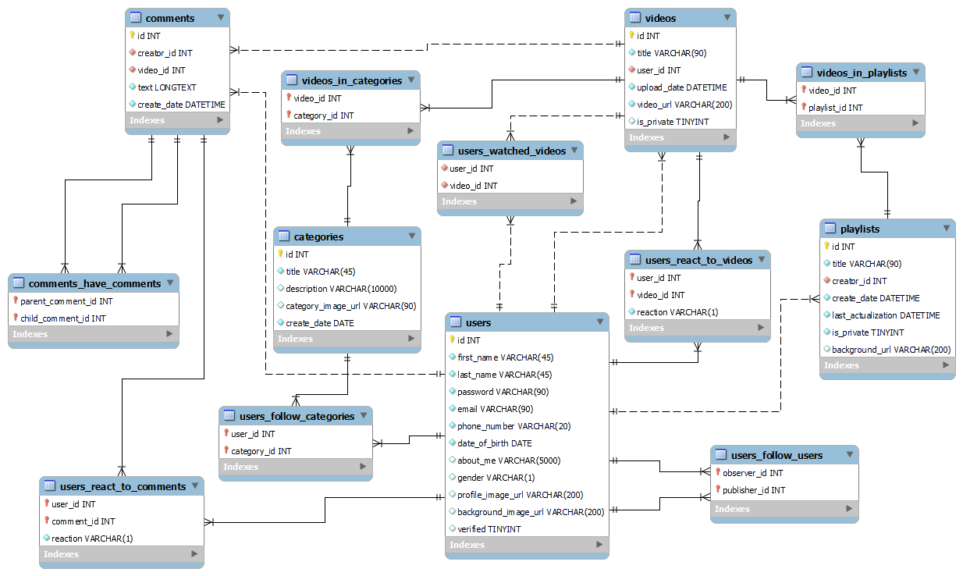
ER Diagram

Slide 6
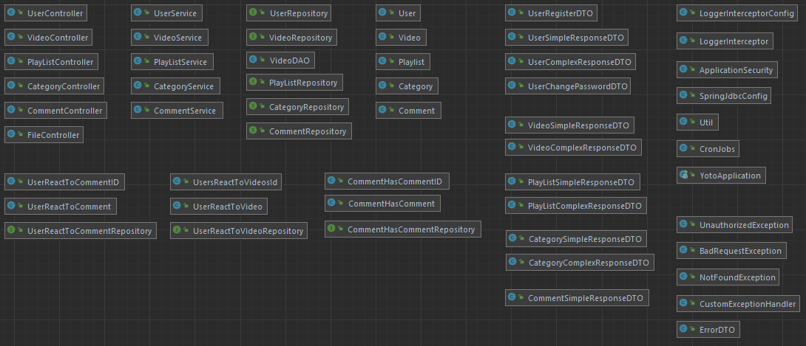
Class Diagram

Slide 7

DEMO

Slide 8
Thank you for the attention

