Slide 1

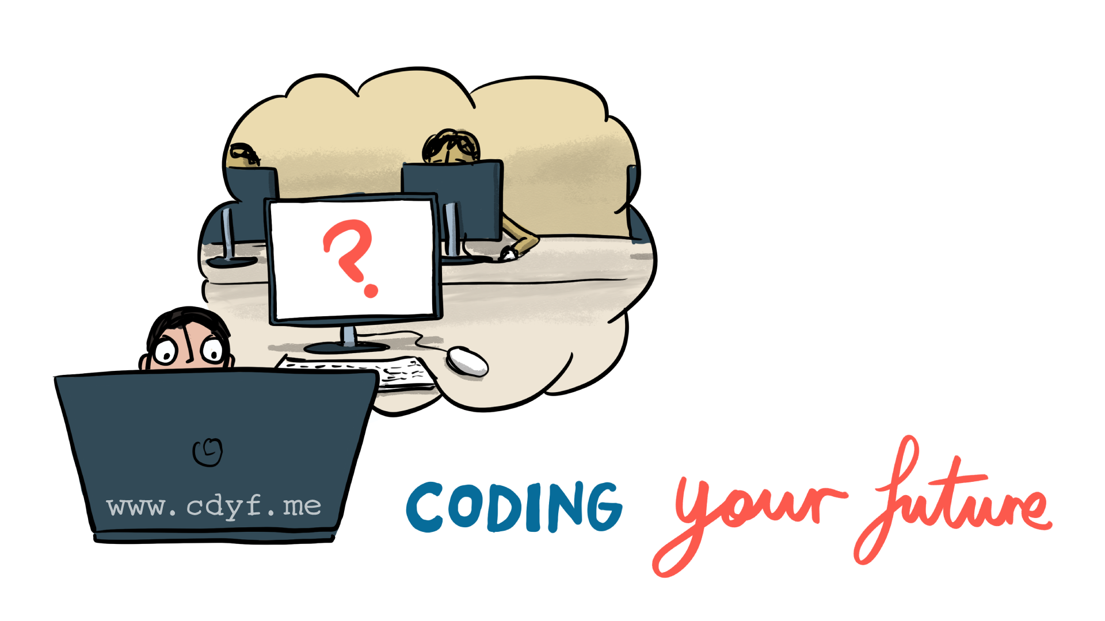
I: DESIGNING YOUR FUTURE
II: BUILDING YOUR FUTURE
1. WHY
BOTHER?
4. SOFT SKILLS
ARE HARD
7. DEBUG YOUR CV
10. YOUR SURVIVAL &
PROMOTION
2. WHO ARE YOU?
5. ARE YOU EXPERIENCED?
8. YOUR SEARCH & NETWORK
11. YOUR ALTERNATIVES
3. YOUR WELL-BEING
6. COMPUTING YOUR FUTURE
9. YOUR INTERVIEWS
12. POSTGRAD?
cdyf.me

