Slide 1



Airbnb.com
IT Talents Season 13
Final Project

Slide 2


Who are we?
Цветислава Янкова
Студент в магистърска програма Бизнес информатика, УНСС
Предишен опит като Одитен анализатор в BIG4 компания
Ния Попова
Студент в специалност информатика в Софийски университет

Slide 3
Airbnb е онлайн платформа, която предлага обяви за краткосрочно наемане на жилища по цял свят.
Airbnb е съкращение от Air mattress, bed and breakfast, т.е. надуваем дюшек, нощувка и закуска.

Slide 4
What did we use
Spring Boot
Java EE
MySQL Workbench
Hibernate
Postman
Git
GitHub
IDE: IntelliJ Idea
Maven
Tomcat
APIs and libraries:
Lombok
BCrypt
Spring Data JPA
ModelMapper

Slide 5

User
Register
Login
Logout
Delete user
Get user by id
Forget password
Change password
Add user photo
Delete user photo
Download user photo
Edit user photo
Edit user

Slide 6

Reservation
Make reservation
Add payment
Cancel reservation
Get reservation by id
Get payment by id
Get payment status by id
Confirm payment

Slide 7

Property
Add property
Add photo(s) of property
Delete property
Delete photo(s)
Download property photo(s)
Get property by id
Add rating
Filter by price
Filter by characteristic
Edit address
Edit characteristic(s)

Slide 8

Review
Add review
Delete review
Get review by id

Slide 9
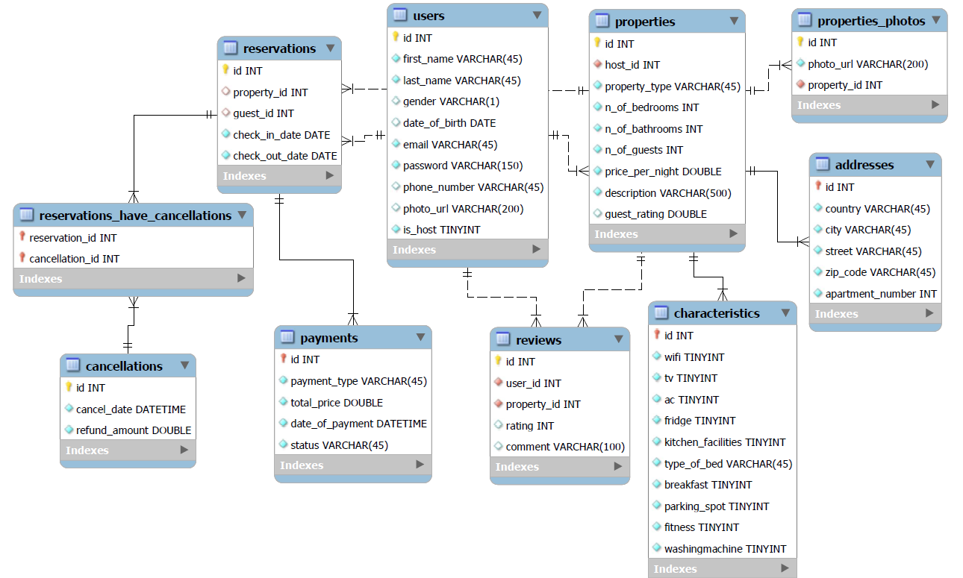
Diagram of the project

Slide 10
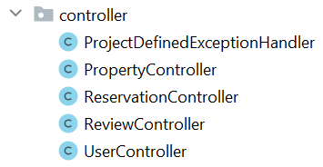
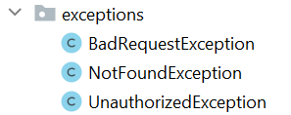
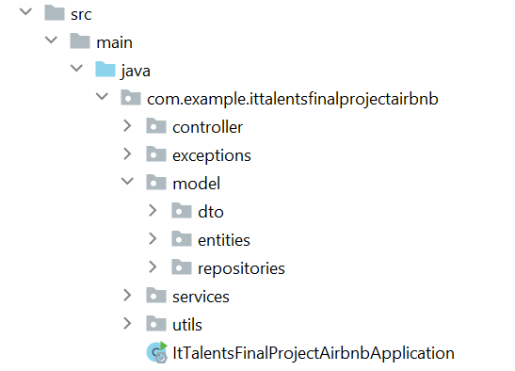
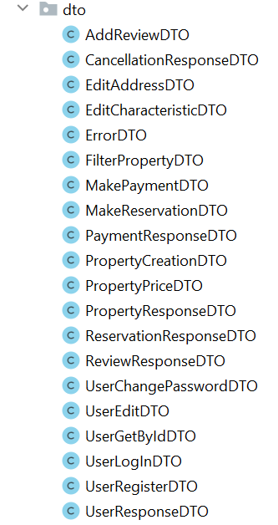
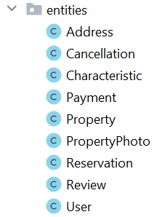
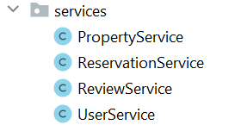
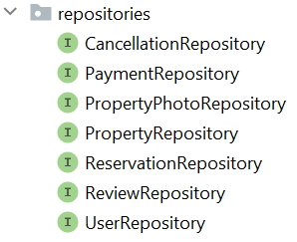


Slide 11
Showtime
Time to see our Demo!

Slide 12

Thank you!

