Slide 1
Data Science Camp
Linear regression

Slide 2

This Lesson
Linear regression with one feature
Cost function
Gradient descent
Linear regression with multi features
Multi features implementation
Ridge regression
Lasso
Normal equation
Polynomial regression

Slide 3
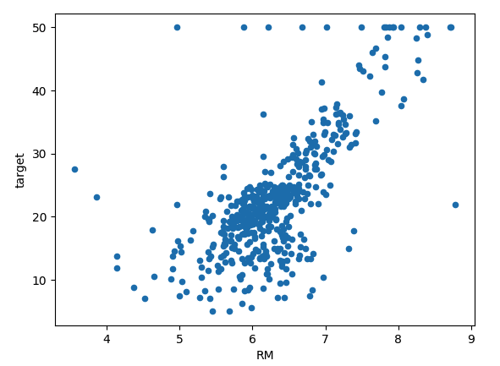

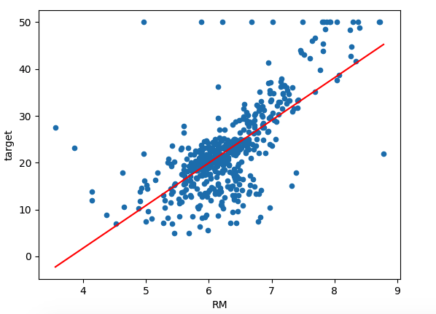
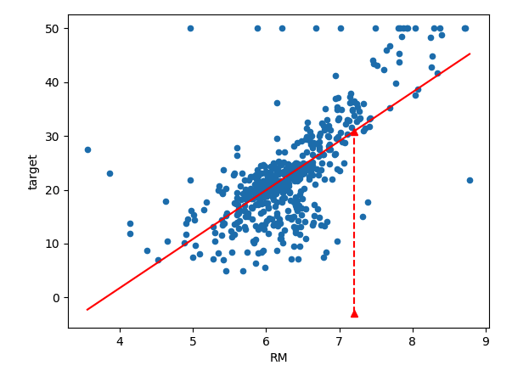
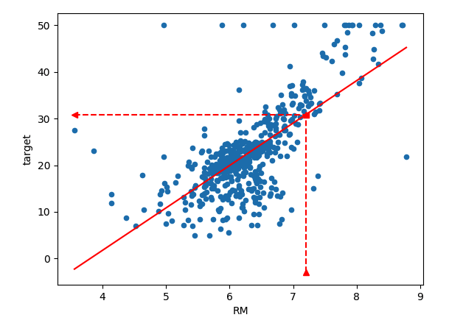
Linear regression with one variable
from sklearn.datasets import load_boston
X, y = load_boston(return_X_y=True)
df = pd.DataFrame (X, columns= ['CRIM', 'ZN', 'INDUS', 'CHAS', 'NOX', 'RM', 'AGE', 'DIS', 'RAD', 'TAX', 'PTRATIO', 'B', 'LSTAT'])
# Use RM - average number of rooms per dwelling
Notes:
Note : Linear regression may bring worse results comparing with KNN but it contains just 2 params that allows to predict unseen data and thus works faster

Slide 4
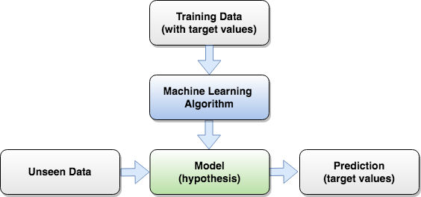
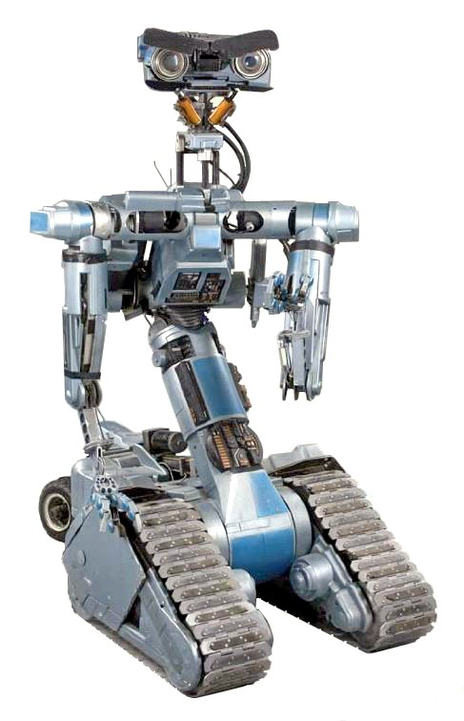
Supervised Machine Learning Flow

Slide 5

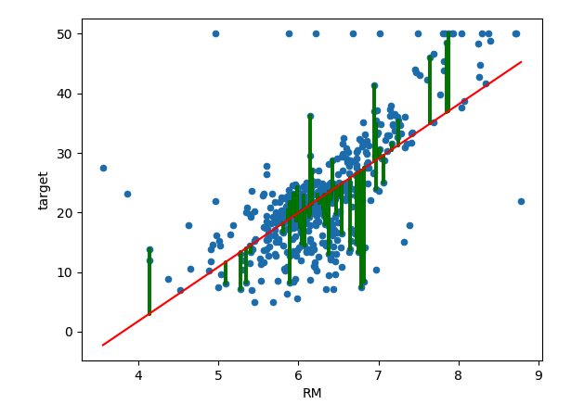


Cost Function
Hypothesis
Error
Cost function (squared error function):
Task: Choose b,w that minimize the cost function

Slide 6
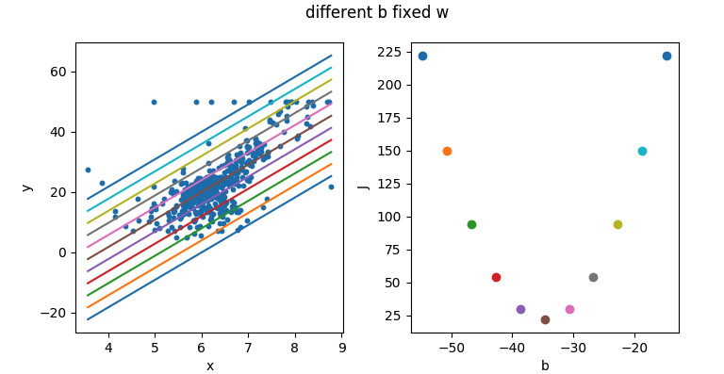
Minimizing Cost Function by parameter b

Slide 7
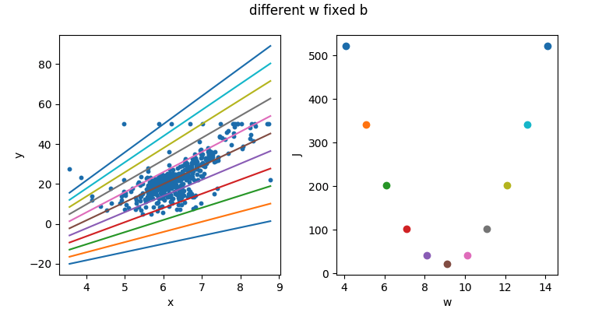
Minimizing Cost Function by parameter w

Slide 8
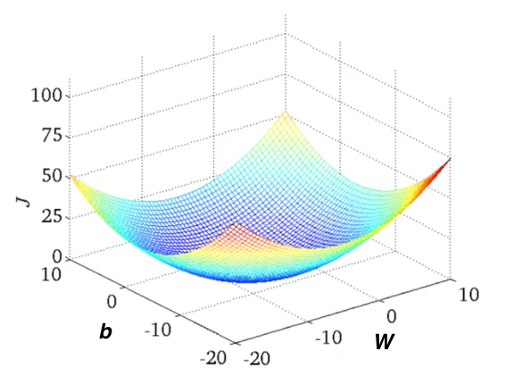
Minimizing Cost Function by both parameters

Slide 9




Gradient Descent
Start from some initial values e.g.
Since gradient shows the direction of the fastest increase of the function, it is used for iterative updating parameters
learning rate

Slide 10
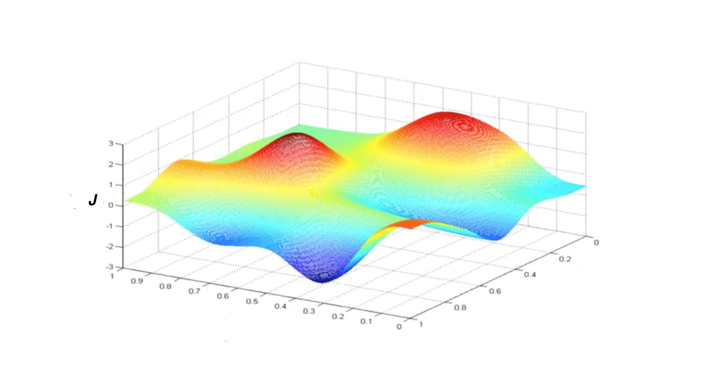
Gradient Descent Visualization

Slide 11

Gradient Descent Visualization

Slide 12

Gradient Descent Visualization

Slide 13
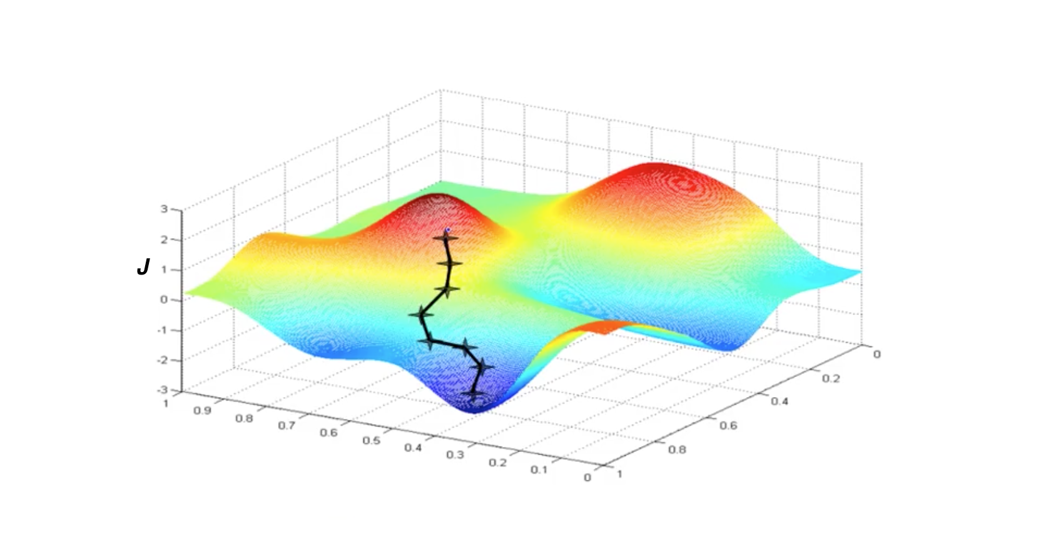
Gradient Descent Visualization

Slide 14
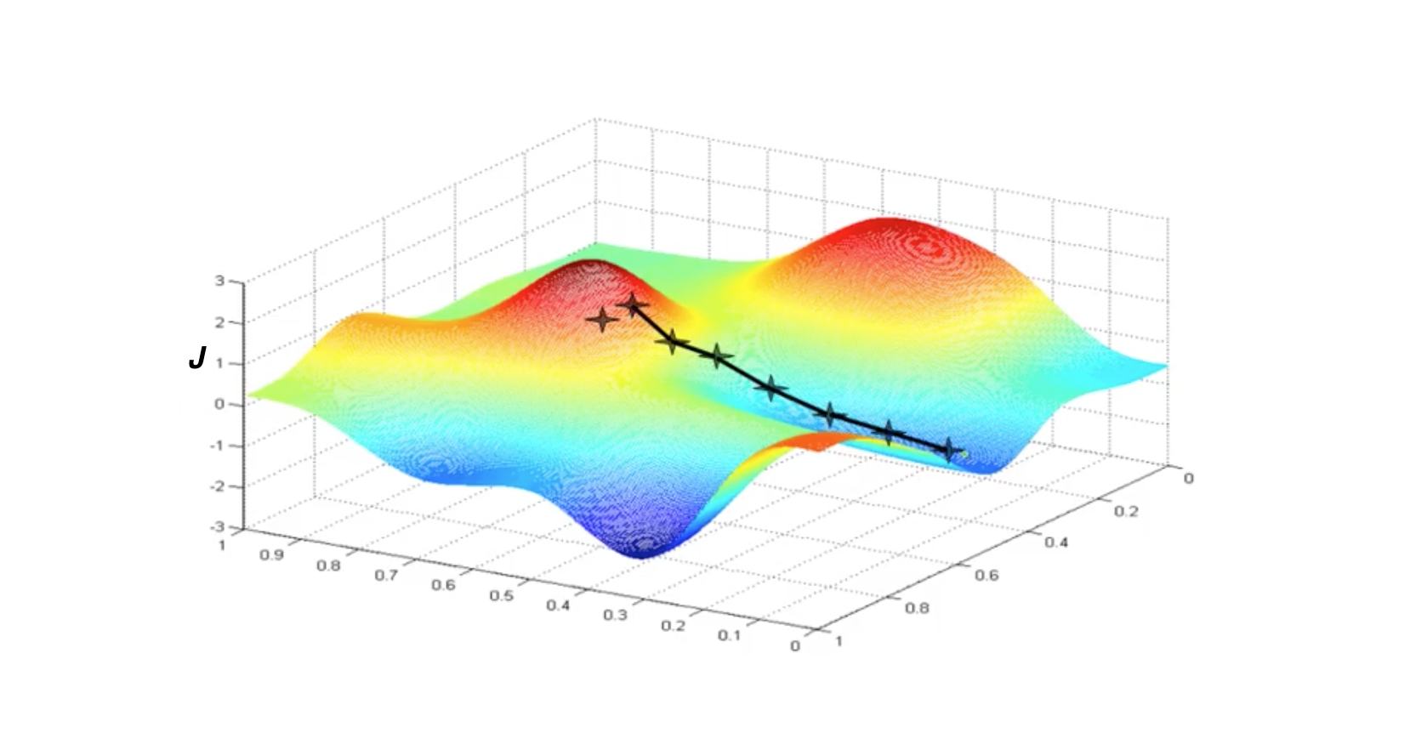
Gradient Descent Visualization
Notes:
Note: it may depend from initial values

Slide 15

Derivatives In Gradient Descent

Slide 16
Gradient Descent comments
For linear regression the surface is convex and always has only one global minimum
The described approach also called Batch Gradient descent that means to consider ALL samples at every iteration

Slide 17


Features Normalization
May even not converge without normalizing
StandardScaler (* works better)
MinMaxScaler
from sklearn.preprocessing import StandardScaler
scaler = StandardScaler()
X_train_scaled= scaler.fit_transform(X_train)
X_test_scaled= scaler.transform(X_test)
from sklearn.preprocessing import MinMaxScaler
...

Slide 18
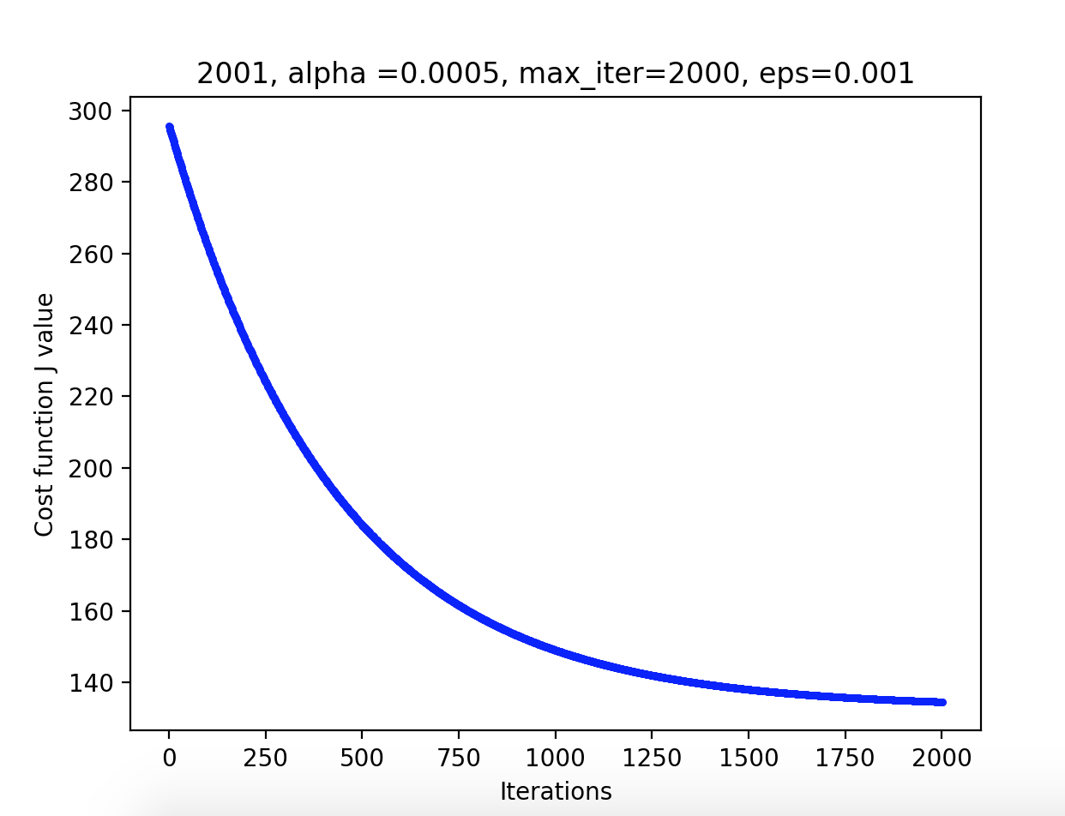
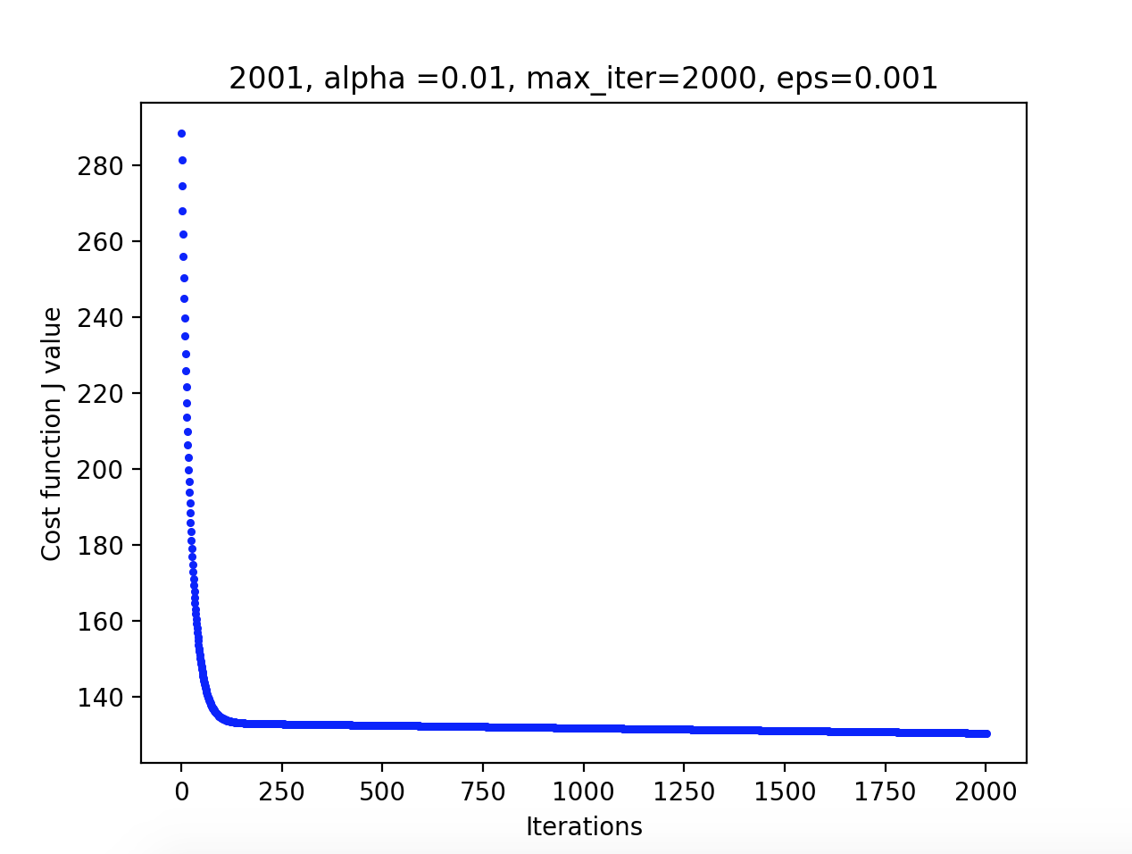
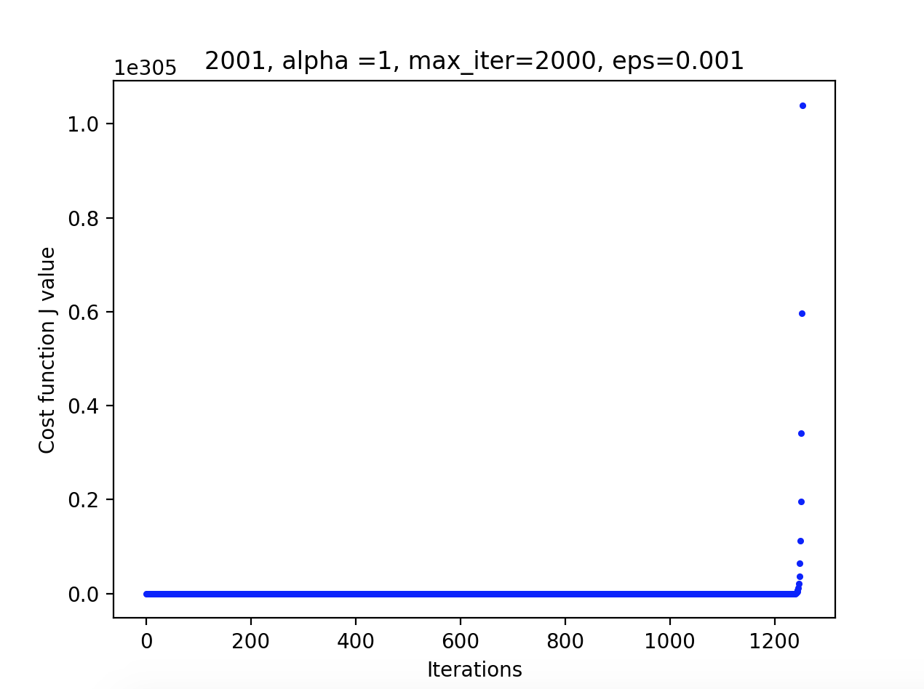
Check the process converges
If is sufficiently small, Cost function should decrease at every iteration
Small - slow convergence, large - may not converge.
Try in [0.001, 0.003, 0.01, 0.03, 0.1, 0.3, 1.0, 3, 10 ...]

Slide 19
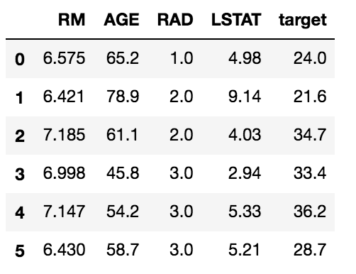
Multiple Features

Slide 20



Multiple Features Notation
m samples
n features

Slide 21



Multiple Features Hypothesis and Cost Function

Slide 22

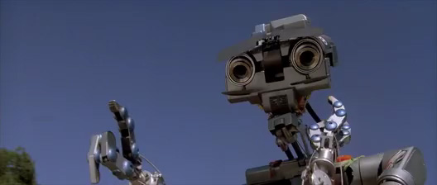
Gradient Descent for Multiple Features
Simultaneously

Slide 23


Cost Function Implementation

Slide 24



Cost function implementation
Notes:
Note : sum(a^2) and a@a.T requires to make sure the a is row-vector - see sample at the end of lesson_6_part_1_Linear_Regression_Multi_Features

Slide 25


Cost Function Derivative Expression

Slide 26



Cost Function Derivatives Implementation

Slide 27

Other linear models for regression
Ridge regression
Normal equation
Polynomial regression

Slide 28
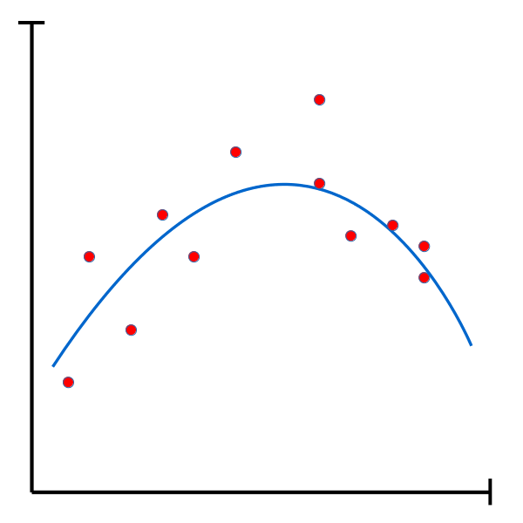
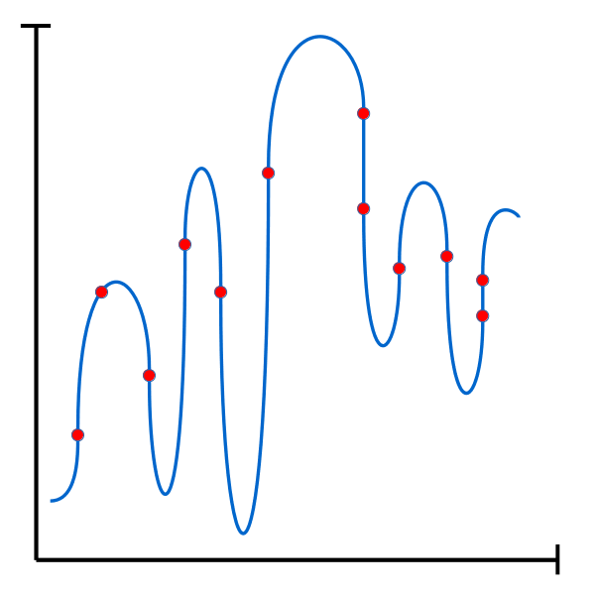
Overfitting in regression
Optimum
Overfitting

Slide 29
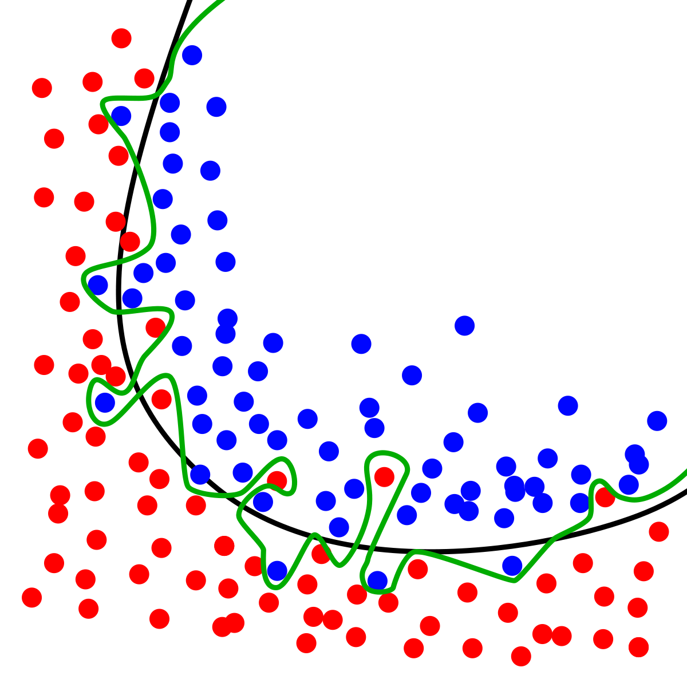

Overfitting in logistic regression

Slide 30

Regularization Ridge

Slide 31

Regularization Lasso
Lasso forces weights of irrelevant features to approach to zero
w= [ 0.00000000e+00 -0.00000000e+00 0.00000000e+00 -0.00000000e+00
0.00000000e+00 0.00000000e+00 0.00000000e+00 -0.00000000e+00
0.00000000e+00 0.00000000e+00 -0.00000000e+00 2.61900239e-03
-0.00000000e+00 3.33117186e-03 0.00000000e+00 0.00000000e+00
...

Slide 32

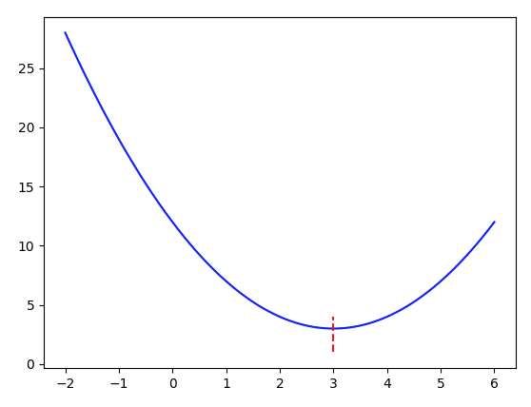

Normal Equation (Analytic Solution )
For function of one argument

Slide 33




Normal Equation For Linear Regression
For cost function

Slide 34


Polynomial Regression
Degree= 2

Slide 35

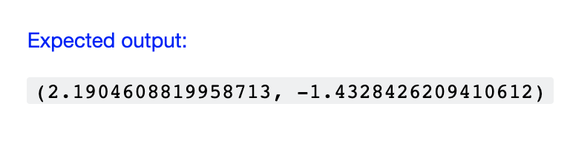
Home Task
Follow guide in Jupyter Notebook “lesson_6_lin_reg_home_task”
Fill in proper code to patterns:
# YOUR_CODE. instriction
# START_CODE
code
# END_CODE
Use “Check” cell’s code to check your results e.g
Use diabetes dataset (sklearn.datasets.load_diabetes)
Apply Ridge, Lasso, Polynomial
Implement Normal Equation (optionally)

Slide 36
Learn more
Machine Learning (free of charge)
https://www.coursera.org/learn/machine-learning/
Applied Machine Learning in Python
https://www.coursera.org/learn/python-machine-learning
An Introduction to Linear Regression Analysis
https://www.youtube.com/watch?v=zPG4NjIkCjc
How to calculate linear regression using least square method
https://www.youtube.com/watch?v=JvS2triCgOY
sklearn.datasets.load_diabetes
https://scikit-learn.org/stable/modules/generated/sklearn.datasets.load_diabetes.html
Notes:
All home task text is provided in handouts

Slide 37

Next Lesson
Logistic Regression

Slide 38

THANKS!
Any questions?

