Slide 1
Tailored Clothes Shopping
PERFECT Cuts | 2023
Based on Client’s Tailoring Business

Slide 2
Table of contents
01
02
03
04
About
Business
Tailoring Business to present and customize clothes for clients
Clothes Shopping Ecommerce App
Values
Overview
Client/Admin prestitched designs and customizable stitching
Have seamless cloth shopping

Slide 3
About the project
PERFECT CUTS | 2023
Clothes Shopping app based on client’s tailoring business .

Slide 4
Software Used To Build
Android App
IDE : Android Studio Giraffe
API Level : 33 and above
Backend Language : Java
Database : SQLite
Website
IDE : Visual Studio Code
Version : 64-bit 2022
Frontend Languages : HTML5/CSS and JavaScript
Backend Language : Java
Database : MySQL

Slide 5
Introduction
PERFECT CUTS | 2023
PerfectCuts, an android app & Website to shop clothes presented by Client’s tailoring business and customize clothes for customer requirements

Slide 6
Perfect Cuts
A seamless shopping experience, like this one:
Pick Your Style/Favorites
Add To Cart
Enter Required Details
Order!
And That’s it order placed!!!!

Slide 7
Divided performance of Project
Admin Panel
Customer Segment
Add New products, add product to incomplete stock and accept Customer order and assign for delivery
Select featured product or send a customized product request, add the selected product to cart and place order

Slide 8
Customer Segment
Select style
Add to cart
Order
From the given list of product select styles or send a request for custimizing the style
After selecting the product choose the size that best fits and add to cart
Enter the required Credentials and place the order

Slide 9
Admin Panel
Add Product
Add To Stock
01
02
Add new product of their work with details asked
Add products to incomplete stocks
03
Cust. Interaction
04
Assign Delivery
Interact with customers over call or chat and understand their requirements more fluently
After completing the order requirements assign it for delivery

Slide 10

Visit our website
Website is also provided to user for having a website based shopping.

Slide 11
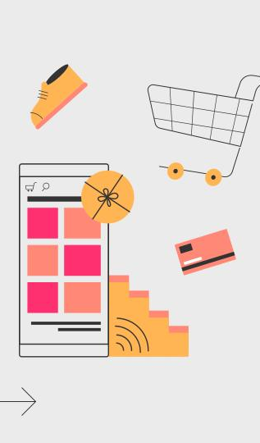
Mobile app
Access the seamless shopping experience through the app

Slide 12
PerfectCuts details
Customer management
Address their requirements
Notify about new products
E-commerce capabilities
Payment processing
Cost effective promotions
Flexibility for Customers
COD(Cash On Delivery) As of now.

Slide 13







A timeline always works well
Step 1
Step 2
Step 3
Step 4
Place The Order
Pick Style
Order Request Completed
Package Delivered

Slide 14
Product lists
A
MEN
Shirts, Pants & Tshirts
B
WOMEN
Skirts, Kurtas, Tops, Lehenga, Blouse and more
C
Kids
Shirts, Tshirts and Products Customizable

Slide 15
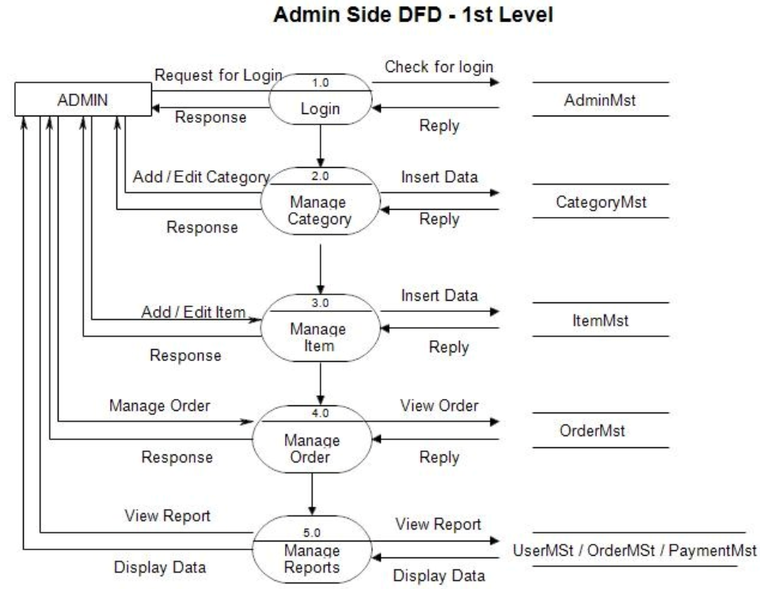
Diagrams Related With the Project

Slide 16
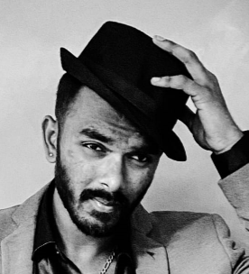


Our team
M V Roopali
Tarun
Abhinam B S
MCA ‘A’
2217120
MCA ‘B’
2217115
MCA ‘B’
2217062

Slide 17
Thanks!
PERFECT CUTS | 2023
Do you have any questions?
perfectcuts@shop.com | +91 9353980418 perfectcuts.shop
%

