Slide 1
Stock Price Prediction Using Linear Regression
Topic 9: Linear Regression – Deep Learning - AI

Slide 2
Table content
I
II
III
IV
Group member
Introduction
Evaluated linear regression
Reference

Slide 3
Table content
I
II
III
IV
Group member
Introduction
Evaluated linear regression
Reference

Slide 4

I
Group Member & Assignment

Slide 5
GROUP MEMBER
01
02
03
Dinh Ngoc Lap Thanh
(20226000)
Coordinate and allocate tasks
Manage progress and review source code
Write project report
Nguyen Duc Anh (20226009)
- Design preoject presentation
Trinh Thi Thuy Duong
(20226034)
- Develop stock price predicting model and cross examine results

Slide 6
GROUP MEMBER
01
02
03
Dinh Ngoc Lap Thanh
(20226000)
Coordinate and allocate tasks
Manage progress and review source code
Write project report
Nguyen Duc Anh (20226009)
Design project presentation
Trinh Thi Thuy Duong
(20226034)
- Develop stock price predicting model and cross examine results

Slide 7
GROUP MEMBER
01
02
03
Dinh Ngoc Lap Thanh
(20226000)
Coordinate and allocate tasks
Manage progress and review source code
Write project report
Nguyen Duc Anh (20226009)
Design project presentation
Trinh Thi Thuy Duong
(20226034)
Develop stock price predicting model and cross examine results

Slide 8
GROUP MEMBER
01
02
03
Dinh Ngoc Lap Thanh
(20226000)
Coordinate and allocate tasks
Manage progress and review source code
Write project report
Nguyen Duc Anh (20226009)
Design project presentation
Trinh Thi Thuy Duong
(20226034)
Develop stock price predicting model and cross examine results

Slide 9
GROUP MEMBER
01
02
03
04
05
06
Dinh Ngoc Lap Thanh
(20226000)
Nguyen Duc Anh (20226009)
Trinh Thi Thuy Duong
(20226034)
Doan Thi Thu Quyen (20226063)
Compute model evaluation metrics and design visual summaries of model results
Duong Phuong Thao
(20226001)
Develop stock volume predicting model and cross examine results
Compute model evaluation metrics and visual results
Vu Ngoc Dung (20226032)
- Review Thao’s code

Slide 10
GROUP MEMBER
01
02
03
04
05
06
Dinh Ngoc Lap Thanh
(20226000)
Nguyen Duc Anh (20226009)
Trinh Thi Thuy Duong
(20226034)
Doan Thi Thu Quyen (20226063)
Compute model evaluation metrics and design visual summaries of model results
Duong Phuong Thao
(20226001)
Develop stock volume predicting model and cross examine results
Compute model evaluation metrics and visual results
Vu Ngoc Dung (20226032)
Review Thao’s code
Write report for model 2

Slide 11
GROUP MEMBER
01
02
03
04
05
06
Dinh Ngoc Lap Thanh
(20226000)
Nguyen Duc Anh (20226009)
Trinh Thi Thuy Duong
(20226034)
Doan Thi Thu Quyen (20226063)
Compute model evaluation metrics and design visual summaries of model results
Duong Phuong Thao
(20226001)
Develop stock volume predicting model and cross examine results
Compute model evaluation metrics and visual results
Vu Ngoc Dung (20226032)
Review Thao’s code
Write report for model 2

Slide 12
II
Introduction
Based on the research paper by J. Margaret Sangeetha and K. Joy Alfia
This project about linear regression (include stock price and volume prediction model)
This presentation shall give the detail algorithim detail and include evaluation metrics to confirm the accuracy of the model

Slide 13
Introduction
Based on the research paper by J. Margaret Sangeetha and K. Joy Alfia
Implement linear regression in stock market forecast (include stock price and volume prediction model)
This presentation will give the detail of algorithms and include evaluation metrics to confirm the accuracy of the model

Slide 14

Key information
d

Slide 15
Data source
Yahoo finance through utilizing yfinance library

Slide 16
Data source
Observation number
Yahoo finance through utilizing yfinance library
1258 entries spanning 5 years

Slide 17
Data source
Observation number
Yahoo finance through utilizing yfinance library
1258 entries spanning 5 years
Independent parameter

Slide 18
Independent parameter
Stock price predict model
Stock volume predict model
open, close, low, high
price (mean of open, close, low, high)

Slide 19
Data source
Observation number
Yahoo finance through utilizing yfinance library
1258 entries spanning 5 years
Independent parameter

Slide 20
Data source
Observation number
Yahoo finance through utilizing yfinance library
1258 entries spanning 5 years
Dependent parameter
Independent parameter

Slide 21
Dependent parameter
Stock price predict model
Stock volume predict model
The following day stock price
The following day stock volume

Slide 22
III
EVALUATED LINEAR REGRESSION

Slide 23
1. Stock price prediction model

Slide 24

Algorithm detail

Slide 25
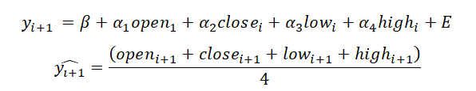
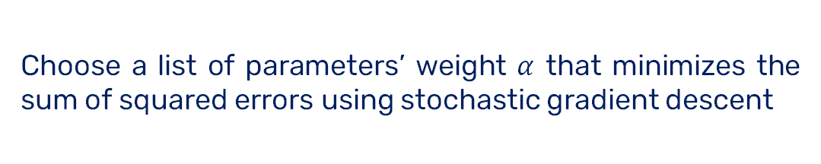
Linear regression model
Choose a list of parameters’ weight $α$ that minimizes the sum of squared errors using stochastic gradient descent
AIM

Slide 26
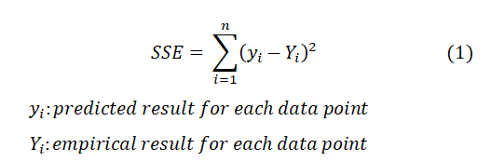
Our error function is defined as the difference between the predicted value and the true value.

Slide 27
Model explanation
Model main function least square fit

Slide 28






$$xs$$
List of vector
$$ys$$
List of floats
Model main function
$$Least_square_fit$$
$$learning_rate$$
The size of the steps
$$num_steps$$
number of iterations
$$batch_size$$
number of entries

Slide 29


Set initial guess for $α$ = 0.
Each iteration, the loop through the list of vectors $xs$in batches to create $batch_xs$& $batch_ys$.
Computes the gradient from the squared error for a data point (x,y) with current guess

Slide 30
Updating the current guess using the computed gradient and the learning rate.
The function returns the final guess for the regression coefficient after all iterations are complete.
Notes:
Slide 14 morph hộ phát

Slide 31

Result & Analyzation

Slide 32

Claim
The following results were conducted with data from 29-5-2019 to 28-5-2024, each entry recorded at 04:00 AM Eastern Time

Slide 33
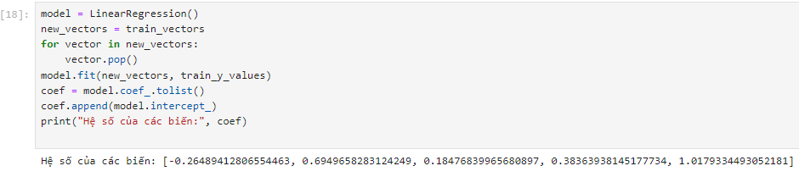
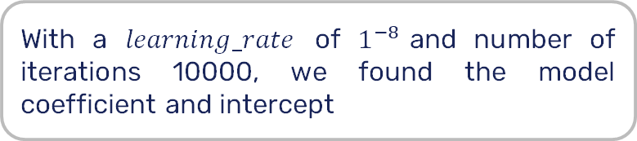
Model Results
With a $learning_rate$ of $1^{−8}$and number of iterations 10000, we found the model coefficient and intercept
Compared with the given model LinearRegression() provided by the sklearn library, the conducted model share a similarity in parameters’ weights
Notes:
Morph hộ

Slide 34
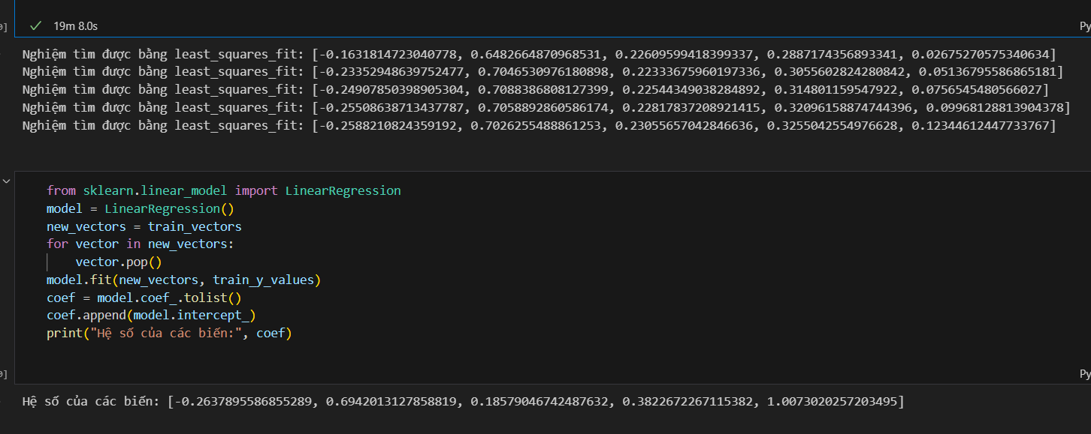
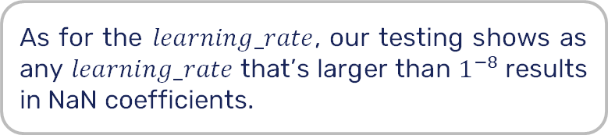
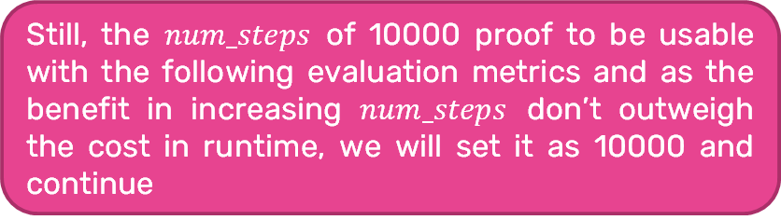
Model Results
Figure 3 shows that as we increase the number of iterations, our model’s coefficients and intercept converging to those of the benchmark
Still, the $num_steps$ of 10000 proof to be usable with the following evaluation metrics and as the benefit in increasing $num_steps$ don’t outweigh the cost in runtime, we will set it as 10000 and continue
As for the $learning_rate$, our testing shows as any $learning_rate$ that’s larger than $1^{−8}$results in NaN coefficients.
Notes:
Morph hộ

Slide 35
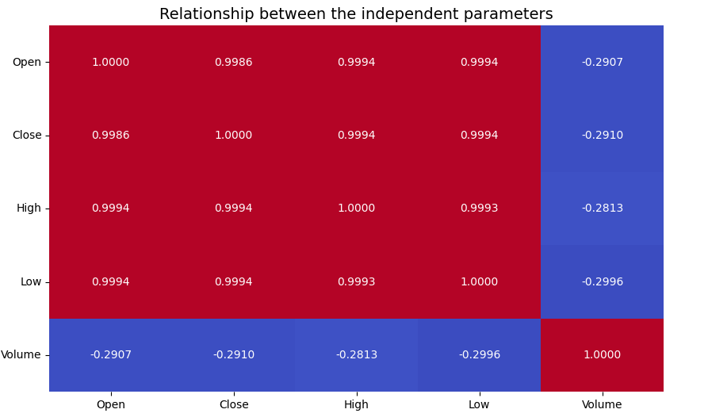
Evaluation metrics & model comparison
feature volume has negative coefficient of correlations on open, close, low, and high, and thus, we exclude it from our final calculations

Slide 36
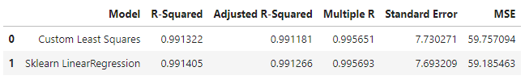
With the number of iterations limited to 10000, the final evaluation metrics nearly approach those of sklearn’s.

Slide 37
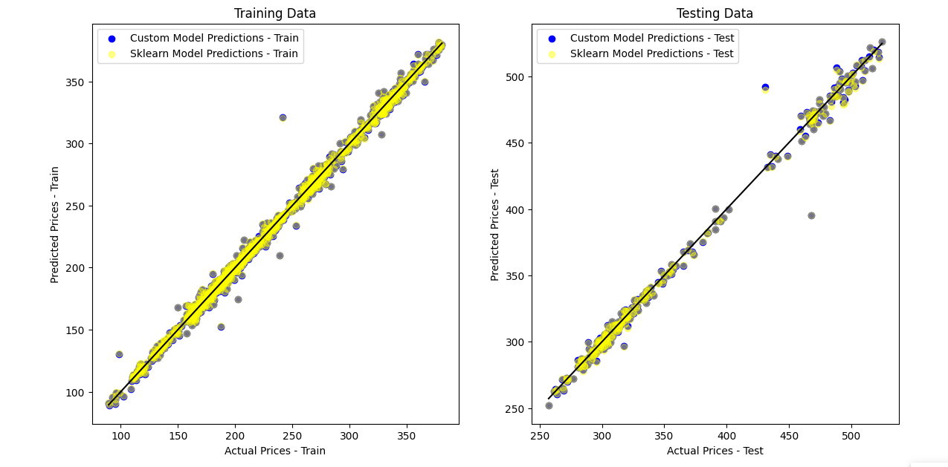
Figure 4 shows a considerable similarity between the estimation of two models
Notes:
Morph

Slide 38
2. Stock volume prediction model

Slide 39

Algorithm detail

Slide 40

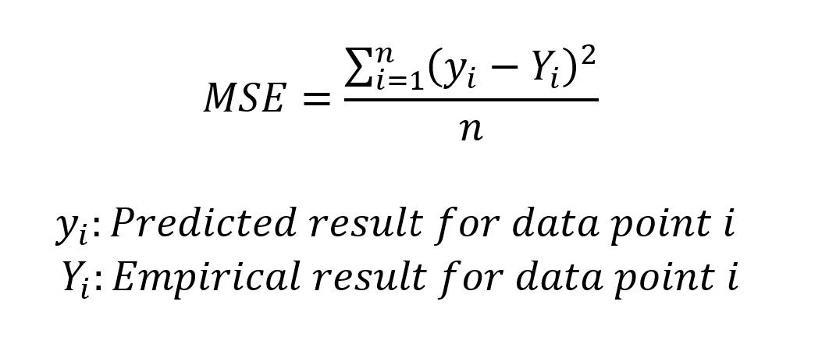
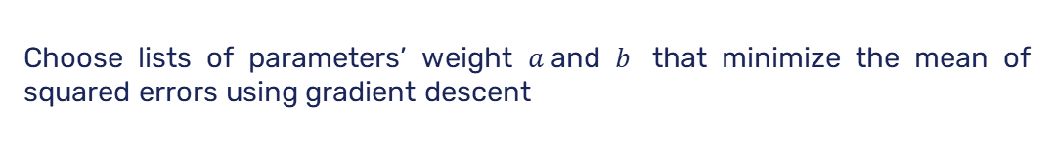
Linear regression model
AIM
Choose lists of parameters’ weight $a$and $b$ that minimize the mean of squared errors using gradient descent

Slide 41

Model explanation
Model main funtion predict

Slide 42









$$volume_pred$$
$$alpha$$
Size of the steps
Predicted volume arrays
$$Epochs$$
Number of iterations
Model main funtion
$predict$
$$error$$
Differences
$$m$$
Number of entries
$$a$$
Slope of each data point
$$b$$
Intercept of data point
$$db / da$$
Derivative of data point

Slide 43
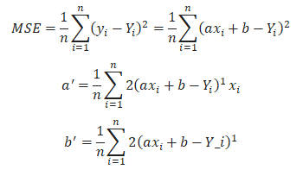
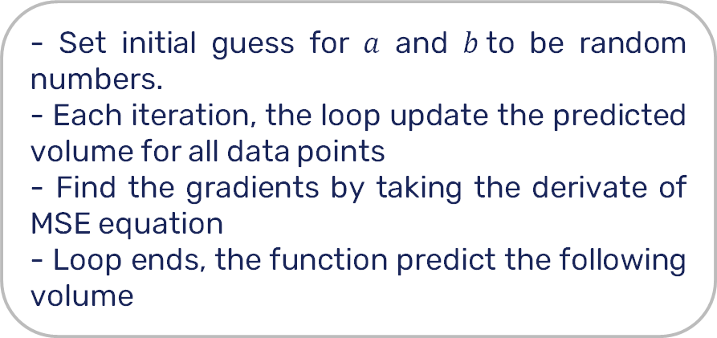
- Set initial guess for $a$ and $b$to be random numbers.
- Each iteration, the loop update the predicted volume for all data points
- Find the gradients by taking the derivate of MSE equation
- Loop ends, the function predict the following volume
Model explanation

Slide 44
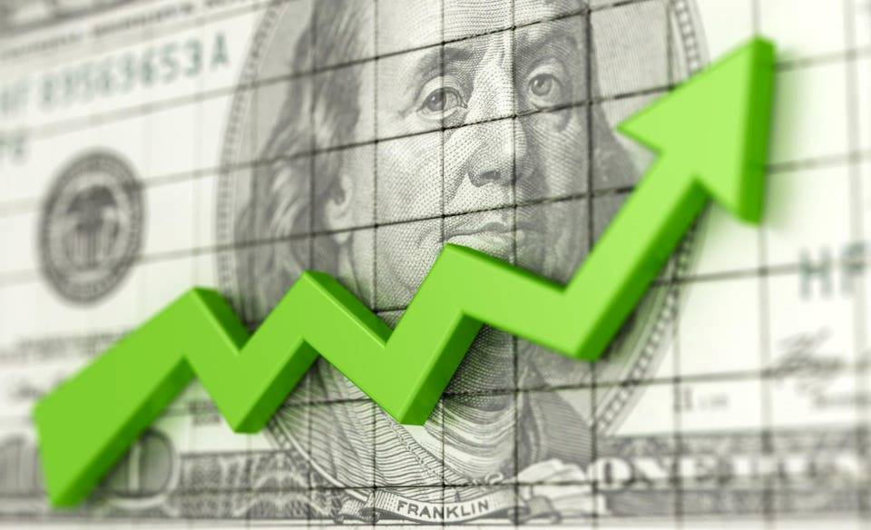
Result & Analyzation

Slide 45
Claim
The following results were conducted with data from 29-5-2019 to 28-5-2024, each entry recorded at 04:00 AM Eastern Time

Slide 46
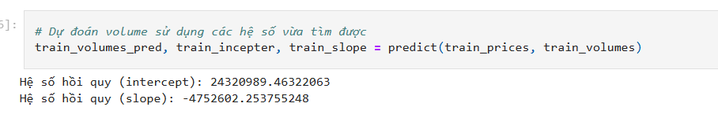
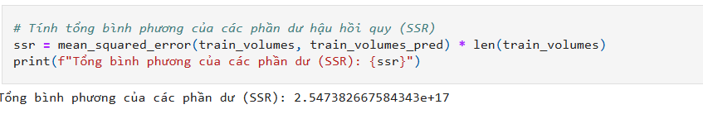
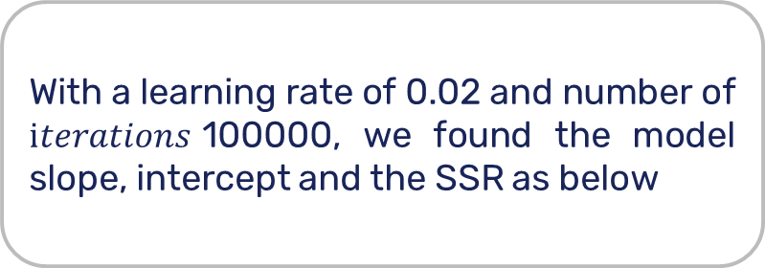
With a learning rate of 0.02 and number of $iterations$100000, we found the model slope, intercept and the SSR as below
Model Results

Slide 47
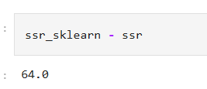

Model Results
Compared with the given model LinearRegression() provided by the sklearn library, the conducted model differ greatly in parameters’ weights but share roughly the same SSR value

Slide 48
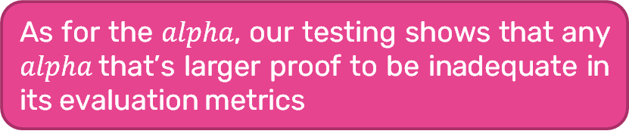
The iterations of 100000 is proof to be usable with the computed values and as the benefit in increasing iterations doesn’t outweight the cost in runtime, we will set it as 100000.
Model Results
As for the $alpha$, our testing shows that any $alpha$that’s larger proof to be inadequate in its evaluation metrics

Slide 49
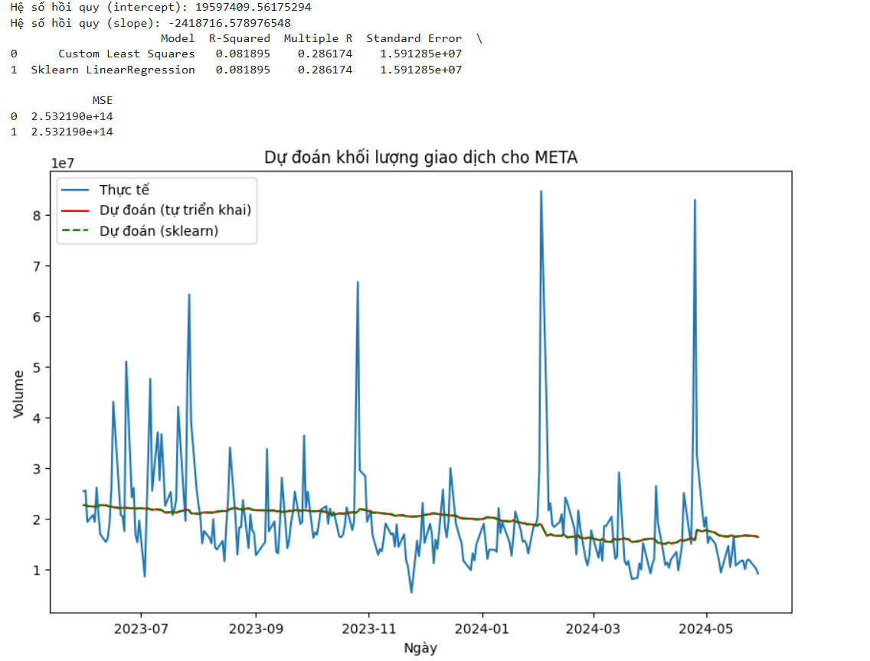
Evaluation metrics & model comparison
the final evaluation metrics equal to those of sklearn’s
Iterations limited to 100000
The results of both models on the test data

Slide 50

IV
Reference

Slide 51
Reference
J. Margaret Sangeetha and K. Joy Alfia (2023) Financial stock market forecast using evaluated linear regression based machine learning technique

Slide 52
Thanks for listening!

