Slide 1
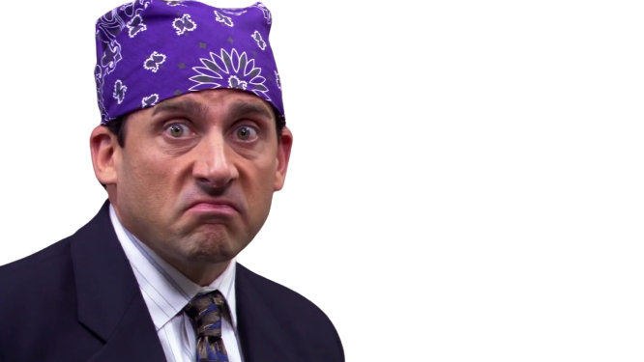
Predicting Episode ratings
The Office Dataset
-
Tóth Bence Zoltán

Slide 2
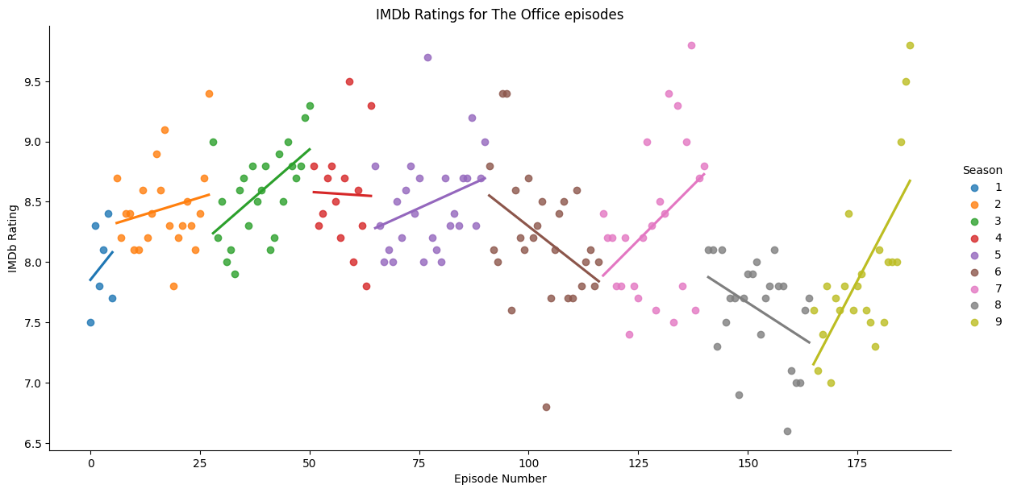


The Dataset

Slide 3
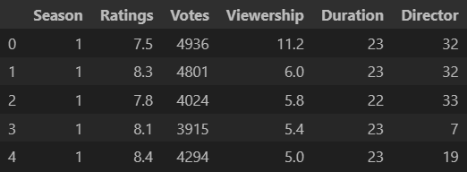
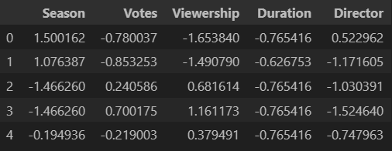
Encoding & Scaling

Slide 4
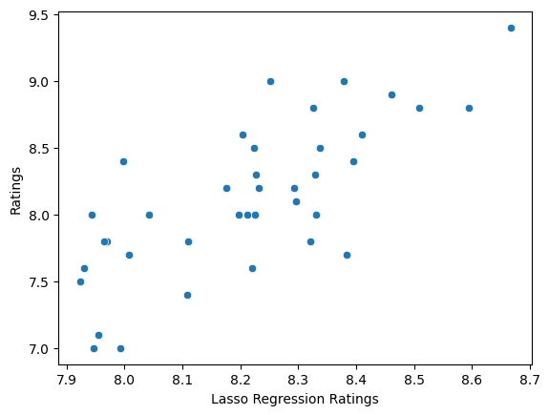
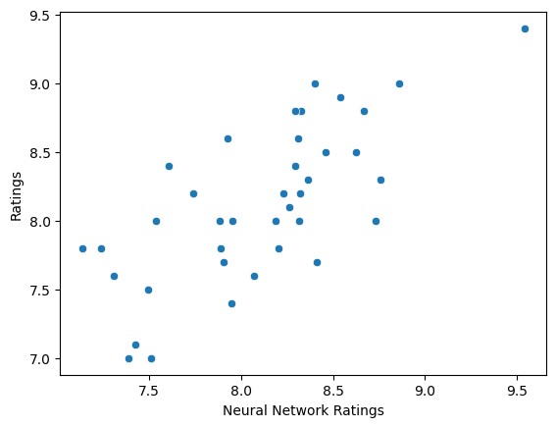
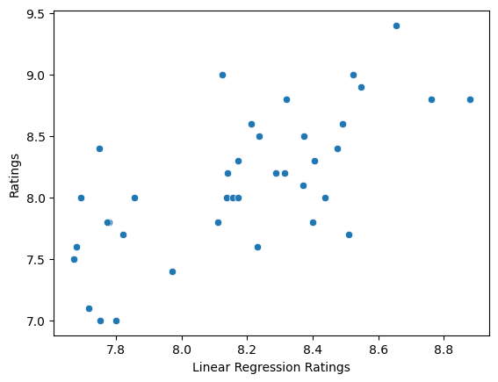


Used models
Linear Regression
Lasso Regression
Custom Neural Network

Slide 5
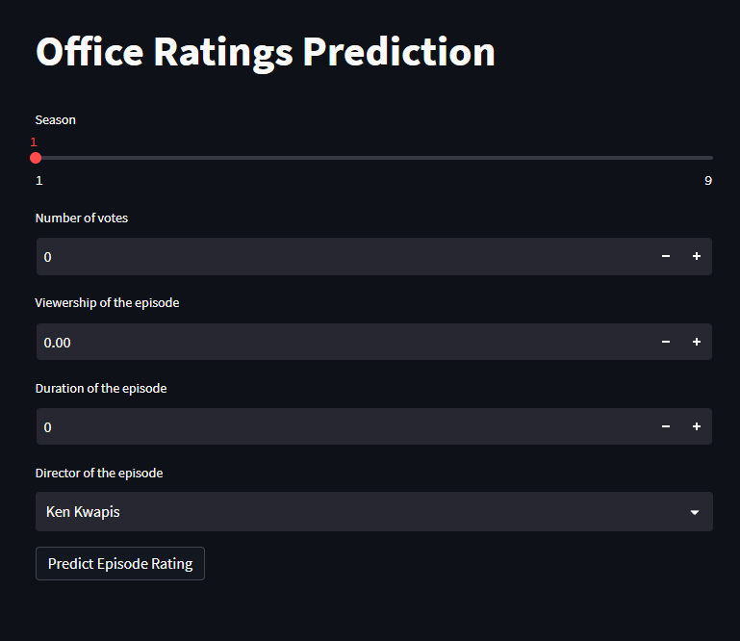
Frontend
Streamlit
https://tthbnc-geptan2-streamlit-jh0puv.streamlit.app

