Slide 1
GeltmSoft. Inc Language Development
CT7901 – Introduction to Programming Languages
Ash Isbitt
S4542714@glos.ac.uk

Slide 3
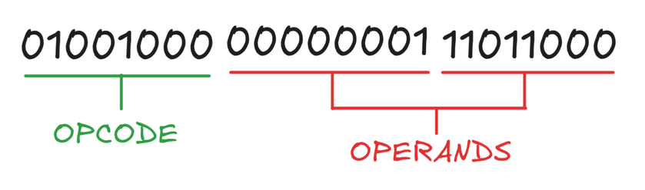
Machine Code
0x48, 0x01, 0xD8
[1][2][3]

Slide 4
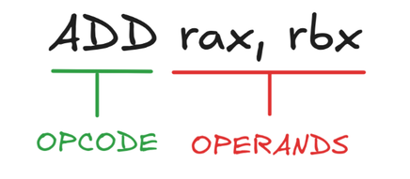
Assembly Language
[4]

Slide 5
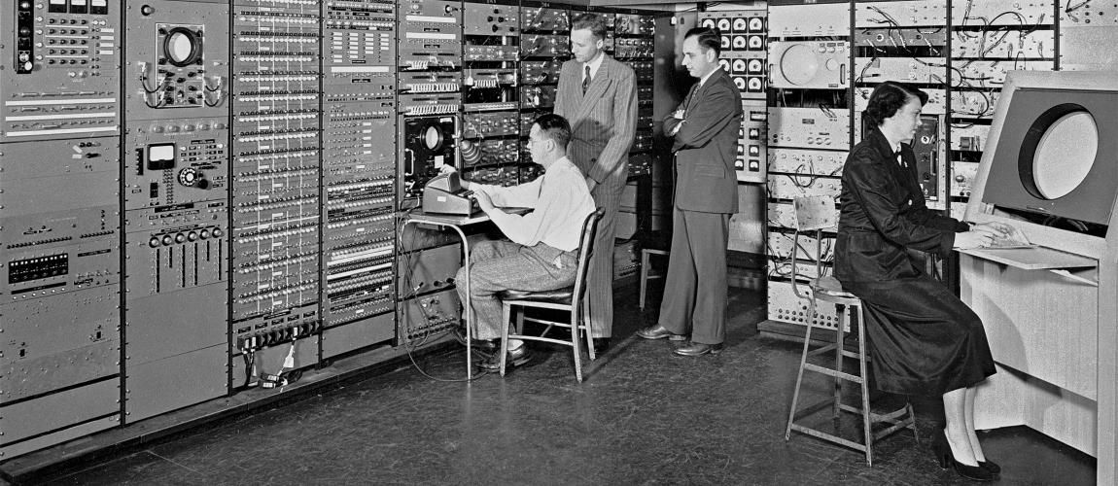
High level languages
[5][6][7][8]

Slide 6
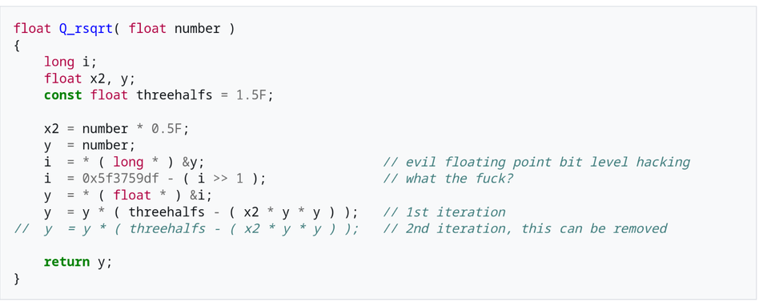
High level languages
[9][10][11]

Slide 7










Slide 8
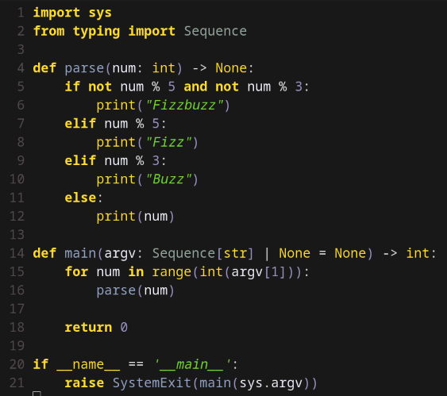
Procedural Languages
[12][13]

Slide 9
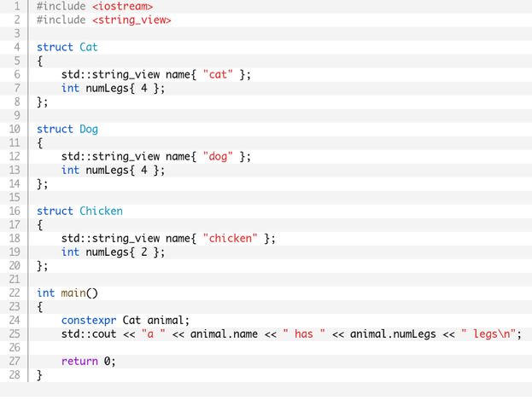
Object Oriented Programming
[14][15][16][17]

Slide 10
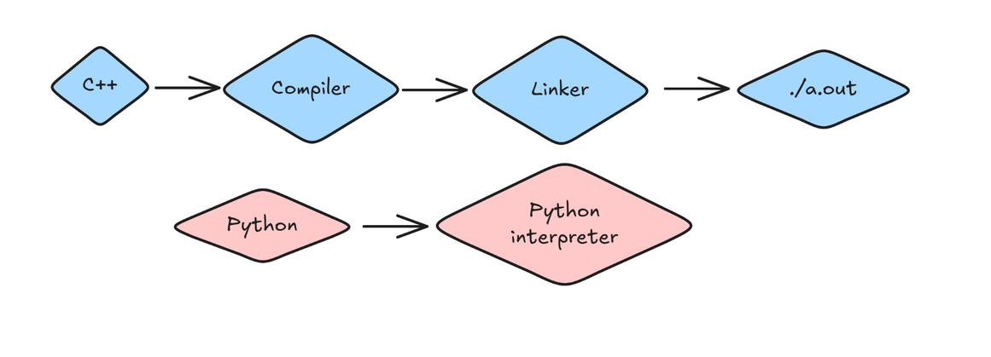
Programming Environment
[18][19][20]

