Slide 1
Deep Neural Networks Program for speech enhancement
Lin Chi Hui

Slide 2
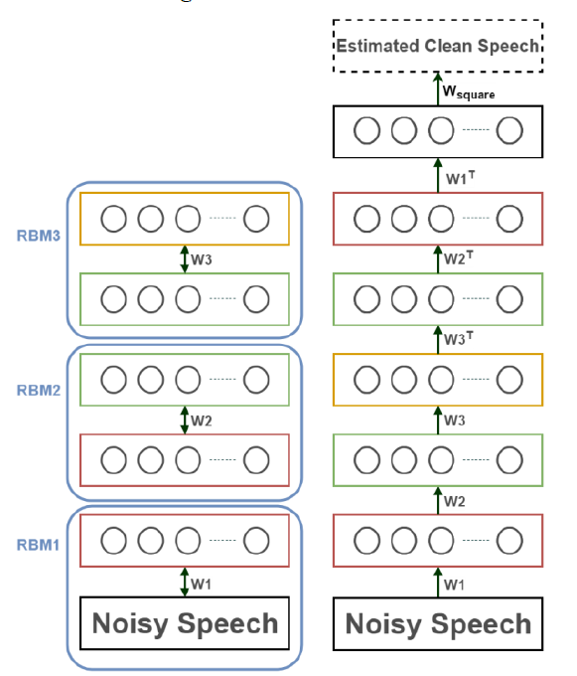
DNN model
Multiple Layer Perceptron
Composed mainly by a number of RBMs
Sometimes with a layer of neurons
has linear activation function

Slide 3
Database
A Clean dataset
30 samples
32 types of Noisy datasets
4 types of strengths
8 types of noise
Each datasets
30 samples

Slide 4
The filename of DNN program.
The reference for the filename of 3 output profiles of this DNN program. In this example, the program will name the 3 files according to “example.txt”. These three files will be example.txt ( the learning rate of the DNN model), testexample.txt ( the error rate of the DNN model on test dataset), weightexample.txt (the weight value of the DNN model)
The information for the training Dataset for DNN, extracted from the database. There 3 groups, each of which has 2 parameters. The 1st group of parameters shows information of clean samples (target data). The 2nd and 3rd give information of noise types and intensities of noisy samples (input data). For those parameters in each group, the former shows the initial position in the database and the latter shows the number of samples.
The learning rate and number of iterations for the RBM.
The initial update value for RPROP, the learning method for the MLP.
The information for the structure of the DNN. The first parameters shows the number of RBMs. The following parameters show the number of neurons in order.
The information for the structure of the DNN. The parameters show if adding a final layer of neurons, which has a linear activation function, after unrolling all RBMs. 1 for YES and 0 for NO.
The information for the testing datasets. The 1st parameter shows the number of test datasets. The following parameters show the setting for each dataset. The format for these settings are the same as the format of the setting for the training dataset, mentioned in the step 2.

