Slide 1
Colorado Powracle
A LangChain ski-conditions agent grounded in real Colorado data
Big Data Architecture · Spring 2026
Chi-Hui Lin · [ teammate ] · [ teammate ]
github.com/Ttopiac/colorado-powracle
Notes:
Title slide. Introduce team and one-line pitch.

Slide 2
WHY POWRACLE
The Problem
▸ Colorado skiers juggle snow reports, I-70 traffic, weekend forecasts, and pass eligibility across 19 resorts.
▸ No single tool answers the real question: “where should I ski this weekend?”
▸ We wanted answers grounded in real data — not LLM guesses.
So… where does the grounded data come from?
▸ Live APIs — SNOTEL · COtrip · Open-Meteo · SerpAPI
▸ 10 yr Historical Snow — SNOTEL daily CSVs → Parquet → DuckDB (40,780 rows)
▸ 10 yr Historical Traffic — CDOT hourly volumes → DuckDB traffic_patterns view
Notes:
Set up the question the rest of the deck answers. Emphasize 'grounded data'.

Slide 3
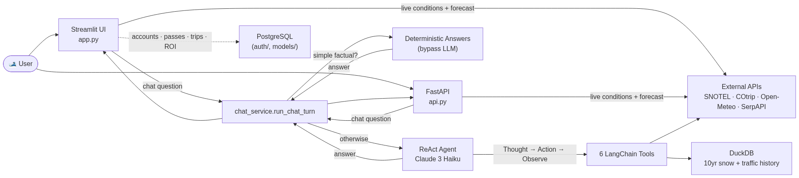
OVERVIEW
What We Built
Streamlit UI + FastAPI · ReAct agent (Claude 3 Haiku) · 6 tools · DuckDB + 4 live APIs · PostgreSQL accounts
▸ Streamlit UI + FastAPI — two front doors, one shared agent
▸ 4 live APIs + 10-yr historical data in DuckDB — 6 tools total
▸ Deterministic fast path for simple factual questions
▸ PostgreSQL user accounts with guest-mode fallback
Notes:
Simple overview. Mention dual entry points share one chat service. Foreshadow deterministic fast path.

Slide 4
AGENT
The Agent — ReAct Loop
Claude 3 Haiku via OpenRouter · zero-shot-react-description
▸ LLM reasons step-by-step — picks the right tool per sub-question
▸ Multi-tool composition — snow + traffic + forecast in one turn
▸ Stop condition — agent emits Final Answer when it has enough evidence
▸ Mandatory output contract — every reply ends with [RANKING: …] line parsed by the UI
▸ Why ReAct over function-call only? — the Thought trace is debuggable and shows up in our verbose logs
Question
Thought
↓
Action (tool call)
↓
Observation
↺ repeat
Final Answer
Notes:
Set up ReAct mental model before showing the prompt.

Slide 5
HOW WE STEER THE AGENT
Prompt Architecture
agent/prompts.py — the agent's instruction manual
agent/prompts.py
What's actually inside (≈80 lines):
SYSTEM_PROMPT = """
You are the Colorado Powder Oracle — concise,
knowledgeable assistant for Colorado skiers.
CONVERSATION MEMORY:
follow-ups → previous topic; new topic →
treat as fresh question (topic-bleed fix)
LIVE DATA ALREADY IN CONTEXT:
read snapshot before calling tools
TOOLS AND WHEN TO USE THEM:
"historically", "average", month names →
get_snowpack_history (never current)
weekend / forecast → get_snow_forecast
road / chains → get_live_traffic
RESORT KNOWLEDGE: IKON · EPIC · INDY
SNOWPACK SCIENCE: SWE · powder thresholds
TRAFFIC KNOWLEDGE: I-70 peaks · Eisenhower
MANDATORY RANKING LINE:
[RANKING: Resort1, Resort2, ...]
"""
▸ 1. Conversation memory rules — follow-ups vs. topic switches
▸ 2. Live data already in context — read snapshot first, don't loop tools
▸ 3. Tool routing rules — keyword → exact tool
▸ 4. Resort knowledge — 19 resorts grouped by pass
▸ 5. Snowpack science + traffic — SWE, I-70 peak hours, chokepoints
▸ 6. Output contract — [RANKING: …] line parsed by the UI
The prompt is a routing table, a domain knowledge base, and an output contract — all in one.
Notes:
Walk the right column. Mention this is also where the topic-bleed fix lives — full bug story on the lessons slide.

Slide 6
TOOLS
The 6 Tools
Each tool is a typed function the agent can call by name
Tool
Source
Latency
get_current_snowpack
SNOTEL REST API (live)
~2 s
get_snowpack_history
DuckDB · 10 yr daily SNOTEL
~50 ms
get_live_traffic
COtrip API (live)
~1 s
get_best_departure_time
DuckDB · traffic_patterns view
~50 ms
get_snow_forecast
Open-Meteo (HRRR → best_match)
~1 s
web_search
SerpAPI (fallback for anything)
~2 s
Dual data path:
▸ UI bulk-fetches SNOTEL + forecasts on page load (cached 30 min / 3 hr)
▸ Agent calls the same tools per conversation — no double work, fresh data when needed
Notes:
Don't read the whole table aloud. Highlight live vs DuckDB split and the web_search safety net.

Slide 7
DEMO
Live Walkthrough — Real ReAct Trace
Captured from a real agent run, not a mock-up
Suggested prompt (forces multiple tools):
"I want powder this Saturday but avoid I-70 — when should I leave Denver?"
Expected trace shape:
▸ Thought 1 — user wants powder + traffic-aware departure → call snow forecast
▸ Action 1 — get_snow_forecast("Steamboat Springs") · get_snow_forecast("Winter Park")
▸ Thought 2 — now resolve traffic → check best departure for non-I-70 corridor
▸ Action 2 — get_best_departure_time("US-40 Saturday")
▸ Final — ranked recommendation + departure window + [RANKING: …]
DRONA — please rewrite this slide with a real captured trace. Run the agent with verbose=True against the prompt above (or your own). Show Question → Thought / Action / Observation cycles → Final Answer.
Notes:
Drona owns this slide. Goal: a single multi-tool real trace, not invented.

Slide 8
OPTIMIZATION
Deterministic Fast Path
agent/deterministic_answers.py — opt-in shortcut
▸ What it covers — exactly two metrics — most fresh snow (72 h) and deepest base — nothing else
▸ Why — for these questions, reasoning adds no value; SNOTEL data is already structured
▸ Toggle — checkbox in the UI sidebar, flag in the FastAPI request body
Decision logic:
Question in
→
Blocker words?
→
Trigger phrase?
→
Sort 19 resorts → top 1 + next 2
yes → return None → fall back to LLM
Blocker words:
historical · average · january…december · forecast · weekend · recommend · compare · consistent
Trigger phrases:
"fresh snow" · "new snow" · "snowiest right now" · "deepest base" · "biggest base"
Notes:
Fast path is intentionally narrow. Anything ambiguous falls through to the agent untouched.

Slide 9
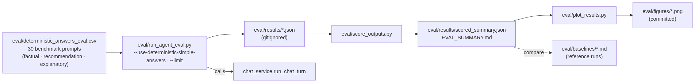
MEASURING THE AGENT
Evaluation Harness
Built around the deterministic fast path
▸ 30 benchmark prompts
▸ 10 factual
▸ 10 recommendation
▸ 10 explanatory
▸ Compares deterministic fast-path vs full agent
▸ Baselines committed in eval/baselines/
DRONA — please rewrite. Add real numbers from the latest run (factual accuracy, deterministic vs agent, latency). Code: eval/run_agent_eval.py · score_outputs.py · plot_results.py.
Notes:
Drona owns. Show one bar chart from eval/figures/ if possible.

Slide 10
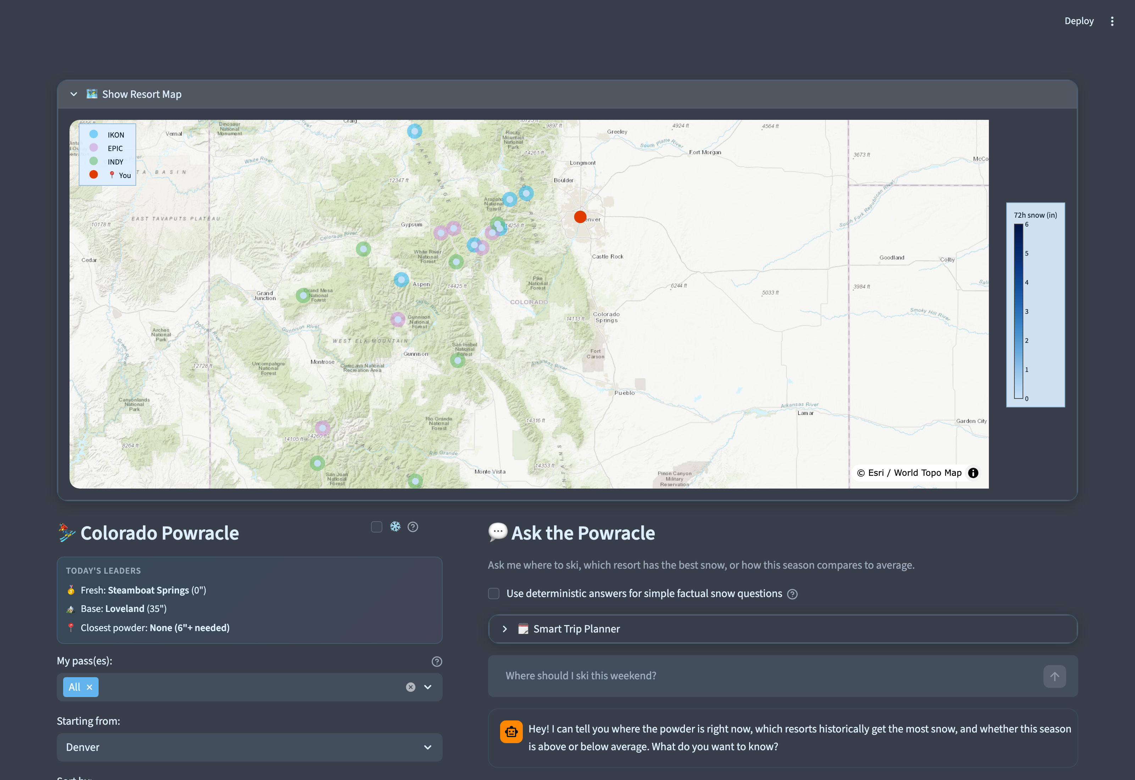
FRONT END
Streamlit UI
What the user actually sees
▸ Map — Plotly Scattermapbox · ESRI topo · pass-colored markers
▸ Today's Leaders — fresh snow · base · closest powder banner
▸ Quick filters — 6"+ powder · 50"+ base · <100 mi · 4"+ weekend
▸ Sort modes — Fresh · Base · Distance · AI Pick
▸ Smart Trip Planner — multi-day itinerary, distances injected
▸ Snowfall effect — CSS animation (proposed: default on)
▸ Theme — Mountain Stone — slate + accent blue
JOSEF — please review. Suggestion: drop the snowfall toggle and just default the snowfall effect on, if the CSS animation isn't expensive on lower-end machines. Add anything else you'd like to highlight on the UI.
Notes:
Will capture real screenshots before final.

Slide 11
API LAYER
FastAPI Service
Programmatic access — same agent, same chat service
▸ POST /chat — ChatRequest → ChatResponse with answer, ranking, raw_response
▸ GET /health — liveness probe
▸ Same chat_service.run_chat_turn as the Streamlit UI — no logic duplication
▸ TTL caches — 30 min for live conditions, 3 hr for forecasts (matches UI)
▸ Lazy agent init — first /chat builds the agent — /health stays cheap
▸ Why it matters — future mobile client, third-party integrations, eval harness uses it too
JOSEF — please rewrite. Code: api.py. Feel free to add request/response examples or curl snippets.
Notes:
Josef owns.

Slide 12
ACCOUNTS
User Accounts & Pass ROI
PostgreSQL-backed personalisation
▸ Login / register — auth/auth_manager.py — sessions in PostgreSQL
▸ Profile — home city, ski ability, terrain preference, ski pass management
▸ Trips — trip history with per-day check-ins and star ratings
▸ Stats — season ROI dashboard — days skied, pass cost, ticket value, break-even progress
▸ ROI calculation — auth/roi_calculator.py · day_ticket_price tracked per pass
▸ Guest mode — if Postgres is unavailable, login UI hides and core features still work
JOSEF — please rewrite. Code: auth/, models/user.py, db/postgres.py, db/run_migrations.py.
Notes:
Josef owns.

Slide 13
WHAT BROKE & WHY
Engineering Lessons — Real Bugs We Hit
Every fix is in the git history
▸ Topic-bleed in conversation memory (commit 6e816f0) — Agent kept answering the previous question after a topic switch. Asked about resorts, then asked about restaurants → still got resorts. Fixed with an explicit “treat NEW topics as fresh” rule in SYSTEM_PROMPT.
▸ Historical questions hit the wrong tool (commit 9f7ab6a) — Agent called get_current_snowpack when asked “most snow in January”. Fixed with explicit keyword routing in the prompt — “historically”, “on average”, month names → get_snowpack_history.
▸ SNOTEL API surprises (CLAUDE.md notes) — Network code is SNTL not SNOTEL. /data response nests elements under a per-station data key. Both broke our first ingestion attempt.
▸ AI Pick poisoned by assistant replies (commit af1a6d1) — We were passing assistant responses as ranking context, biasing later rankings. Fixed by passing only user messages.
▸ AI Pick silent failure (commit ffa2464) — Used deprecated .predict(); switched to .invoke(), surfaced errors instead of falling back silently.
▸ Sequential SNOTEL fetch killed page load (commit 9db93df) — Replaced 19 sequential calls with batched + progressive loading.
Notes:
Pick the top 3 to actually narrate. Rest are backup if asked. All grounded in commits.

Slide 14
WORKFLOW
AI-Assisted Collaboration
How three humans + AI assistants shipped this without breaking each other
CLAUDE.md · distributed context
Developer + AI assistant
Root file = project overview, run commands, the 6 tools, key decisions. Subdir CLAUDE.md in agent/, tools/, ingestion/, db/ = local gotchas the AI picks up automatically.
↓
reads CLAUDE.md / AGENTS.md
↓
AGENTS.md · cross-tool sync
writes code
Same content as root CLAUDE.md but in the convention used by Cursor and other AI tools. Kept in sync via a checkbox in the PR template — every assistant sees the same rules.
↓
opens PR → checklist auto-loads
↓
.github/pull_request_template.md + /review-pr skill
/review-pr skill audits diff + runtime
Template auto-loads on every PR: streamlit run cleanly · 2 canonical questions tested · no secrets staged · docs updated in the same PR · tools registered + prompt updated. Custom Claude Code skill .claude/skills/review-pr/SKILL.md walks every checkbox against the actual diff and runtime (not just whether the box is ticked) and posts an audit comment.
↓
merge to main
The repo is its own onboarding doc — every bug we hit became a rule the next contributor (human or AI) inherits.
Notes:
Tie this back to slide 13: bugs become rules in CLAUDE.md, prevented from recurring.

Slide 15
ROADMAP
Future Work
Where we'd take Powracle next
▸ Phase 3 — Location & routing — OpenRouteService for real driving distances and ETAs
▸ Mobile client — thin React Native app over the existing FastAPI
▸ Larger eval set — expand beyond 30 prompts; nightly regression against eval/baselines/
▸ More deterministic shortcuts — extend the fast path to other narrow factual classes
▸ Personalised ranking — feed user pass + ski-day history into the agent prompt
Notes:
Optional slide — drop if running long.

Slide 16
Thank You
Questions?
Chi-Hui Lin · [ teammate ] · [ teammate ]
github.com/Ttopiac/colorado-powracle
Palette: AlpineFrost

