Slide 1

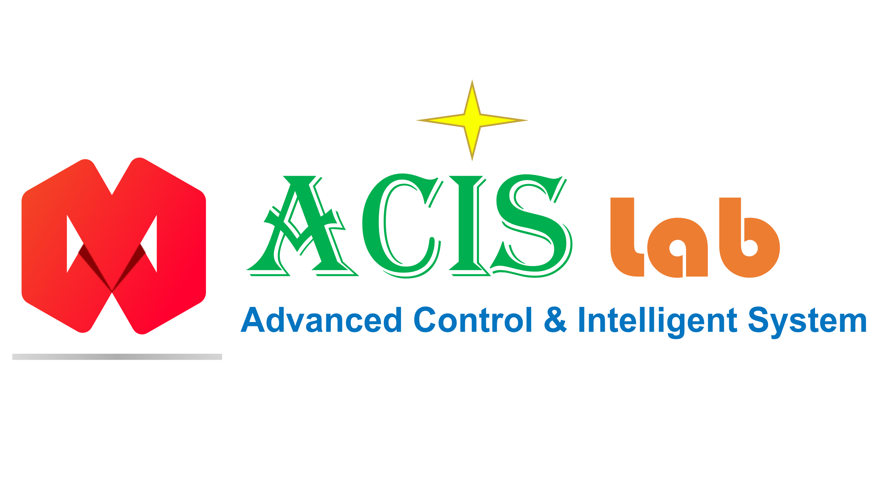


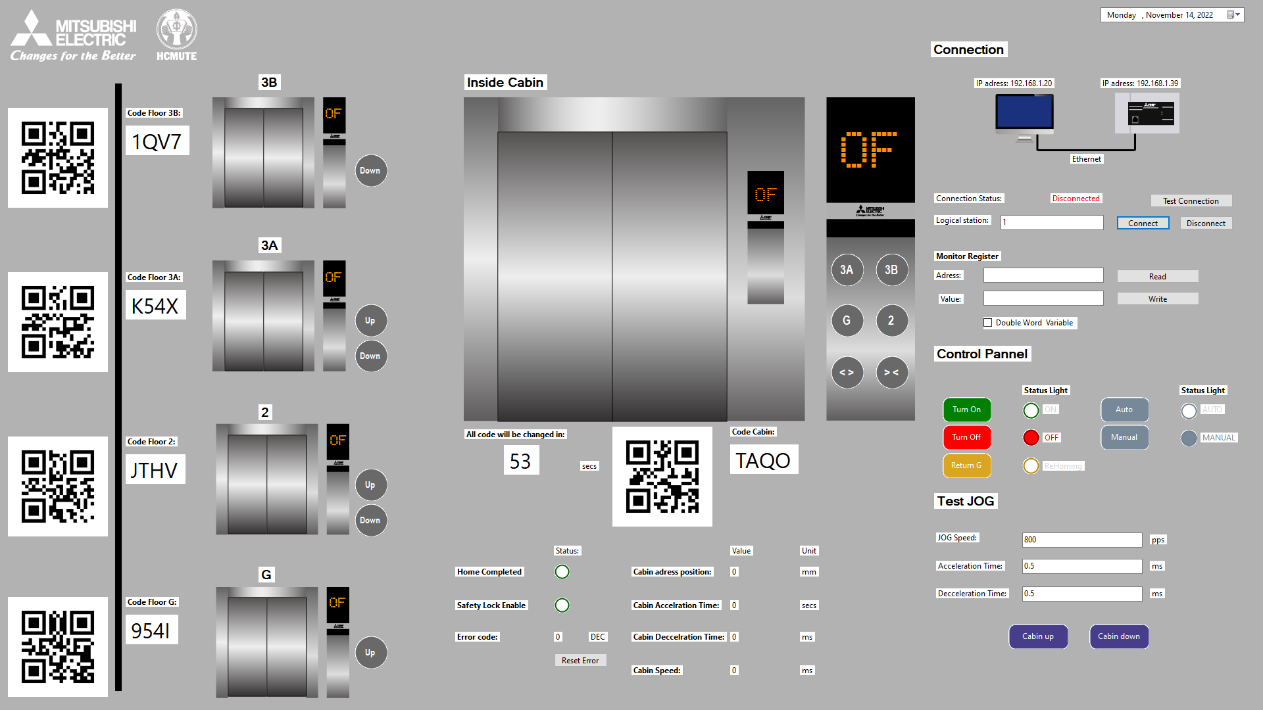

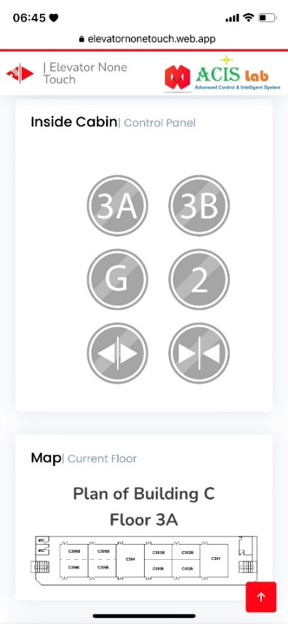
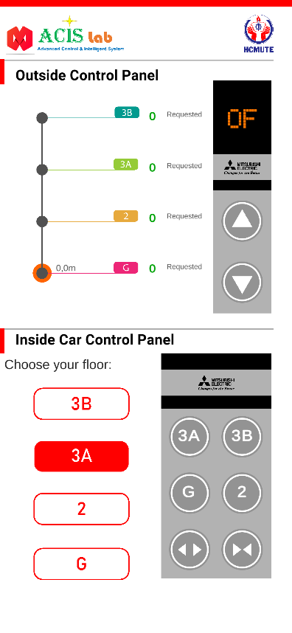

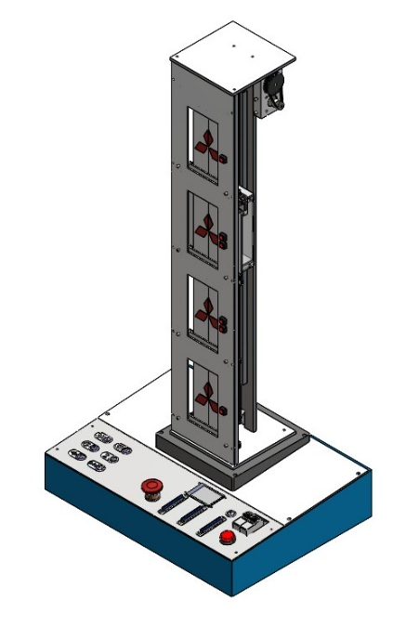
PROGRAMMABLE LOGIC CONTROLLER PROJECT
Thu Duc city, December 25, 2022
ELEVATOR NONE TOUCH
CONTROLLER SYSTEM
Gia-Thinh NGUYEN-TU^{1*}
Instructor: Assoc. Prof. Minh-Tam NGUYEN¹
¹ Ho Chi Minh City University of Technology and Education, Vietnam
*19151041@student.hcmute.edu.vn

Slide 2
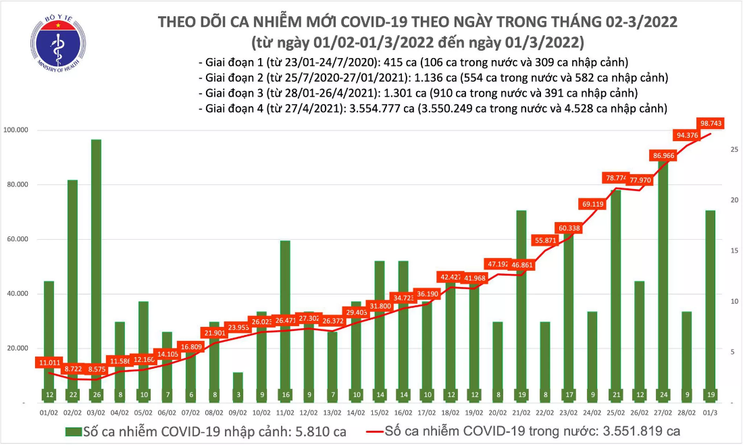
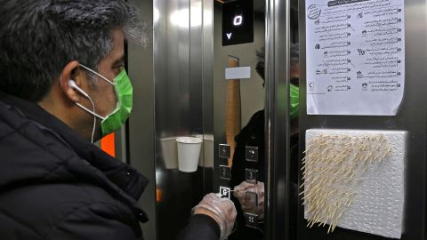
Clinical Context
Issues related to COVID-19 and Internet of Things (IoT) Application
[Ministry of Health, 2022]
Cause of COVID-19
Apartment app
Traditional Chart of the number of COVID-19 cases in Vietnam.
People worldwide are finding ways to avoid touching elevator buttons.
The development of applications for smart buildings.
[CNN Business, 2020]
Elevator none touch controller system
This man in Tehran is using toothpicks to touch Elevator button.
Programmable Logic Controller Project - December 25, 2022 1

Slide 3

Methods – Overall System Structure
Cloud
Web service
Android App
Firebase Cloud
SCADA system
SCADA system
Android app
Web service
Hardware system
Elevator prototype
Internet is needed
Ethernet comunication
Programmable Logic Controller Project - December 25, 2022 2

Slide 4
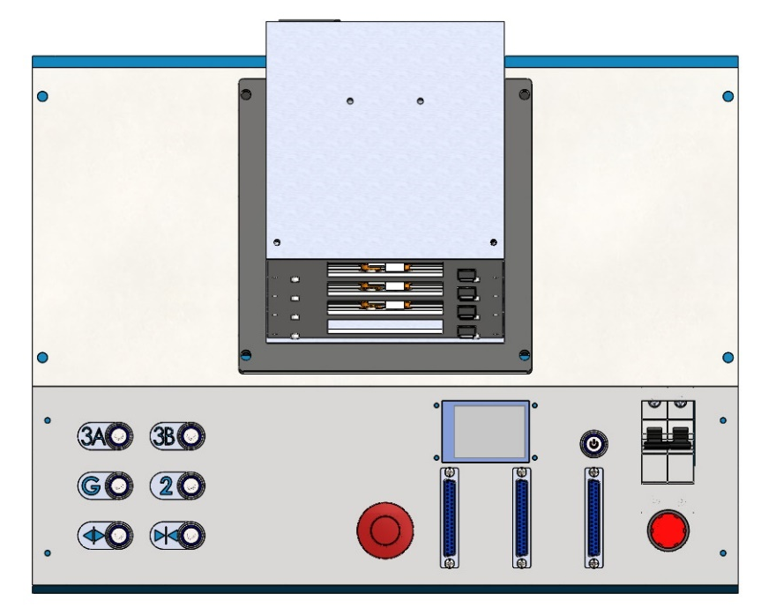
Methods – Hardware Subsystem
1
4
3
6
2
5
7
Elevator 4 Floor Prototype Top View
No | Description
1 | Drive Box
2 | Cabin
3 | Button of Cabin
4 | QR code Display
5 | EMG Stop
6 | Power Indicator
7 | Extension Connector
3
4
5
7
6
Elevator 4 Floor Prototype Overall View
Programmable Logic Controller Project - December 25, 2022 3

Slide 5
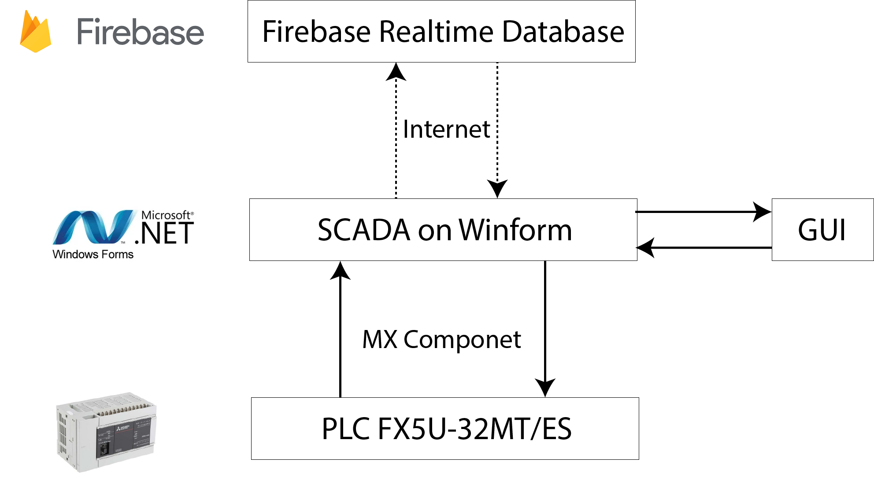
Methods – Software Subsystem
Design Supervisory Control And Data Acquisition (SCADA) System
The SCADA system updates and retrieves data via internet, so internet is required.
Data Flow Process of SCADA system
Programmable Logic Controller Project - December 25, 2022 4

Slide 6
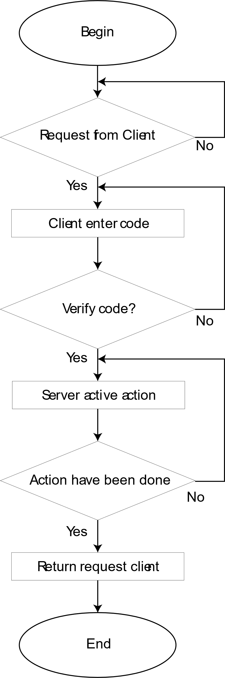
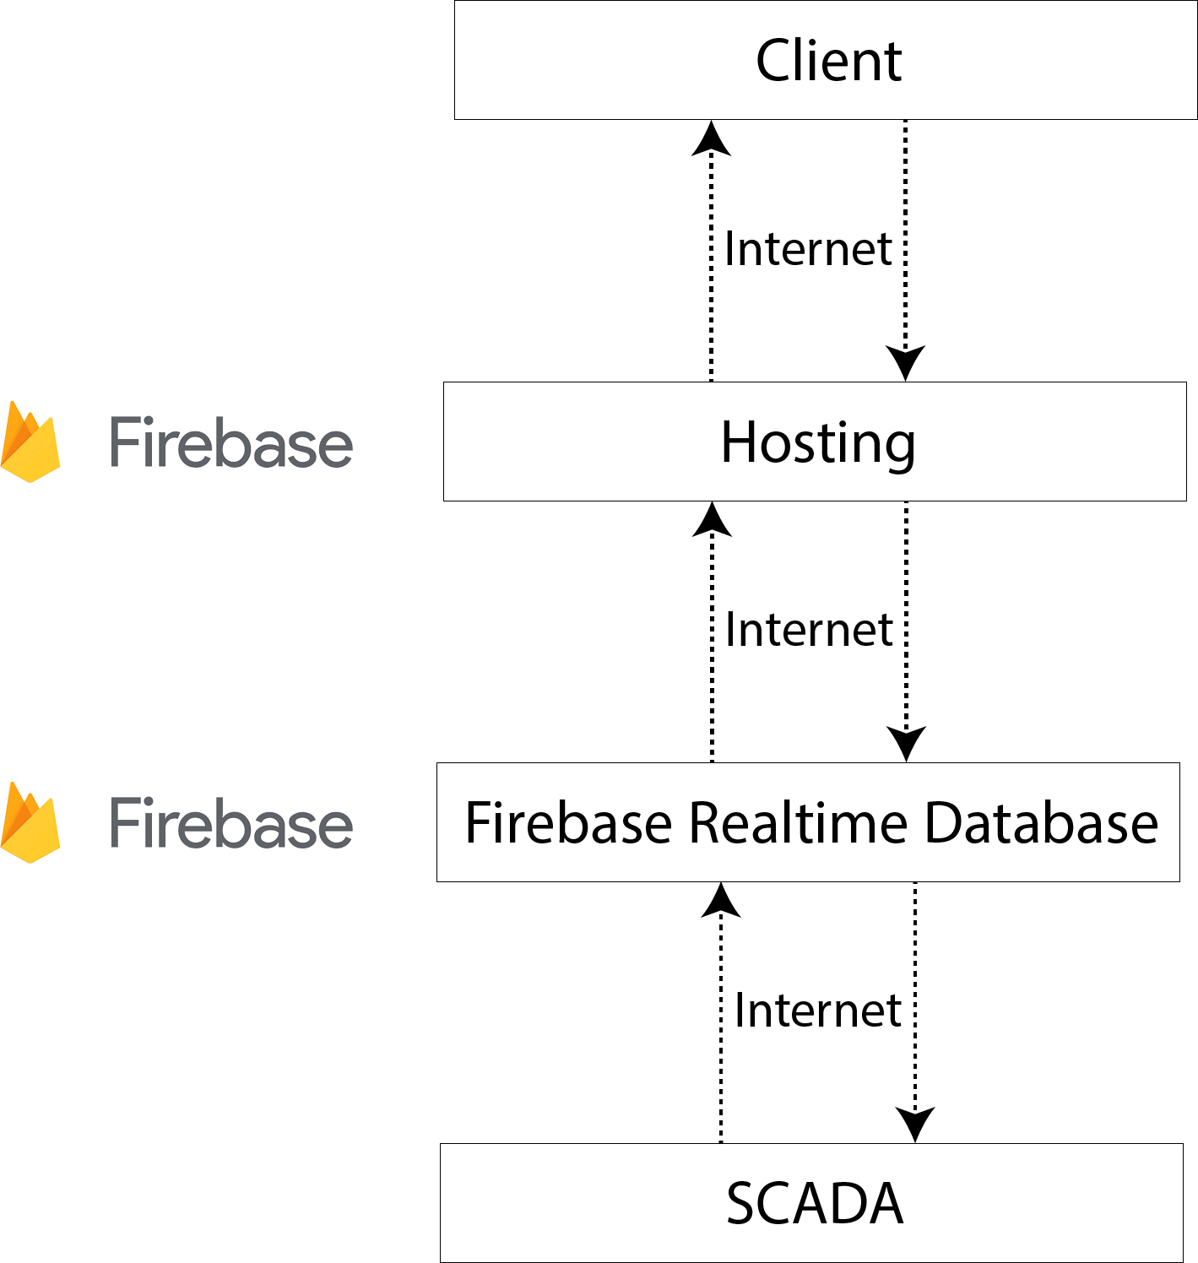
Methods – Software Subsystem
Design Web Service
Firebase Hosting is used to deploy website.
Supervise and Control button of system by code.
Observe information of each Floor.
Data Flow Process of Web Service
Operate Flow Chart of Web Service
Programmable Logic Controller Project - December 25, 2022 5

Slide 7
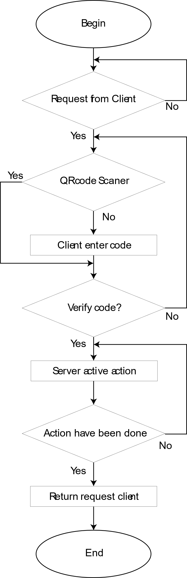
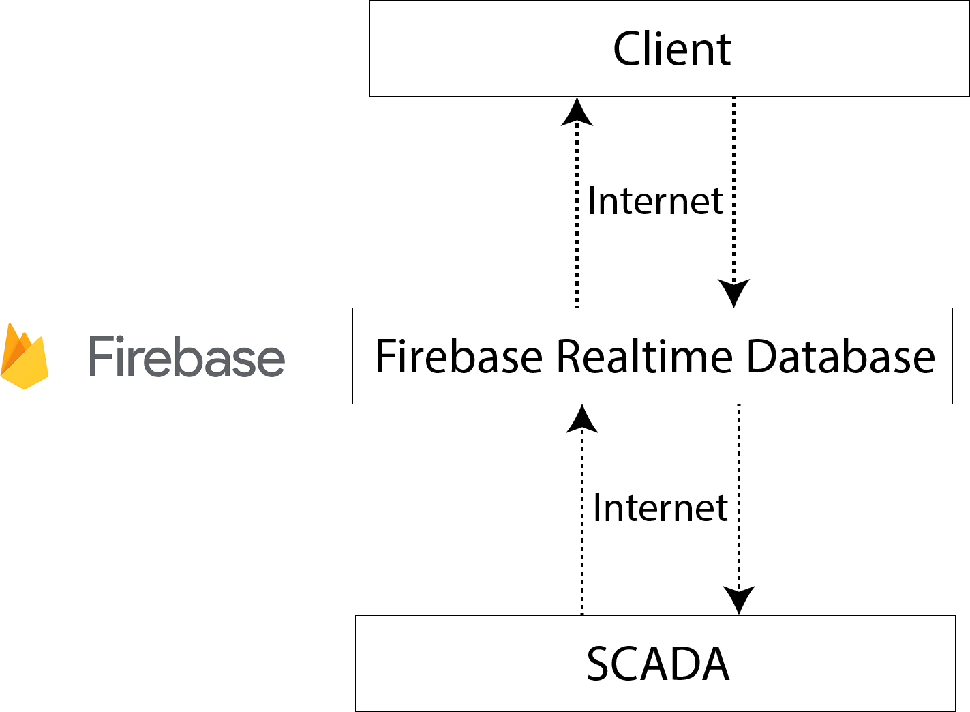
Methods – Software Subsystem
Design Android Application
Data is updated by Firebase Realtime Database which required internet.
Supervise and Control button of system by code.
Scan QR Code to control button of system.
Data Flow Process of Android Application
Operate Flow Chart of Android Application
Programmable Logic Controller Project - December 25, 2022 6

Slide 8
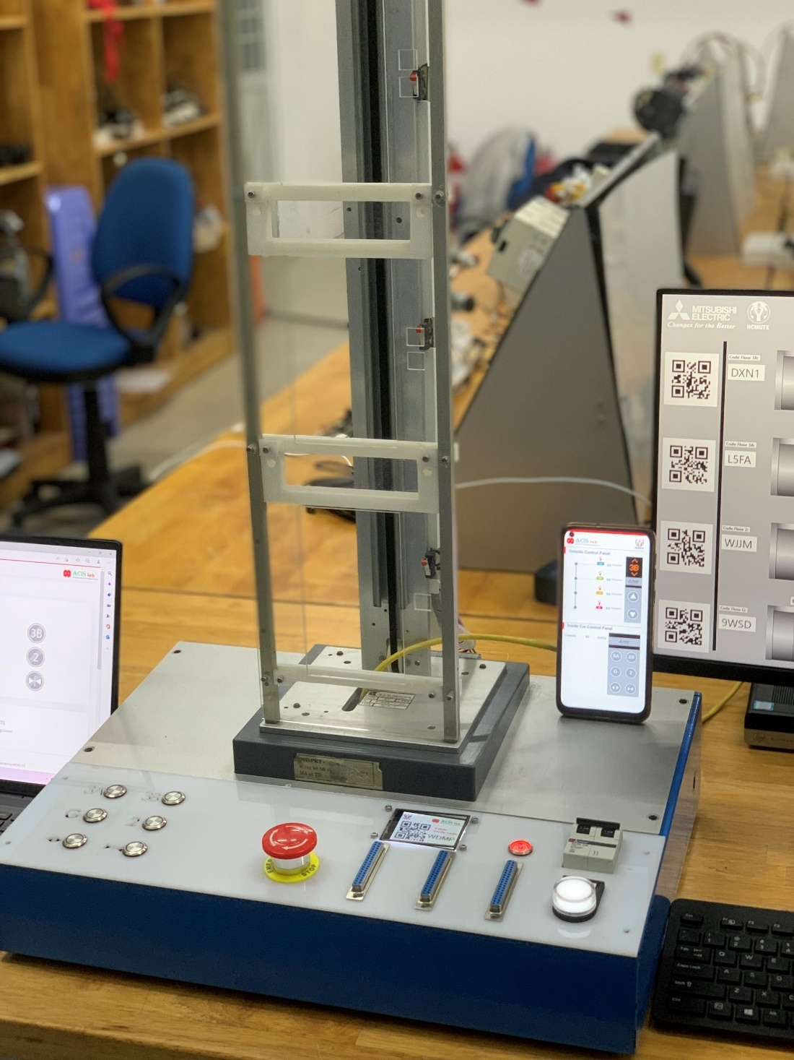
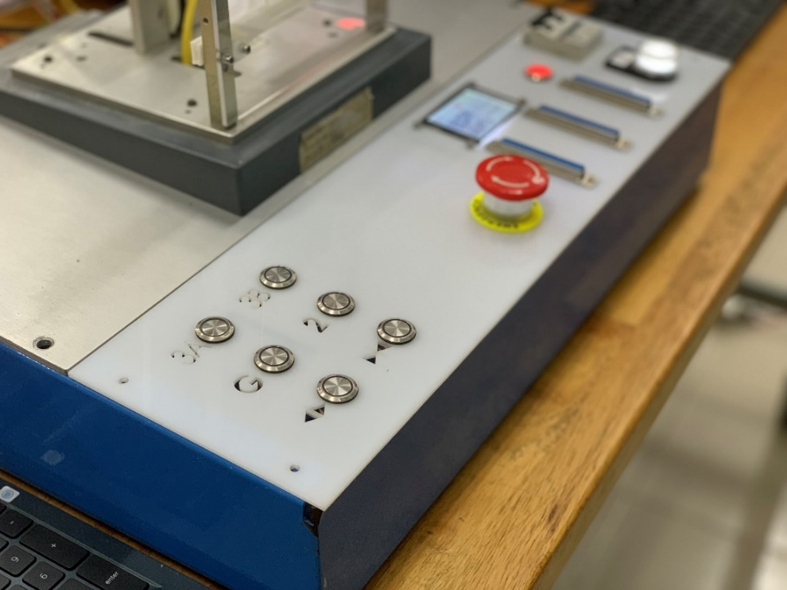
Results – Hardware Subsystem
Project hardware subsystem
Hardware dashboard
Programmable Logic Controller Project - December 25, 2022 7

Slide 9
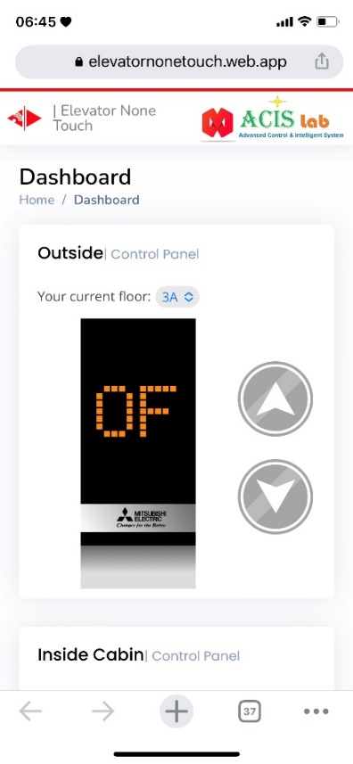
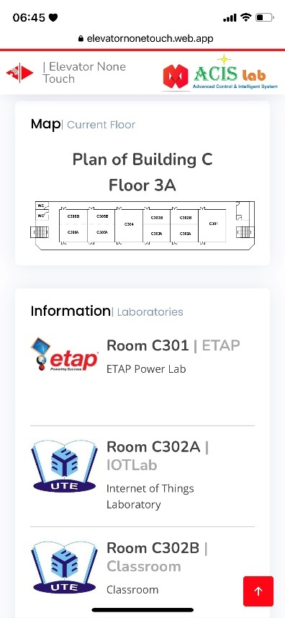
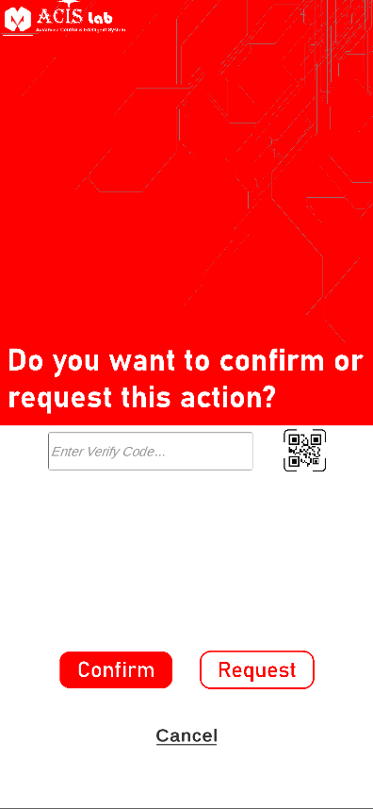
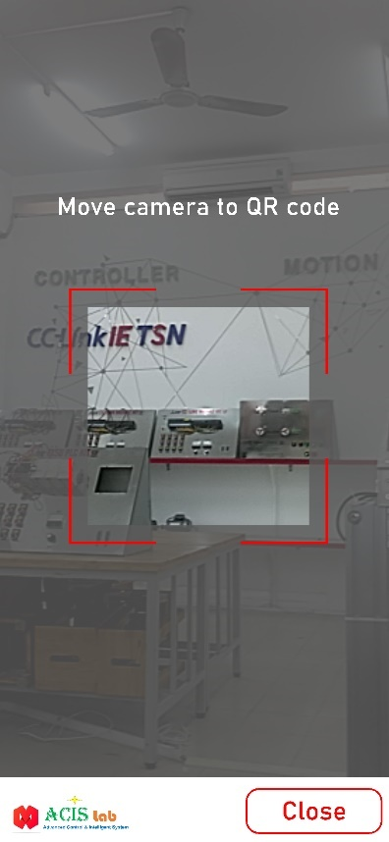
Results – Software Subsystem
Web Service page on Internet
Android Application on Phone
SCADA interface on Computer
Programmable Logic Controller Project - December 25, 2022 8

Slide 10
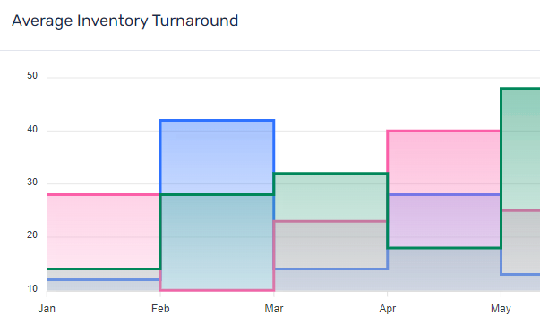
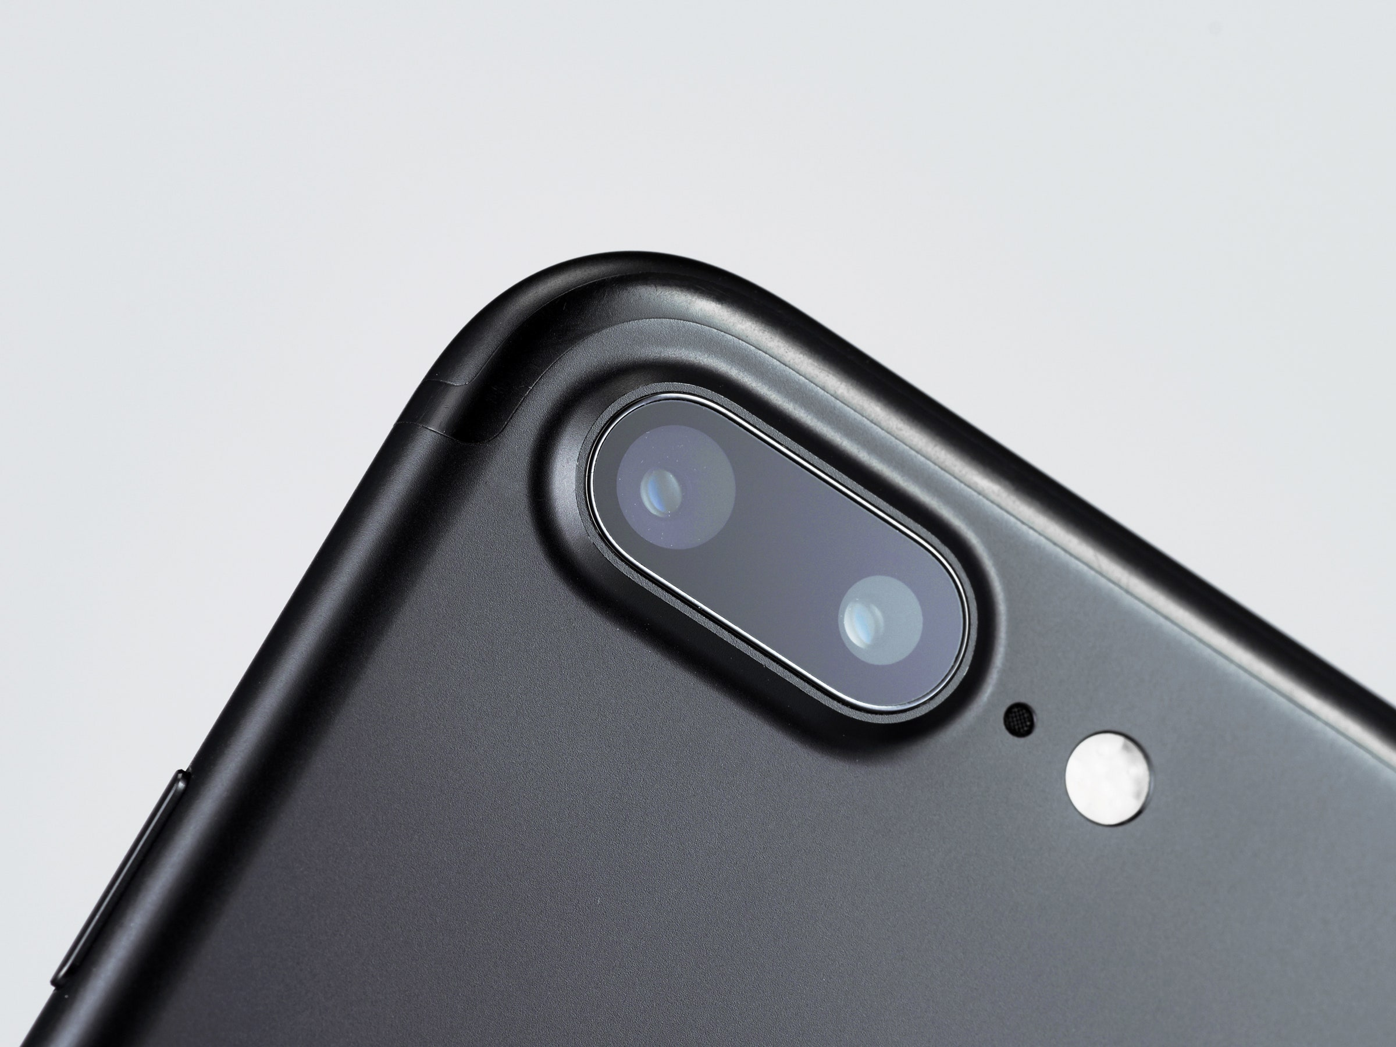
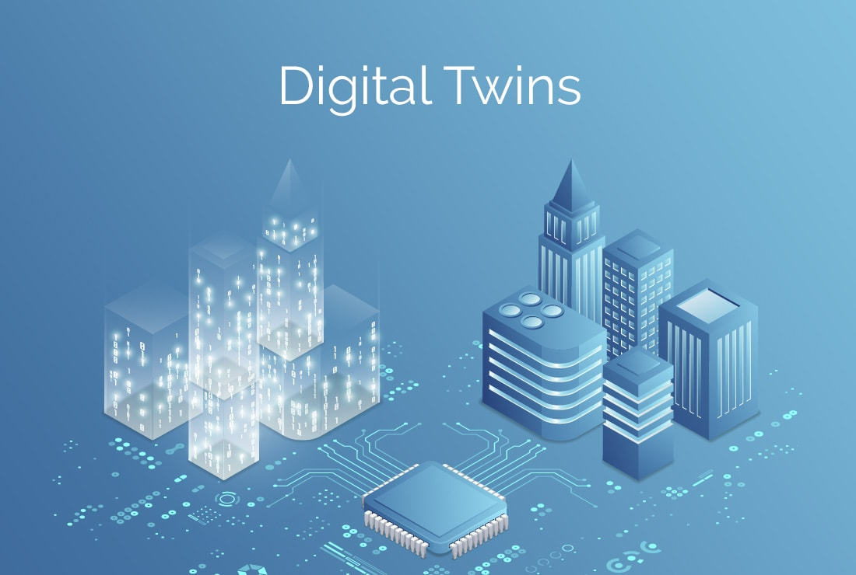


Perspectives
Based on:
Webserver
More function of Data analysis
Checking QR code by a camera phone
Cloud database and Firebase service
Notification.
Integrated with another IoT app.
…
Development IOS app
Programmable Logic Controller Project - December 25, 2022 9

Slide 11
Acknowledgements
This project is funded by the Ho Chi Minh City University of Technology and Education scientific research program, Vietnam, 2022.
THANKS FOR WATCHING!
Programmable Logic Controller Project - December 25, 2022 10

