Slide 1

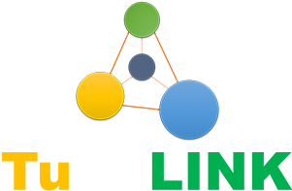
Problems:
Idle Computing Resources:
There are more than millions computers and smartphones
which are not used at least in the evening.
How to share?
People do not know how to share their computers and so on.
Trust Problem!
People do not trust to share because of computer virus.

Slide 2
TuDoLink provides a data analysis
infrastructure to solve these problems.
A platform for people to share their idle resources.
KvK could use it for company data analysis.
Hospitals could use it for genomic data analysis.
Machine Learning + Blockchain provides program guarantee and insurance for computers.
Only safe codes could be submitted on the platform.
Codes from every program are stored in the blockchain.
Suppliers could always check the codes running on their computers.

Slide 3
Profit Model:
Airbnb model:
We charge 3% - 12% of service fee for each deal that is completed.
This service fee is what actually goes to the project's operation, enables
the platform that we provide, and allows us to offer great customer
support before, during and after deal
Technology Support
We provide organizations, such as university and hospitals, to build
a distributed computing system by using their own idle computing resources.

