Slide 1


Pure Transformers Can Be Powerful Hypergraph Learners
Department of Computer, Control and Management Engineering
Master Degree in Artificial Intelligence and Robotics
Thesis Defense
Candidate:
Peng Kai, ID: 1947951
Thesis Supervisor & Co-Supervisor:
Dr. Giovanni Trappolini & Prof. Fabrizio Silvestri
Academic Year:
2022/2023

Slide 2
Background/Motivation
Graph/hypergraph convolution operations (message-passing methods) can lead to over-smoothing problems.
Modified structure transformers are designed for specific tasks may limit versatility, hindering integration into multi-task and multi-modal general-purpose attentional architectures.
Tokenized Graph Transformer(TokenGT) has successfully addressed these issues in the graph area.
This thesis aims to expand TokenGT to the hypergraph area to solve the limitations of message-passing and graph-specific structural modifications in the hypergraph field, and provide an optional method for processing hypergraphs.

Slide 3
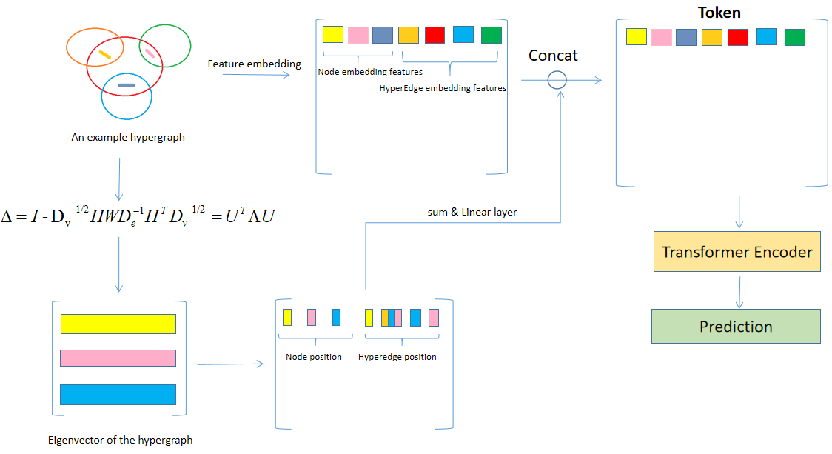
Tokenized Hypergraph Transformer(TokenHGT)

Slide 4
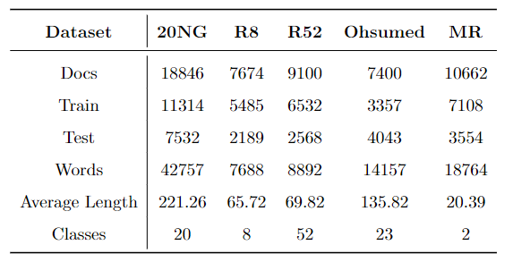
Experiment - Dataset
Solution: Refer to hyperGAT, a hypergraph can be converted from a text document. The method as follows:
- Using Latent Dirichlet allocation(LDA) to mine the latent topics from text documents.
- Each topic can be represented by a probability distribution over the words.
- We consider each topic as a semantic hyperedge that connects the top K words with the largest probabilities in the document.
Problem: TokenHGT algorithm is designed to operate at the graph-level.
Ideally, the dataset should include
- many hypergraphs
- preferably include both node and hyperedge features to capture the structural.
It is challenging to find readily available datasets that meet these requirements.

Slide 5
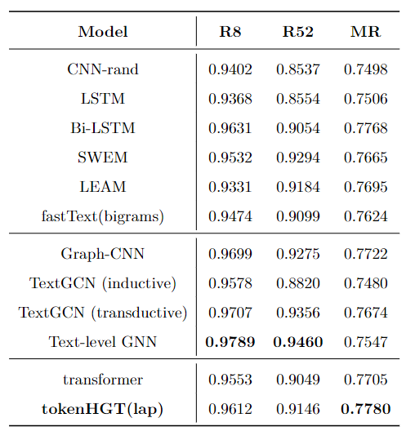
Experiment - Accuracy-Result

Slide 6
Conclusions
The tokenHGT model generally applies pure transformers to the hypergraph area.
The tokenHGT’s effectiveness in overcoming the limitations of message passing methods, leading to superior performance on specific datasets.
Meanwhile, the pure transformer architecture guarantees the versatility of the models, which contributes to future multimodal research.
Limitations
TokenHGT is not good at processing large hypergraphs. According to Graphomer, the self-attention module exhibits a quadratic complexity, which poses limitations on its applicability to large graphs.
It requires a suitable hypergraph dataset, which can be challenging to find.

Slide 7
THANK YOU FOR YOUR ATTENTION!
Peng Kai, 1947951

