Slide 1


CA3
PRESENTATION
Online Notes Sharing platform
Project by :
Tushar Bhardwaj (12216999 )

Slide 2





TECH STACK/TOOLS
HTML 5
CSS
PHP
phpmyadmin
Xamp Server
Mysql

Slide 3



OUR
PROJECT
This project is an online notes-sharing platform built with PHP and PHPMyAdmin, designed to enable students to easily upload and download PDF files. Users can securely share academic resources by uploading files, which are stored in a centralized database. The platform provides a straightforward interface for managing notes, making it efficient for academic collaboration and resource sharing.

Slide 4


TECH OVERVIEW
The tech stack for this online notes-sharing platform includes:
HTML: Structures the content and layout of web pages, enabling users to interact with the platform.
CSS: Styles and enhances the visual presentation, providing a user-friendly and cohesive interface.
PHP: Powers the backend, handling file upload, download functionalities, and communication with the database.
PHPMyAdmin: Manages the MySQL database, where metadata and file paths for uploaded PDFs are stored securely.
XAMPP: Provides a local server environment, integrating Apache, PHP, and MySQL to streamline development and testing on a single machine.

Slide 5
OBJECTIVES
Facilitate Easy File Sharing: Enable users to easily upload, store, and download educational files, such as notes in PDF format, to enhance collaborative learning and information sharing.
Ensure File Security and Integrity: Implement file validation, such as type and size restrictions, to prevent malicious files and ensure that only permitted content is uploaded.
Enhance User Accessibility: Create an intuitive user interface that simplifies file upload and download processes, making it easy for users to navigate and access the platform's features.

Slide 6
LIMITATIONS
File Size and Format Restrictions: The platform currently limits uploads to 2MB and accepts only PDF, JPG, and PNG files. Users needing to upload larger files or different file formats may find this restrictive.
Limited Security Features: Basic validation and file sanitization are implemented, but the platform lacks more advanced security features such as virus scanning, encryption, or protection against SQL injection and file path traversal attacks.

Slide 7

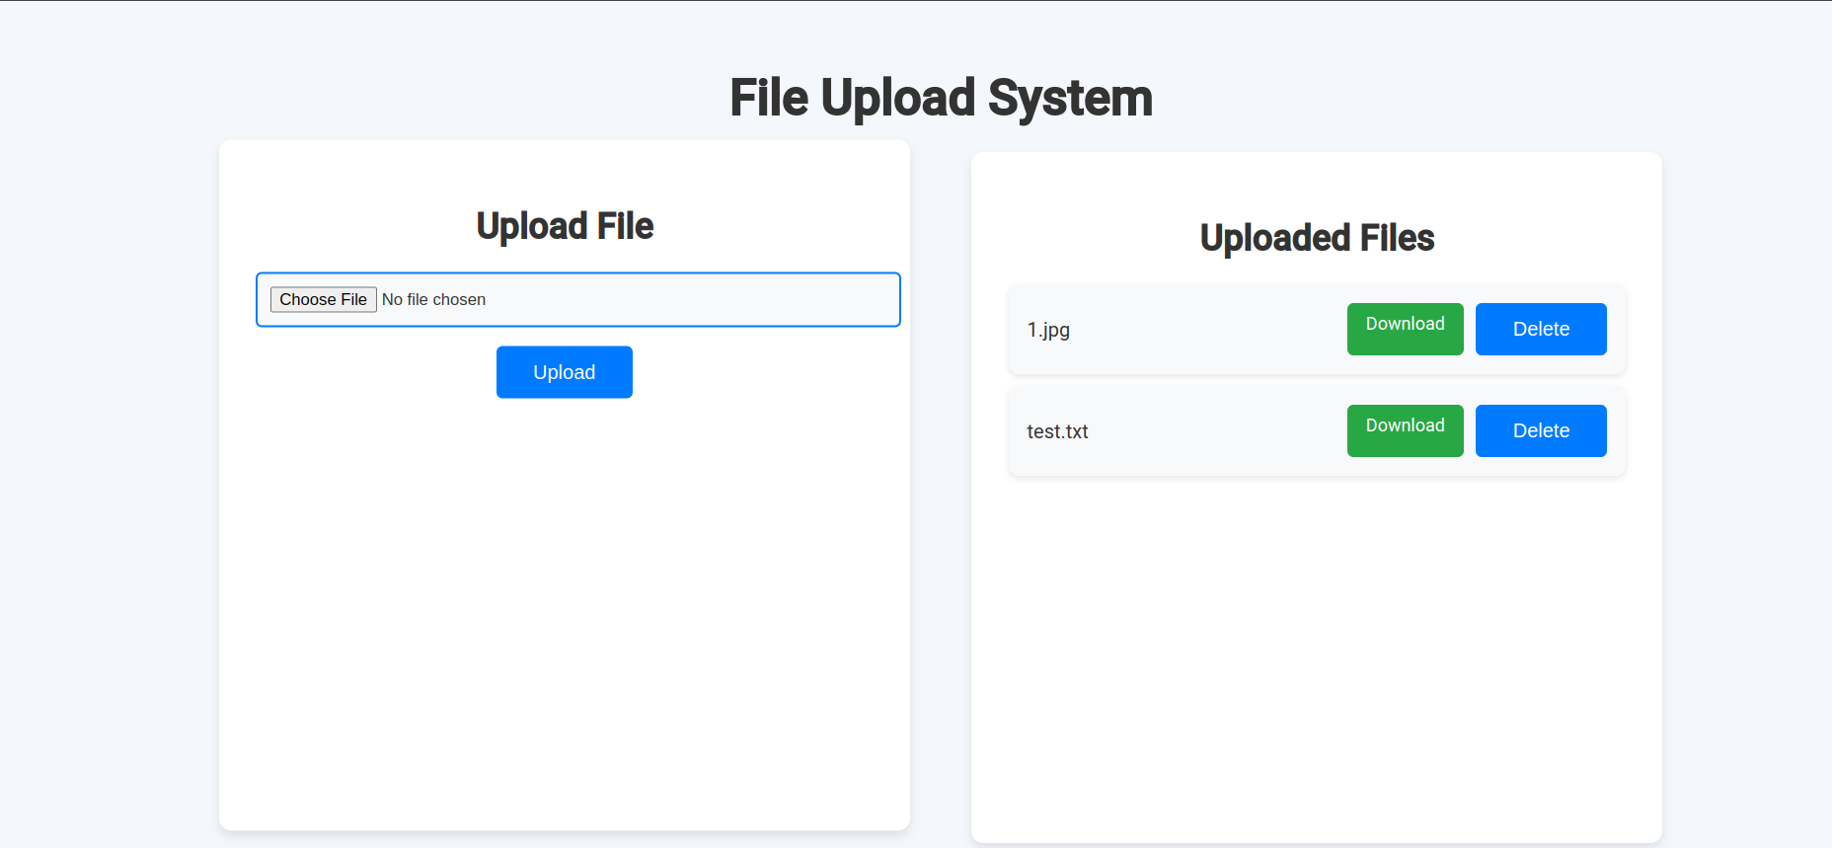
FRONT - END

Slide 8
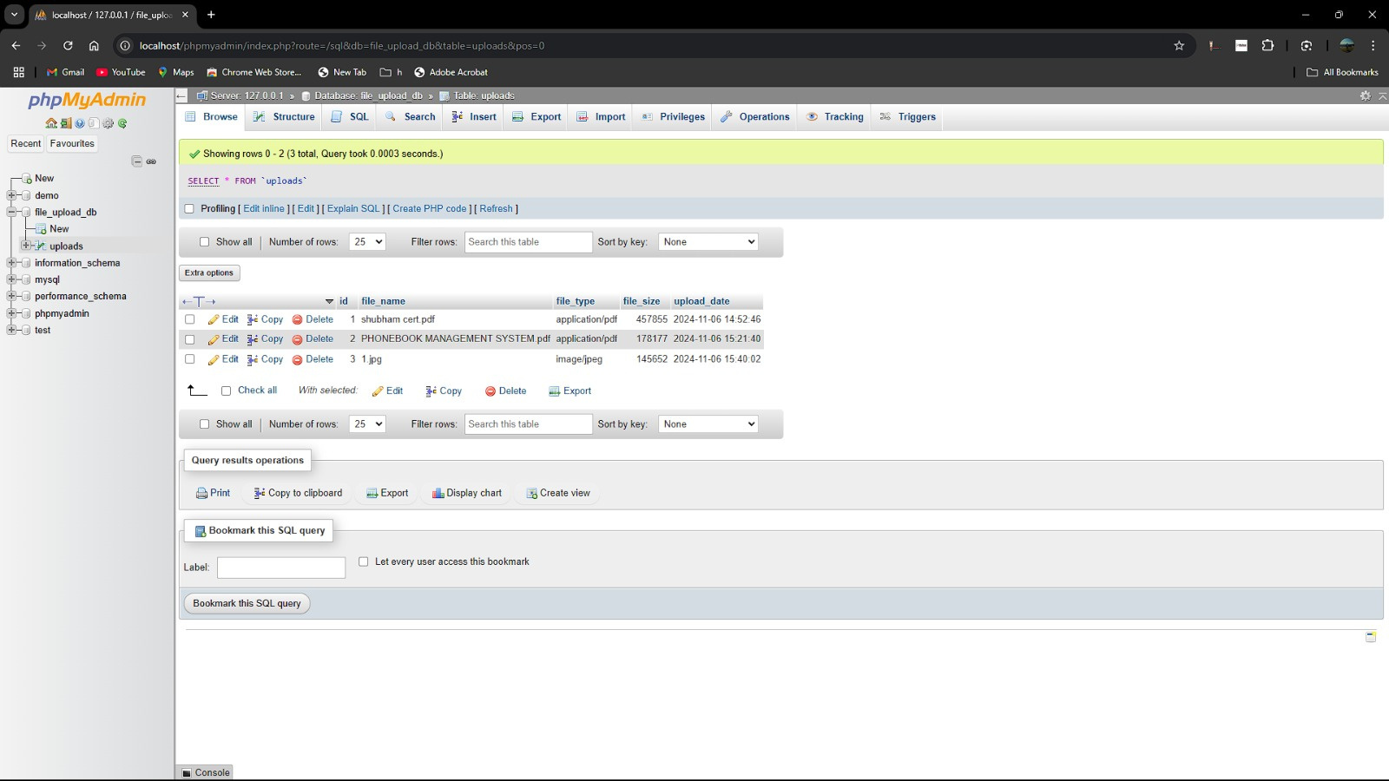
BACK -END

Slide 9
WORKING OF UPLOAD
Initialize Database Connection Details: It defines database credentials for connecting to a MySQL database named file_upload_db.
Check Form Submission: When the upload form is submitted, the script processes the file upload. It sets a target directory (uploads/) and specifies a 2MB file size limit.
Validate File Size and Type: It checks that the file is within the size limit and matches allowed file types (JPG, PNG, or PDF). If any condition fails, the upload is halted.
Move and Store File: If the file passes all checks, it's moved to the target directory, and a database connection is established.
Execute Database Insert: The file details are inserted into the database using a prepared SQL statement, ensuring data security.

Slide 10
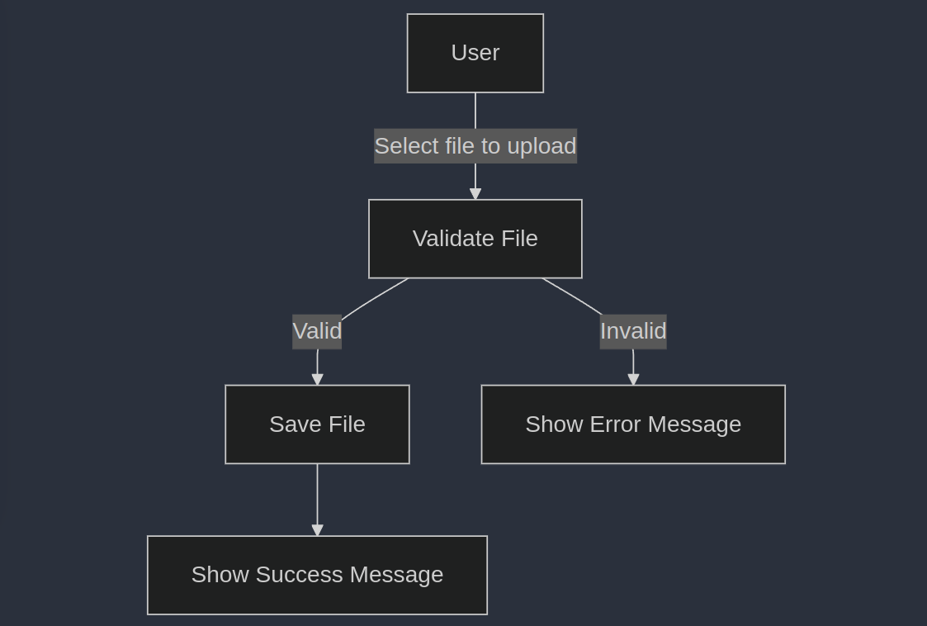
Data Flow - Upload

Slide 11
WORKING OF DOWNLOAD
Check File Parameter: It checks if the file parameter is set in the URL. This parameter determines which file the user wants to download.
File Existence Verification: It constructs the path for the file in the uploads folder and checks if the file actually exists.
Set Download Headers: It sets various HTTP headers to prepare the file for download. These headers ensure that the file is downloaded as an attachment rather than displayed in the browser.
Send File to User: The readfile function reads the file from the server and sends it to the user’s browser, allowing them to download the file.

Slide 12
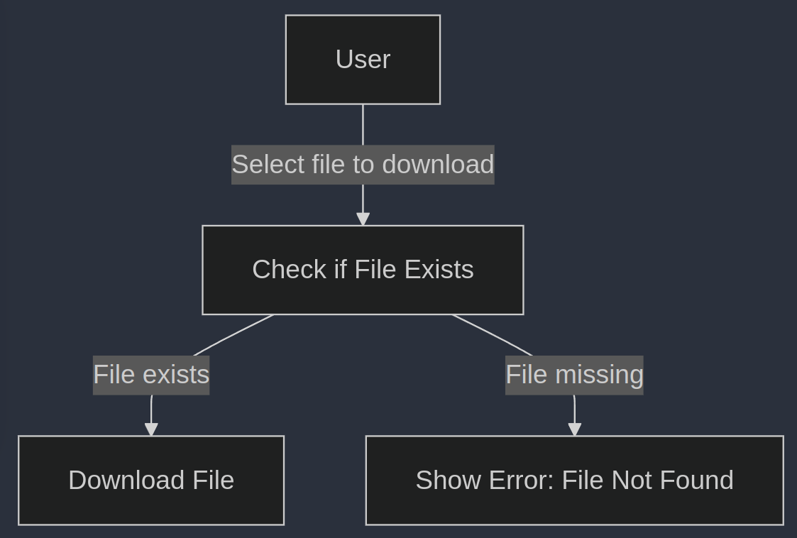
Data Flow -Download

Slide 13
WORKING OF DELETE
Check File Existence: It constructs the path to the file in the uploads directory and checks if the file exists. If the file is not found, it sets an error message.
Delete the File: If the file exists, the unlink function deletes it from the server. A success message is set if deletion is successful; otherwise, an error message is set.
Redirect with Message: After attempting the deletion, the script redirects the user back to index.php, passing a status message as a URL parameter.

Slide 14
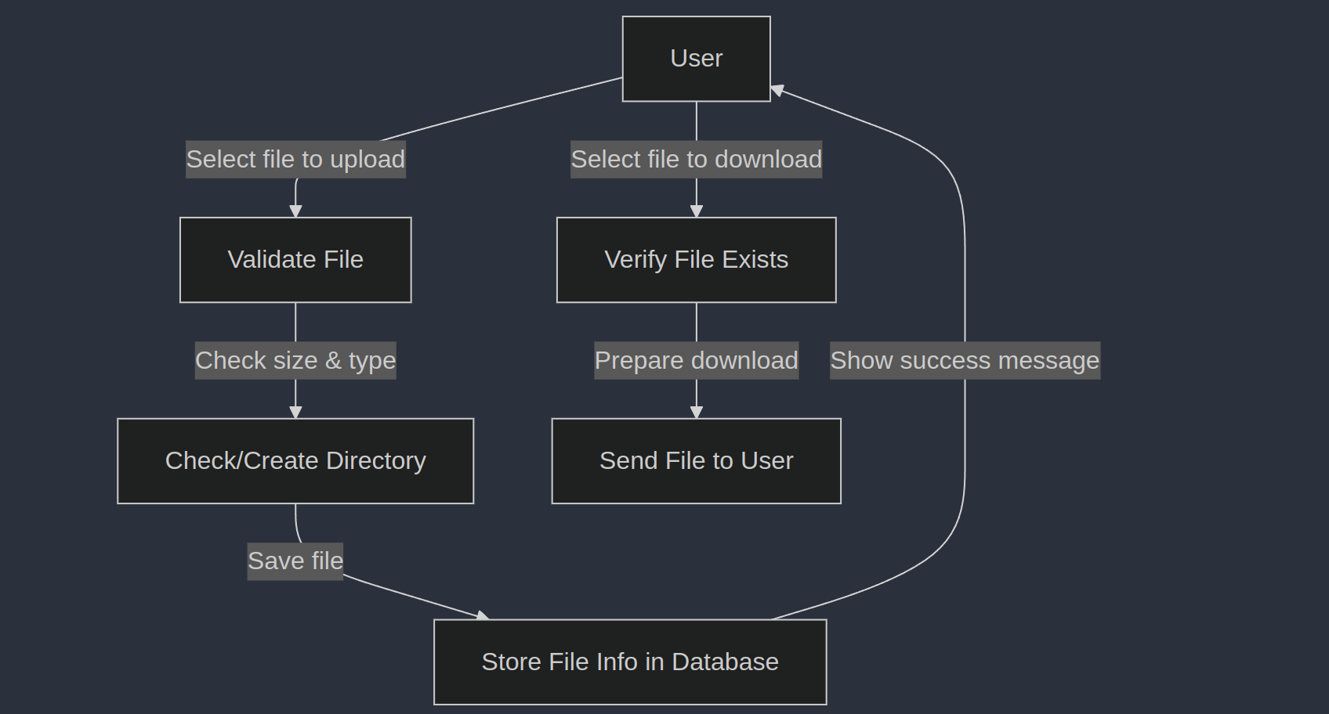
Data Flow

Slide 15

THANK YOU !

