Slide 1

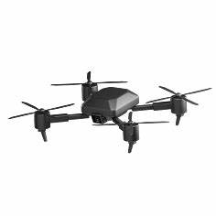




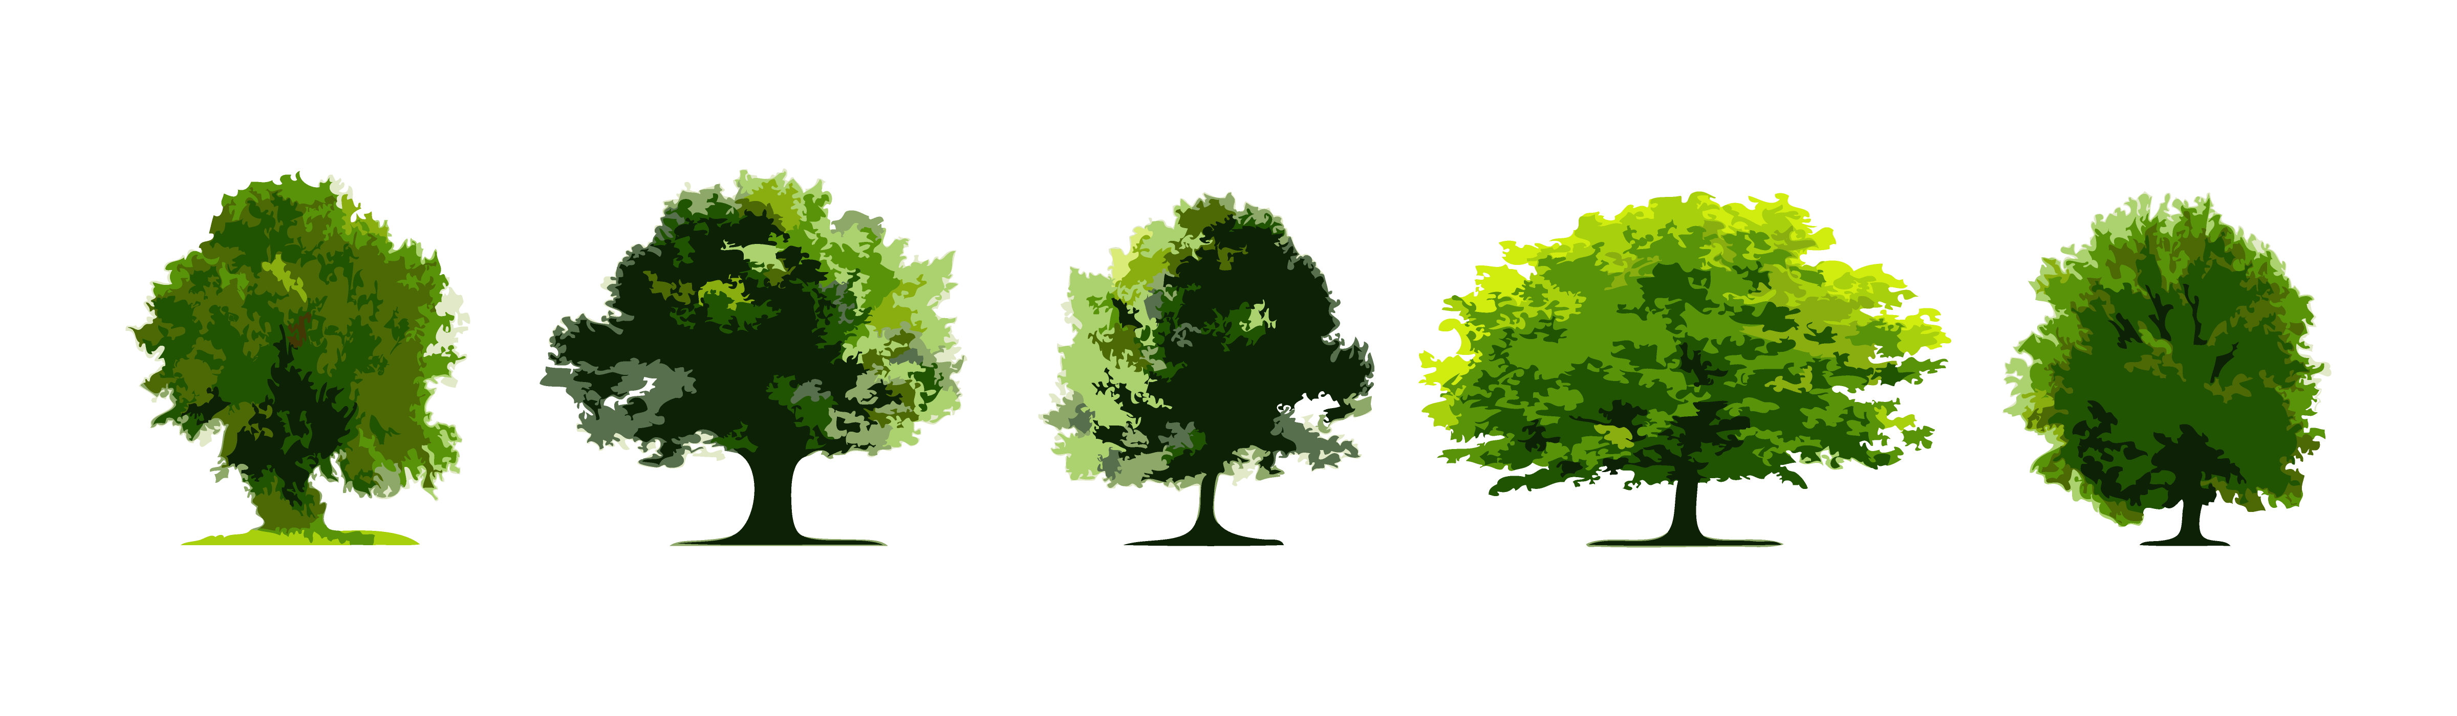
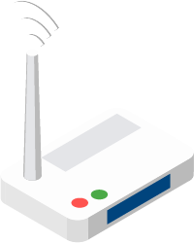

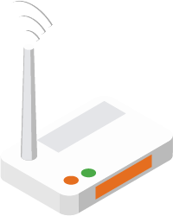














Environment
State $s_{t}$
Actor network
Action $a_{t}$
Decision variables
$$V_{u}(t)$$
$$m(t)$$
$$α(t)$$
UAV movement
$$V_{g}(t)$$
$$p(t)$$
Power control
User association
$$(s_{t},a_{t},r_{t},s_{t+1})$$
Gradient descent
Gradient descent
Min
Min
Phase I:
Pre-evaluation
$$s_{t}, s_{t+1}$$
Critic target 1
Critic target 2
Reward
function
Sample transitions from replay buffer
Critic 1
Critic 2
Phase II:
Swap operation
<$s_{t}, a_{t}, r_{t}, s_{t+1}$>
Replay buffer
Soft
update
Soft
update

Slide 2
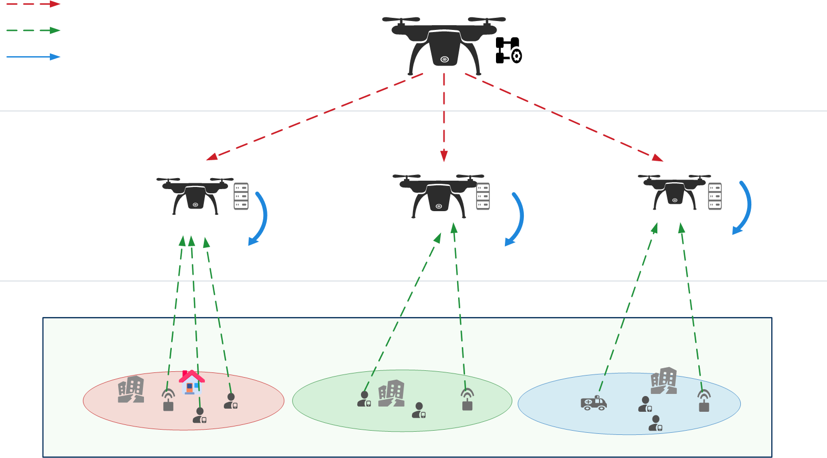





Environment
Actor network
State
Action
Hybrid decisions
S(n)
$λ$_{u}
Offloading ratio
$$vm$$
UAV velocity
associate&allocate
$$(s_{t},a_{t},r_{t},s_{t+1})$$
Policy update
Critic update
Policy loss
Critic loss
Phase I:
Hotspot clustering
$$s_{t}, s_{t+1}$$
Target Q'_{i}
Target Q'_{j}
Priority
reward
Sample
mini-batch
Critic Q_{i}
Critic Q_{j}
Phase II:
Centralized solver
<$s_{t}, a_{t}, r_{t}, s_{t+1}$>
Replay buffer
Soft
update
Soft
update

Slide 3
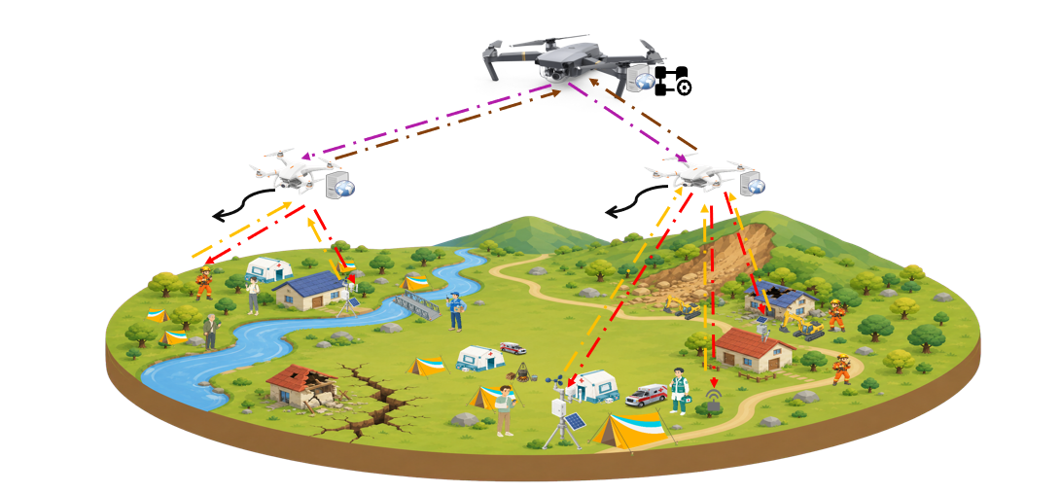




Environment
State
Actor network
Action
Hybrid decisions
S(n)
$λ$_{u}
Offloading ratio
$$vm$$
UAV velocity
associate&allocate
Policy update
Critic update
$$(sₙ, aₙ, rₙ, sₙ₊₁)$$
Policy loss
Critic loss
$$sₙ, sₙ₊₁$$
Target Q'_{i}
Target Q'_{j}
Sample
mini-batch
Critic Q_{i}
Critic Q_{j}
reward
<sₙ, aₙ, rₙ, sₙ₊₁>
Replay buffer
Soft
update
Soft
update

Slide 5
Environment
State $s_{t}$
Actor network
Action $a_{t}$
Decision variables
$$V_{u}(t)$$
$$m(t)$$
$$α(t)$$
UAV movement
$$V_{g}(t)$$
$$p(t)$$
Power control
User association
$$(s_{t},a_{t},r_{t},s_{t+1})$$
Gradient descent
Gradient descent
Min
Min
Phase I:
Pre-evaluation
$$s_{t}, s_{t+1}$$
Critic target 1
Critic target 2
Reward
function
Sample transitions from replay buffer
Critic 1
Critic 2
Phase II:
Swap operation
<$s_{t}, a_{t}, r_{t}, s_{t+1}$>
Replay buffer
Soft
update
Soft
update

