Slide 1
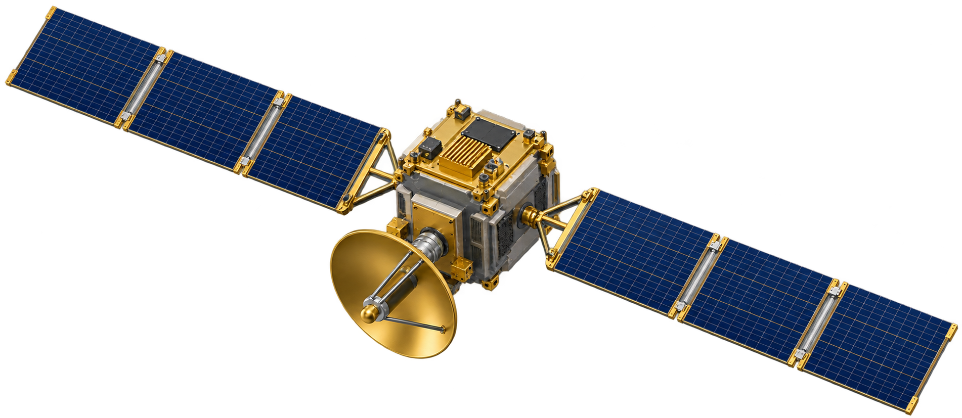

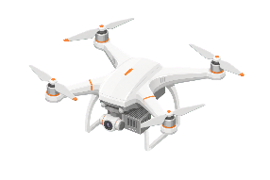
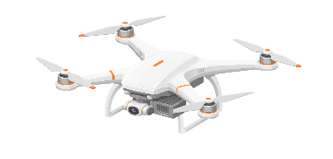

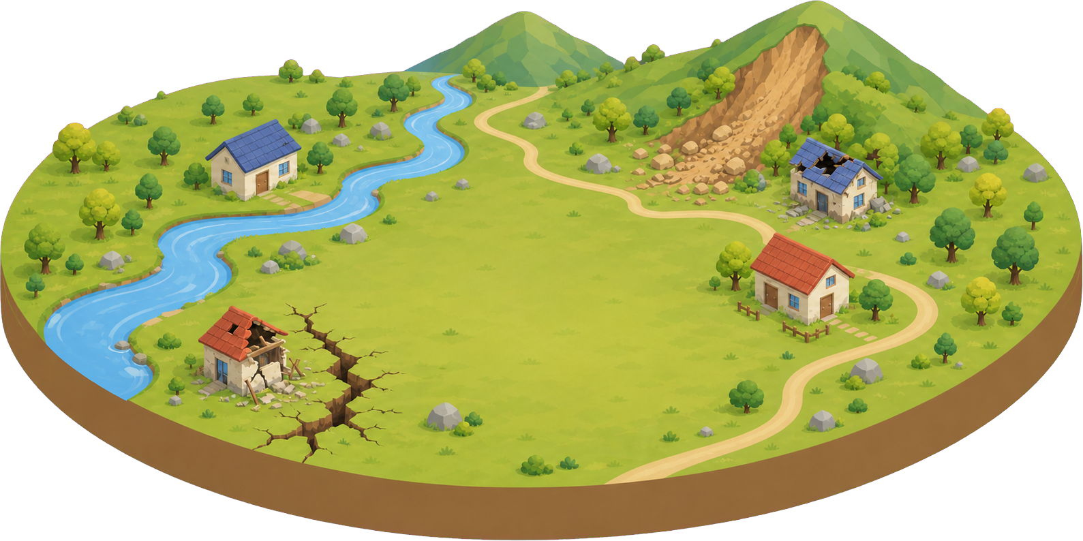



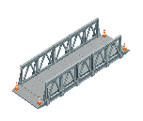










UD–UAV offloading
Deadline-based task priority
LEO satellite with edge computing
Direct UD–LEO offloading
Task {D, C, τ}
Local computing
Priority ω = 1/τ
UAV trajectory
Shorter deadline, higher priority
State / control signaling
600 km altitude
Edge server
Logical centralized decision maker
100 MHz shared, 50 GHz
UAV 1
Offloading and bandwidth / CPU allocation
UAV 3
UAV trajectory control
Direct UD–LEO
UAV 2
offloading
10 MHz, 10 GHz
10 MHz, 10 GHz
10 MHz, 10 GHz
UD 1
UD 6
UD 3
UD 4
UD 5
UD 2
Local computing
UD 7
UD 20
Post-disaster rescue area: 20 mobile UDs with local computing
Each task executes at exactly one destination: local, one UAV, or the LEO satellite
Notes:
System: 20 mobile UDs, three computing UAVs, one directly accessible LEO satellite. Each task is indivisible and executes at a single destination.
Current v3 parameters: each UAV has its own 10 MHz bandwidth pool and 10 GHz CPU. The satellite has a shared 100 MHz pool and 50 GHz CPU. UAV altitude 50 m. LEO altitude 600 km. Per-UAV energy budget 12000 J. Priority is only the reciprocal deadline; no discrete priority classes are modeled.
Representative links show individual task assignments, not simultaneous splitting of a task. No UAV–satellite relay, inter-UAV offloading, inter-satellite links, physical cloud, or extra controller UAV is modeled. The decision maker is a logical ideal-control abstraction.
Model sources: docs/01_系统模型.md, configs/environment.json, manuscript_tvt/sections/system_model.tex. A pre-existing 20 MHz satellite value in project_context.md is stale; current v3 model and configuration use 100 MHz.
Reused visual sources: original user-supplied 系统模型图_论文完善版.pptx. The two supplied published-paper images informed layout only; their networks and graphical assets are not reproduced.
Satellite illustration generated with the built-in ImageGen tool. Original terrain, UAV, people, shelter and server artwork retains its original raster form; labels, task links, phones, curves and logical-controller annotation are native editable PowerPoint objects.

