Slide 1
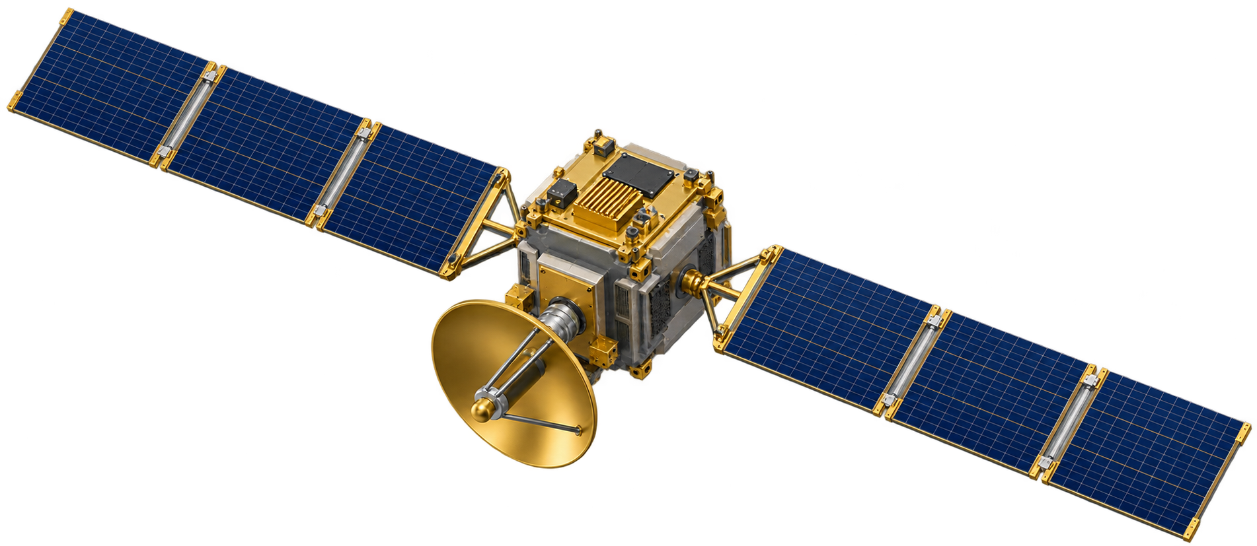

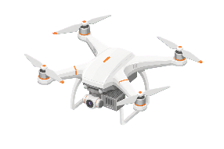
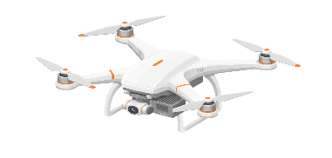



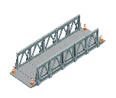










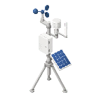


UD–UAV offloading
Direct UD–LEO offloading
Local computing
UAV trajectory
State / control signaling
600 km altitude
Edge server
100 MHz shared, 50 GHz
UAV 3
Direct UD–LEO
UAV 2
offloading
UD 1
UD 6
UD
UD 4
UD 5
UD 2
Local computing
UD 7
UD 20
Post-disaster rescue area: 20 mobile UDs with local computing
Each task executes at exactly one destination: local, one UAV, or the LEO satellite

Slide 2
UD–UAV offloading
Deadline-based task priority
LEO satellite with edge computing
Direct UD–LEO offloading
Task {D, C, τ}
Local computing
Priority ω = 1/τ
UAV trajectory
Shorter deadline, higher priority
State / control signaling
600 km altitude
Edge server
Logical centralized decision maker
100 MHz shared, 50 GHz
UAV 1
Offloading and bandwidth / CPU allocation
UAV 3
UAV trajectory control
Direct UD–LEO
UAV 2
offloading
10 MHz, 10 GHz
10 MHz, 10 GHz
UD 1
UD 6
UD 3
UD 4
UD 5
UD 2
Local computing
UD 7
UD 20
Post-disaster rescue area: 20 mobile UDs with local computing
Each task executes at exactly one destination: local, one UAV, or the LEO satellite

Slide 3
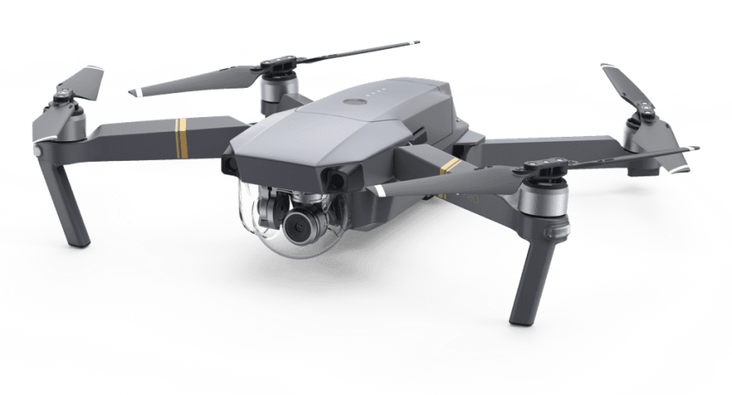











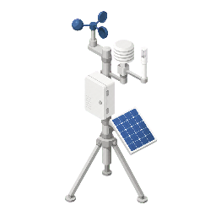


SUAV-LUAV link
LUAV-SUAV link
UD-UAV link
UAV-UD link
Edge server
SDN controller
Trajectory

Slide 4
UD–UAV offloading
Direct UD–LEO offloading
UAV trajectory
State / control signaling
Edge server

