Slide 1
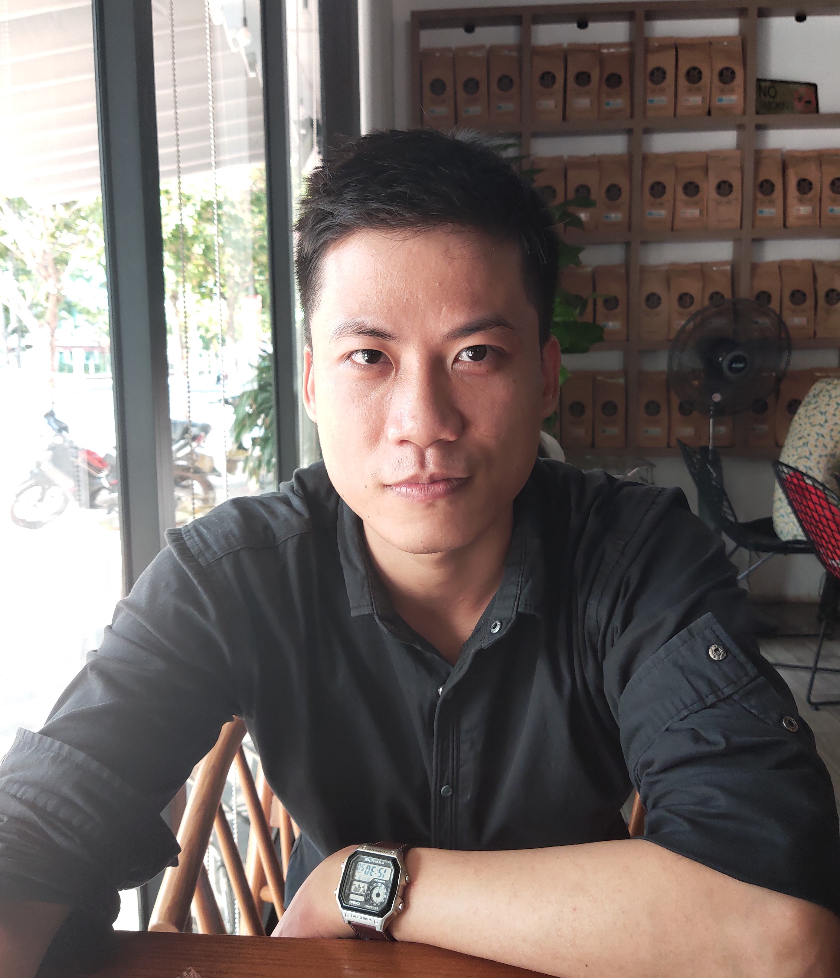

HA XUAN TUAN
PROFILE
I graduated in University with Good Bachelor and had over 9 months experienced in Automatic Software Embedded by C/C++ Language. Possible to comunicate in English and basic Japanese Language.
INFORMATION
EDUCATION
Male
 December 14, 1997
 Single
 An Cuu District, Hue City
 hatuan141297@gmail.com
 +84347981320
BE in Univ. of Science and Technology – the University of Da Nang
Major in Mechatronic
2015 – Jan 2020
GPA: 3.2/4.0
TOEIC: 720
Received:
Encouraged scholarship for top 5% highest score (6/8 Semester).
Second Prize in DaNang Scientific Research Contest.
Activity :
Workshop on Computer Aided Engineering, corporate with Yokohama National University.
Projects:
Image Processing in Plate: Create a WinForm to recognize a plate by C# Language. Using many techniques like EmguCV(library of OpenCV in C#) Machine Learning (Google OCR to recognize characters), applying Masks to filter Noise and find Plate Area, ...
Robot Arm: Program Arduino by C Language to control 6 DOF Robot Arm through inverse kinematic.
Application in C++: Program an Sales Management Application in C ++ Language in QT Platform, use MySQL Lite to storage Database.
Final Project: Program An Application on Computer by C# Language connecting with PLC to control 3 DOF Arm Robot and Pneumatic Systems (through vans).
SKILLS
C/C++ Programing
OOP
STL
Design Pattern
UML
C# Programing
VBA Programing
Research Skill
Team-Work Skill
Independence Work Skill

Slide 2

HA XUAN TUAN
WORK EXPERIENCE
DANANG NIPPON SEIKI COMPANY
Research & Development Engineer
Feb 2020 – Nov 2020
Main Responsibilities:
Design Application by using MATLAB – Simulink.
Design and modify application of instrument Clusters for Automobiles by C Language.
Unit test and Integration test.
Learn Japan Language.
INTERESTS
Novel
Chat with friends
MORE INFORMATION
Personal:
Be calm, quickly adaptive environment, not afraid of difficulties and excitement in finding solution to the problem.
Self-study and fast absorbing new knowledge.
Orientation:
Work in a big, professional company at first, this will help me develop my programming skills by learning from senior, also work in a professional company will help me improve my workflow.
Contribute a part to help the world become more modern.

