Slide 1
Review the last lesson
What did we learn from the last lessons?

Slide 2
Chapter 32 Software requirements and risk management

Slide 3
Objectives
Presents a brief tutorial on software risk management and a number of risk factors that can raise their ugly heads during requirements engineering activities.
Understand that potential problems might have an adverse impact on the project’s cost, schedule, or technical success; the product’s quality; or the team’s effectiveness.
Be able to identify a list of potential requirements risks facing in their project.

Slide 4
Contents
Fundamentals of software risk management
Requirements-related risks
Risk management is your friend

Slide 5
Fundamentals of software risk management
What is risk?
A risk is a condition that could cause some loss or otherwise threaten the success of a project. (Software Requirements, Third Edition, Karl Wiegers and Joy Beatty)
A risk is an uncertain event or condition that, if it occurs, can have a positive or negative effect on one or more objectives. (PMBOK 7th Edition, PMI)
What is issue?
If something untoward has already happened on the project, it’s an issue, not a risk.
What is risk management?
Risk management is the process of identifying, evaluating, and controlling risks before they harm your project. (Software Requirement)
Risk management is the process of identifying, evaluating, and controlling risks to maximize positive risks (opportunities) and decrease exposure to negative risks (threats). (Project Management)

Slide 6
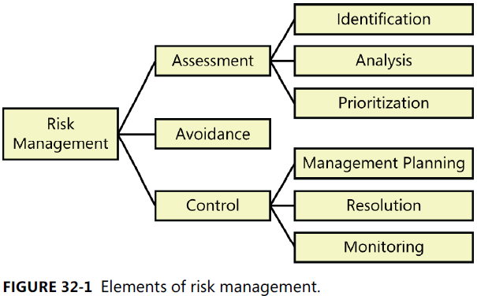
Elements of risk management

Slide 7
Requirements-related risks: Requirements elicitation
Product vision and project scope: Scope creep
Time spent on requirements development: Tight project schedules
Customer engagement: Insufficient customer
Completeness and correctness of requirements specifications
Requirements for innovative products
Defining nonfunctional requirements
Customer agreement on requirements
Unstated requirements: implicit expectations
Existing product used as the requirements reference
Solutions presented as needs
Distrust between the business and the development team

Slide 8
Requirements-related risks: Requirements analysis
Requirements prioritization
Technically difficult features
Unfamiliar technologies, methods, languages, tools, or hardware

Slide 9
Requirements-related risks: Requirements specification
Requirements understanding
Time pressure to proceed despite open issues
Ambiguous terminology
Design included in requirements

Slide 10
Requirements-related risks: Requirements validation
Unvalidated requirements
Inspection proficiency

Slide 11
Requirements-related risks: Requirements management
Changing requirements
Requirements change process
Unimplemented requirements
Expanding project scope

Slide 12
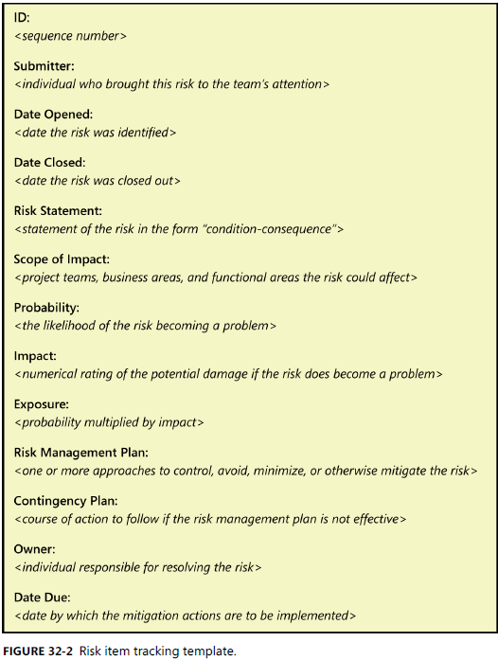
Documenting project risks

Slide 13
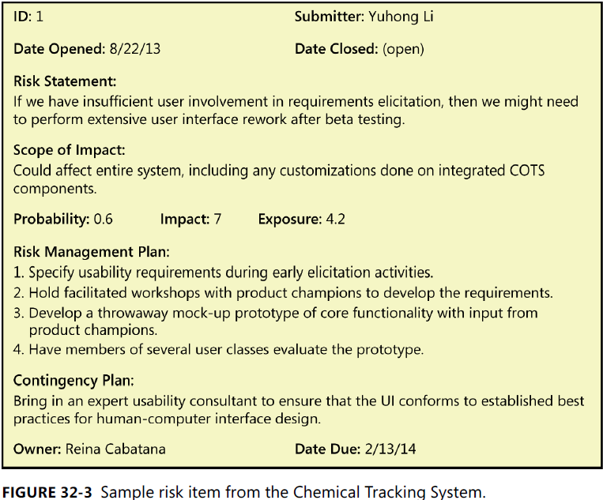
Documenting project risks

Slide 14
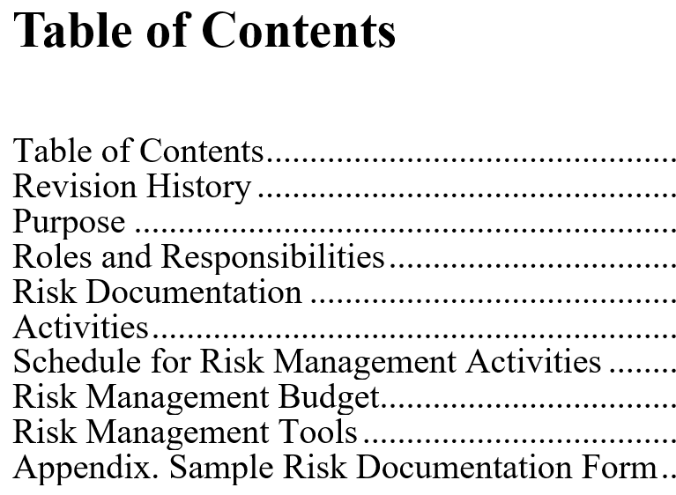
Planning for risk management

Slide 15
Risk management is your friend
Risk management helps you keep your eyes open and make informed decisions, even if you can’t control or avoid every adversity your project might encounter.

Slide 16
Summary
What do we learn from today lesson?

