Slide 1
BASIC PROJECT 4
BUILD BATTLESHIP ONLINE FIGHTING GAME APP
Instructors: ThS. TRẦN ĐÌNH SƠN
ĐOÀN QUANG TUẤN AN - 23IT002
LÊ NGỌC HÙNG - 23IT094
Da Nang, December 2025

Slide 2
I. Introduction
Content
II. General research
III. System Design Analysis
IV. Conclusions and development directions

Slide 3
I. Introduction
In the context of the strong development of information technology and online applications, the demand for entertainment through online games is increasingly popular. Online fighting games not only provide an entertaining experience but also create an interactive, competitive environment between many players in different geographical locations.
However, many information technology students today mainly stop at learning the theory of network programming, client-server models, but have not had many opportunities to build a practical application capable of real-time communication between many users. From that fact, the topic "Building an online fighting game application Battleship according to the client-server model" was chosen to combine entertainment elements and the application of professional knowledge.
The application allows multiple players to participate in the Battleship game in the form of online fighting, create – join the playroom, arrange ships, make shots, and track the results of matches. In addition, the system also supports account management, playing rooms, and match history. The construction of this topic helps the implementer to consolidate and apply the knowledge of network programming, socket communication, synchronous processing, as well as practice skills in analyzing, designing and deploying a complete client-server system.

Slide 4
II. GENERAL RESEARCH
Objectives:
The goal of the project "Building a Battleship online fighting game application according to the client-server model" is to develop a stable online game system, support multiplayer, ensure interactivity and good experience for users, and apply the knowledge of network programming to the actual product. Specifically, the objectives include:
Build a Battleship game application with a friendly and easy-to-use interface: intuitive interface design, simple operation, making it easy for players to log in, create rooms, join rooms, arrange ships, and play games without much difficulty.
Implementation of the client-server model for online fighting games: building a central server to manage connections, game rooms, and game order; Clients will connect to the server to send and receive data (moves, chessboard status, win/loss results) in real time.
Supports player and match management functions: allows to manage user account information, playing room, player status in the room, save some basic information about match history (players, time, results,...).
Improve the ability to apply professional knowledge: apply knowledge of network programming, sockets, TCP/IP protocols, multithreading, as well as software system analysis and design, thereby helping implementers accumulate experience for practical projects in the future.

Slide 5
II. GENERAL RESEARCH
Applied Technology:
Python Language
Network programming with TCP/IP protocol
MySQL Data Management System
Support Tools: Visual Studio Code (VSCode), XAMPP

Slide 6
III. SYSTEM DESIGN ANALYSIS:
Functional Requirements
For Players:
Register/log in to the app to join the game.
Create a room or join an available playroom.
Competition:
Ship Layout
Make a shot
See the result of the game.
Message other players in the playroom.
For Administrators:
Player management (view player lists, lock, unlock, delete player accounts).
Manage playrooms (see playroom list, cancel playrooms).
View match history (see match list, see match details).

Slide 7
III. SYSTEM DESIGN ANALYSIS:
Non-functional requirements
User-friendly interface, easy to use with everyone.
Strictly secure user information.
Ability to expand the system later.

Slide 8
III. SYSTEM DESIGN ANALYSIS:
System Operation Description:
The online fighting game application Battleship is designed to simulate a sea battle between two players in a Client–Server model. The app offers an engaging competitive, interactive experience, allowing players to compete intellectually and tactically against each other in a cyber environment.
Players can easily "Register/log in to the app" to participate. Once logged in, players will enter the main lobby, where they can "create a new play room" or "join an existing play room" created by someone else.
When a room has enough 2 people, the game moves to the preparation stage. Each player has a 10x10 and 60-second field to "arrange their 4 ships" (1x5, 1x4, 1x3 and 1x2 sizes) into their arbitrary positions. Each person's ship location is completely hidden from the opponent.
Once both have been arranged, the Server will "randomly select the player who goes first". In turn, players have 15 seconds to "make a shot" by selecting a tile in their opponent's field. The application (Server) will process and return the results immediately:
If the ship container is "hit", the app will notify it and the player is "keep firing until it misses".
If the "shot misses", the application notifies and "passes the turn to the opponent".
When all the cells of a ship are fired, the ship is considered "destroyed".
During the competition, players can "message other players in the playroom" to increase interactivity. The game ends when one player destroys all of the enemy's ships, and the player can "see the win/lose outcome" shortly afterwards.

Slide 9
III. SYSTEM DESIGN ANALYSIS:
System Operation Description:
On the Server side, this is the automated processing center, which is mainly responsible for "coordinating shots", processing results, "status synchronization" and "time monitoring" strictly (60 seconds of placing the train, 15 seconds per turn). The server also automatically "manages the playing room" (creates, updates, deletes when the match ends) and "stores all account information and match results" in the database. It is necessary to distinguish the Server (automatic) role from the Administrator role, which is a user who has the privilege of monitoring and manually intervening in the system when necessary, such as "player management" (locking out violating accounts) or "game room management" (destroying faulty rooms).
The entire application is developed with a "friendly, lively interface", supporting players to participate quickly and easily operate. This is a good example for a Client–Server networking application, which helps learners practice "socket programming, multi-threading, and data management".

Slide 10
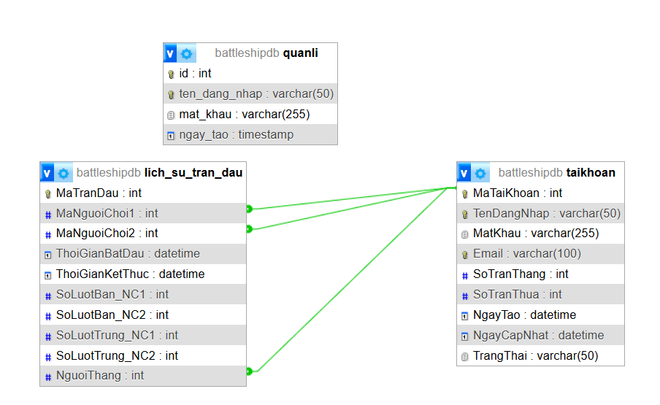
III. SYSTEM DESIGN ANALYSIS:
Database Diagram:

Slide 12
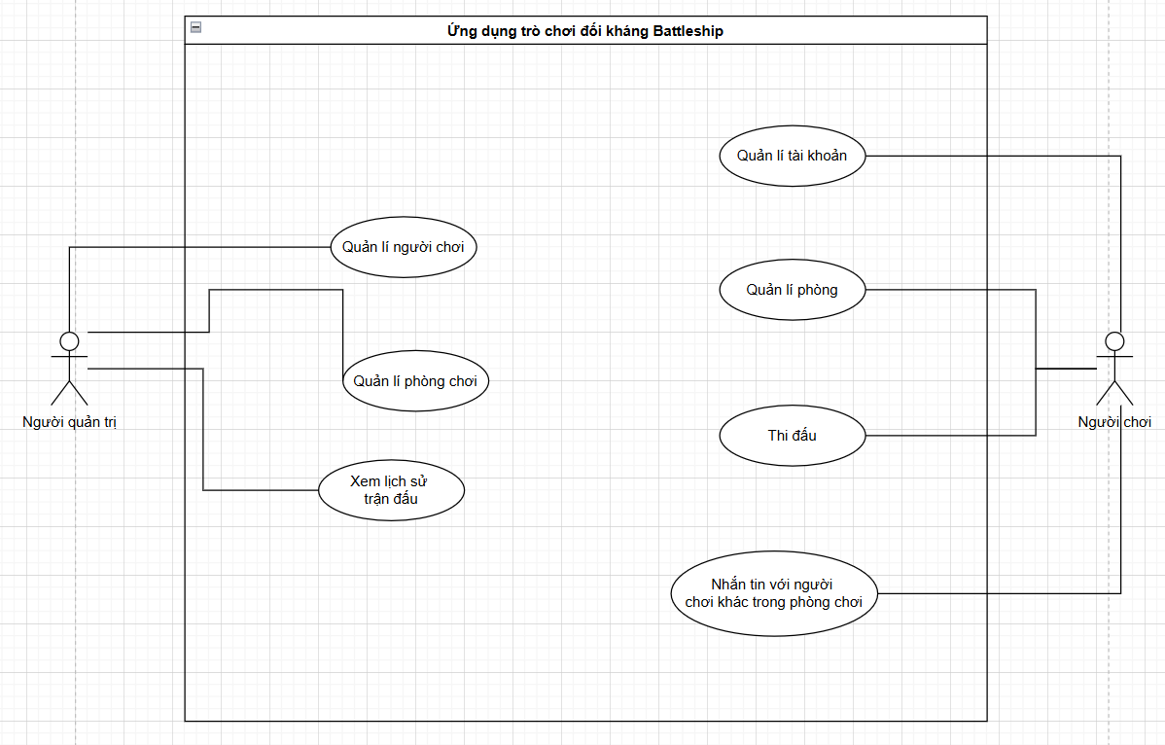
III. SYSTEM DESIGN ANALYSIS:
Use-case diagram:

Slide 14
III. SYSTEM DESIGN ANALYSIS:
PLEASE SEE THE DIAGRAMS, SPECIFICATION OF FUNCTIONS, AND MODELING ACTIVITIES IN THE WORD REPORT

Slide 15
RESPECT!

