Slide 1

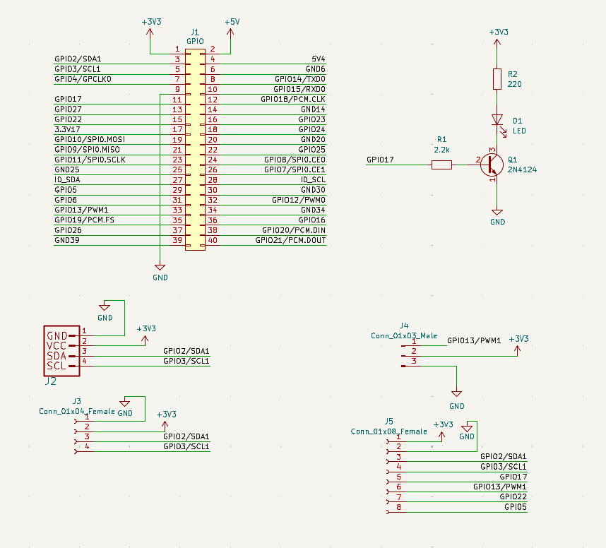
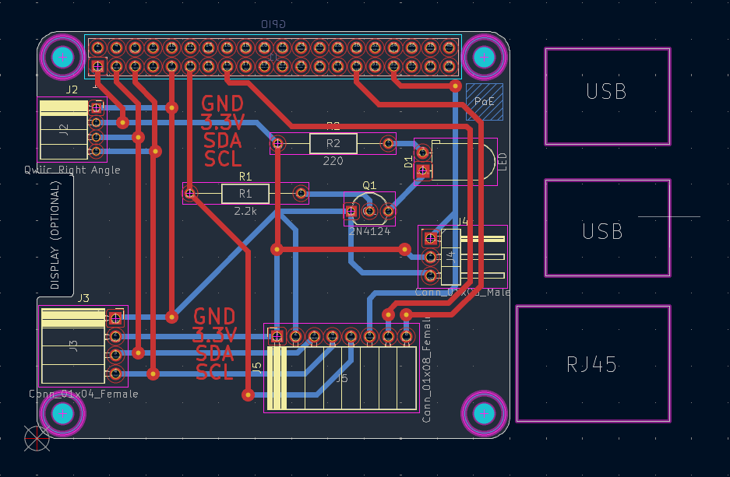
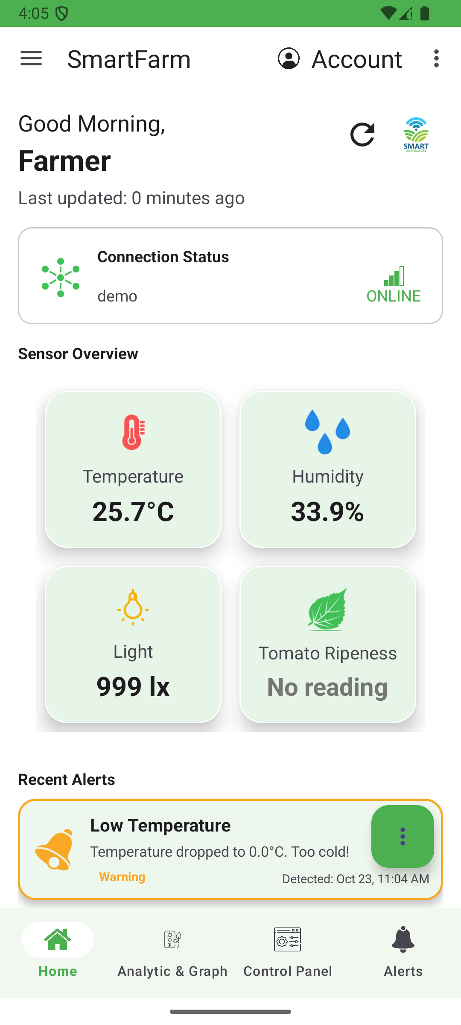
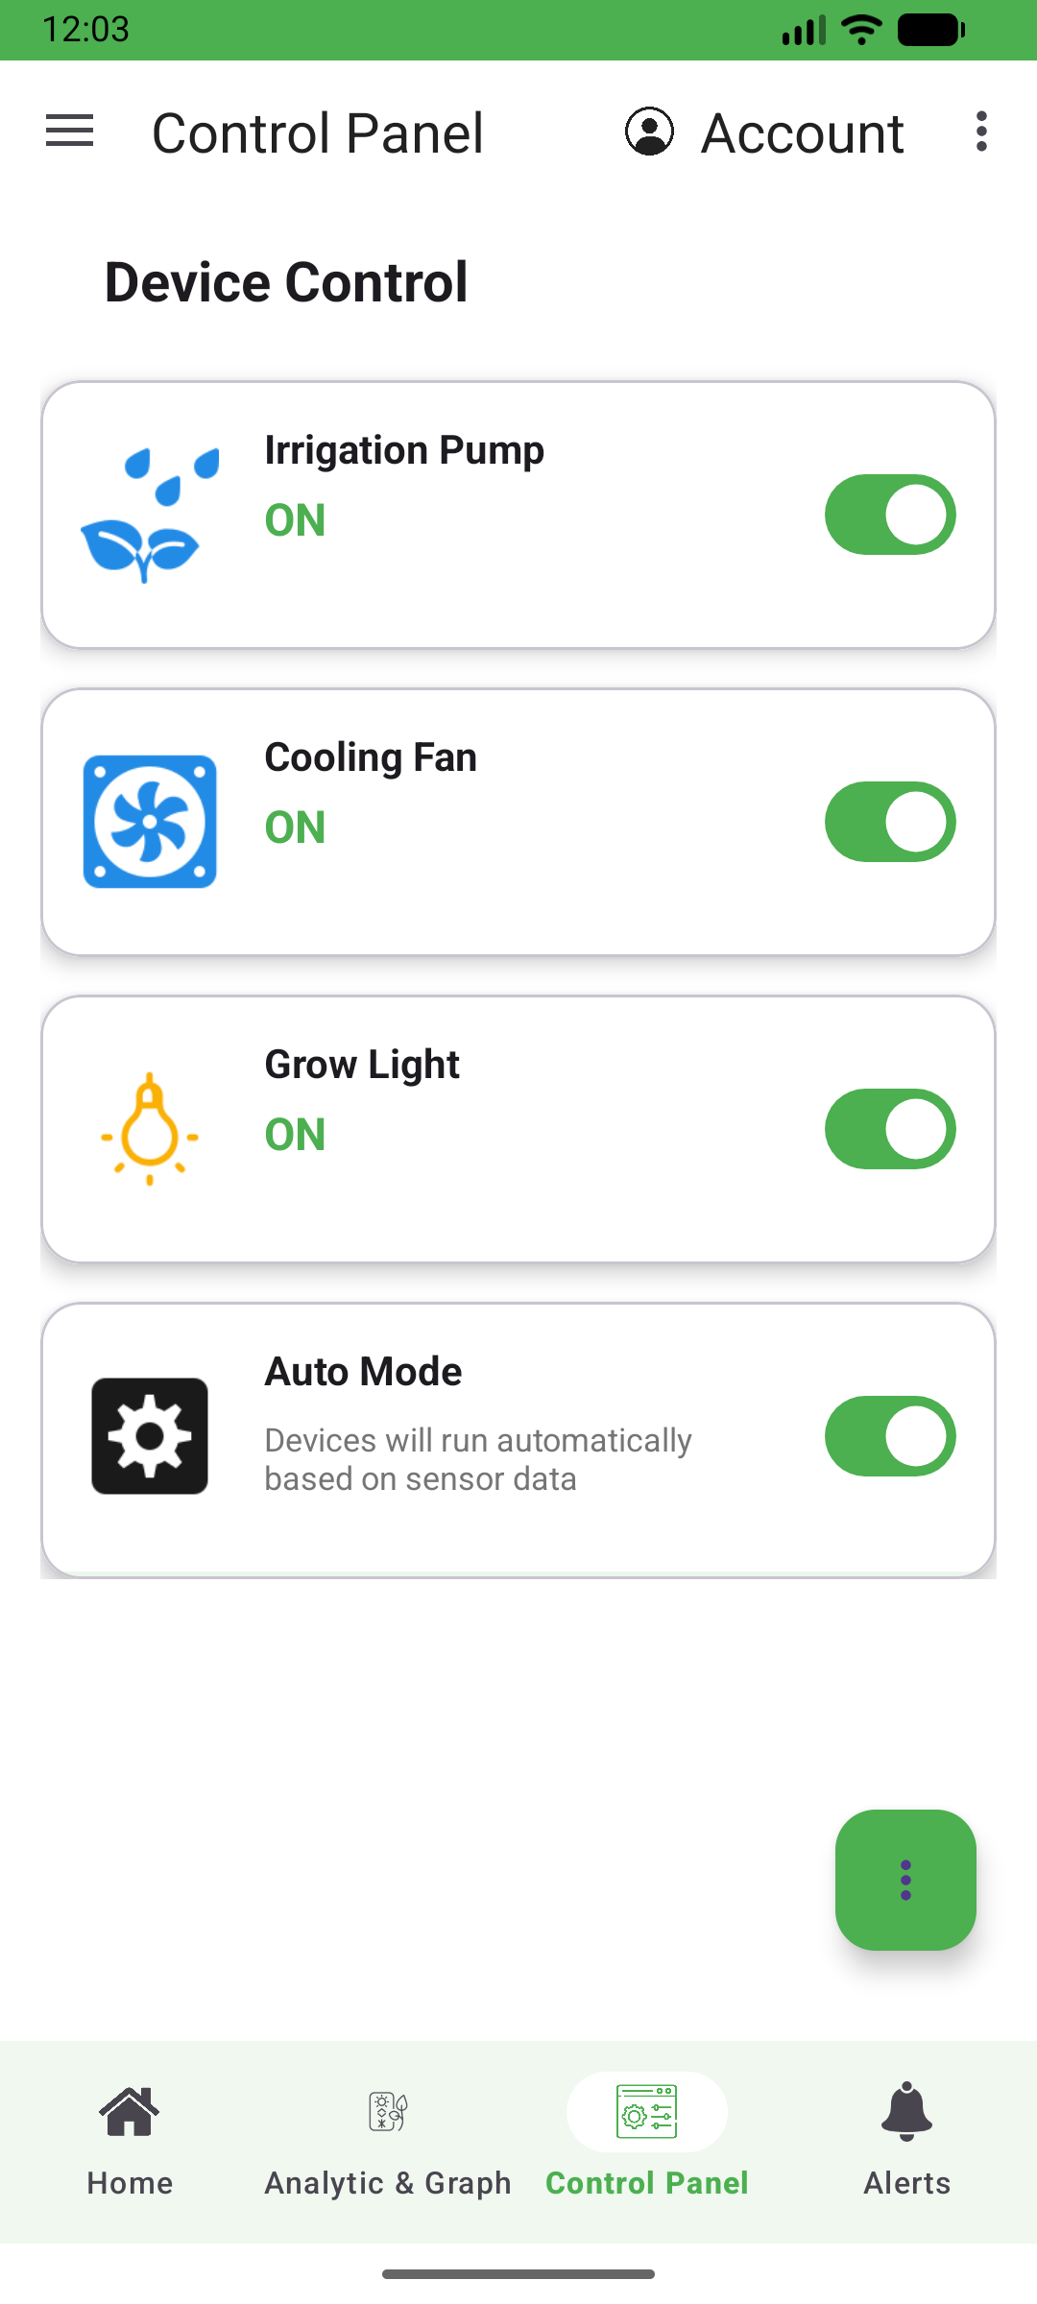
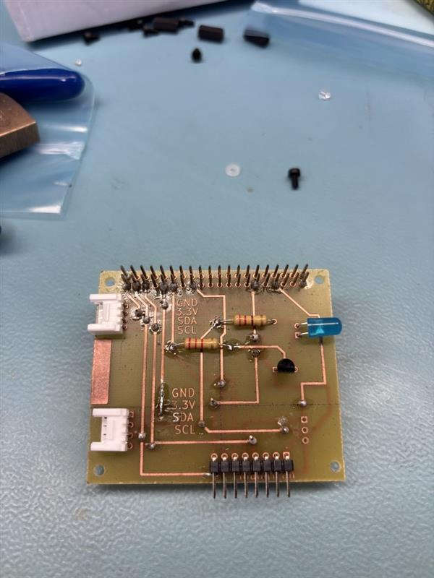
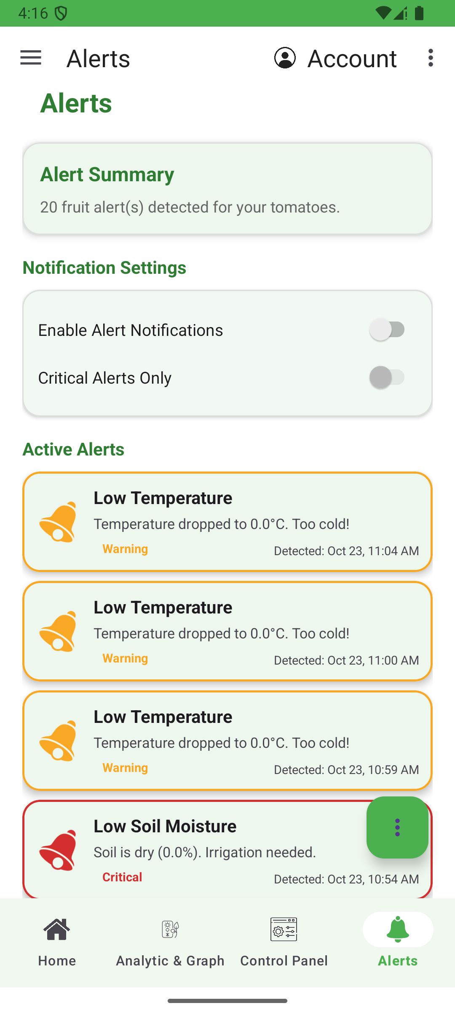






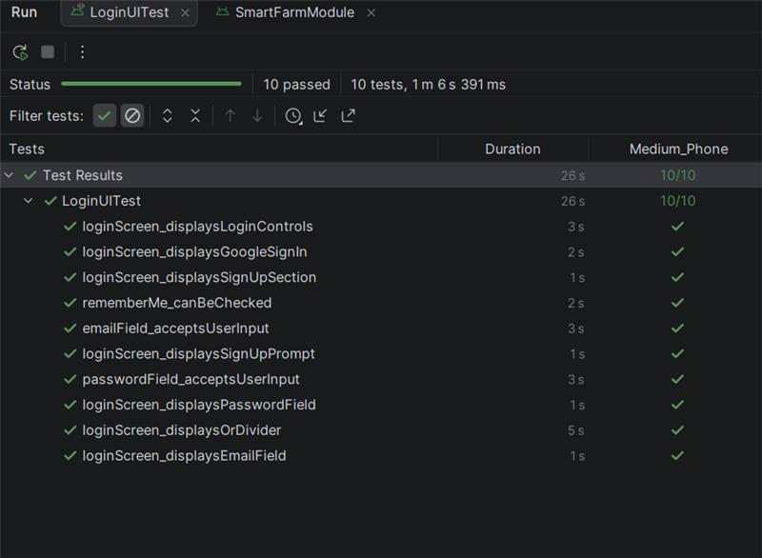

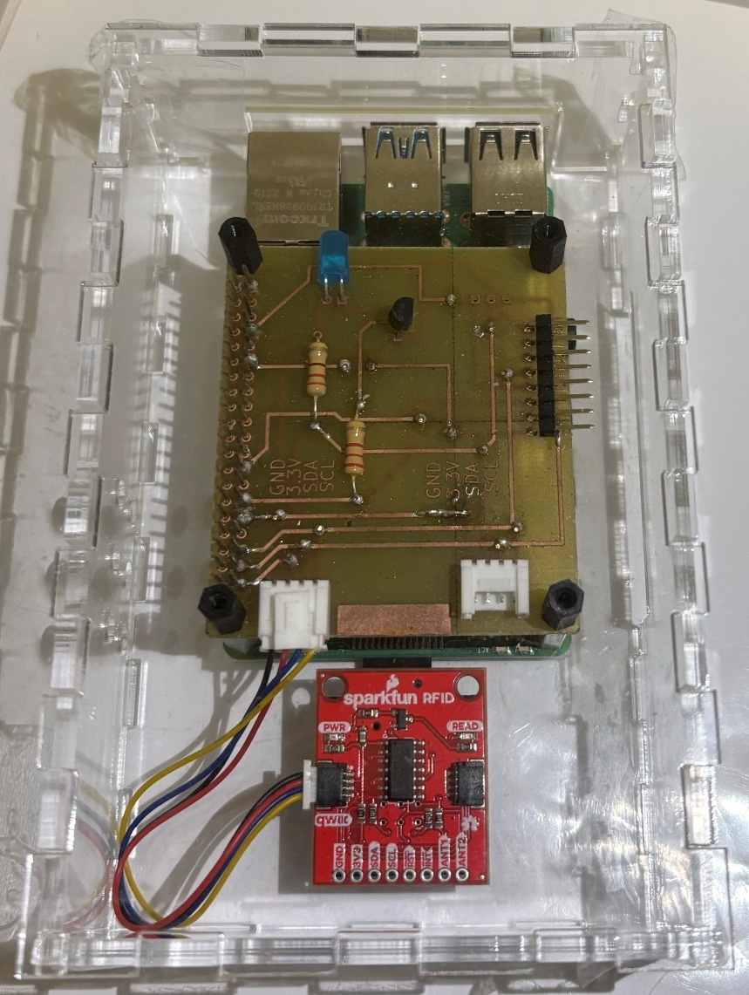

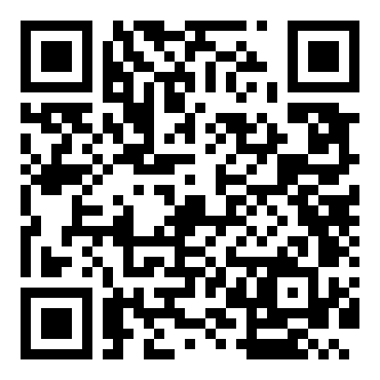
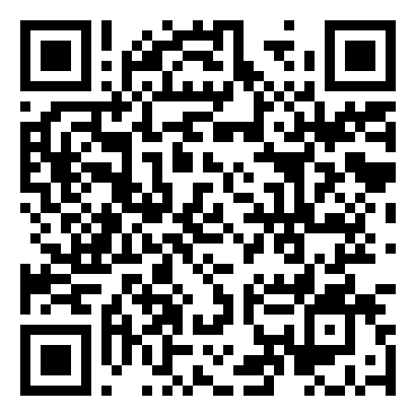
SMART FARM Real-time greenhouse monitoring, alerts and control
Chau Vi Cuong Nguyen, Hoang Tran, Truong An Nguyen, Tuan Anh Pham | CENG 355 Capstone, Computer Engineering Technology, Humber Polytechnic
INTRODUCTION
PCB ASSEMBLY
MOBILE APP RESULTS
DATABASE
Problem Crop conditions change faster than a farmer can check.
Solution Pi sensor node, cloud database, Android app.
Result Live data, instant alerts, remote control.
Custom Raspberry Pi HAT KiCad design, hand-soldered
Native Android app Java, Material design, minSdk 31
sensor_data
readings: bme688, veml7700, opt4048, rfid
device_controls
pump, fan, light, autoMode
1
SENSE
BME688, VEML7700, OPT4048, RFID on one I²C bus
alerts
history with Warning or Critical level
devices
one entry per farm device
Two-layer PCB layout
PROCESS
Raspberry Pi + custom HAT, Python firmware
Schematic
2
5
I²C devices, one bus
users
profile linked to Auth user ID
feedback
ratings + screen_tracking usage
3
SYNC
Cloud Firestore over campus Wi-Fi, every 60 s
60 s
cloud upload interval
ACT
Android app: dashboard, alerts, controls
6
OLED status pages
Dashboard
Control panel
Live listeners push changes to the app
Offline cache keeps the app usable without signal
4
History
min, max, average graphs
Assembled HAT
TESTING AND NEXT STEPS
Device | Measures | Address
BME688 (I²C) | Temp, humidity, pressure | 0x77
VEML7700 (I²C) | Ambient light | 0x10
OPT4048 (I²C) | Colour ( Green, Yellow, Red) | 0x44
ID-12LA (I²C) | Reading tag ID | 0x15
SSD1305 (I²C) | OLED display | 0x3C
Temperature
Humidity
Light
Fan
Irrigation
Accounts
email or Google, many farms
101
automated tests
JUnit, Robolectric, Espresso
ENCLOSURE DESIGN
Laser-cut clear acrylic
Finger-joint tiles, no glue
Open sides for Qwiic cables
Settings
°C/°F, theme, language
Espresso login tests: 10 / 10
Next: Pi acts on app controls (pump, fan)
Next: fix OPT4048 colour accuracy
Next: open beyond the Play closed test
Python firmware one thread per device
BME688
VEML7700
OPT4048
RFID
OLED
Alerts
App architecture
ACKNOWLEDGEMENTS
Cloud Firestore
sensor_data / device / readings
UI Home, Analytics, Control Panel, Alerts
Kris Medri, Supervising Faculty
Controllers Login, Signup, Account ViewModel
Qwiic chain daisy-chains sensors with no extra wiring
Sense HAT removed to free the I²C bus
GPIO17 drives a status LED through a transistor switch
Firestore managers Sensor, Device, Alert, User
GitHub
source code
Google Play
closed test
Pi + HAT + RFID reader in the case
Firebase Auth + Cloud Firestore, offline cache
20 W
max power
16 Vrms
max AC input
32.5 cm
max length
Built with
Java
Material UI
MPAndroidChart
Google Play test
Notes:
Section Start Slide

