Slide 1






Building a web-based application
that manages activities of the Maid Service
Group 6
Notes:
Xin chào hội đồng, các thầy cô, quý vị phụ huynh cùng toàn thể các bạn sinh viên có mặt trong hội trường ngày hôm nay.
JR = Blue
RC = Green

Slide 2
Introduction
Supervisor:
Mr. Nguyễn Trọng Tài
Bùi Tiến Tuân
Nguyễn Tấn Công
Mạnh Quang Tuyến
Member

Slide 3
OUTLINE
Register into recruitment
Cancel applying
Report maid
Demo
Questions and Answers
Notes:
-ứng tuyển vào đơn tuyển việc.
-Hủy thuê
-Báo xấu người giúp việc
-Demo
-Hỏi và trả lời

Slide 4
State diagram of Recruitment
Customer
Click “Hủy thuê”
Customer
Waiting
Customer
Applied
Customer
Approved
Click “Gia hạn”
Click “Thuê”
Click “Hoàn tất”
Customer
expire
Click “Tạm ẩn”
Expired
Customer
Hide
Click “Công khai”
expire

Slide 5
State diagram of JobRequest
Customer
Click “Hủy thuê”
Staff
Waiting
Customer
Applied
Staff
Approved
Click “Gia hạn”
Click “Thuê”
Click “Hoàn tất”
expire
expire
Staff, Maid mediator
Click “Tạm ẩn”
Expired
Staff, Maid mediator
Hide
Click “Công khai”
expire

Slide 6



Register function
Old
Hire
Job request
Post
Customer
Maid mediator
New
Hire
Job request
Post
Post
Register
Recruitment

Slide 7
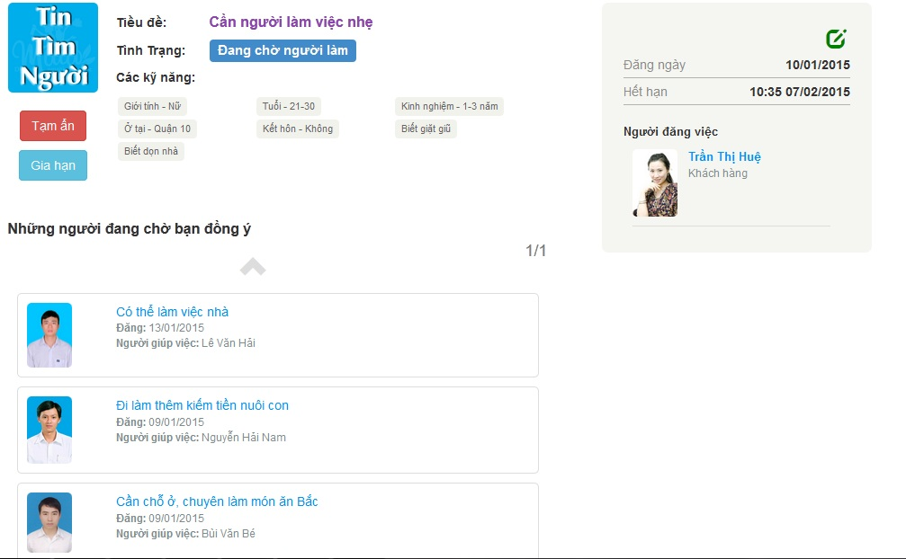
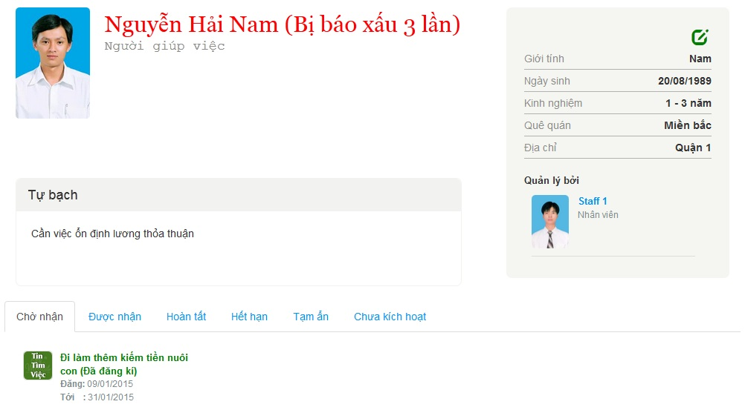
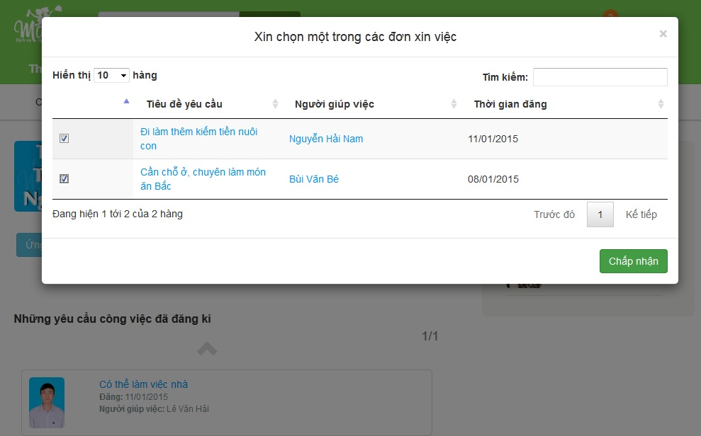
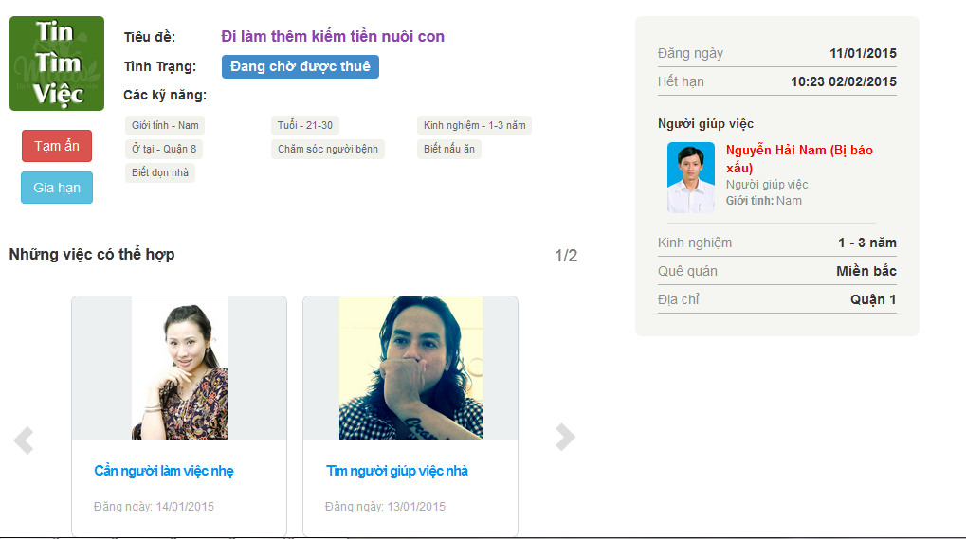
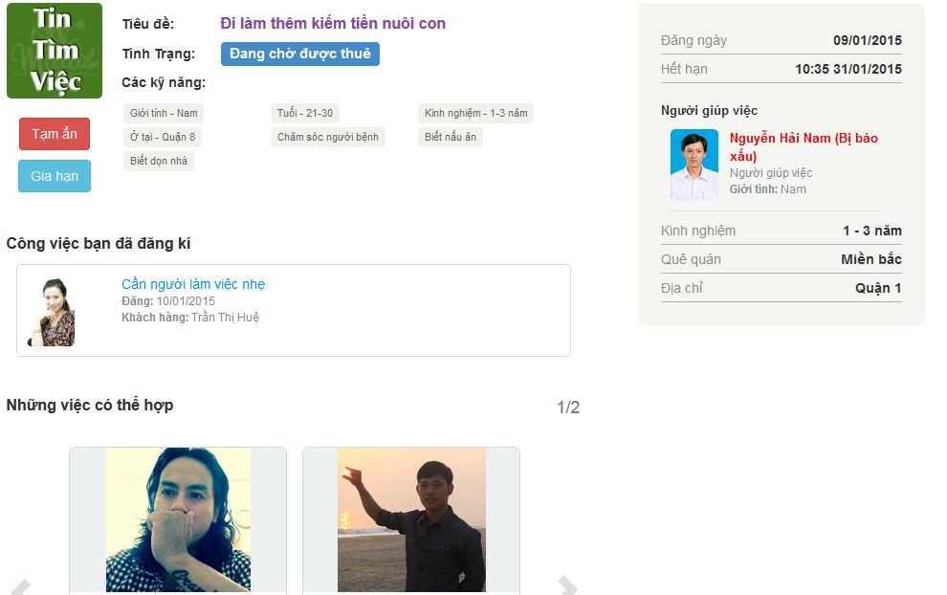
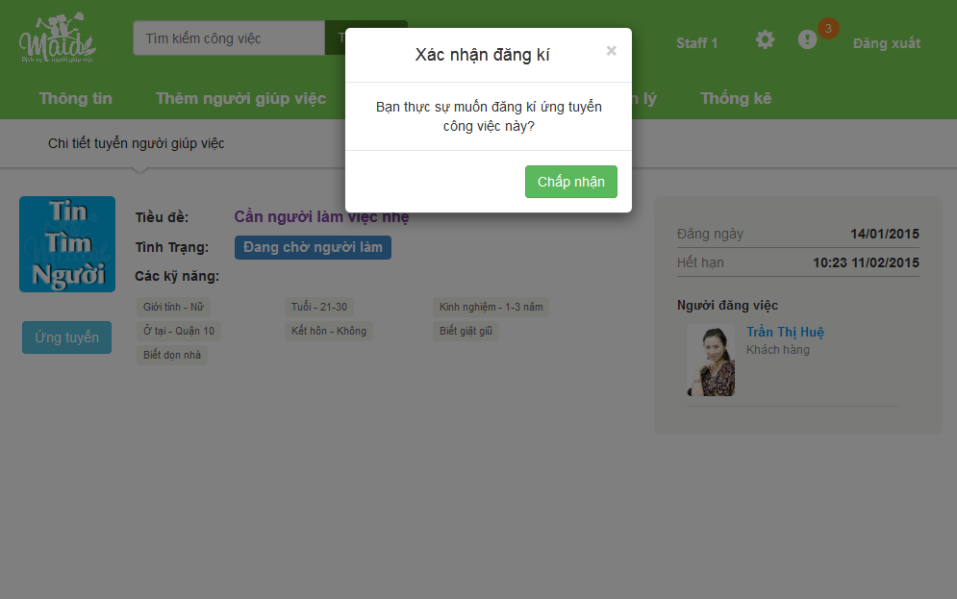
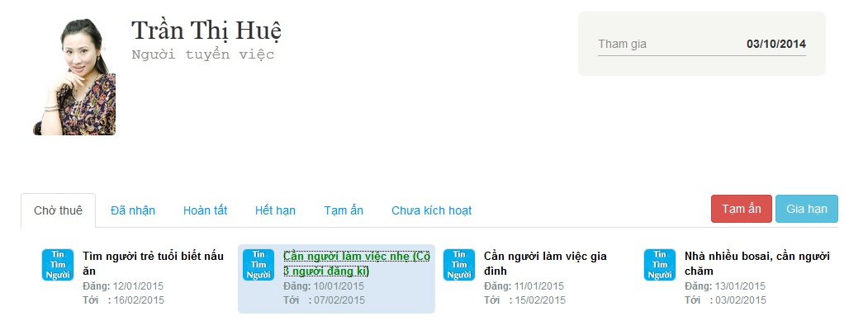



Register demo
Staff
View a recommend recruitment
View a random recruitment
Register

Slide 8



Cancel applying
Reasons:
Can not contact the applied maid.
The applied maid is not fit with demands.
Customer wants to hire new maid after the probation period.

Slide 9
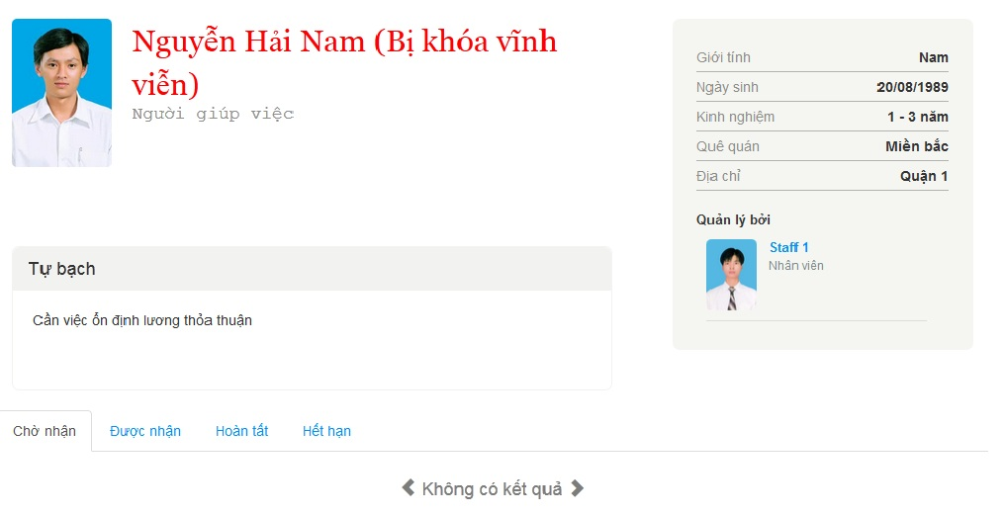
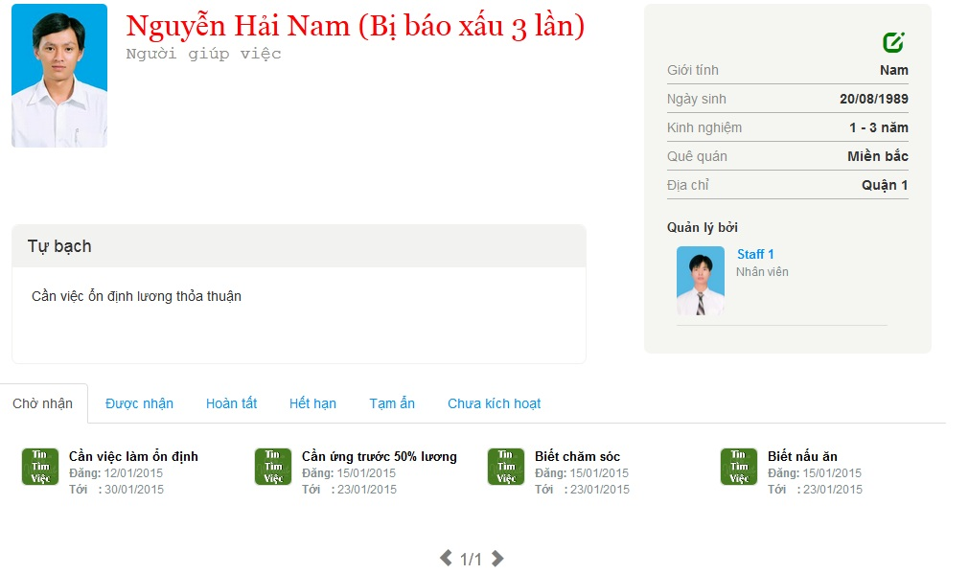
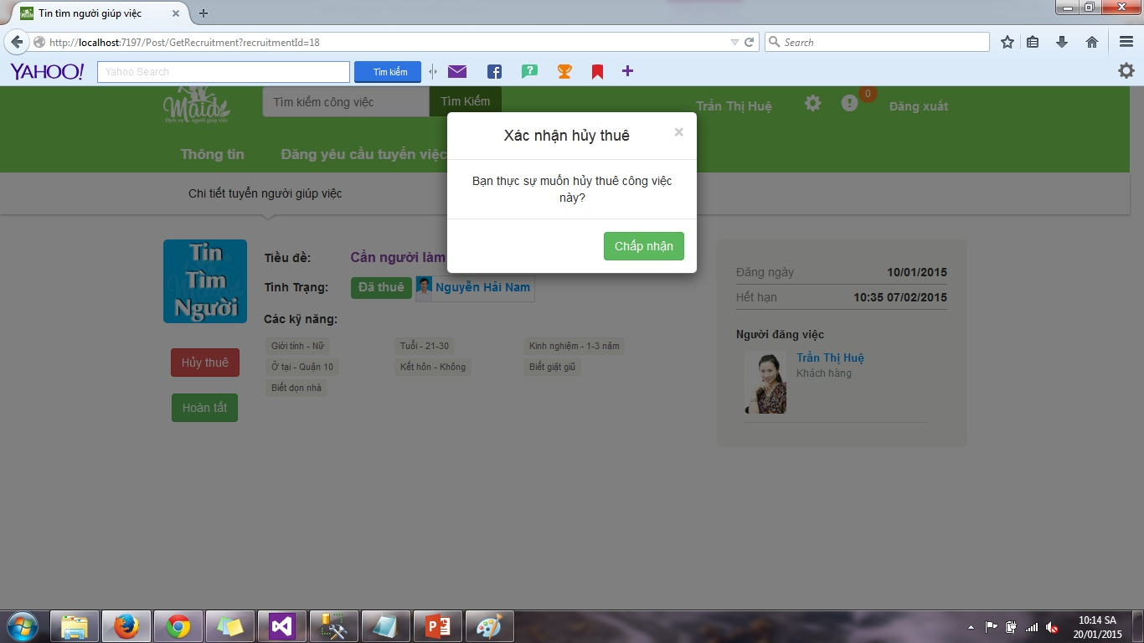
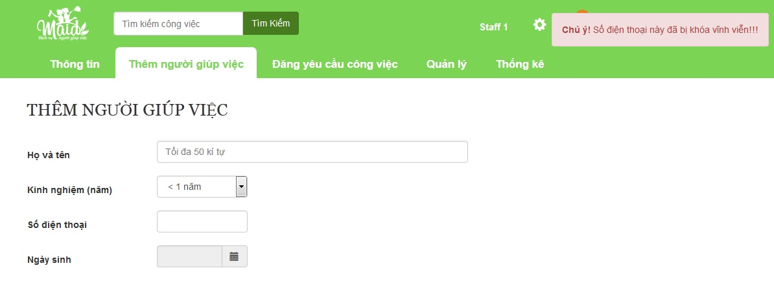
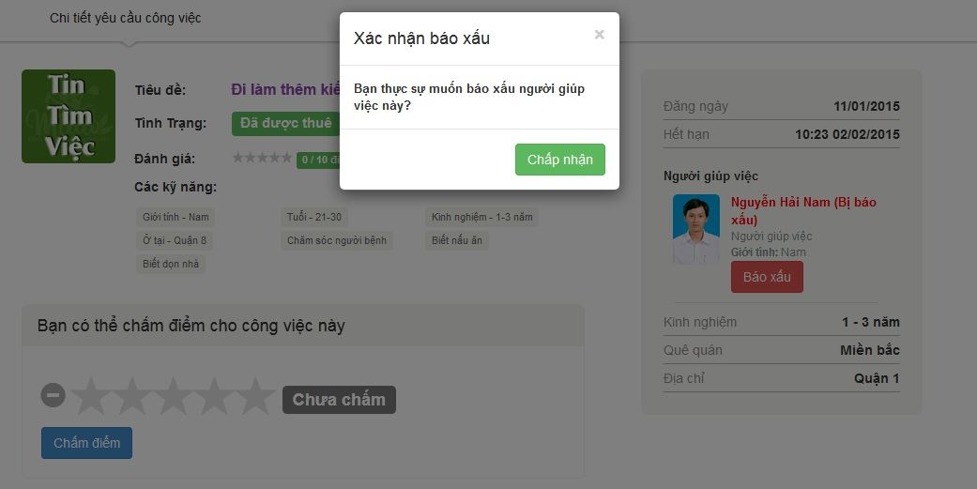


Cancel applying and report demo
Customer
View an applied recruitment
Cancel applying
View an approved recruitment
Report

Slide 10
Questions and Answers
THANK YOU VERY MUCH!

