Slide 1
Design and Implement the Smarthome Panel
Supervisor: Dr. Trinh Hoang Hon
Student: Vu Tuan Hung
ID: 1450231

Slide 2
Contents
Introduction
Hardware Design
Software and Algorithm Design
Conclusion

Slide 3
Introduction
Reason for choosing the topic
Objectives
Suggested solution

Slide 4
Reason for choosing the topic
- Practical topic
- SmartHome is human’s desire
- To learn how to implement a centralized control system

Slide 5
Objectives
Centralized control over RS-485 standard
Control cross devices with different physical buttons
Build Web Server to control from distance with smart devices
Build Database to collect data from triggered events
Develop Facial Recognition and Motion detection system

Slide 6
Suggested Solution

Slide 7
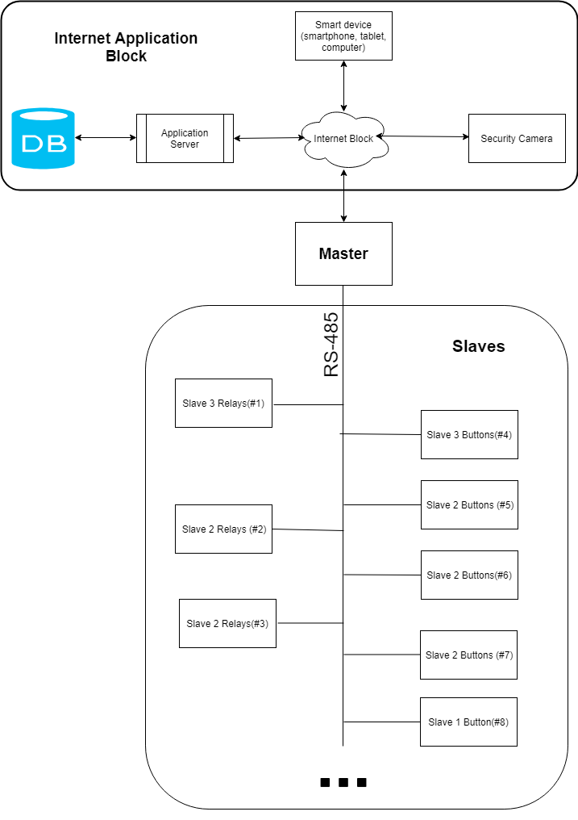

Slide 8
Hardware design

Slide 9
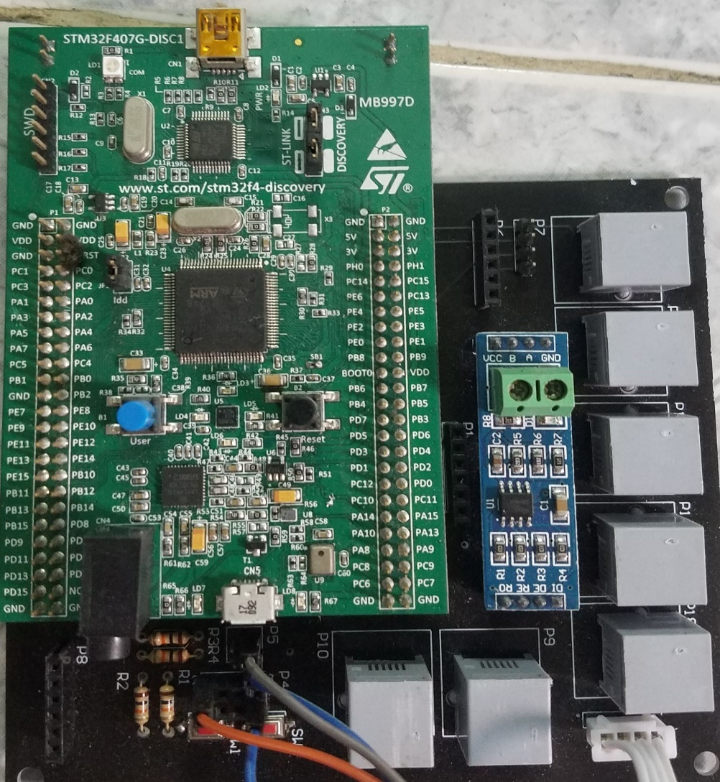
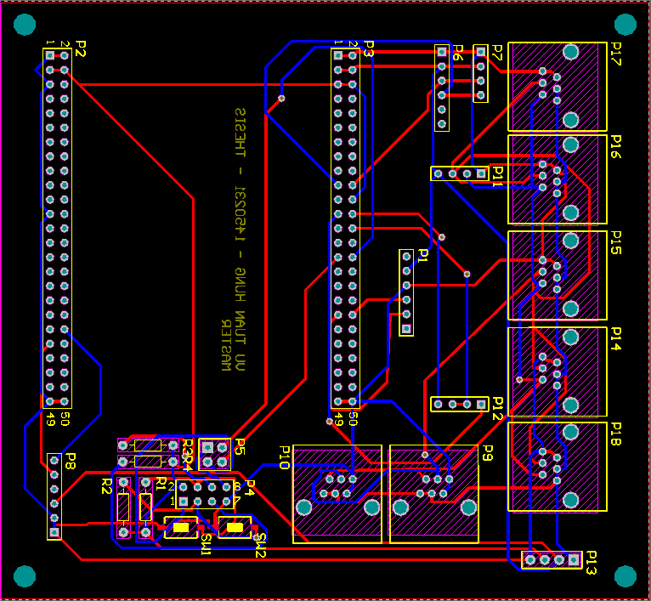
Master

Slide 10
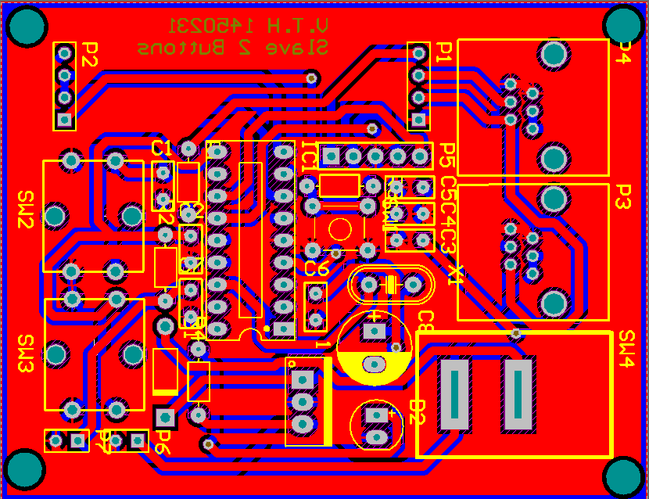
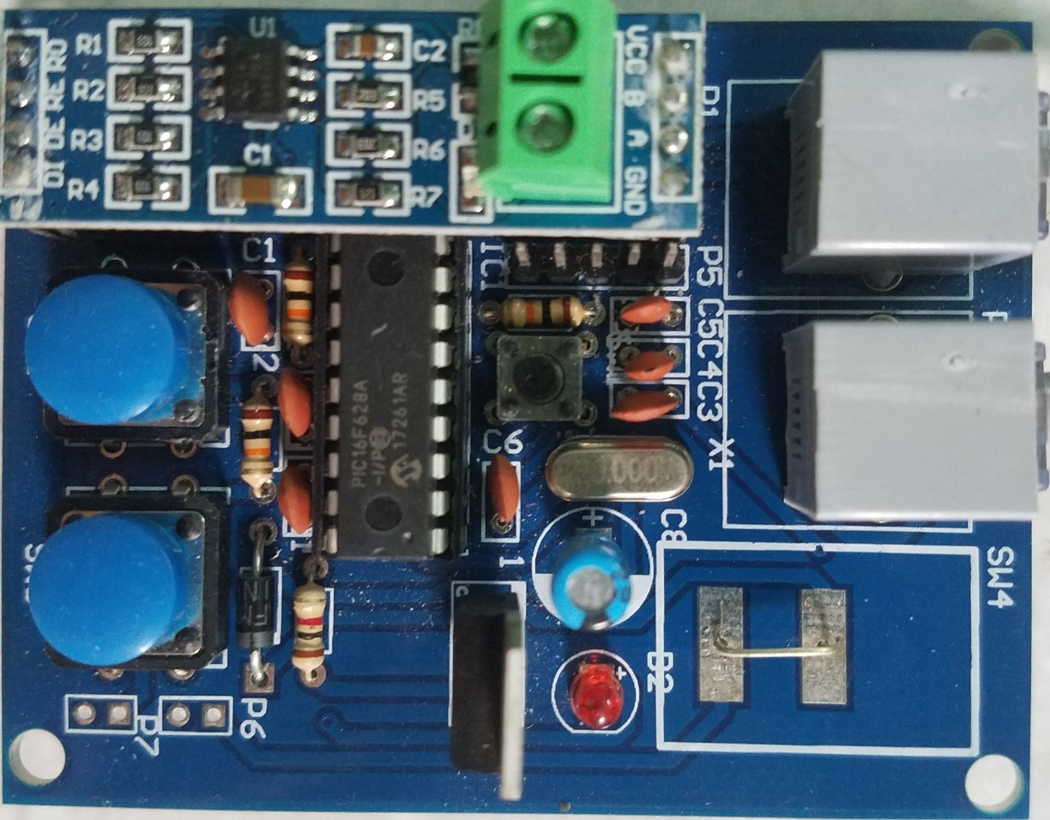
Slave Button(s)

Slide 11
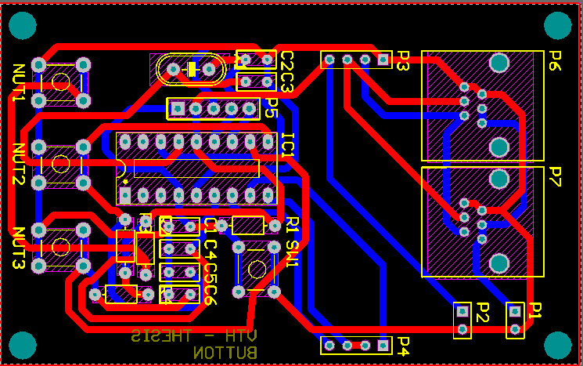
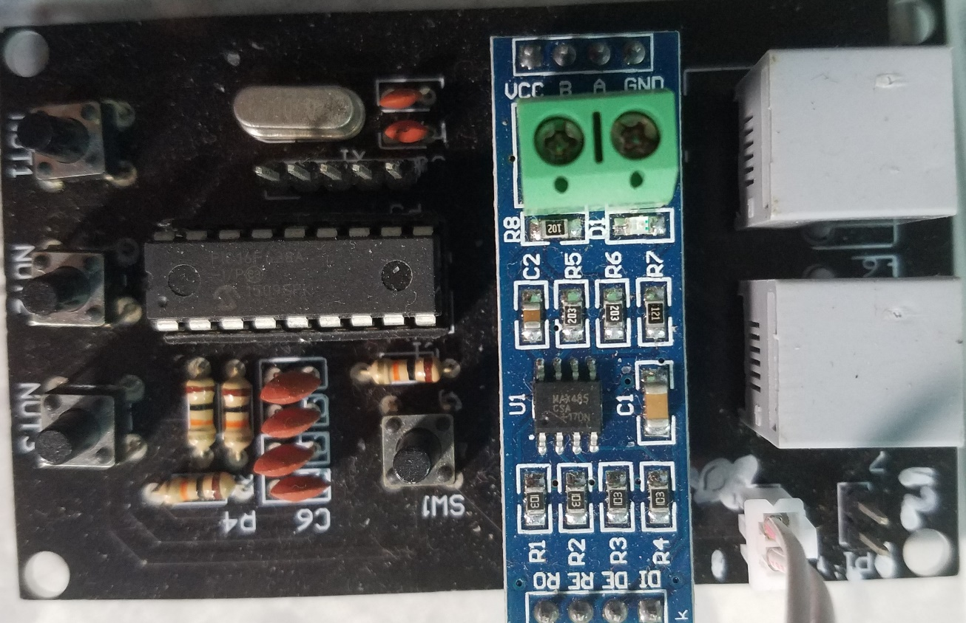
Slave 3 Buttons

Slide 12
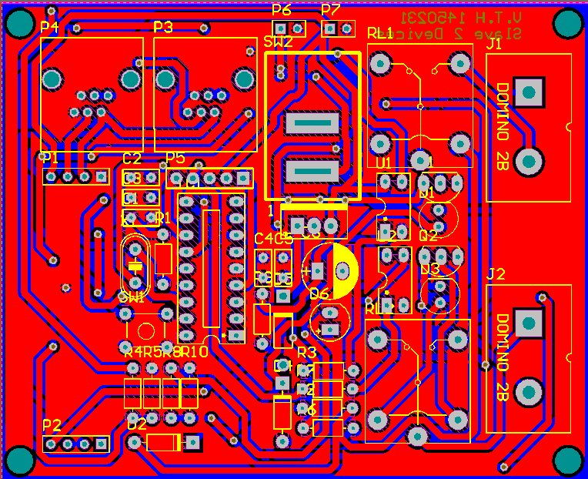
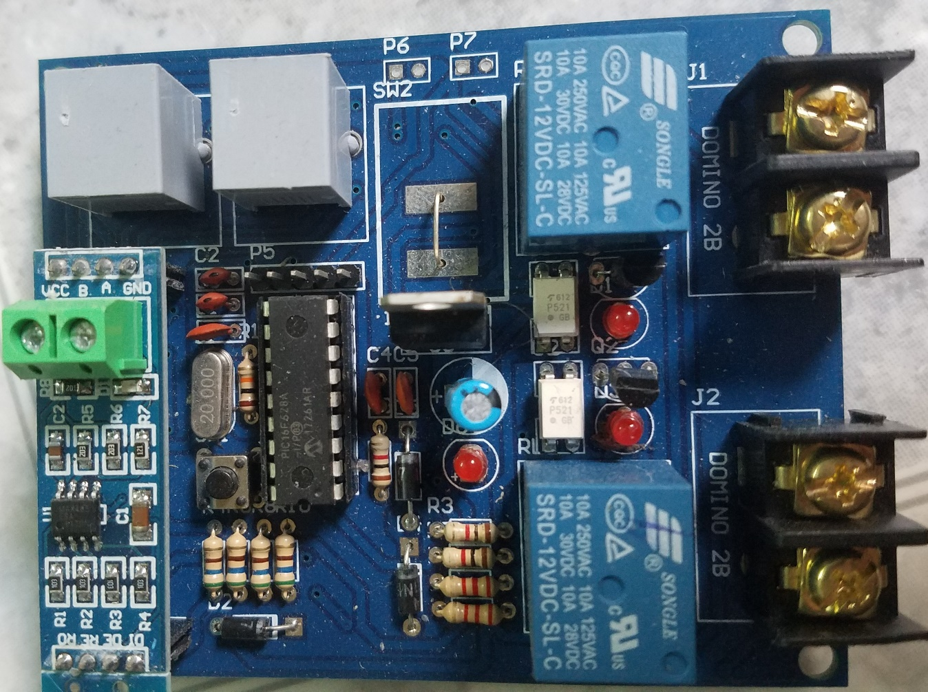
Slave Relay(s)

Slide 13
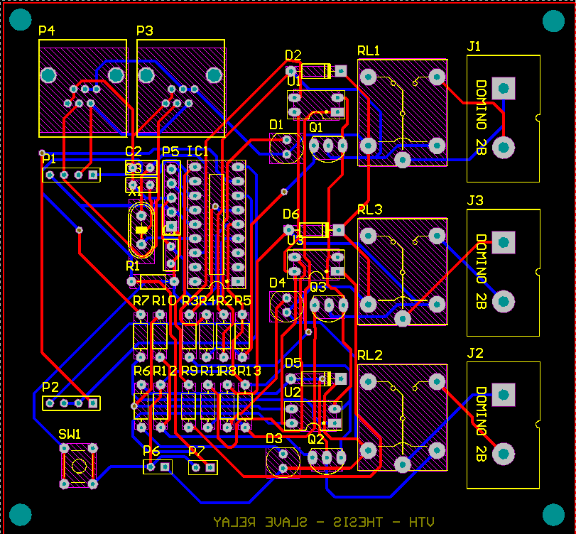
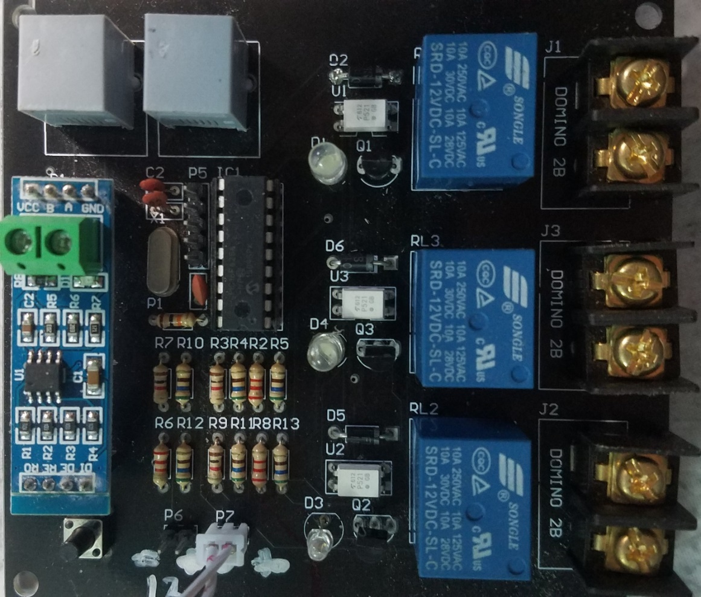
Slave 3 Relays

Slide 14
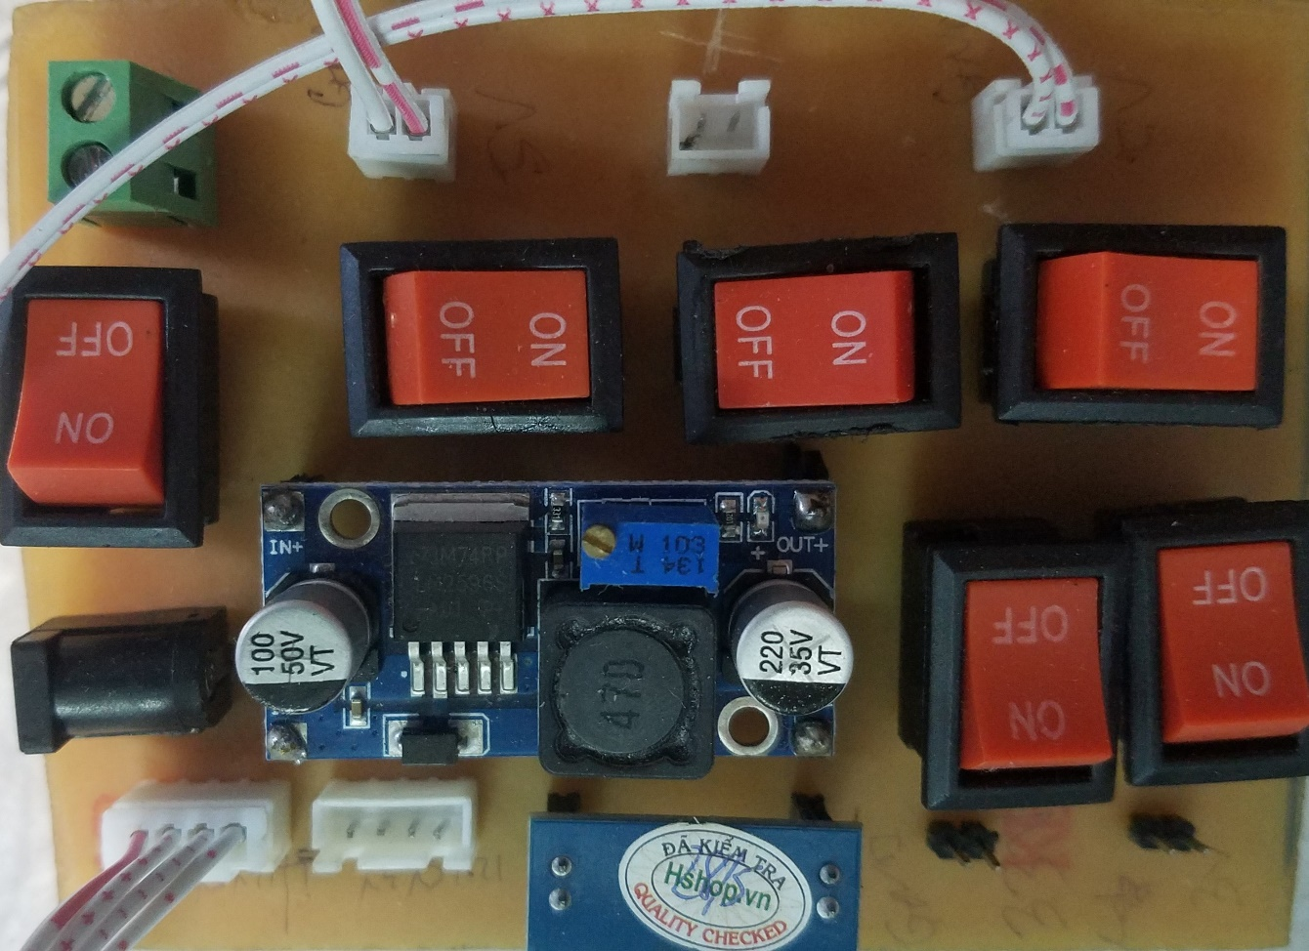
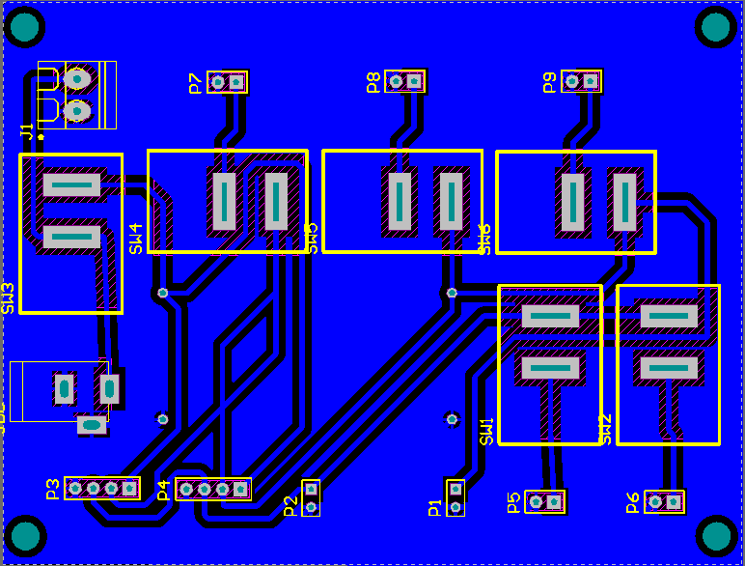
Power

Slide 15
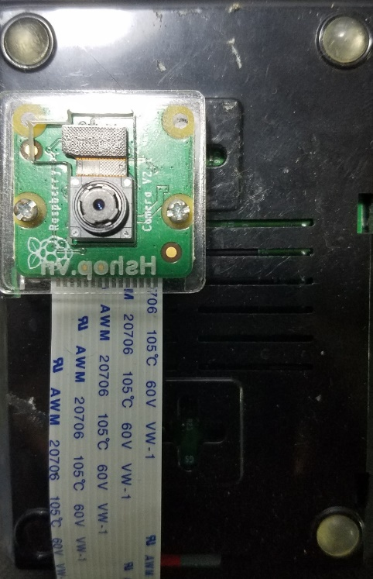
Camera block

Slide 16
Software and Algorithm Design
Total frames 11 bytes
Starting bytes
Byte identify source
Byte identify function
Bytes depends on each case below
Ending bytes
Command frames design
Master to Slave Relays
Slave Button to Master
Notes:
X1=0 Slave to Master
X2=0 Control assigned Relay with defined Button
Master to Slave Relays
Identity of each component on Slave Relays need to be controlled
Byte to turn on/off delay (0 for off)
Slave Button to Master
Source identity (slave button)
Destination identity (slave relay)
Byte to turn on/off relay

Slide 17
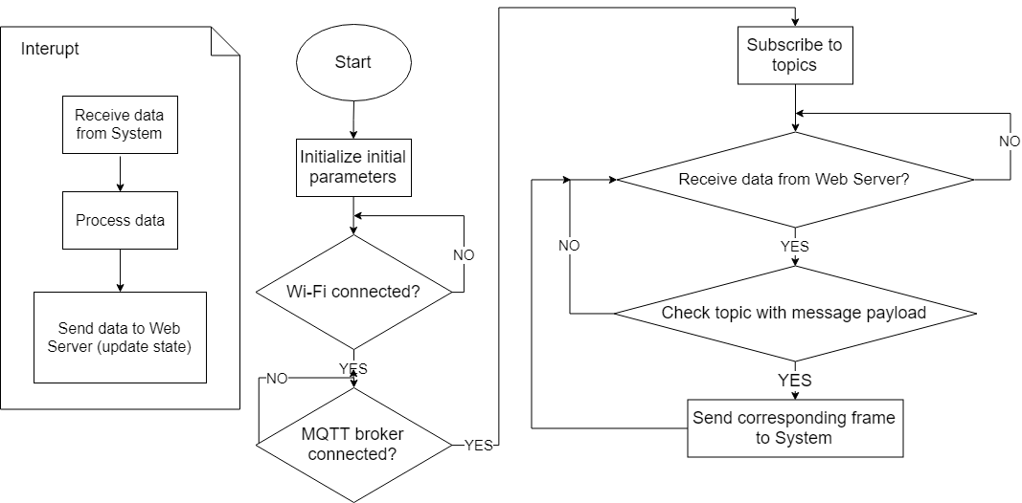
NodeMCU software

Slide 18
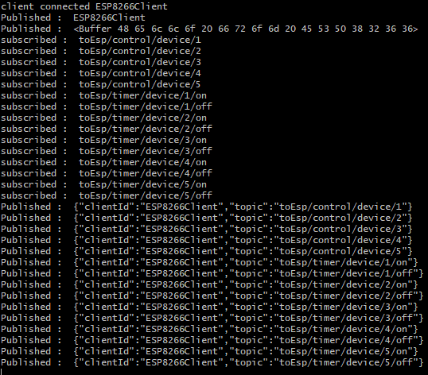
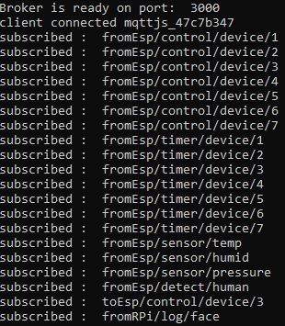
MQTT Topics
MQTT is abbreviation of Message Queue Telemetry Transport.

Slide 19
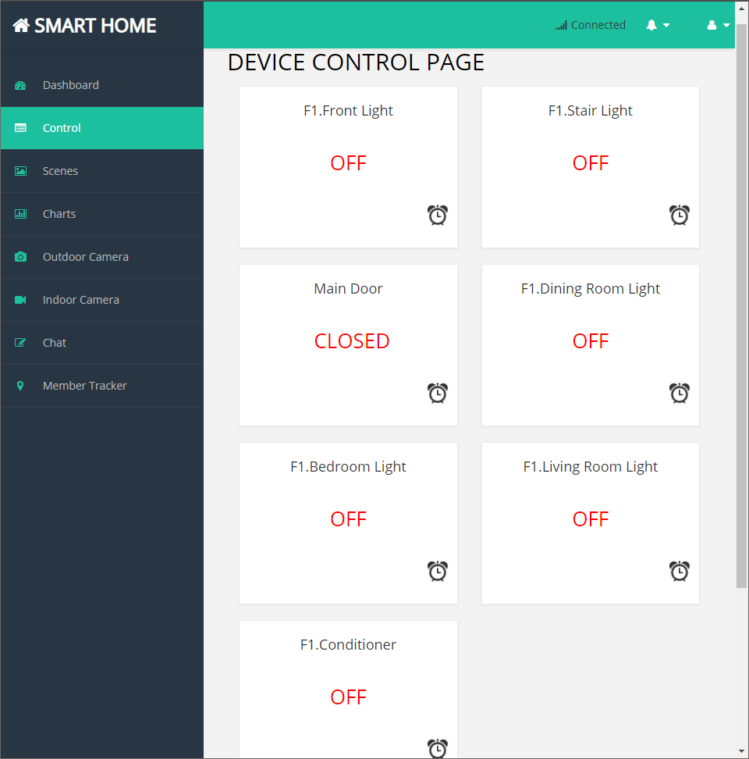
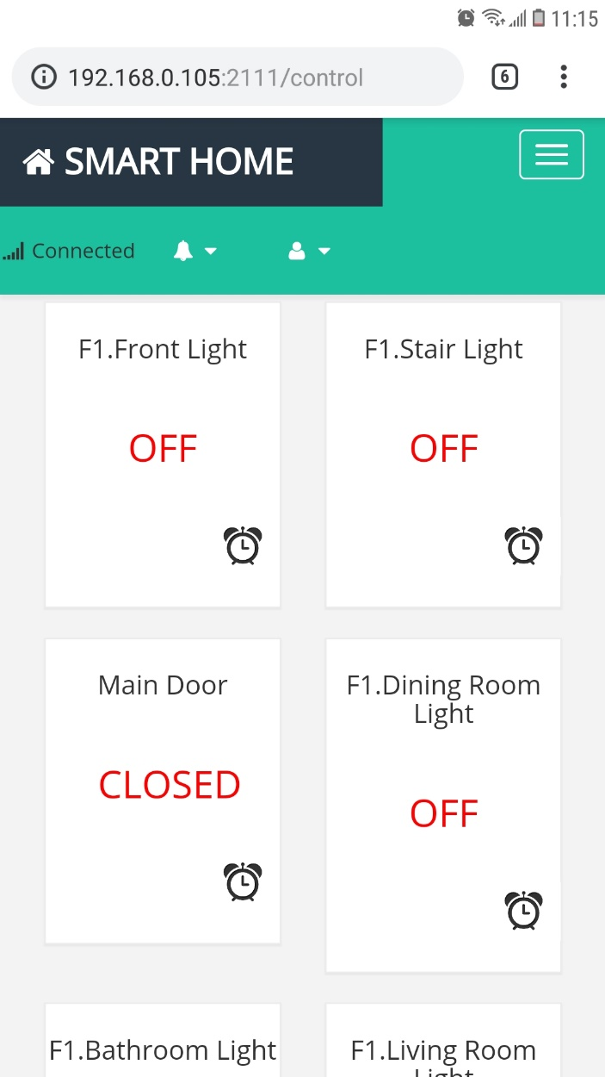
Web Server Design

Slide 20
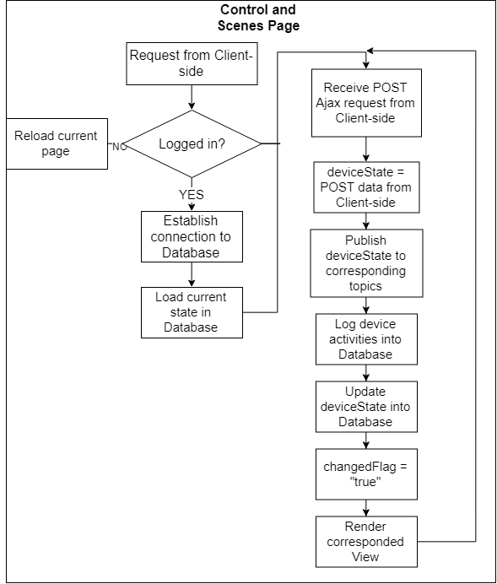

Slide 21
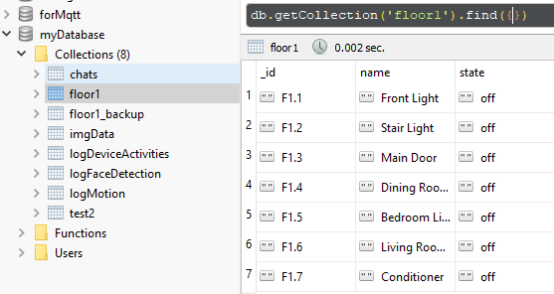
Database Example

Slide 22
Security Camera Block Gathering Dataset

Slide 23
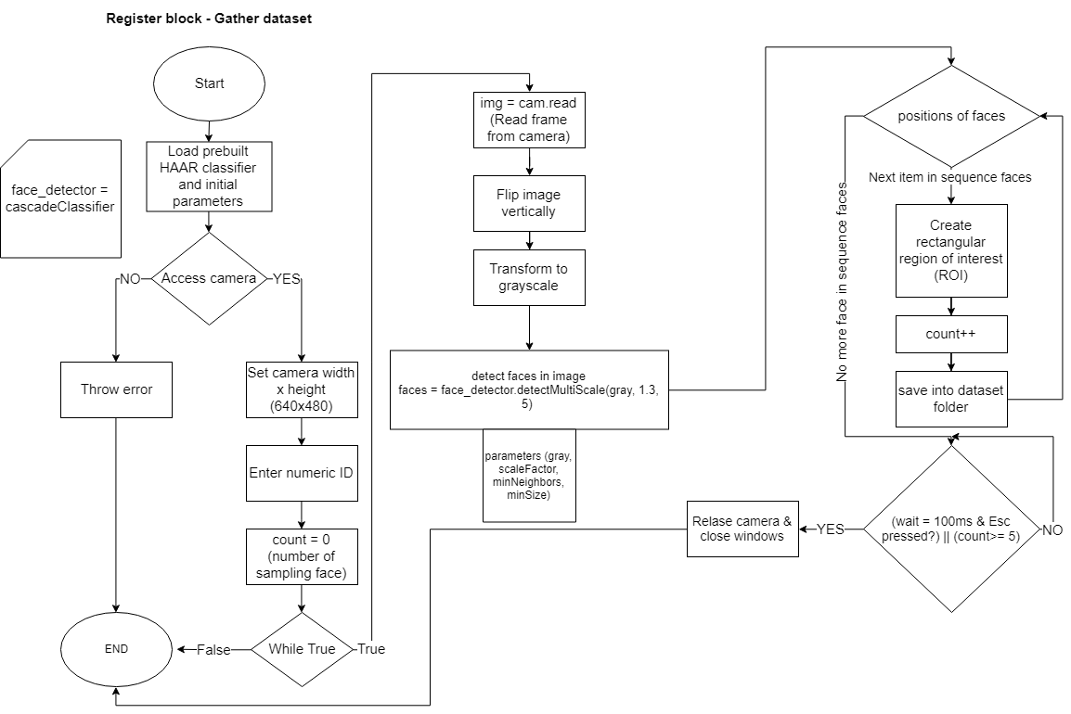

Slide 24
Security Camera Block Train data

Slide 25
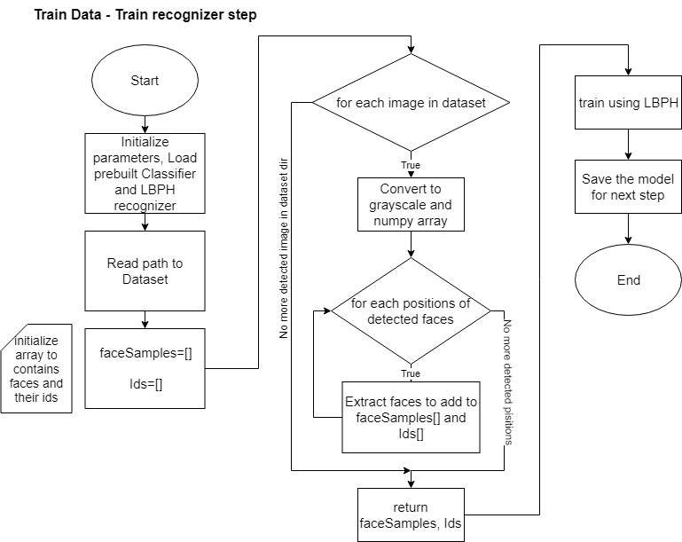

Slide 26
Security Camera Block Recognition

Slide 27
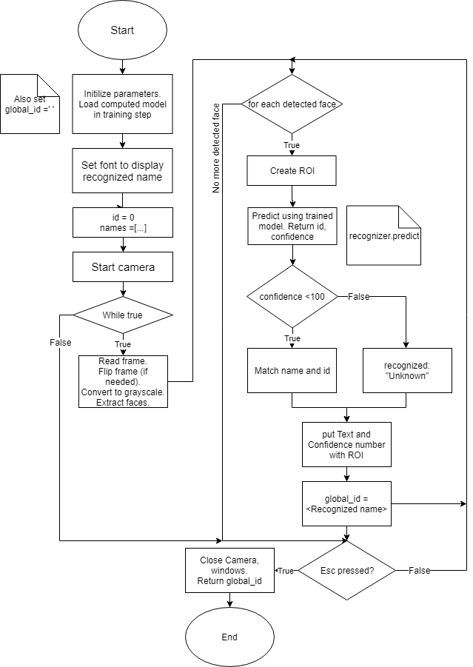

Slide 28
Conclusion
- Successfully implemented Master-Slave model
- Built Web Server to control devices from far distance
- Built Database to log data for further processing
- Built Face Recognition system on Raspberry Pi

Slide 29
Thank you for your attention

Slide 30
Demonstration

