Slide 1
BUILD A CHAT PROGRAM USING TCP/IP PROTOCOL
Teacher: Ths. Nguyễn Văn A
Student: Nguyễn Văn A

Slide 2
Table of contents
01
02
03
04
Introduction
Methods
Theoretical Basis
Demo

Slide 3
01
INTRODUCTION

Slide 4

The reason for choosing the topic
Texting and sending files directly on the Internet is also an essential need today:
Job exchange
Chat with friends and family
Learn and build a client-server conversational application that works according to TCP/IP protocol

Slide 5
02
METHODS

Slide 6
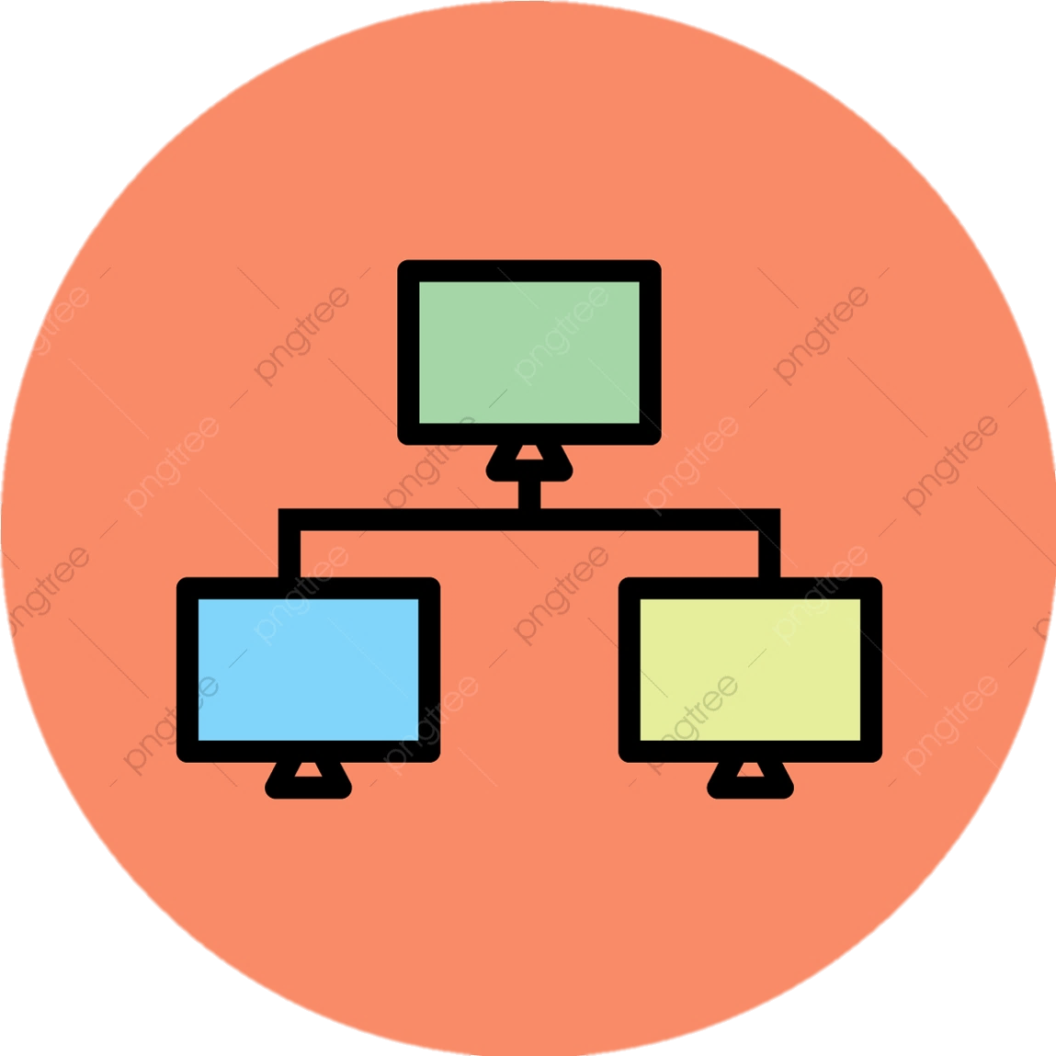



Methods of implementation
Socket.IO
Java
Client-Server
Learn how to transmit and receive data of the TCP/IP protocol
TCP/IP
Learn how the Socket.IO works
Use programming language
Apply Model Client - Server
Use support tools such as: VMWare ,Xampp, Navicat, Netbeans IDE .

Slide 7
03
THEORETICAL BASIS

Slide 8

Client – Server Model
It provides information (data) or access to specific services
Which is capable of receiving information or using a specific service from service providers

Slide 9
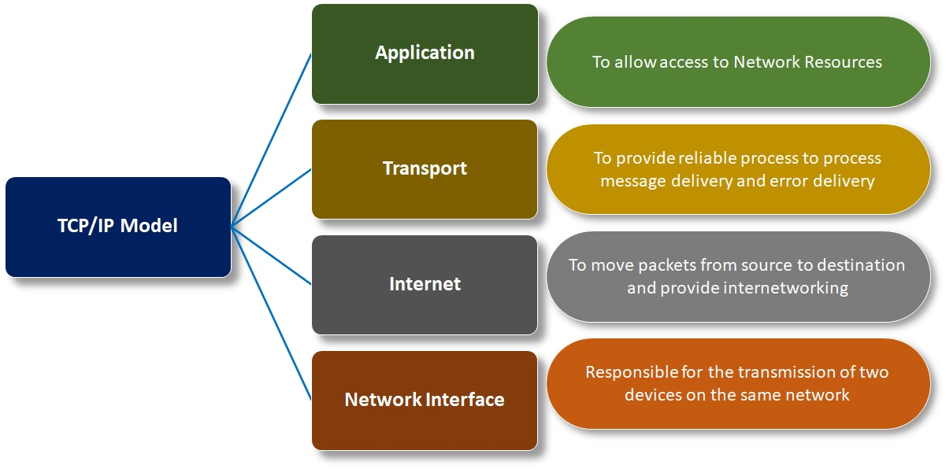
TCP/IP Protocol

Slide 10
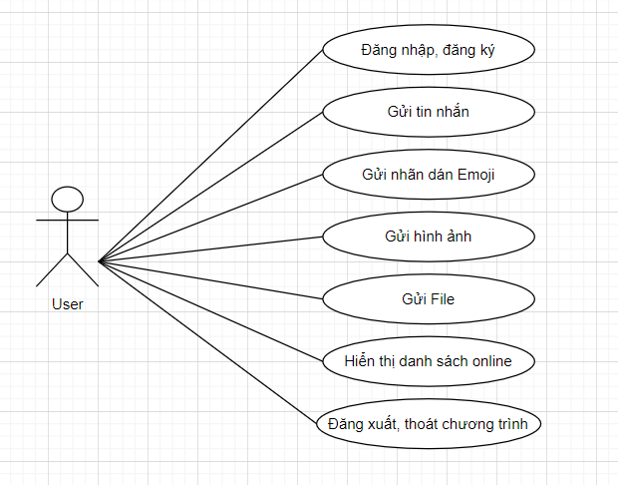
System analysis and design
Function of login and account registration
Message sending function
Sticker sending function
File sending and receiving function
Function to send, receive images and zoom in to view images
Display list user online
Set user avatar
Send and receive voice chat

Slide 11
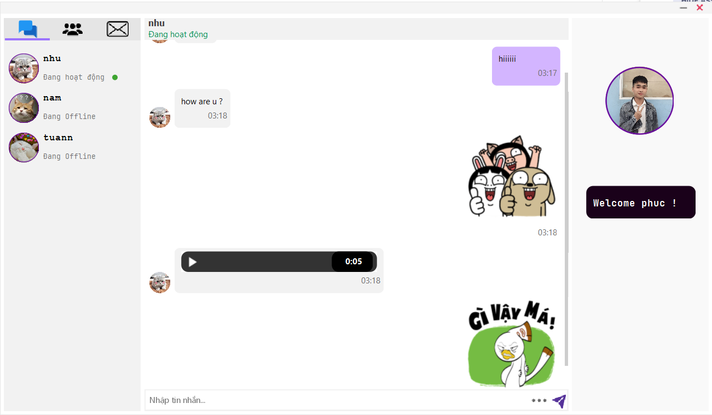
04
DEMO

Slide 12
Thanks!
Do you have any questions?

