Slide 2
Objectives
• Display an XML document in a browser • Identify the style rules of CSS • Apply different styles to XML elements using CSS and XSL

Slide 3
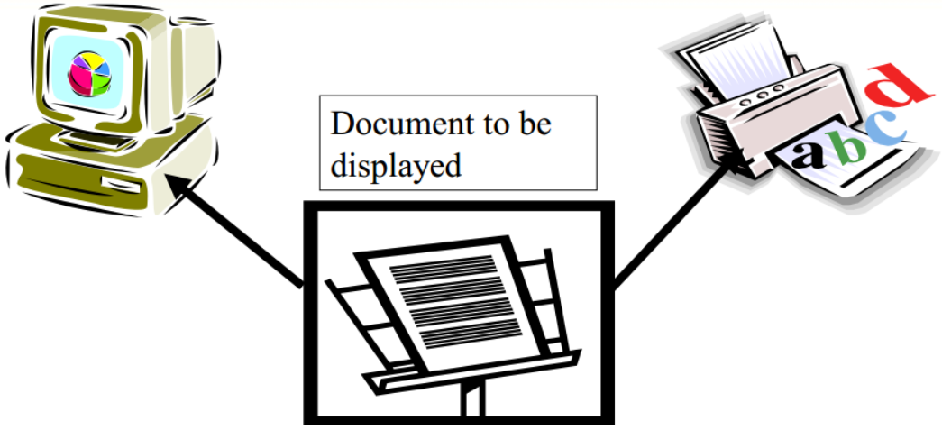
Style Sheets
An XML document can be displayed in different formats in different display devices such as computer, printer, and the like.

Slide 4

Style Sheets
• A Style sheet is a set of instructions to display the documents:
• It separates presentation layer from the content data of the document.
• A single XML documentcan have multiple style sheets

Slide 5
XML and Style Sheets
• XML documents are plain text files. • The style sheets are used to format and view the XML document. • Two commonly used style sheets with XML are: – CSS - an extension of HTML – XSL - an XML specific styling language

Slide 6
Working of XML
XML File
(XML+XSL)
Aware browser
Formatted document
CSS File

Slide 7
Displaying an XML Document Using CSS
XML document
<?xml version="1.0" encoding="UTF-8"?> <?xml-stylesheet type="text/css" href="style.css"?> <xsampdoc> <greeting>Hello, <extension>there!</extension> </greeting> <answer> <ans>Good <extension>morning!</extension> </ans> <question> How are you? </question> </answer> </xsampdoc>
Notes:
<?xml version="1.0" encoding="UTF-8"?> <?xml-stylesheet type="text/css" href="style.css"?> <xsampdoc> <greeting>Hello, <extension>there!</extension> </greeting> <answer> <ans>Good <extension>morning!</extension> </ans> <question> How are you? </question> </answer> </xsampdoc>

Slide 8
Linking the CSS to XML
• The Cascading style sheet has to be referenced in the XML document. • We use a processing instruction to do so. • Syntax: <?xml-stylesheet type="text/css" href="url"?>
Example <?xml-stylesheettype="text/css" href="hello.css"?>

Slide 9
Simple CSS example
xsampdoc { margin-top:.7in; margin-bottom: .7in; margin-left:1.5in; margin-right:1in; color: navy; background-color:white; display: block } question { display:block; font-size:x-large; color: black; }
Greeting { display:block; font-family: Arial, Helvetica; font-size: 32pt; width: 30em; color: red; } answer.ans { display: block; font-size: 20pt; color: blue; }

Slide 10
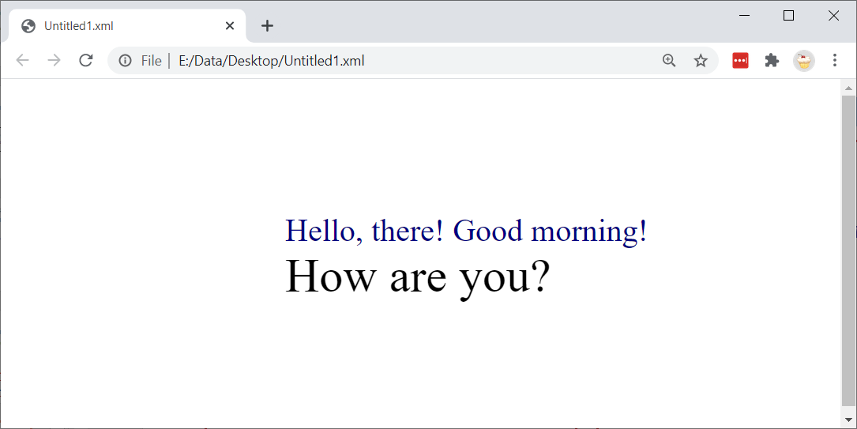
Displaying an XML Document Using CSS

Slide 11
CSS Style Rules
• The Syntax for style rules in a Cascading Style Sheet is: selector{declaration} • The selector identifies the tag to which the style applies. • The declaration provides the style rules applied to the selector. • This is referred as “Simple Selector”.

Slide 12
Multiple Selector
• Used to apply the same style rule for different elements • Syntax: selector1, selector2…….{declaration}
Example
greeting, question { font-family: sans-serif; font-size: 32pt; }

Slide 13
Contextual Selectors
• It helps us to differentiate between the different occurrence of a tag.
• A contextual selector matches when an element is an arbitrary descendent of some ancestor element. A contextual selector is made up of two or more selectors separated by white space.
Example
greeting extension{[declarations]} answer ans extension{[declaration]}

Slide 14
Characters used in CSS
Character | Name | Function
: | Colon | Separates property and its value
; | Semicolon | Separates multiple property/value combinations
, | Comma | Separates multiple selectors in a style rule

Slide 15
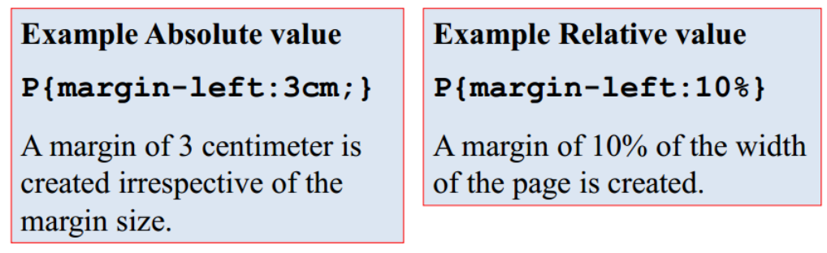
Properties and Values
• A value of the CSS styling property may be a string, a number with a unit, an integer, or a color value. • Values can be absolute or relative, inheritable or noninheritable.

Slide 16


Color Values
XML supports the following color values:
 | Gray | White | Red
Short form | #888 | #FFF | #F00
Decimal Integer | rgb(136,136,136) | rgb(255,255,255) | rgb(255,0,0)
Percentage | rgb(55%,55%,55%) | rgb(100%,100%,100%) | rgb(100%,0,0)

Slide 17
Formatting the Text
• The CSS properties allow to specify the font in which an element will be displayed, its size and color. • <absolute-size> and <relative-size> keywords are used with font properties
<absolute-size> xx-small x-small small medium
<relative-size> large smaller

Slide 18
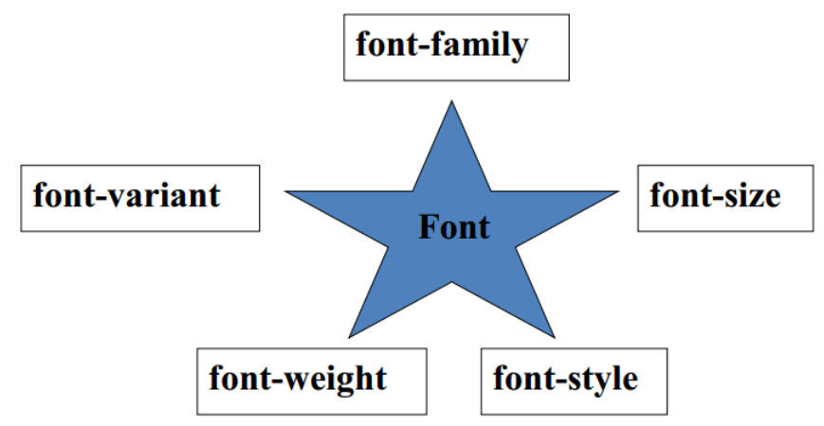
Formatting the Text
• The different font properties that can be set are:

Slide 19
Boxes
• Blocks of text can be contained in a box. • The following three properties apply to the boxes: – Margins – Border – Padding • Padding is the distance between the contents of the adjacent box. • Margin is the distance between the border and the outer edge of the adjacent box, or between the border and its containing box.

Slide 20
Boxes
Left margin
Right margin
Top margin
Border
Left padding
Right padding
Top padding
TEXT
Bottom padding
Bottom margin

Slide 21
Q & A

