Slide 1




The Things Lab
ESP32-C3 Super Mini + PE64906 DTC
Faculty of Computer Engineering
University of Information Technology

Slide 2
OUTLINE
Setup — Arduino IDE & Board Package
Hardware Wiring & SPI Configuration
DC power supply & Ferrite Bead install
Code Walkthrough — How It Works
Controlling Capacitance & Flashing

Slide 3
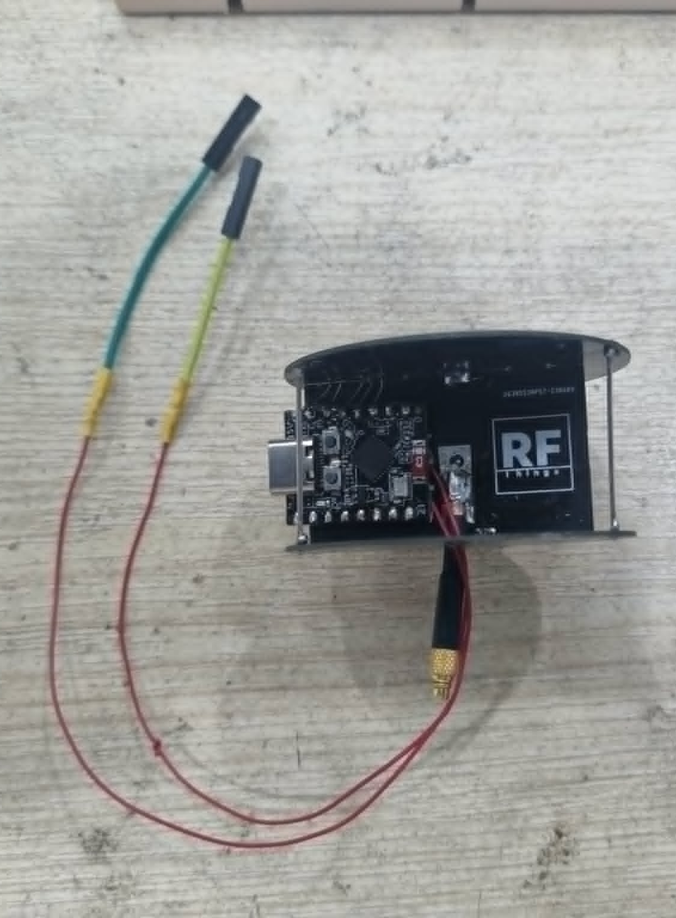
System Overview
ESP32-C3 Super Mini
RISC-V 160 MHz, 4 MB Flash — USB CDC direct (no FTDI adapter needed)
PE64906 DTC: 5-bit digitally tunable capacitor, range 0.6 to 5.4 pF
SPI Communication (3-wire)
CLK = GPIO3 | MOSI = GPIO4 | SEN = GPIO2 (manual chip select)
SPI.begin() can be assigned to any GPIO on ESP32-C3
TTLab / FCE-UIT

Slide 4
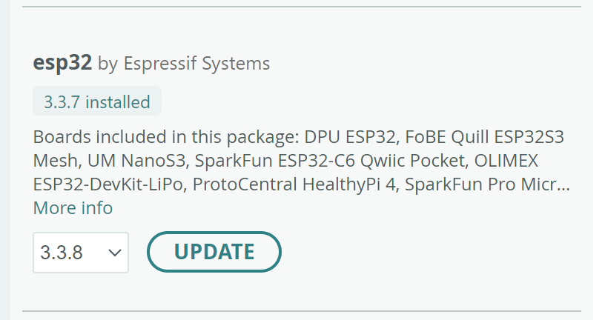
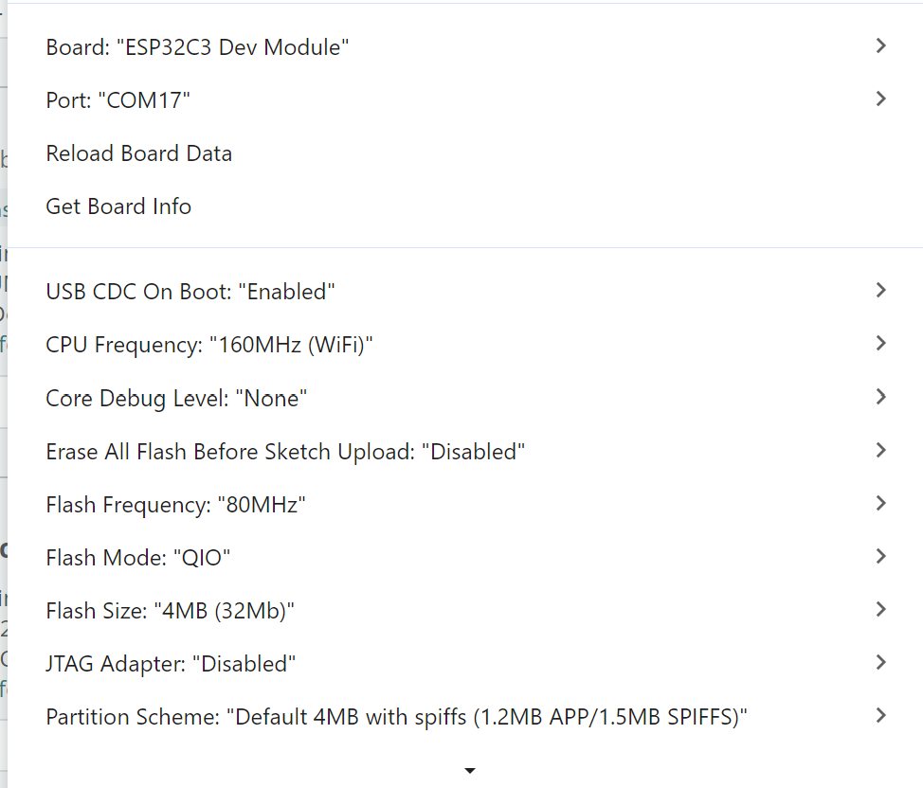
Arduino IDE — Board Setup
Install Board Package
File → Preferences → paste Espressif JSON URL into Additional Boards Manager URLs
https://espressif.github.io/arduino-esp32/package_esp32_dev_index.json
https://espressif.github.io/arduino-esp32/package_esp32_index.json
Tools → Boards Manager → search esp32 → Install (Espressif Systems)
Required Tool Settings
USB CDC On Boot: Enabled | CPU Freq: 160 MHz | Flash Size: 4 MB (QIO)
Partition: Default 4 MB with SPIFFS | JTAG Adapter: Disabled
TTLab / FCE-UIT

Slide 5
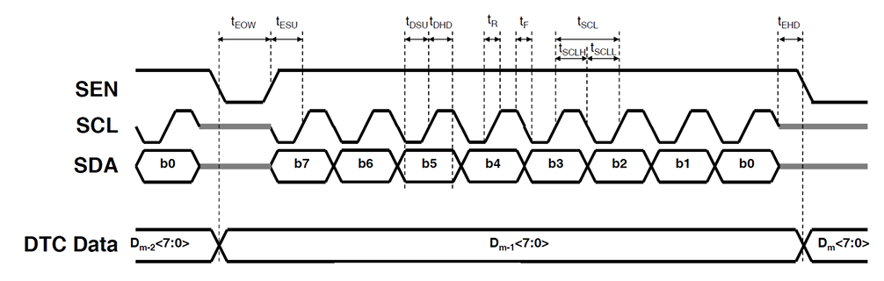
Hardware Wiring — SPI + SEN
Pin Mapping
GPIO2 → SEN
GPIO3 → CLK/SCL
GPIO4 → SDA (MOSI)
3.3 V → VDD
GND → GND
MISO = -1 (not connected)
ESP32-C3
GPIO2
SEN
PE64906
GPIO3
SCL
GPIO4
SDA
3.3 V
VDD
GND
GND
SEN Timing (Critical)
SEN LOW → 1 ms → SEN HIGH (open window) → SPI.transfer() → SEN LOW (latch)
SEN is NOT a standard active-low CS — it gates the data acceptance window
TTLab / FCE-UIT

Slide 6
SPI Configuration Explained
SPISettings Parameters
100 kHz rate: conservative — eliminates ringing and glitch on breadboard wires
MSBFIRST + SPI_MODE0 (CPOL=0, CPHA=0): required by PE64906 datasheet
Register Map [0][0][STB][d4..d0]
Bit5 = STB: 0 = active, 1 = standby (low-power); Bits 4-0 = capacitance state
state clamped to 31 (5-bit max); SPI.transfer() sends all 8 bits
TTLab / FCE-UIT

Slide 7
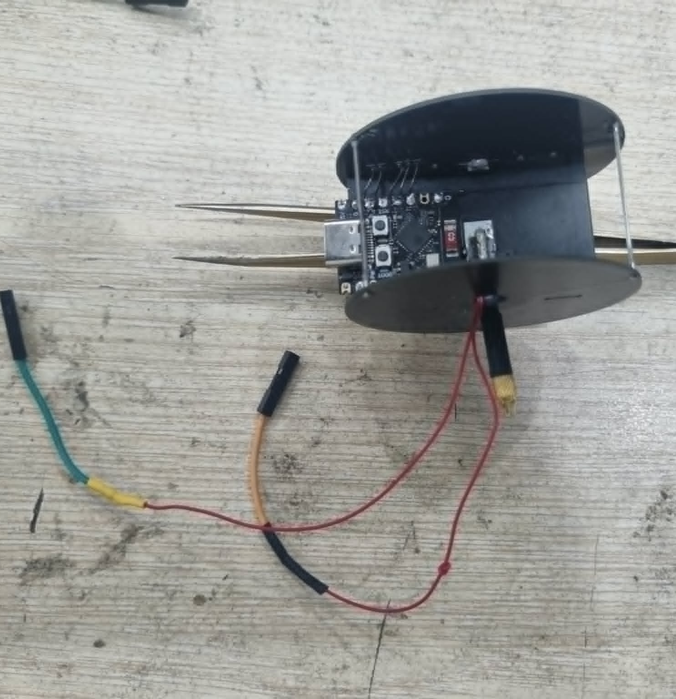
DC power source
GND
+3.7-5 V
GND
+3.7-5 V
TTLab / FCE-UIT

Slide 8
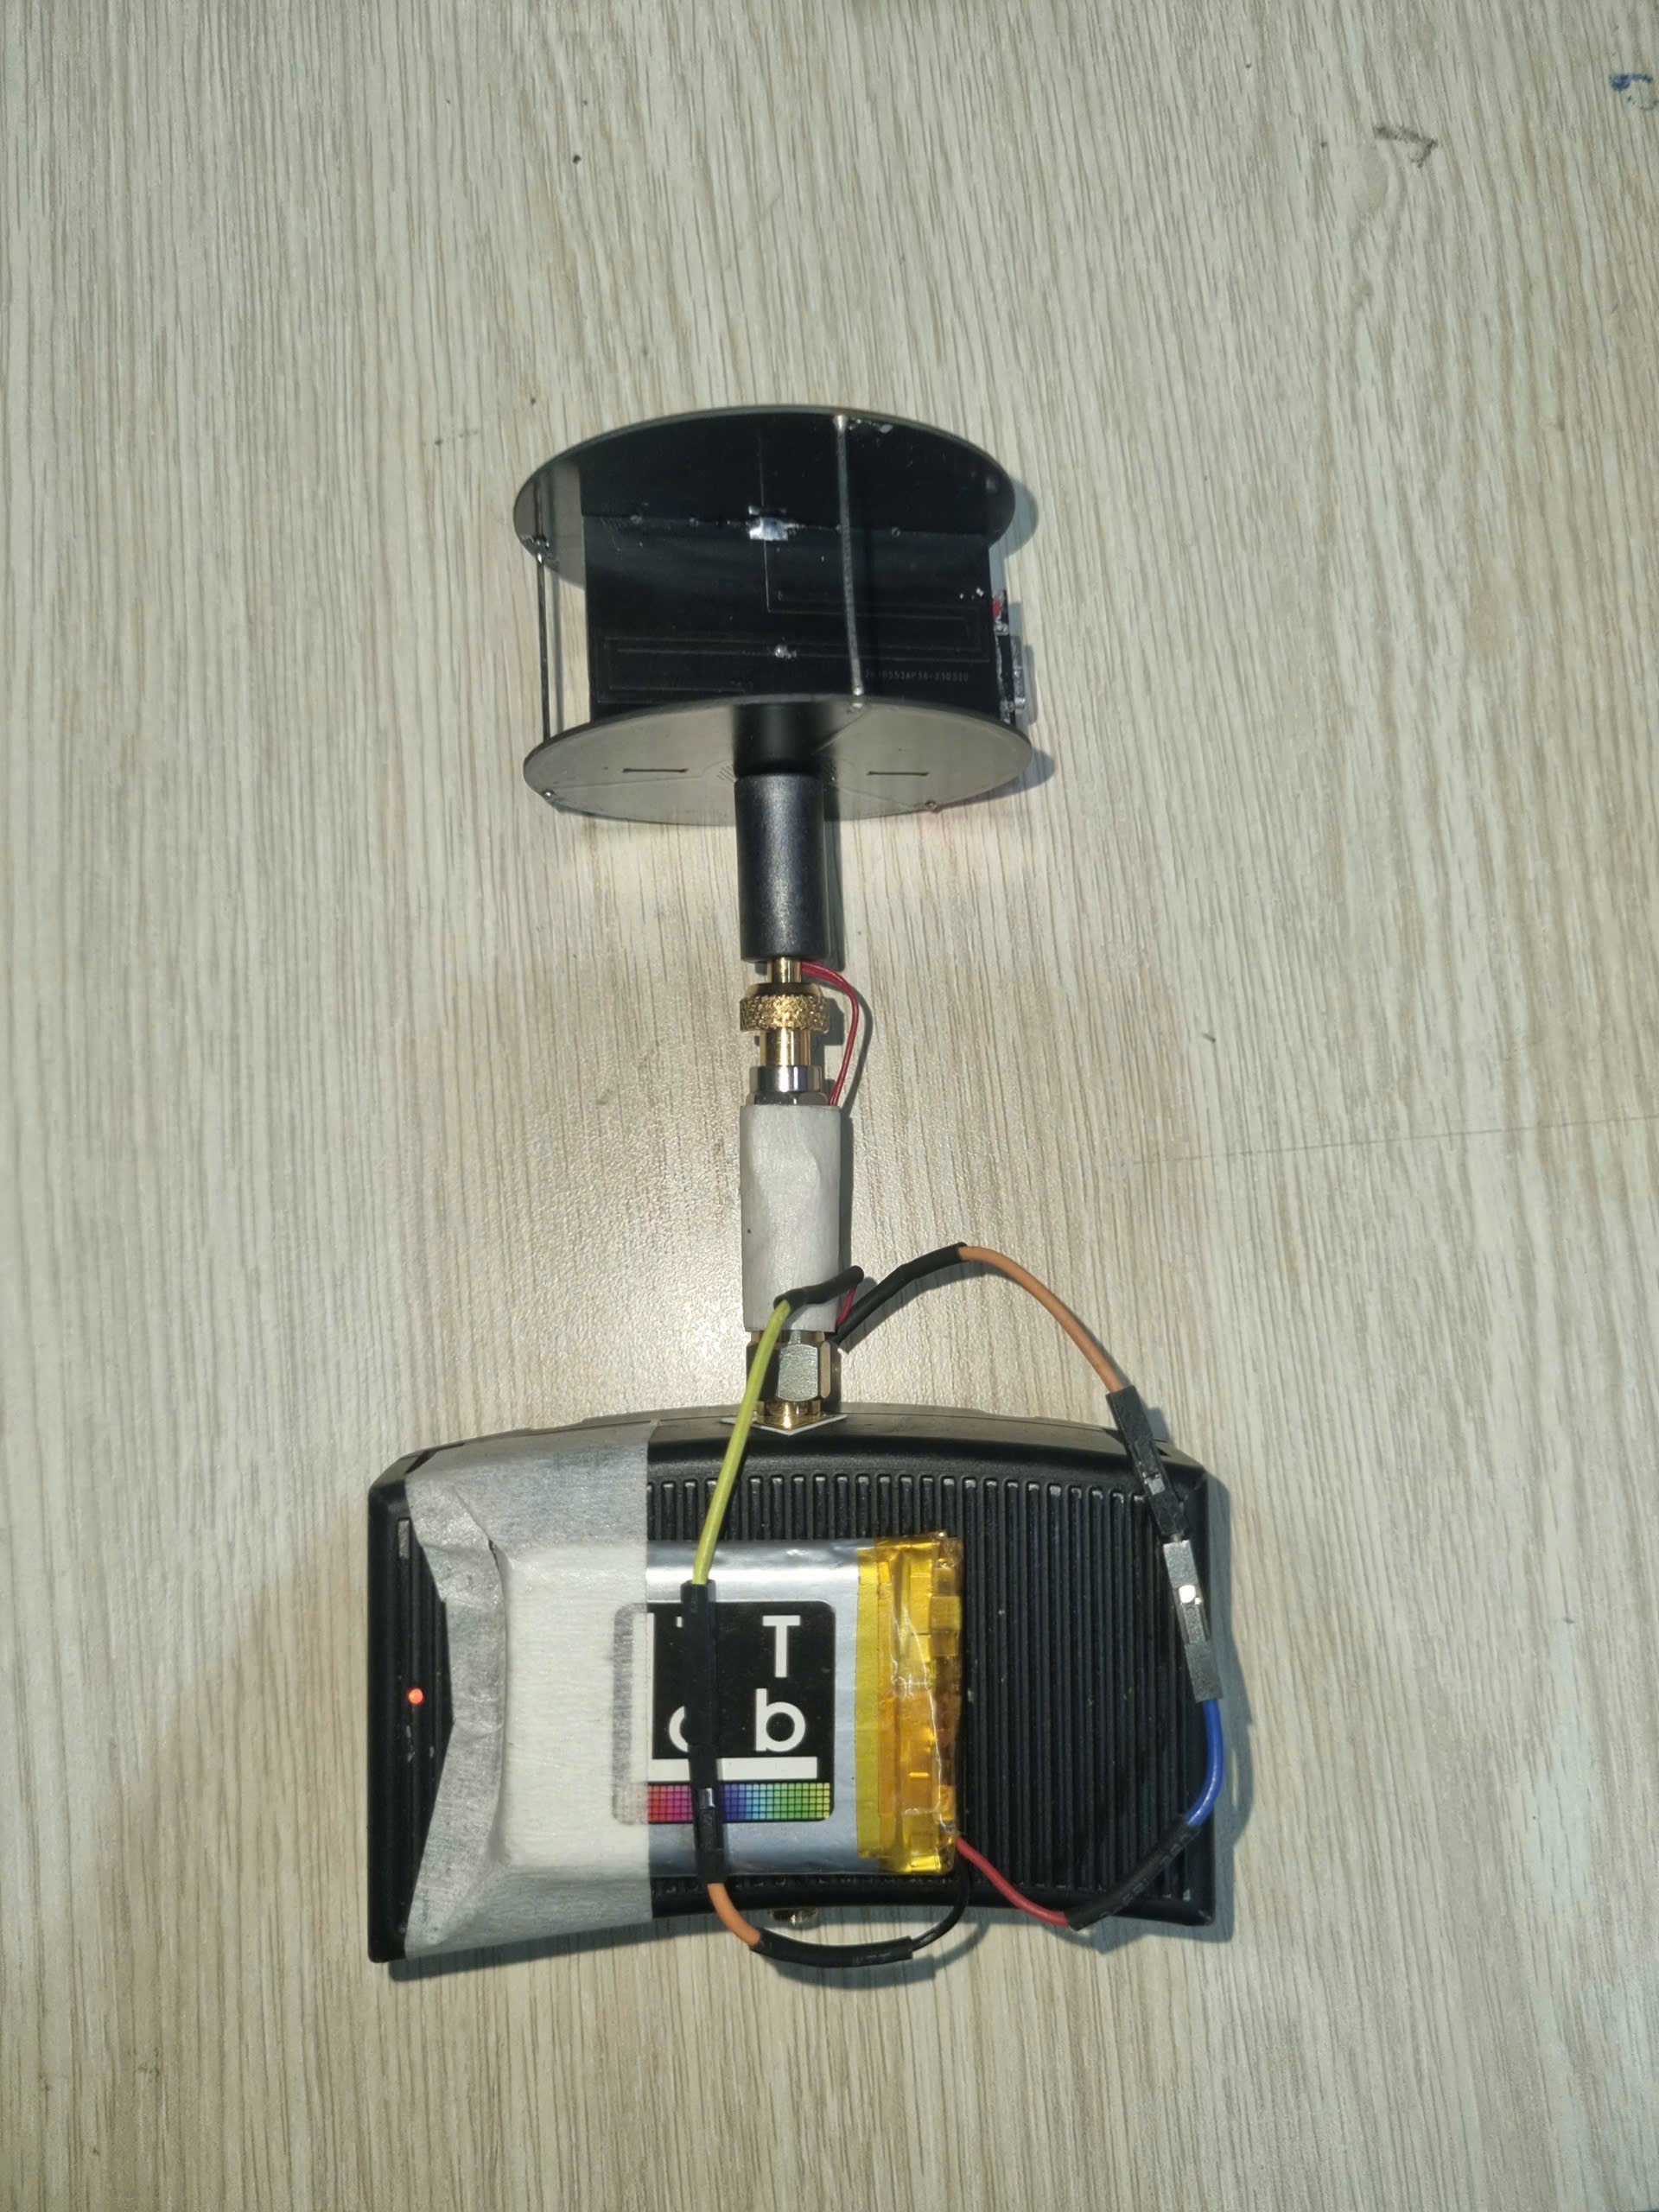
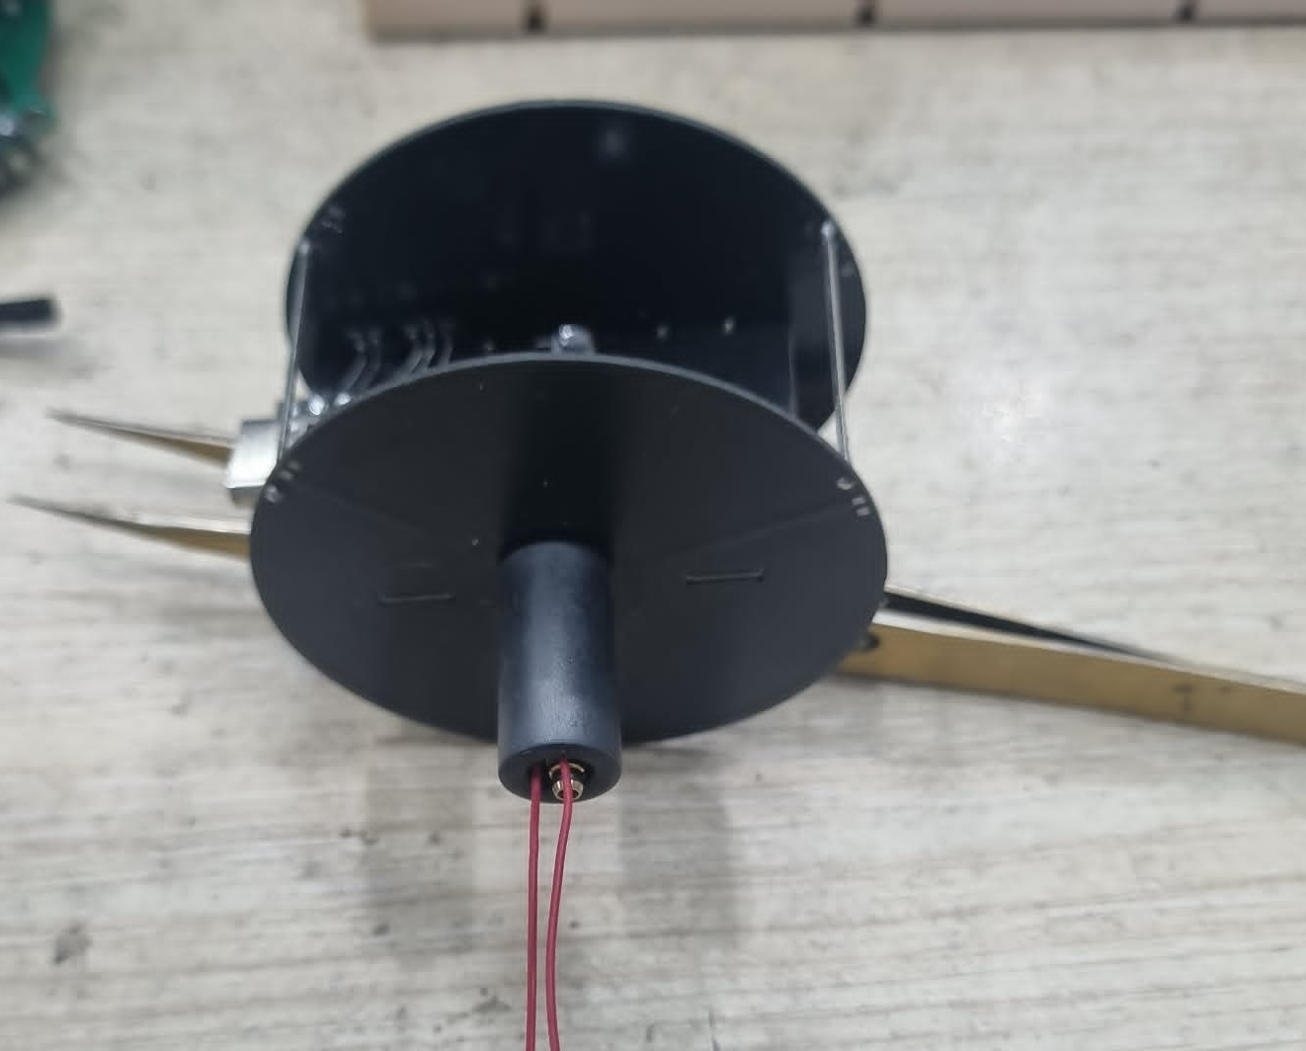
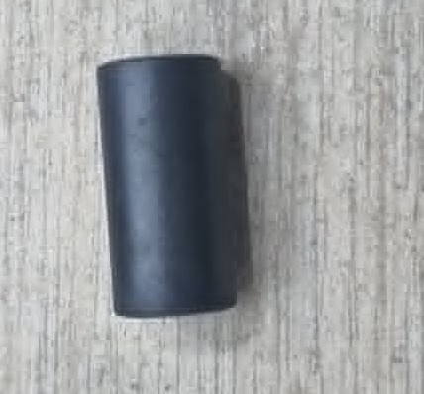
Install Ferrite Bead
Final installation
TTLab / FCE-UIT

Slide 9
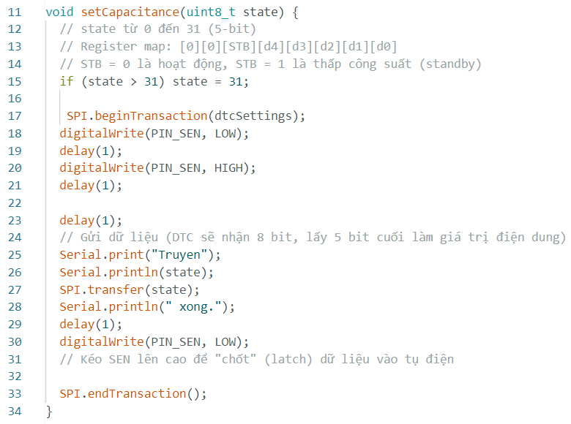
Fixed Capacitance State
Setting a Single Fixed Value
Call setCapacitance(N) in setup() and leave loop() empty to hold the state
N = 0 to 31 maps approximately 0.6 pF (state 0) to 5.4 pF (state 31)
Standby Mode and Memory
Standby: send (state | 0x20) to assert STB=1 — reduces power consumption
No NVRAM: PE64906 loses state on power-off — always re-initialize in setup()
TTLab / FCE-UIT

Slide 10
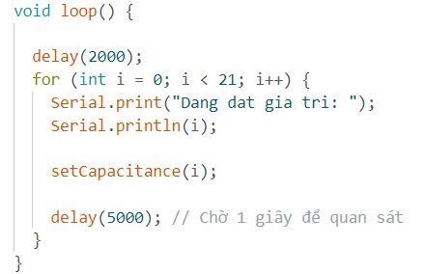
Sweep Loop — All 32 States
Basic Sweep
for (int i = 0; i < 32; i++) iterates through all 32 capacitance steps
delay(5000) per step for manual observation; use 200 ms for auto-measurement
Bi-directional Sweep
Loop up 0 to 31, then loop down 31 to 0 for a continuous triangular scan
Arduino re-calls loop() after the for-loop ends — sweep repeats indefinitely
TTLab / FCE-UIT

Slide 11
Flashing and Troubleshooting
Upload Steps
Plug USB-C → select COM port → Verify → Upload → open Serial Monitor (115200)
If upload fails: hold BOOT, press RST, release BOOT, then click Upload again
USB Type-C
Common Issues
No COM port: install CH340 driver, or verify USB cable supports data (not charge-only)
Serial Monitor silent: Tools → USB CDC On Boot → Enabled, then re-flash
TTLab / FCE-UIT

Slide 12

THANK YOU

