Slide 1

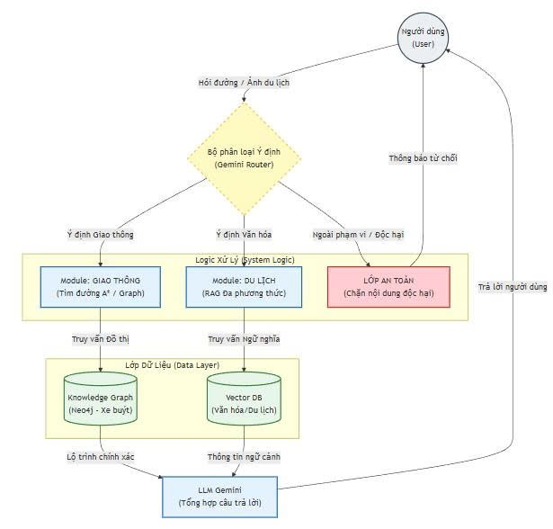
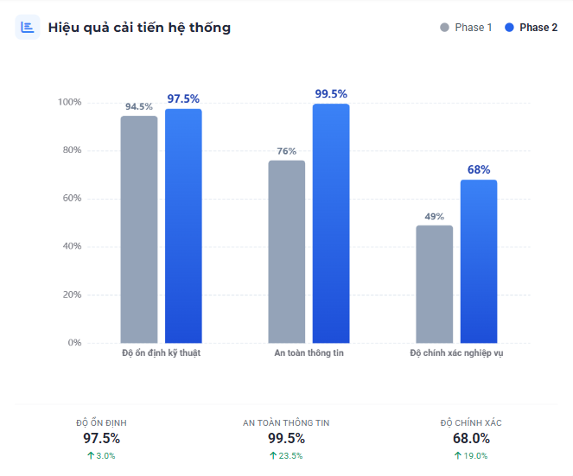
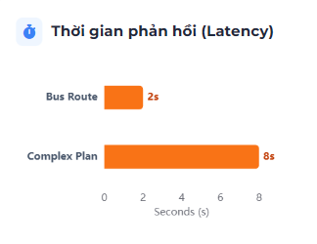
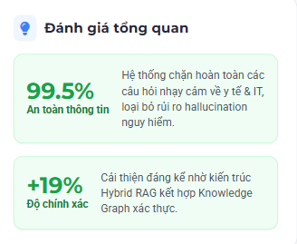
INFORMATION TECHNOLOGY PROJECT
Year: 2025
Topic: Developing a Multimodal Question–Answering System based on RAG in the Fields of Transportation - Culture and Tourism
Tran Ngoc Phat¹, Ngo Anh Tuan², Tran Thanh Phuoc*
^{1, 2} Software Engineering Student, *Supervisor, Faculty Information Technology
ABSTRACT In the context of smart tourism development, travelers often struggle to navigate HCMC’s public transport while seeking in-depth Vietnamese cultural insights. Existing Large Language Models (LLMs) frequently suffer from "hallucinations" when generating specific transit routes. This study proposes a Multimodal Assistant based on Modular Retrieval-Augmented Generation (RAG) architecture. By leveraging Neo4j Graph Database to model the bus network topology for deterministic pathfinding and Vector Search for semantic cultural retrieval, the system effectively mitigates AI inaccuracies. Experimental results demonstrate that the solution delivers absolute routing precision alongside rich, context-aware tourism information, offering a seamless experience for users. | PROPOSED ARCHITECTURE
DATA PROCESSING & OPERATIONAL PIPELINE 1. Data Acquisition & Preprocessing (ETL): Unicode normalization, bus data cleansing, and OCR processing for tourism documents. 2. Data Modeling: Transit: Constructing Graph topology (Nodes/Relationships) for the bus network. Tourism: Implementing text chunking and Vector Embedding. 3. Centralized Storage: Integrating data into Neo4j Graph Database (leveraging both Graph and Vector Indexes). 4. Information Retrieval: Executing ShortestPath algorithms for routing and Hybrid Search for semantic querying. 5. Response Synthesis: Generating natural language responses via Gemini 2.0 based on retrieved context. | Experimental Results and Performance Optimization
Notes:
Tên loại: Size: 48; Font: SVN Gilroy Xbold, In hoa tất cả
Năm - ngành: 36 (Năm: SVN Gilroy Semibold + Italic – Ngành: SVN Gilroy + Bold)
Tên đề tài: Size: 46; Font: SVN Gilroy + Bold
Tên người thực hiện: Size: 40; Font: SVN Gilroy + Italic
QR Code: 3’’ x 3’’
Tên loại đề tài:
ĐỀ TÀI NGHIÊN CỨU KHOA HỌC
KHÓA LUẬN TỐT NGHIỆP
BÀI BÁO KHOA HỌC
NGHIÊN CỨU DOANH NGHIỆP

