Slide 1
BUSINESSES THAT LOST REVENUE AND SHUT DOWN WITH THE COVID-19 OUTBREAK ın turkey
TUANNA BOZKURT
17030411041
Notes:
NOT: Bu slayda farklı bir görüntü eklemek mi istiyorsunuz? Resmi seçip silin. Sonra, yer tutucudaki Resimler simgesine tıklayarak kendi resminizi ekleyin.

Slide 2
INTRODUCTION
The coronavirus (COVID-19), which emerged in China at the end of 2019, began to spread rapidly around the world at the beginning of March. After COVID-19 was seen in 114 countries, the World Health Organization (WHO) declared a pandemic. To prevent the spread of the epidemic, schools, workplaces, cinemas, theaters, restaurants were closed, sports events were postponed. Land, air, sea and rail transports were stopped, country borders were closed. With the panic caused by COVID-19, stock market indices fell rapidly, stocks lost value, asset prices decreased. And both large businesses and small businesses have been adversely affected by this situation. Loss of income started to increase day by day with the progress of the pandemic.

Slide 3
Negatively impacted sectors
It can be said that almost all sectors have been negatively affected by the process. The prominent sectors are summarized below:
• Airlines, hotels, restaurants, hospitality services, retail, especially manufacturers with complex supply chains.
• Exporters who are significantly exposed to the Asian market, especially those first affected by the global epidemic.
• Tourism-related businesses: travel agencies, luxury retailers, etc.
• Transport, cruisers, ports and shipping industry
• Oil, gas, mining and metals due to the decrease in both demand and commodity prices

Slide 4
More institutions/organizations have been closed with the pandemic
• Fewer companies established in March-July 2019
• Compared to the pandemic period of 2020 in March-July 2019, more businesses are established in 2020. In the said period of last year, a total of 41 thousand 235 companies, cooperatives and real commercial enterprises were established.
• However, more institutions/organizations closed between the third and seventh months of 2019 compared to the same period of 2020. This number, which exceeded 12 thousand in 2020, became 11 thousand 262 for 2019.

Slide 5
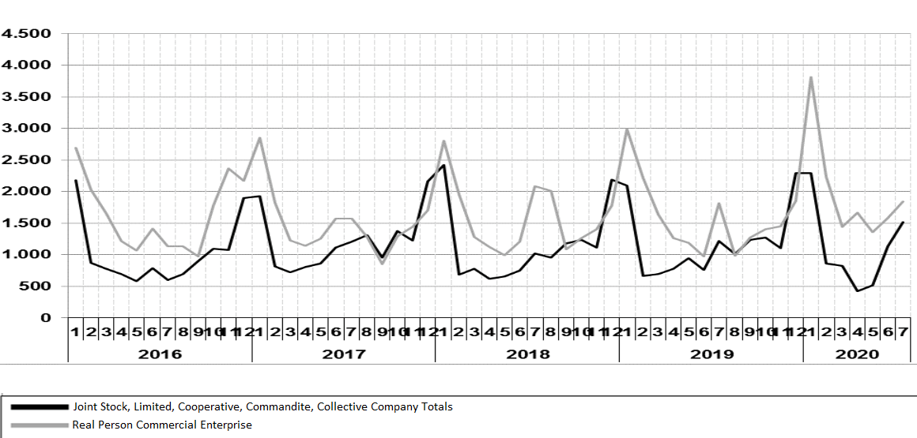
Graph of business data closed by years in Turkey
Graph 1.0

Slide 6
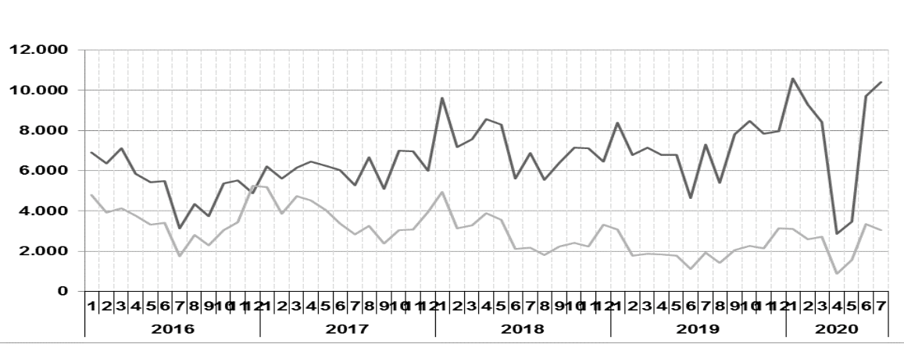
As can be seen in Graph 1.0, in January of 2020, which is the year of the most closure, the closure of Joint Stock, Limited, Cooperative, Commandite, Collective Companies experienced the peak of recent years.The number of companies closed in the first 10 months of 2020 increased to 11 thousand 223.
In Graph 2.0, companies such as Anonymous, Limited, Cooperative, Commandite, Collective established new companies in January 2020 in order to seize opportunities. And it has seen the peak of recent years.
Graph of business data established by years in Turkey
Graph 2.0

Slide 7
March 2019 Business Data Closed
Company​ Type | MARCH 2019​ | FEBRUARY 2019​ | Change Compared to the Previous Month(%)​ | MARCH 2018​ | Change Compared to the Same Month of the Previous Year (%)​ | JANUARY-MARCH (3 MONTHLY)​
 |  |  |  |  |  | 2018​ | 2019​ | Değişim (%)​
Company | 640​ | 625​ | 2,40​ | 732​ | -12,57​ | 3.564​ | 3.192​ | -10,44​
Cooperative | 53​ | 40​ | 32,50​ | 48​ | 10,42​ | 315​ | 258​ | -18,10​
Real Person Commercial E. | 1.634​ | 2.219​ | -26,36​ | 1.282​ | 27,46​ | 6.043​ | 6.840​ | 13,19​

Slide 8
May 2021 Business Data Closed
Company​ Type | MAY 2021 | APRIL 2021 | Change Compared to the Previous Month(%)​ | MAY 2020 | Change Compared to the Same Month of the Previous Year (%)​ | JANUARY-MAY (5 MONTHLY)​
 |  |  |  |  |  | 2020​ | 2021​ | Değişim (%)​
Company | 556​ | 957 | -41,9​ | 513 | 8,4 | 4.634​ | 4.207 | -9.2
Cooperative | 7 | 60 | -88.3 | 4 | 75.0 | 288 | 121 | -58
Real Person Commercial E. | 526 | 1.208 | -56.5 | 1.360 | -61.3 | 10.510 | 9.350 | -11

Slide 9
RESULT
•The pandemic has caused many large and small businesses, especially transportation companies, tourism and trade, to lose and to close for this reason.
•The number of companies closed during the pandemic period increased by 97 percent.

