Slide 1
ADOBE PHOTOSHOP CC 2018
Essential skills

Slide 2


Slide 3
Adobe Photoshop is a raster graphics editor developed and published by Adobe Inc. for Windows and macOS. It was originally created in 1987 by Thomas and John Knoll. Since then, the software has become the most used tool for professional digital art, especially in raster graphics editing

Slide 4
Who uses Photoshop the most ?
Adobe Photoshop is the most widely used image editing software used by millions of creators, artists, designers, web designers, photographers, VFX artists, advertisers and so on, as Photoshop offers them ways by providing powerful tools and means to excel in their professional career and growth that can help people

Slide 5
Photoshop use for ?
Photoshop is the industry-standard photo editing software, and the go-to application for everything from small retouching changes to mind-bending photo art. Photoshop is where editors crop photos, adjust photo composition, correct lighting, and make any subject imaginable look its absolute best.

Slide 6
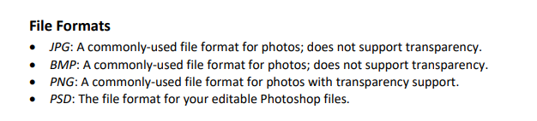
Photoshop only accept file format below

Slide 7

Opening photoshop
Click the Windows Start Button
Navigate to and click Adobe Photoshop CC 2018

Slide 8
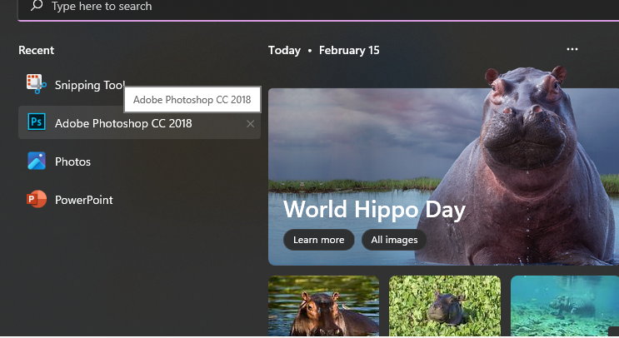

Slide 9
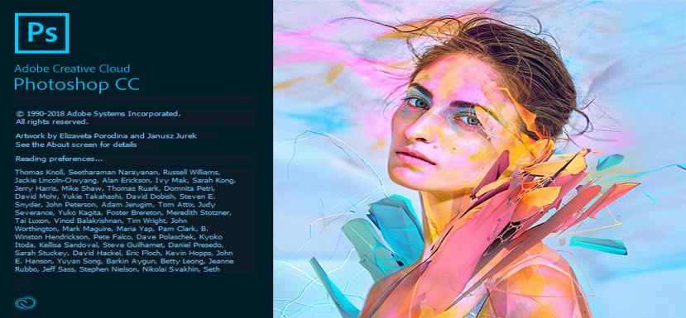

Slide 10
PHOTOSHOP LANDING PAGE
Upon opening Photoshop, you will be taken to the landing page. Here, you can view a list of recently opened files, create a new file, or open a file. The layout of the landing page is follows:

Slide 11
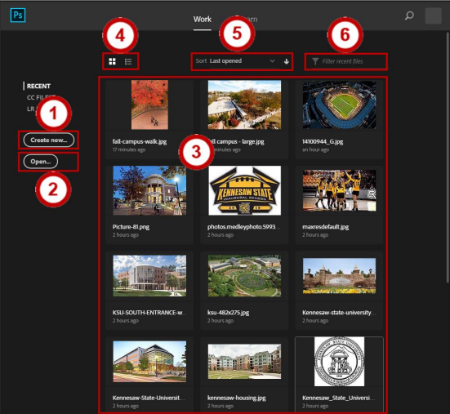

Slide 12
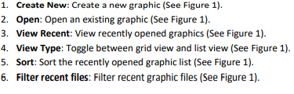

Slide 13
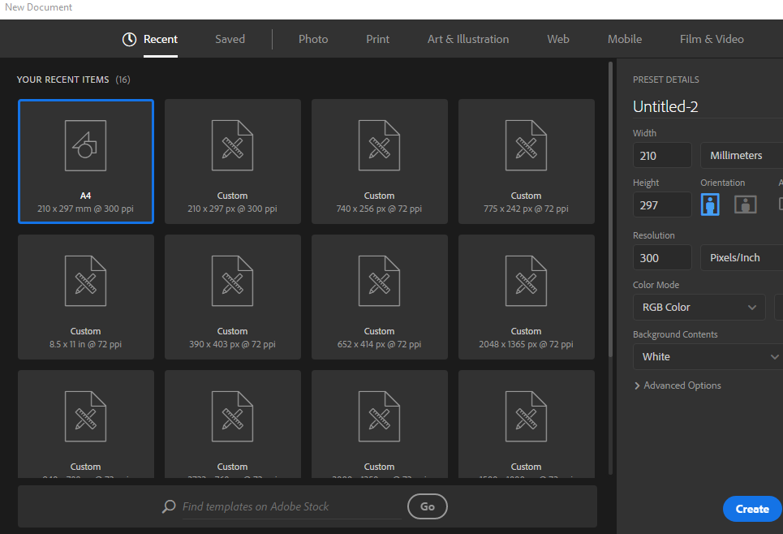

Slide 14
TOOLS AND WORKSPACE
When you open a file in Photoshop, your workspace will be laid out in the default configuration, the Essentials workspace

Slide 15
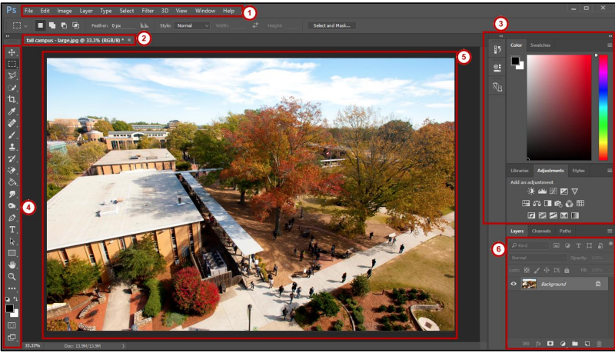

Slide 16
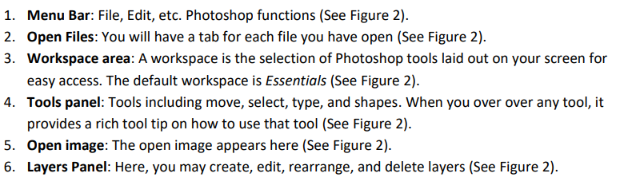

Slide 17
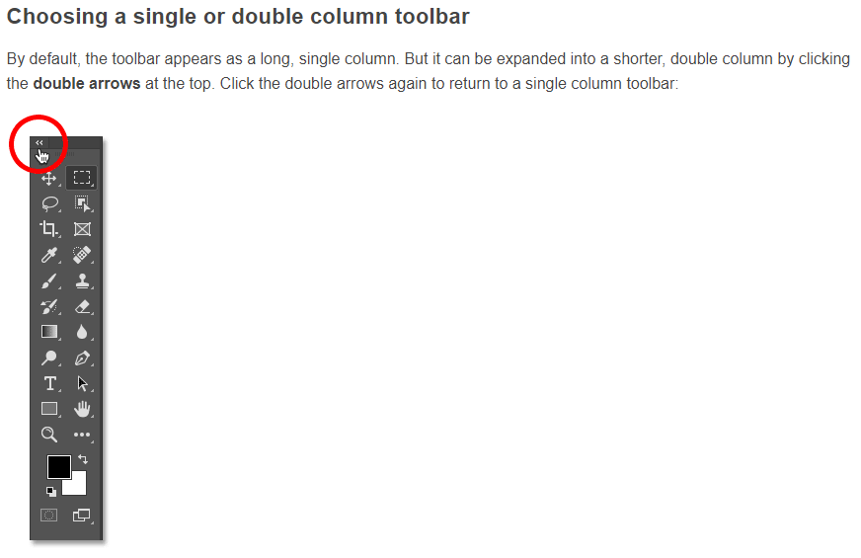

Slide 18
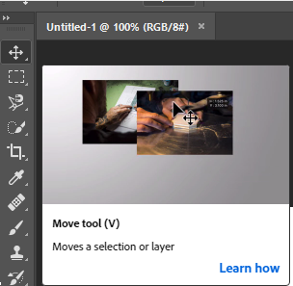
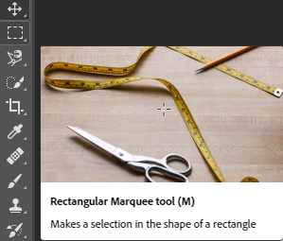
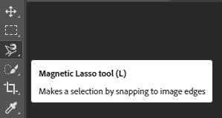
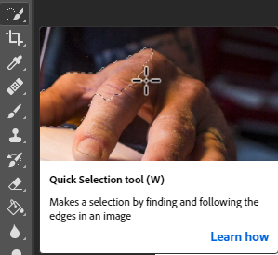
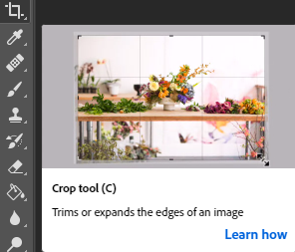
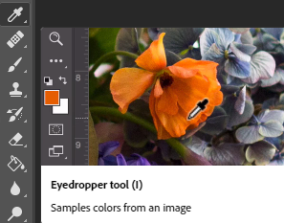
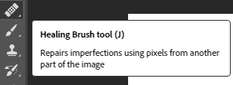
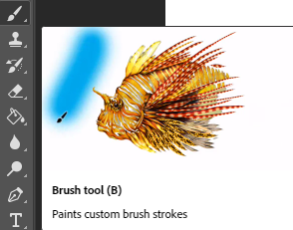
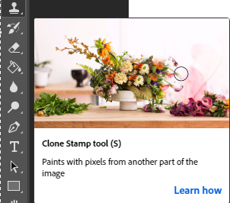
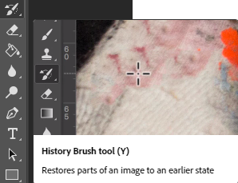

Slide 19
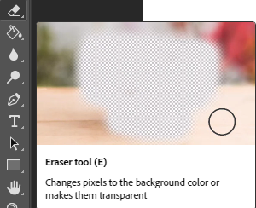
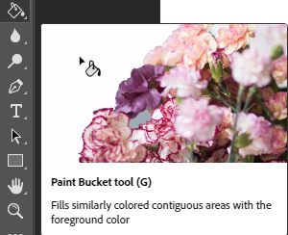
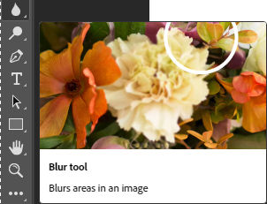
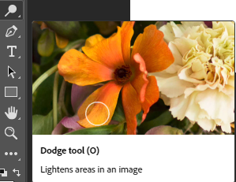
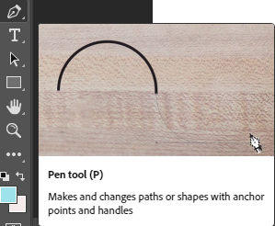
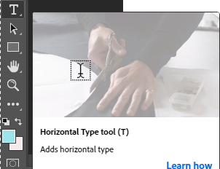
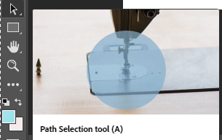
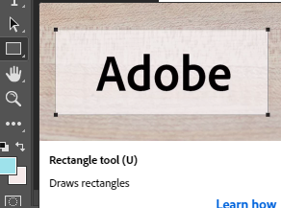
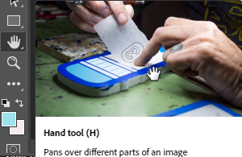
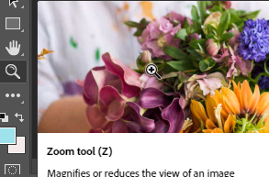

Slide 20






Slide 21
THANK YOU !

