Slide 1
Collections
In Java, collections are data structures that store and manipulate groups of objects.
Java collections refer to a collection of individual objects that are represented as a single unit.
You can perform all operations such as searching, sorting, insertion, manipulation, deletion, etc., on Java collections just like you do it on data.

Slide 2
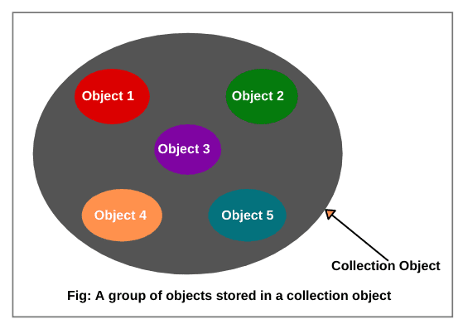
Collections

Slide 3
Collections
They’re part of the Java Collections Framework (JCF), found in the java.util package, and provide ready-made classes and interfaces for handling dynamic data (unlike arrays, which have fixed size).

Slide 4
Collections
Interface | Description | Common Implementations
Collection | The root interface for all collections (except maps). | ArrayList, HashSet, LinkedList
List | An ordered collection (sequence) that allows duplicates. | ArrayList, LinkedList, Vector
Set | A collection that does not allow duplicates and is not ordered. | HashSet, LinkedHashSet, TreeSet
Queue | A collection used to hold elements before processing, typically in FIFO order. | LinkedList, PriorityQueue, ArrayDeque
Map | Holds key-value pairs (not technically a subtype of Collection). | HashMap, TreeMap, LinkedHashMap, Hashtable

Slide 5
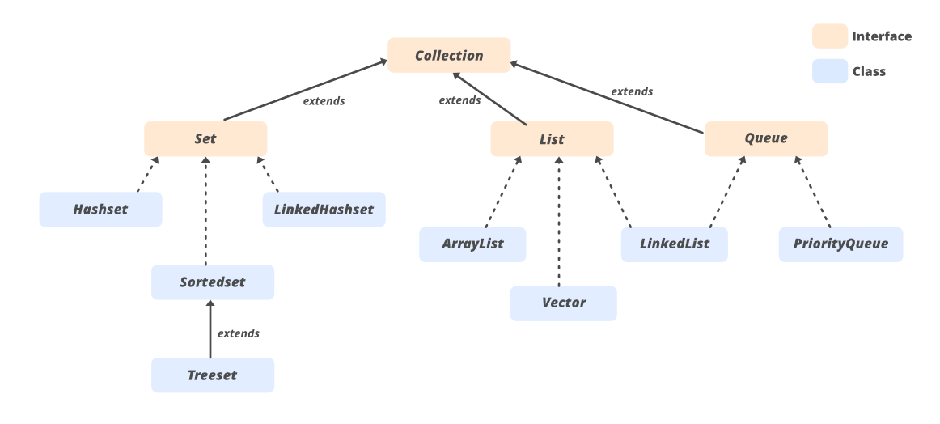
Collections

Slide 6

Collections
Map is a Java interface from the java.util package.
HashMap is a class that implements the Map interface.
Map<Integer, String> ObjectName new HashMap<>()
(Interface part)
(Implementation part)

Slide 7
Collections
Java Collections : Interface
Iterator interface: Iterator is an interface that iterates the elements. It is used to traverse the list and modify the elements. Iterator interface has three methods which are mentioned below:
public boolean hasNext() – This method returns true if the iterator has more elements.
public object next() – It returns the element and moves the cursor pointer to the next element.
public void remove() – This method removes the last elements returned by the iterator.

Slide 8
Collections
In Java, a Vector is a legacy class from the Collection Framework that represents a dynamic array—it can grow or shrink as elements are added or removed.
Unlike ArrayList, it is synchronized (thread-safe), which makes it useful in multi-threaded environments but less efficient in single-threaded contexts.

Slide 9
Collections
Key Features of Vector
Package: java.util
Implements: List, RandomAccess, Cloneable, Serializable
Allows: Duplicates and null values
Thread-safe: All methods are synchronized
Preferred Alternative: Use ArrayList if synchronization is not required

Slide 10
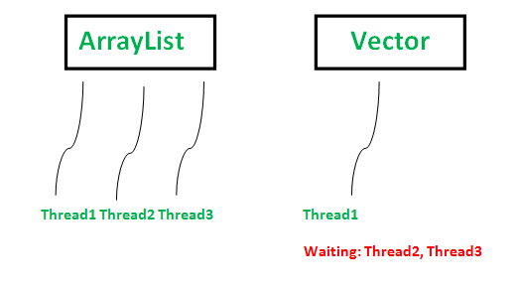
Collections
Thread safety: If multiple threads try to modify the same Vector simultaneously, synchronization ensures that only one thread executes a method at a time, preventing data corruption.

Slide 11
Collections
A thread in Java is essentially a lightweight unit of execution inside a program. Think of it as a mini-program running within your main program. Multiple threads can run concurrently, allowing Java applications to perform several tasks at the same time (parallelism).

Slide 12
Collections
Generics in Java as a way to pass different data types into classes, methods, or interfaces while keeping type safety.
Instead of writing separate versions of a class or method for String, Integer, Double, etc., you write one generic version and then pass the (data) type when you use it, they mean parameterized types.

Slide 13
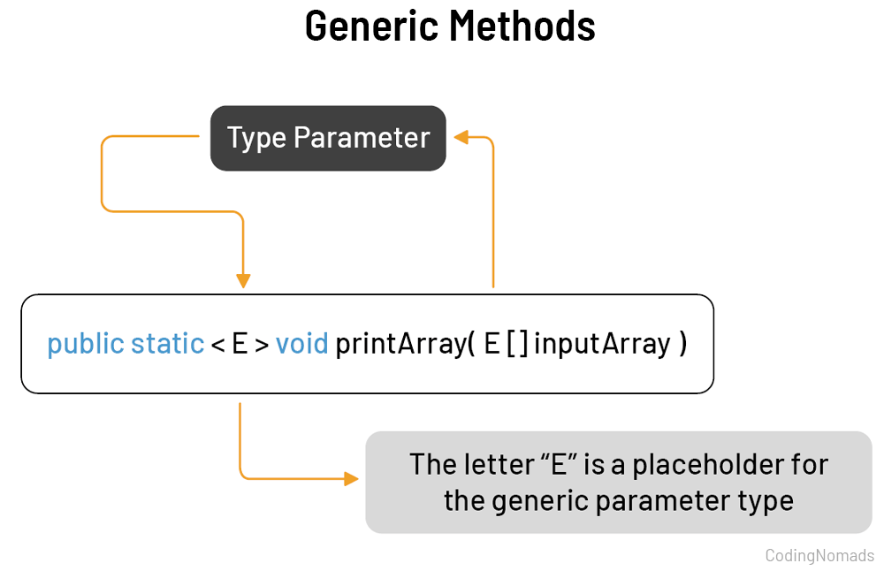

Slide 14
Collections
https://onecompiler.com/java https://www.edureka.co/blog/java-collections/

